Slide 1
Costume

Slide 2
WOMAN IN BLACK - Costume
Describe a moment where you recognised the costume representing a characters status?
In what time period is the Woman in black set?
Name a moment where the costume represented the time period clearly?
Name a piece of costume that was used by Arthur Kipps to represent a character he was playing?

Slide 3
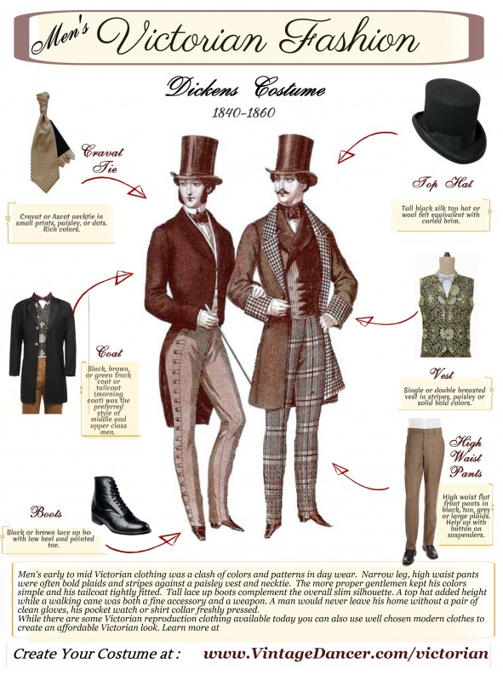
What elements of late Victorian fashion could you see in the production?

Slide 4
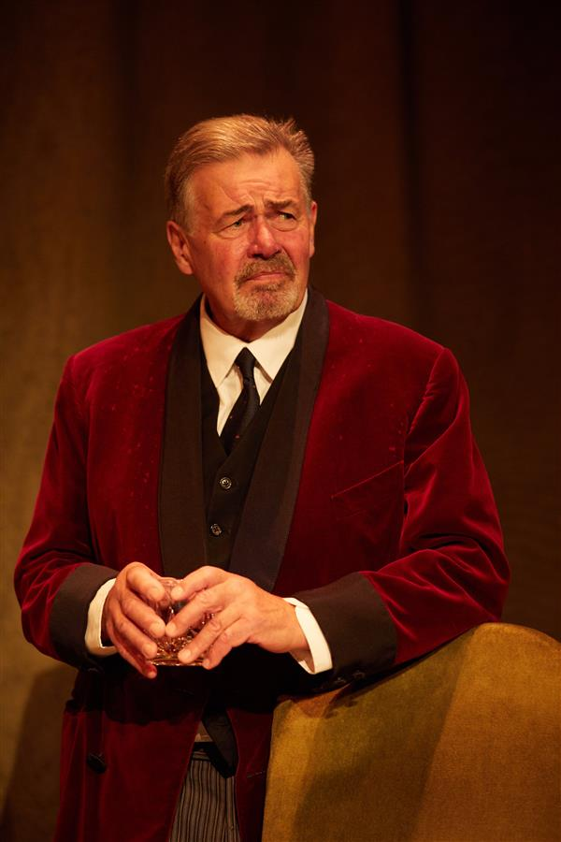
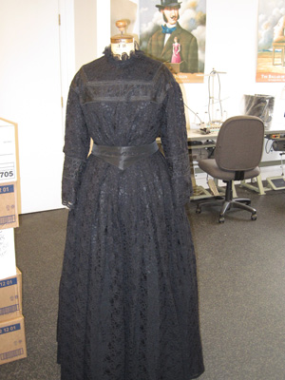
Costume
Late Victorian era costumes to create authenticity for the audience.
Costumes are visibly seen to remind you that this is a play within a play. Is this a successful choice?
Costumes are added too or taken away.
What effect does this have on the performance?
How do the costumes develop as we go through the performance?
How is symbolism used through the use of costume? (colour)

Slide 5
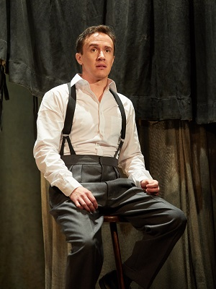
The Actor
Young Mr Kipps when the hauntings start
Young Mr Kipps before the incident
How have the costumes been used to create a sense of time/location/mental of the character?

Slide 6
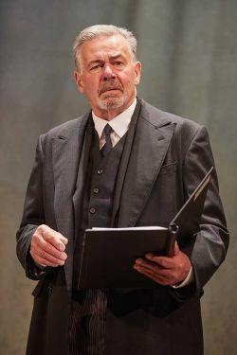
Keckwick
Sam Daily
Jerome
This is the base costume
Other roles and costume:
Mr Bently – Glasses are added
Waiter – Apron is added
Arthur Kipps
How have the costumes been used to create a sense of time/location/mental of the character?

