Slide 1
Cast and Creative Team - 2022
Director: Robin Herford
Lighting Designer: Kevin Sleep
Original Sound Design: Rod Mead

Slide 2
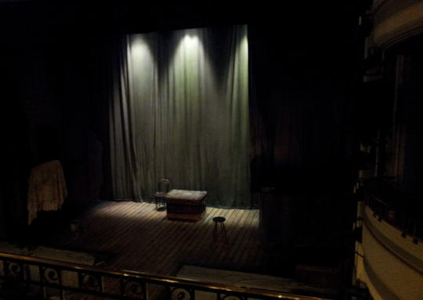
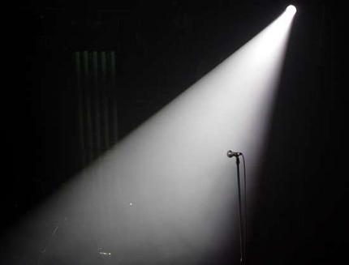
Starter
Learning Outcomes:
To apply feedback provided to improve the quality of your exam answers.
To discuss and explore how lighting was used in the live production, and how this enhanced the atmosphere of the play.
To develop an in-depth knowledge of how the lighting was used and apply this knowledge to an exam question.
In pairs list types of lighting and the effects they create.

Slide 3
Success Criteria
Demonstrate knowledge and understanding of how Drama and Theatre is developed and performed
Investigate and identify how successfully theatre makers communicated meaning to an audience (analysis)
Assess the merit of approaches used and formulate judgements (evaluate)
You should justify your opinions with examples that include a “number of precise details”. You must also aim to use technical language.

Slide 4
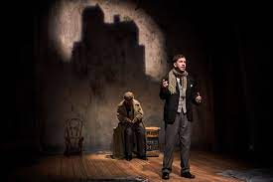
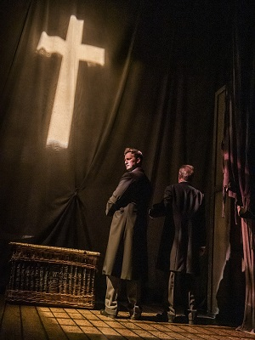
Lighting Lighting plays a key part in creating suspense within the play. The use of Gobos project different locations onto the stage, such as Eel Marsh House, the church, and the shadows of the windows which moves the action effortlessly from one location to the next.
How were the audience notified they were now watching the “play” through the use of lighting?

Slide 5
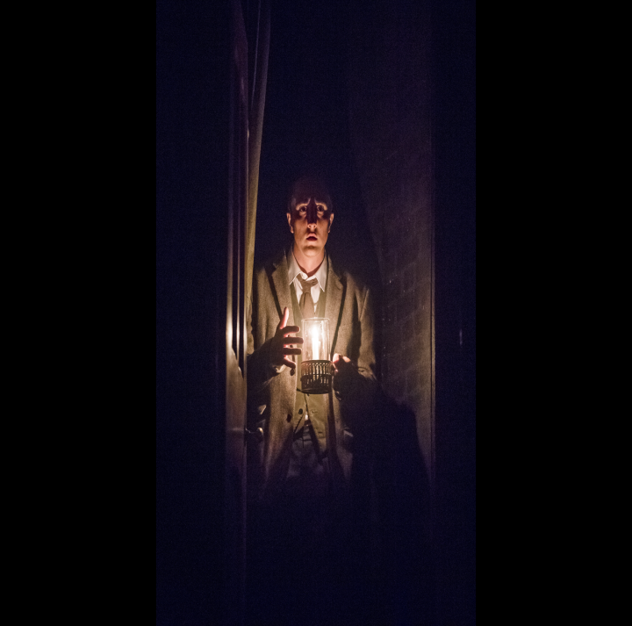
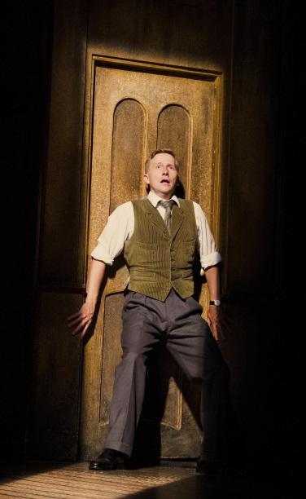
The stage is always kept at a minimum level of darkness, so the whole playing space is never fully visible. Lighting then controls what can and can’t be seen by the audience, so quick reveals and vanishes can be used for The Woman in Black throughout the action.

Slide 6
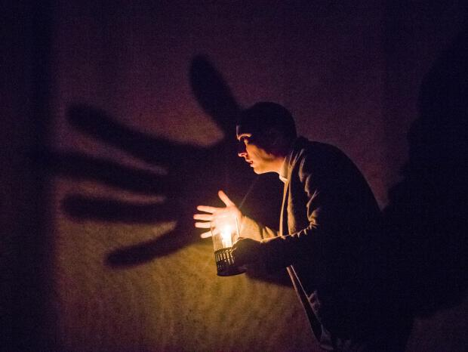
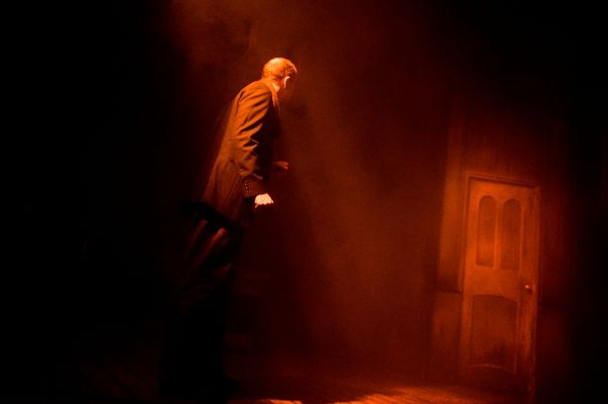
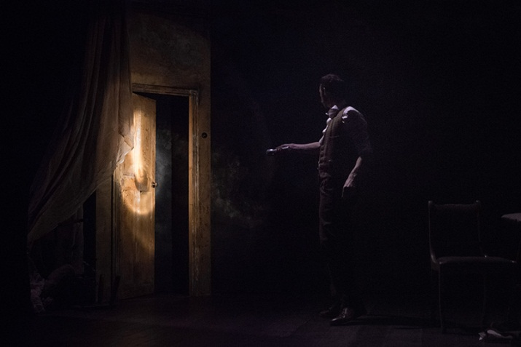
The use of candle and torch light creates a sense of mystery and suspense. The audience cannot see the entire stage which makes us feel tense. Shadows are also created such as the hand on the gauze which again creates a tense atmosphere, a sense that something is closing in on Mr Kipps.
The use of tight spotlights focus the audience on particular objects, such as the rocking chair or door handle, and the audience become aware that something is about to happen.
Why is the colour important when the spotlight hits the door to the nursery?

Slide 7
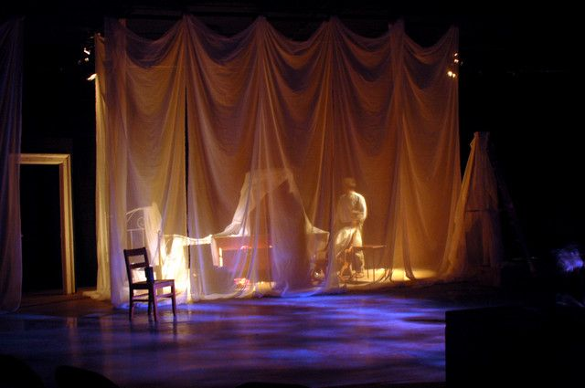
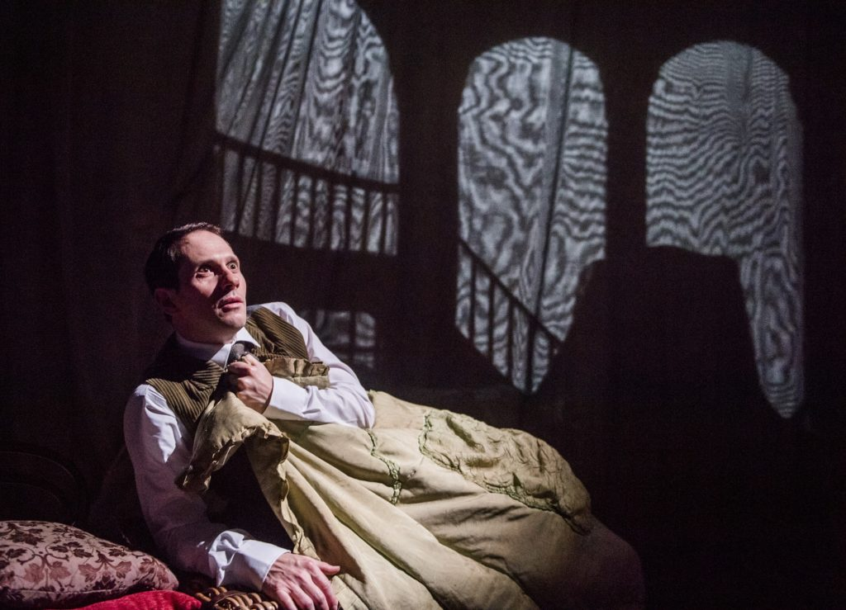
The use of the Gauze
Why is the use of gauze and backlighting effective in creating an atmosphere and location?

Slide 8
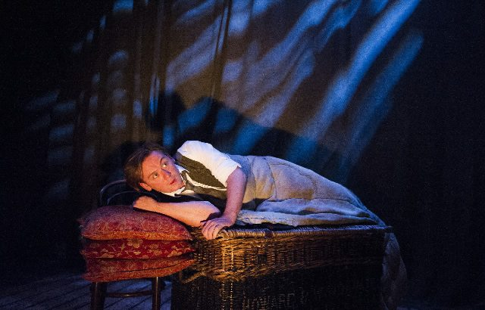
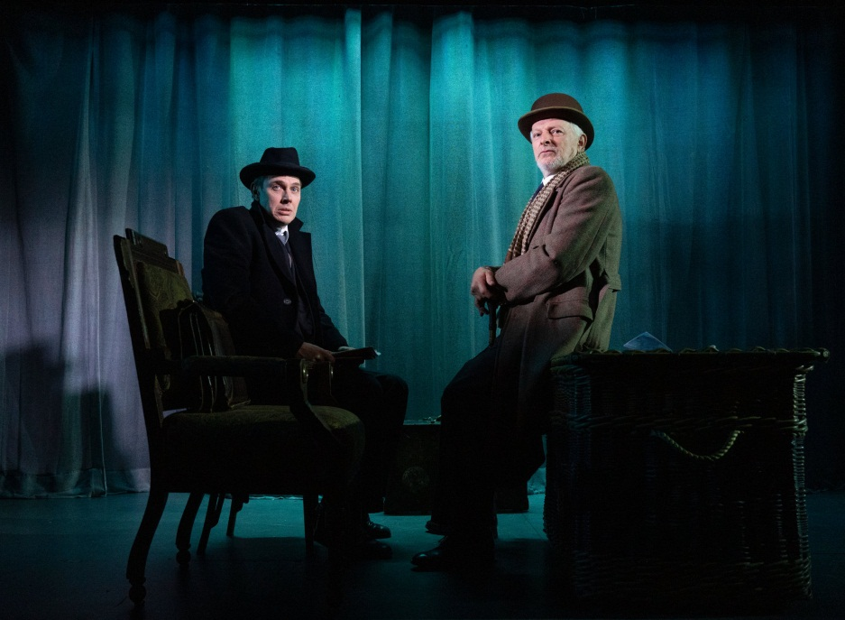
Colours
What effect do the different coloured gels have on creating an atmosphere and sense of location in the performance?
Do note that coloured lighting is rarely used within the play, creating a realistic atmosphere for each location.

Slide 9
Use of Blackouts/ transitions/ fades
The frequent use of blackouts again controls the suspense, as at times nothing at all can be seen onstage directly after a moment of heightened drama.

Slide 10
How is lighting used to help create tension in the following moments?
Analyse and Evaluate
Coloured gels
GOBOs
Lighting states
Colour
Intensity
How did the lighting effectively achieve create a sense of tension and fear?

Slide 11
Practise exam question
Describe how the lighting was used to create atmosphere within the performance. Analyse and evaluate how successful the lighting was in enhancing the atmosphere and mood at various points in the performance. Reference:
The types of lighting
The colour and intensity of the lighting
Any special effects
(32 Marks)
F – Focus on the question
Ex – Example to support argument or point (analysis)
T – Technical language appropriate to question
U – Understanding and knowledge of (lighting/set/costume) design in relation to the performance eg, creating tension
E – (Evaluation) in terms of how successful the (lighting/set/costume) was

