Slide 1
Practical exam – Book 6
Name -

Slide 2
Task 2 Checklist
Task 3 will take 30mins and you will need to complete the following points in this time, videos are located underneath if you are stuck on a particular point
Task | Complete
2A – Quantise your music
2B – Pitch Errors
2C – Duplicate samples
2D - Export audio

Slide 3
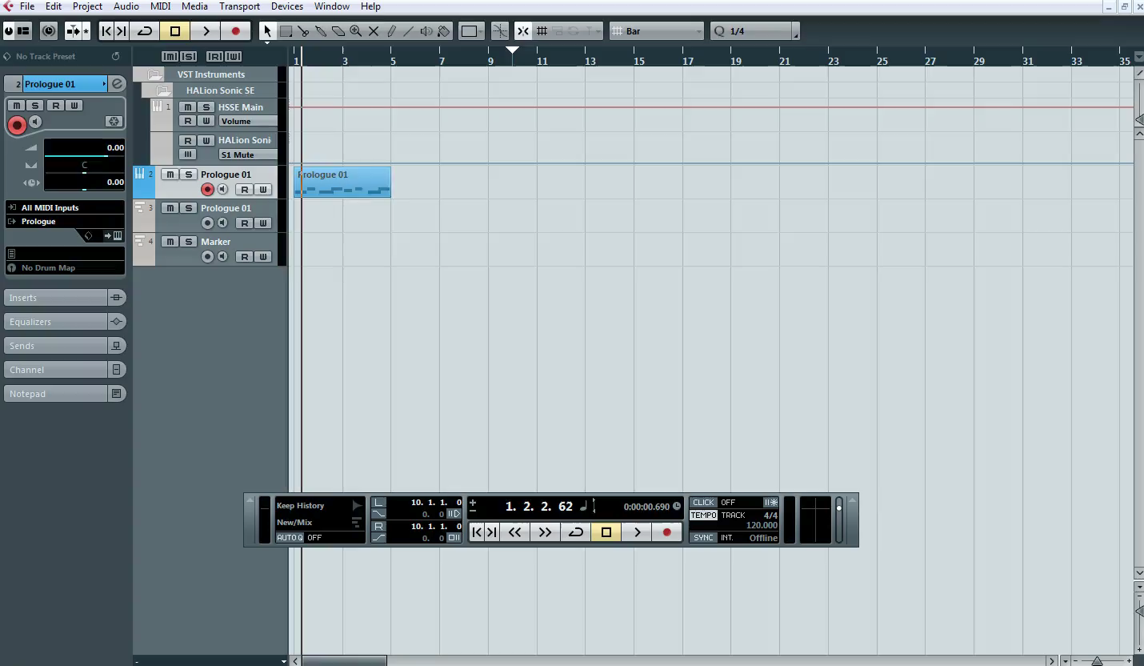
Quantise
1 – Watch the clip below

Slide 4
Task 2 a
P
1 – Task 2a
(p) Written explanation of your process up to this point
M
D
2 - Insert Screenshots to evidence your work

Slide 5
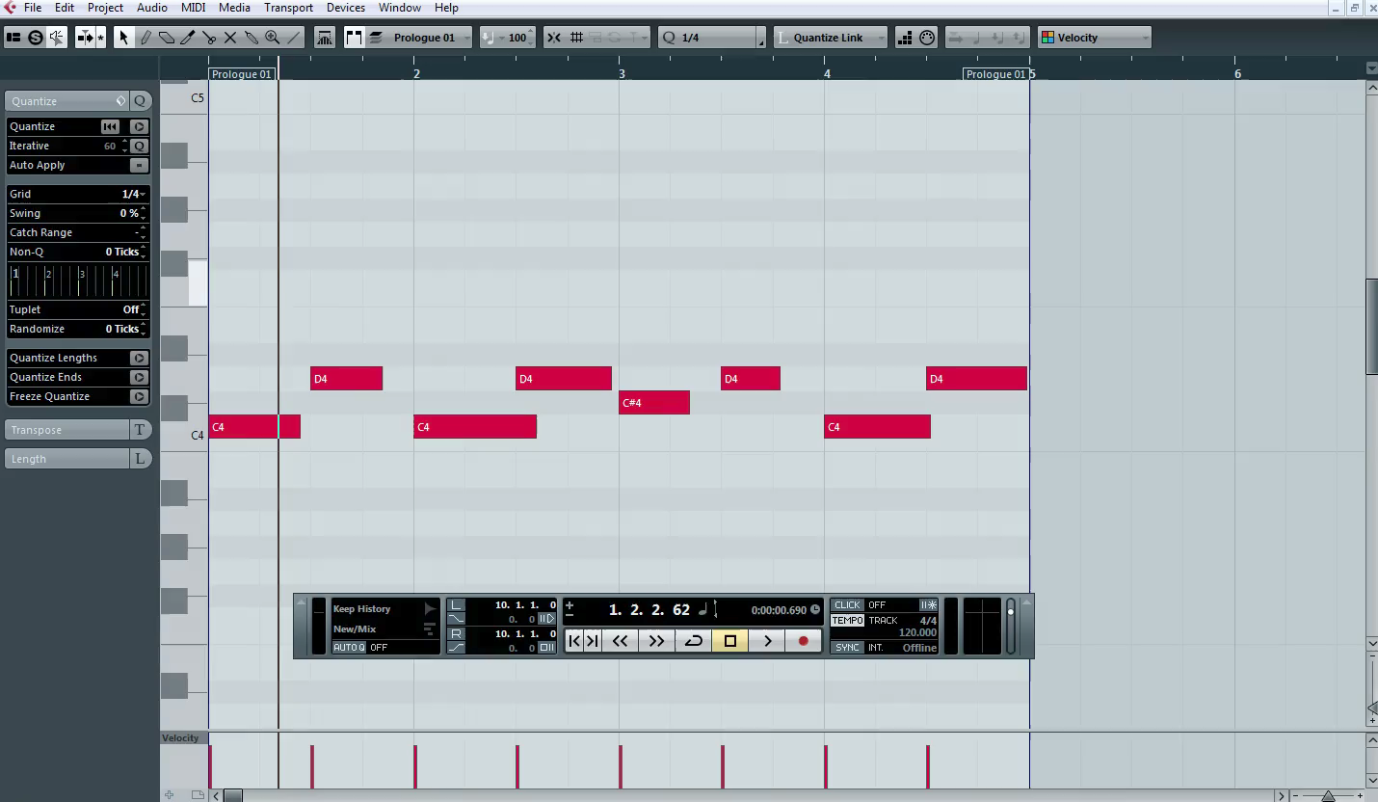
Pitch Errors
1 – Watch the clip below

Slide 6
Task 2 b
P
1 – Task 2b
(p) Written explanation of your process up to this point
M
D
2 - Insert Screenshots to evidence your work

Slide 7
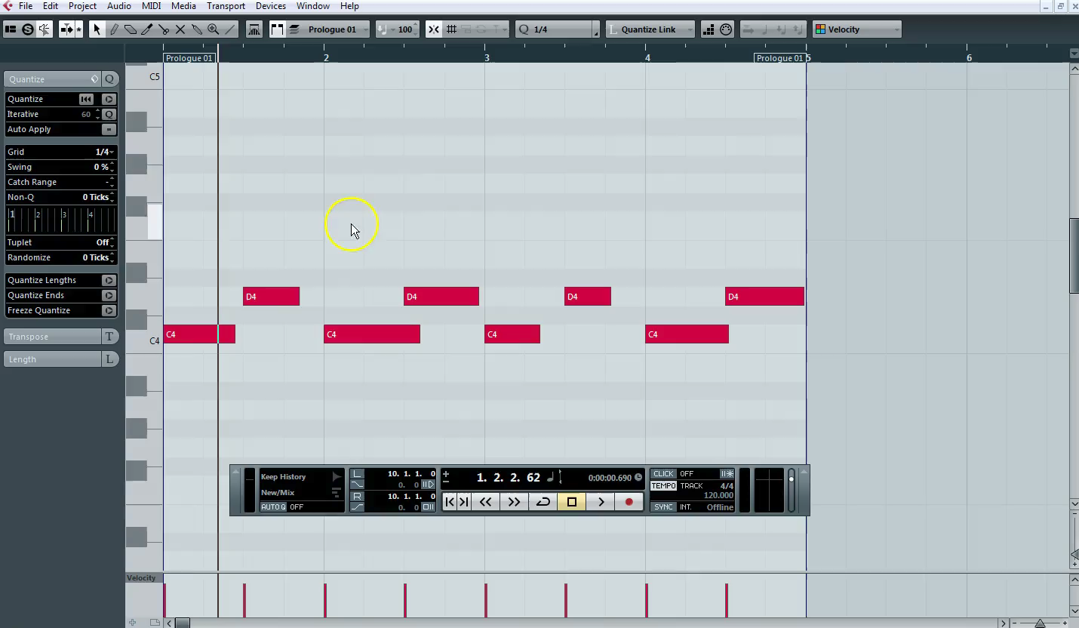
Duplicate samples
1 – Watch the clip below

Slide 8
Task 2 c
P
1 – Task 2c
(p) Written explanation of your process up to this point
M
D
2 - Insert Screenshots to evidence your work

Slide 9
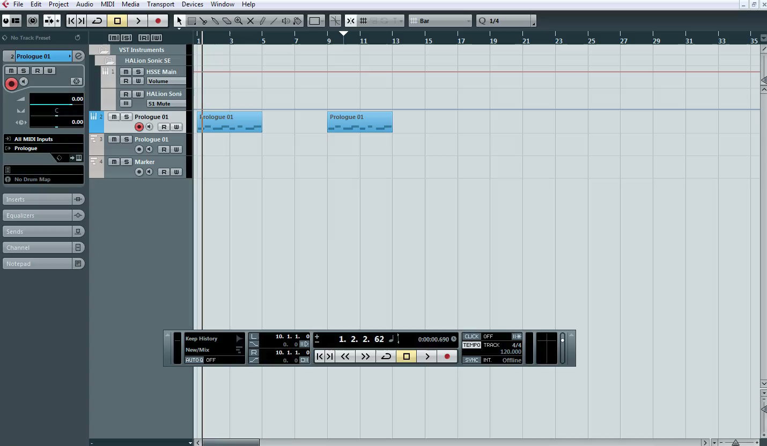
Exporting the song
1 – Watch the clip below

Slide 10
Task 2 d
P
1 – Task 2d
(p) Written explanation of your process up to this point
M
D
2 - Insert Screenshots to evidence your work

Slide 11
Music Technology
Date …. / …. / ….
Grade | Achieved?
NYA
Pass 4
MERIT 5.5
DIST 7
What you did not achieve from the workbook?
Strength
Target
Grade
Teacher Comment | Pupil Response
Q1. Explain ‘Setting the poles’ when exporting in Cubase | …
Q2. What is Quantise? | …
Q3. Duplicate is what? | …
Response & Challenge
Presentation
☺ 😐 ☹
Effort
☺ 😐 ☹

