Slide 1
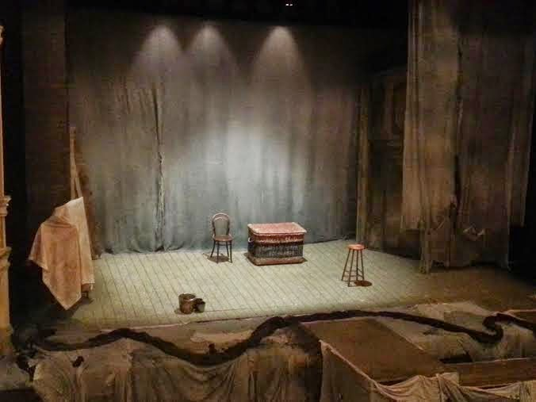
SET FOR WOMAN IN BLACK

Slide 2
The set is surprisingly simple, and as already discussed, uses small items to play a variety of different things.
It also reminds the audience that they are watching a play within a play.
Wicket basket
Horse and trap
Desk
Bed
Carriage
Sheet over a costume rack

Slide 3
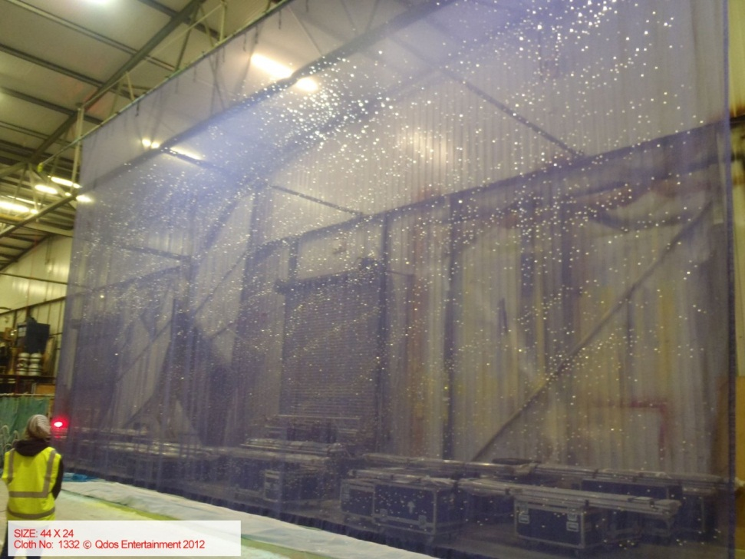
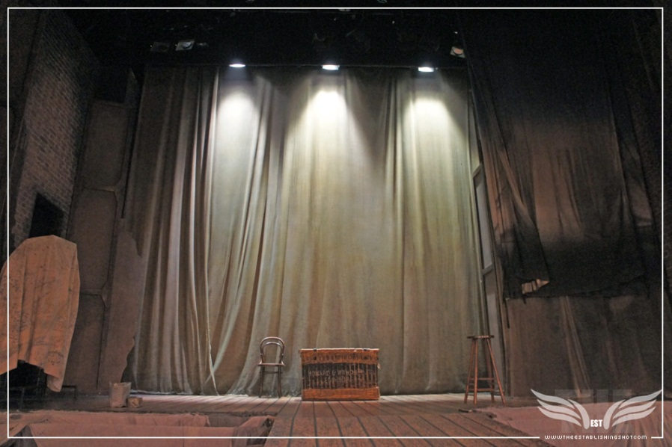
The house set is only revealed halfway through the play, as Kipps begins to explore Eel Marsh House. The use of a scrim or gauze is prevalent to this effect, as it allows the set to vanish and appear when necessary. Made of a light translucent material, this curtain hangs in front of the set, making whatever is behind it only visible when light is brought up behind it. When light shines on the front of the curtain, anything behind it cannot be seen.
The gauze helps to conceal and reveal quickly to enhance the pace.

Slide 4
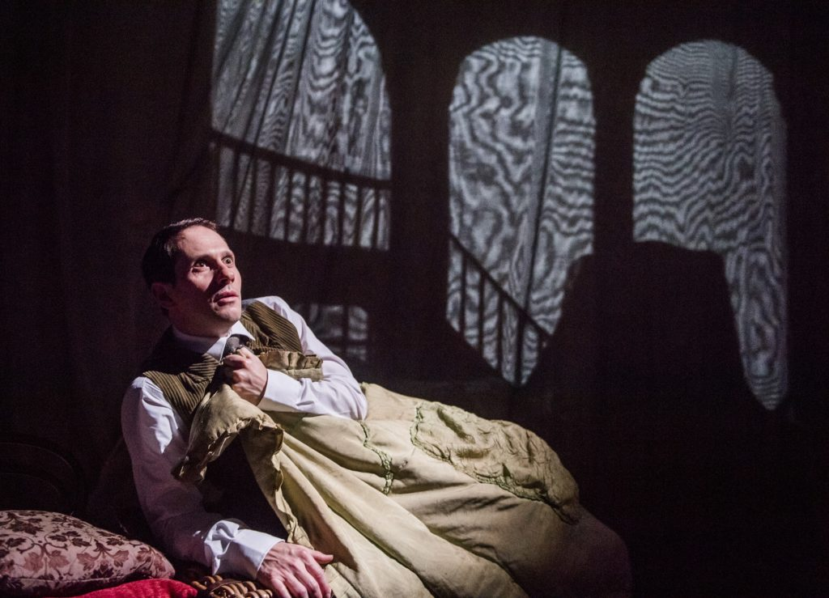
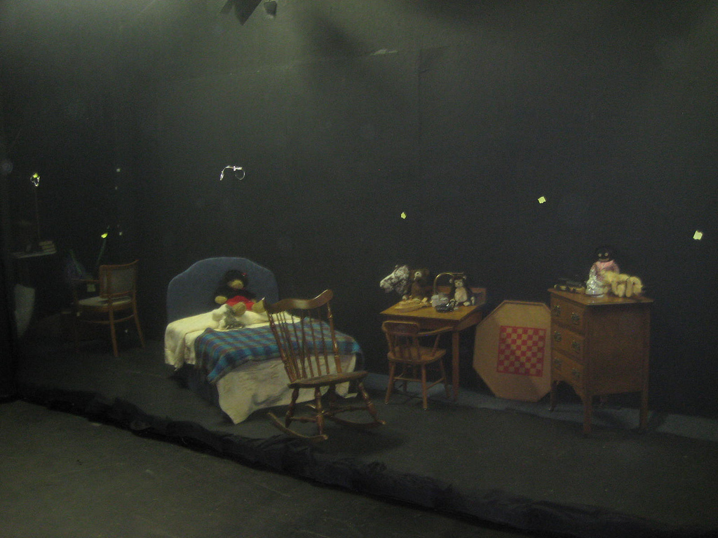
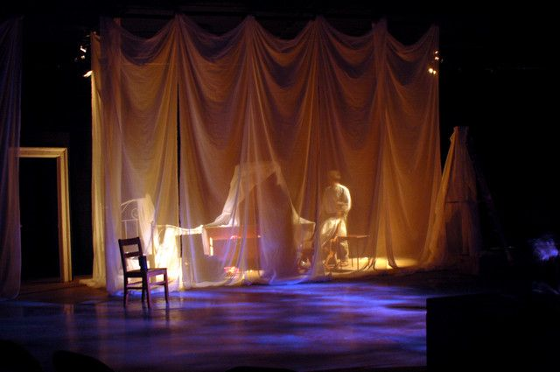
This is used to great effect to reveal the staircase and nursery scenes quickly and efficiently, appearing as if from nowhere.
Levelling - Use of staircase e.g. Woman in Black on stairs at higher level – Powerful, scary + symbolic

Slide 5
Example Question
Describe how the set was used to support the style of the production. Analyse and evaluate how successful the set was in helping to communicate the style of the production. You should make reference to
The appearance of the set
Any changes in the set
How it was used by the actors

Slide 6
F – Focus on the question
Ex – Example to support argument or point (analysis)
T – Technical language appropriate to question
U – Understanding and knowledge of (lighting/set/costume) design in relation to the performance eg, creating tension
E – (Evaluation) in terms of how successful the (lighting/set/costume) was

