Slide 1
Practical exam – Book 4
Name -

Slide 2
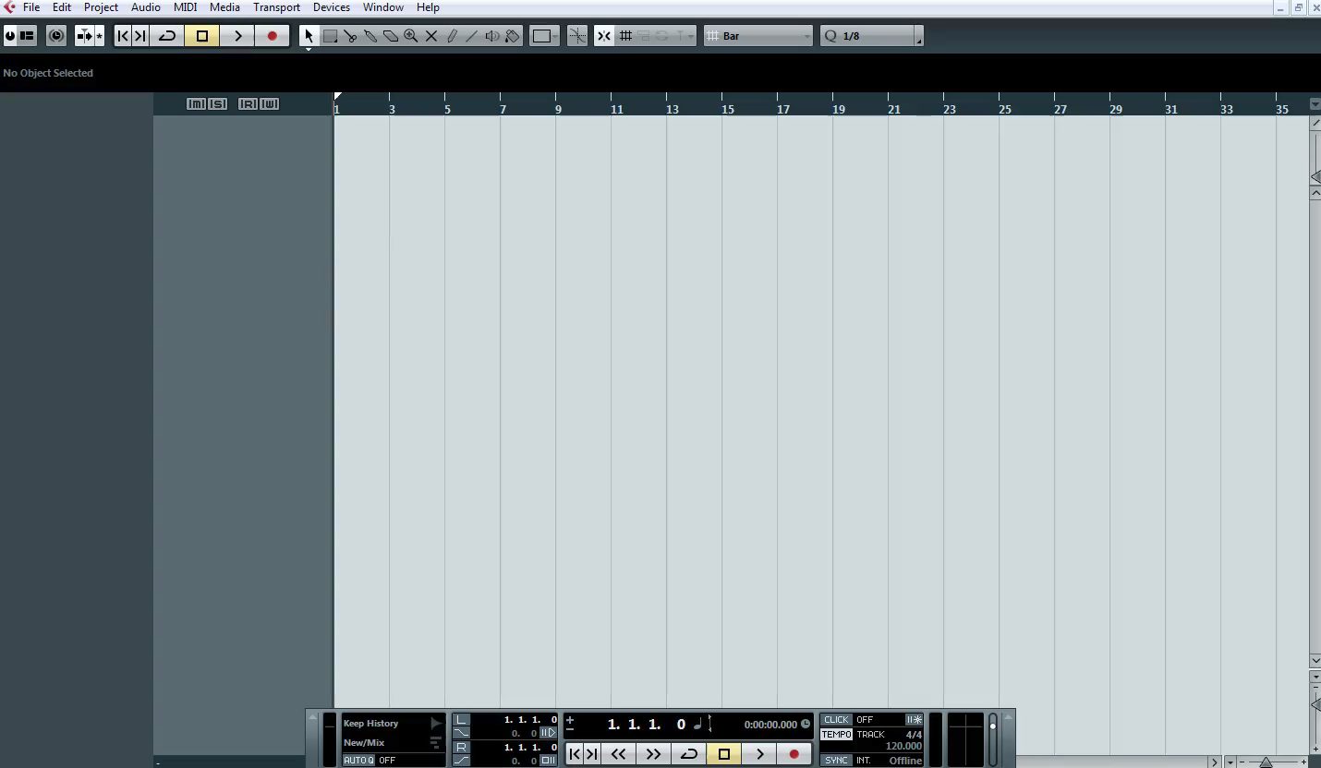
Automation - Create a fade in
1 – Watch the clip below

Slide 3
Automation - Create a fade in
Fade in the drum sample
(p) Written explanation of your process (m) How would you create a fade out?
P
M
2 - Insert Screenshots to evidence your work

Slide 4
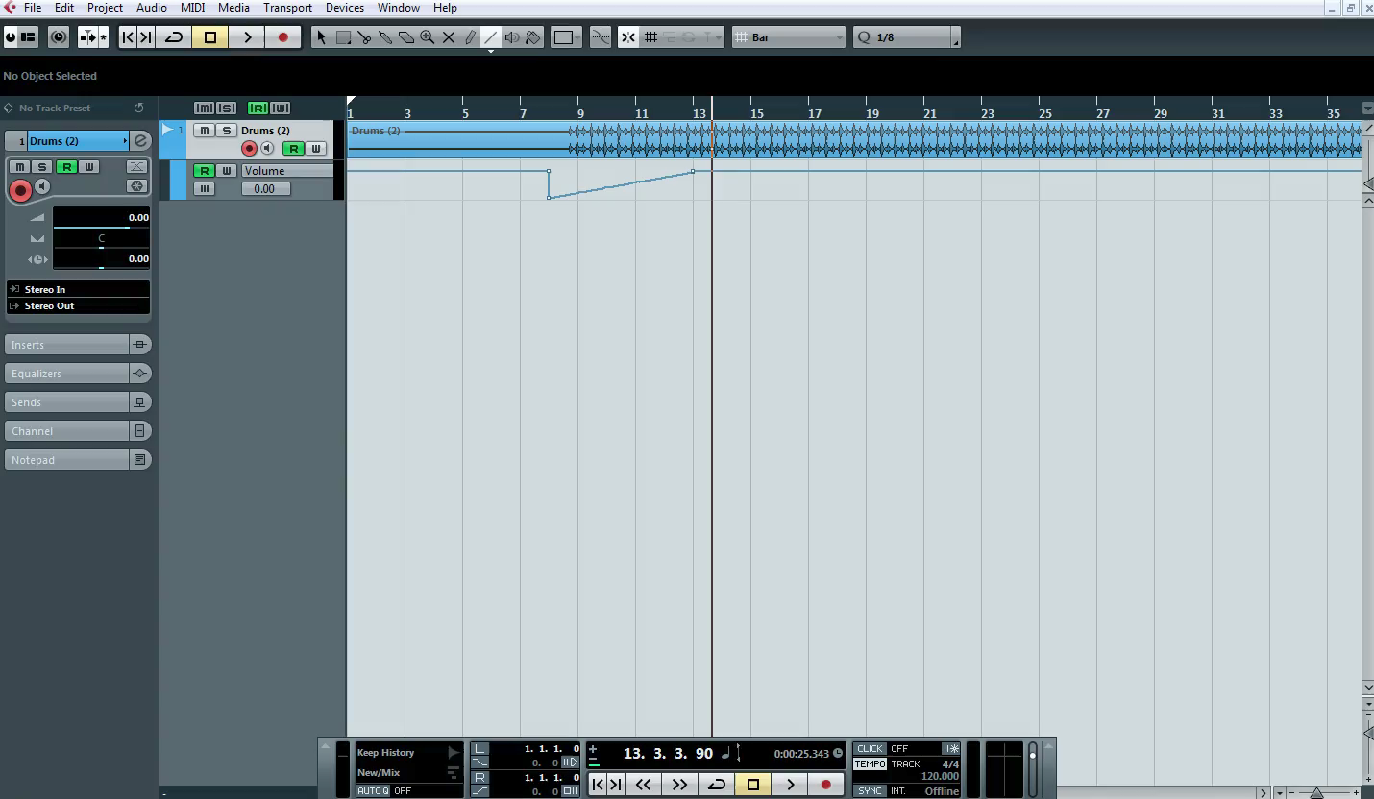
Automation - Panning
1 – Watch the clip below

Slide 5
Automation - Panning
Pan your drums from left to right
(p) Written explanation of your process (m) How do you know what speaker is active when moving the line up or down?
P
M
2 - Insert Screenshots to evidence your work

Slide 6

Effects
1 – Watch the clip below

Slide 7
Effects
Add reverb to the track
(p) - Written explanation of your process (m) What does the Mix dial do in the effects window?
P
M
2 - Insert Screenshots to evidence your work

Slide 8
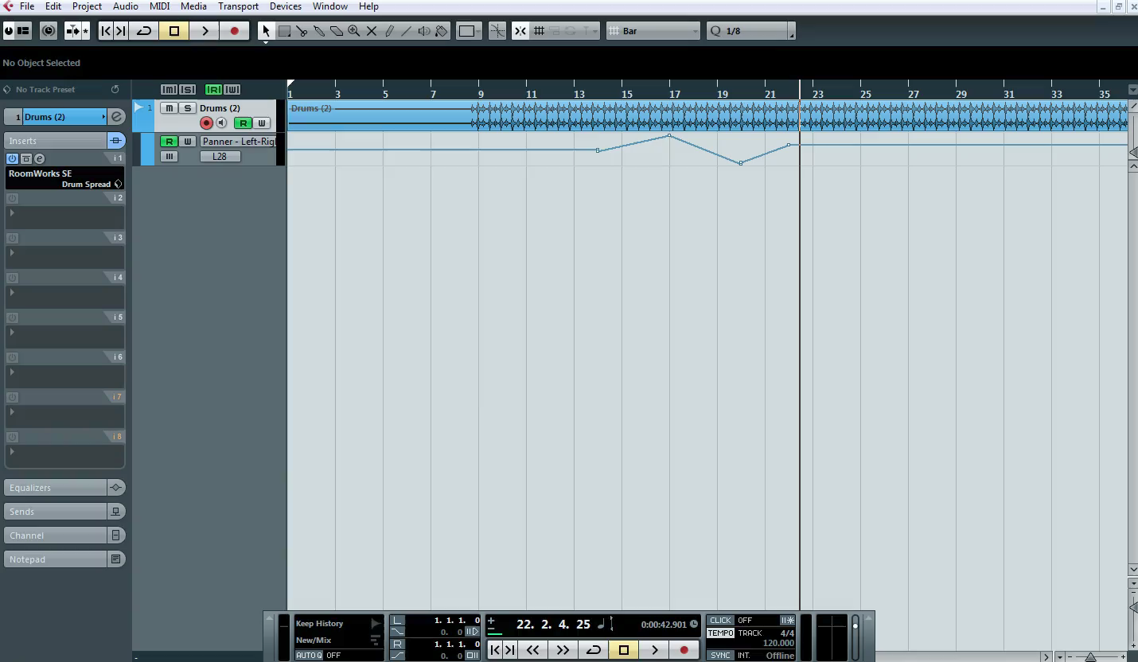
Final Mix
1 – Watch the clip below

Slide 9
Final Mix
(p) Written explanation of your process (m) What happens if your volumes go too loud?
P
M
Insert Screenshots to evidence your work

Slide 10
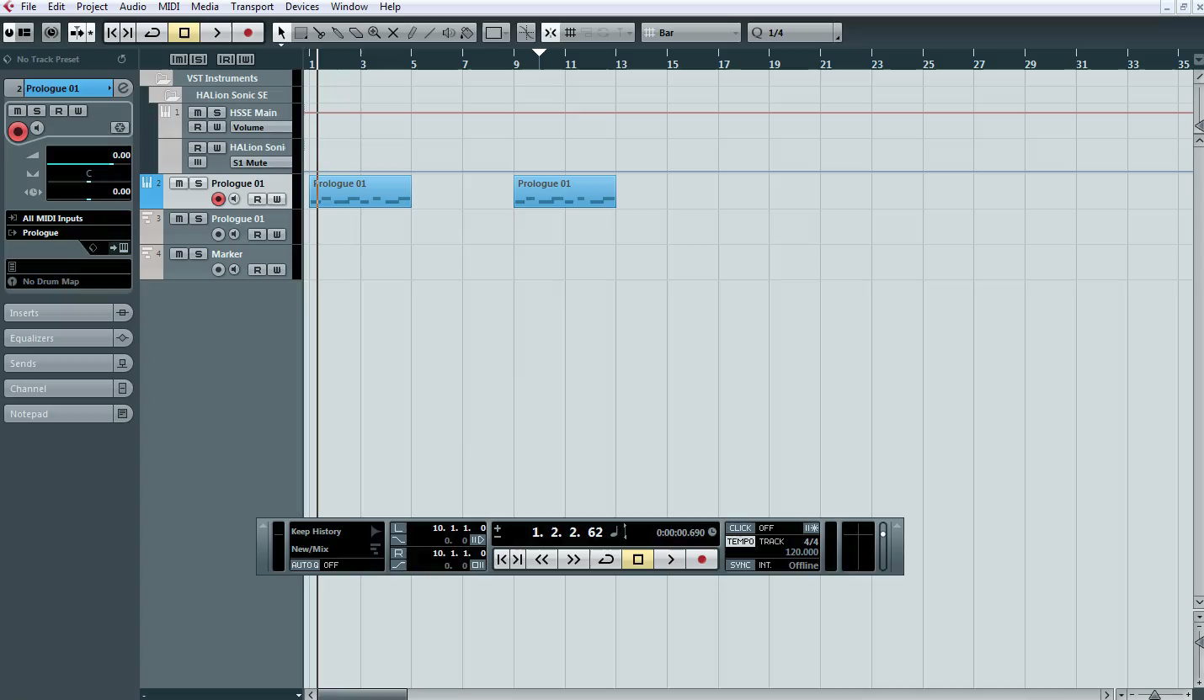
Exporting the song
1 – Watch the clip below

Slide 11
Exporting the song
Show the inputs and outputs for your project
(p) Written explanation of your process (m) What should you do with the exported track at the bottom of your project (D) Why would you do this to the exported track at the bottom?
P
M
D
3 - Insert Screenshots to evidence your work

