Slide 1
Week 2 & 3

Slide 2
ART DEPARTMENT
EMAIL ADDRESSES
MRS TAYLOR – nta@woodlandsschool.essex.sch.uk
MS ASH
Has@woodlandsschool.essex.sch.uk
MISS WILLMOT
Cwt@woodlandsschool.essex.sch.uk

Slide 3
Document this work in your sketchbook – if you have it!
All the work set will be added to your sketchbook. If you want to keep it separate for the time being that is fine, but we expect to see it submitted on the return to school.

Slide 4
Visual response: Creating your version of the portrait
PHOTOGRAPHY
TASK 2:
NOW USE SOME EDITING TO ENHANCE YOUR PHOTO:
BLACK AND WHITE
CONTRAST (DIFFERENCE BETWEEN LIGHT AND DARK)
SATURATION OF COLOUR (MAKING THE COLOUR BRIGHTER/DULLER ETC.)
YOU CAN USE FILTERS ON APPS TOO. EMAIL YOUR TEACHER IF YOU NEED HELP.
TASK 3
TASK 1
PHOTOGRAPHERS:
Use your knowledge of compostion to take photos of yourself or family members
PHOTOGRAPHERS – DO LOTS OF DIFFERENT VERSIONS – EXPLORE EDITING AND MANIPULATIING IMAGES.
Use your phones to take photographs of your work,
Email your teacher – final pieces, any sketchbook work or PPTs
WEEK 2​

Slide 5
Visual response: Creating your version of the portrait
ART
TASK 3
ARTISTS: CREATE FROM YOUR PHOTOS, PAINT ON THEM, DRAW FROM THEM ETC. USE WHATEVER MATERIALS YOU HAVE AT HOME – BIRO/PENCIL/PAINT ETC.
TASK 2:
NOW USE SOME EDITING TO ENHANCE YOUR PHOTO:
BLACK AND WHITE
CONTRAST (DIFFERENCE BETWEEN LIGHT AND DARK)
SATURATION OF COLOUR (MAKING THE COLOUR BRIGHTER/DULLER ETC.)
YOU CAN USE FILTERS ON APPS TOO. EMAIL YOUR TEACHER IF YOU NEED HELP.
TASK 1
ARTISTS: You can use a mirror or ask a family member to pose for you Or take photographs (photographs would be easier!)
Use your phones to take photographs of your work,
Email your teacher – final pieces, any sketchbook work or PPTs
WEEK 2​

Slide 6
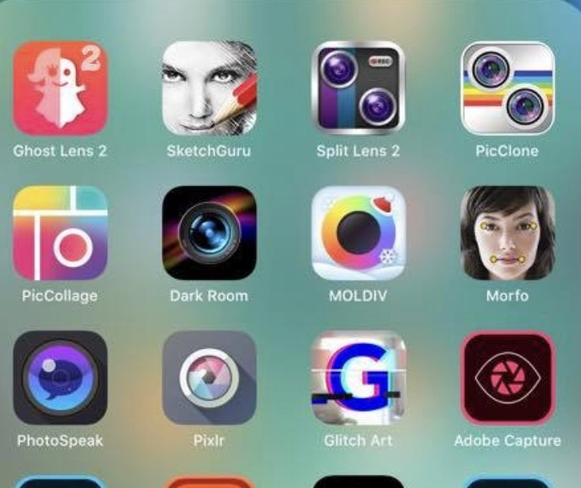
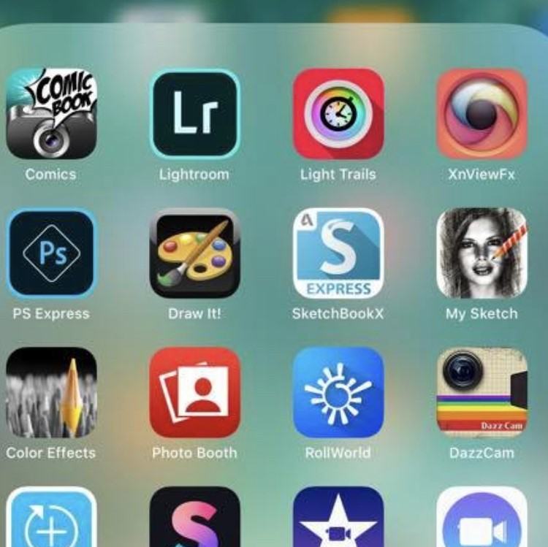
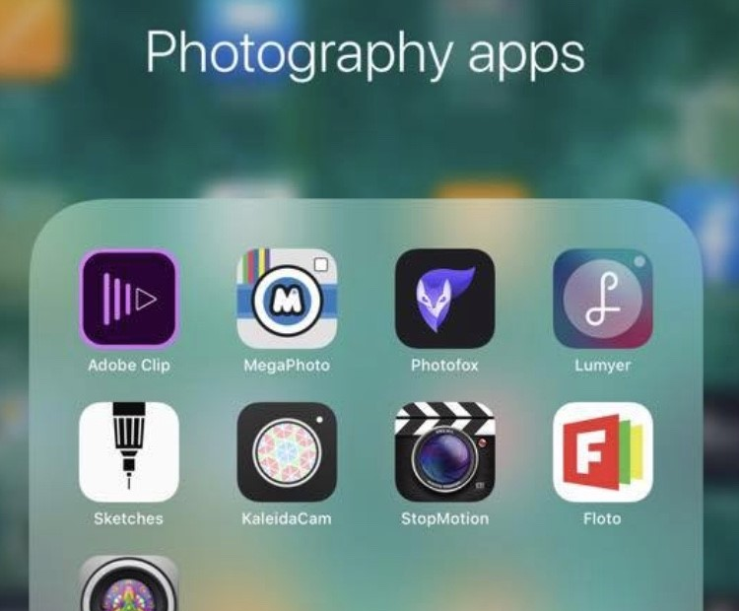
Free Apps for editing photos:
SNAPSEED
VSCO
PIXLR
OVER
LIGHTROOM
SKETCHCLUB
BRUSHES REDUX
MAGIC ERASER
PICS ART
REPIX
GREEN SCREEN
PS EXPRESS
IMOVIE
BEFUNKY
PHONTO
I HAVE BOLDED THE TWO I USE! EXPLORE AS MANY AS YOU LIKE!
TAKE SOME PHOTOS ON YOUR PHONE, LINKED TO YOUR IDEA/ART WORK YOU ARE RESPONDING TO USING SOME OF THESE FREE APPS?
TAKE SCREEN SHOTS OF EDITS AND SAVE YOUR FINALS, READY TO EMAIL TO YOUR SCHOOL ACCOUNT OR TEACHER?
WEEK 2

Slide 7
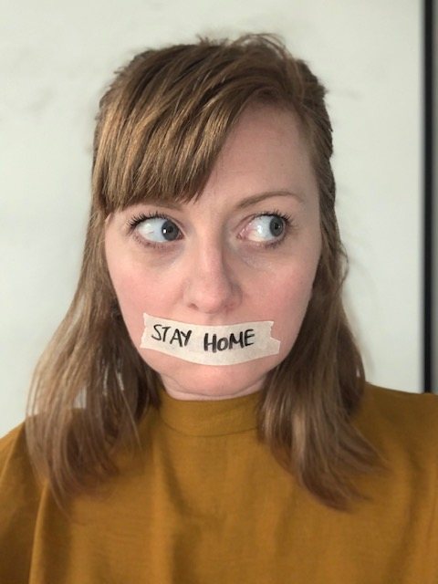
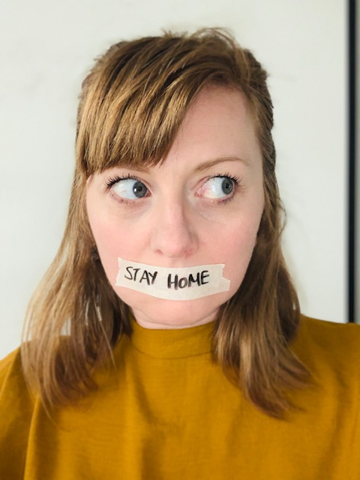
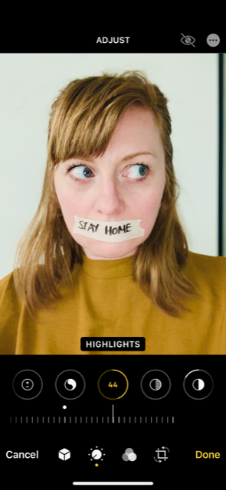
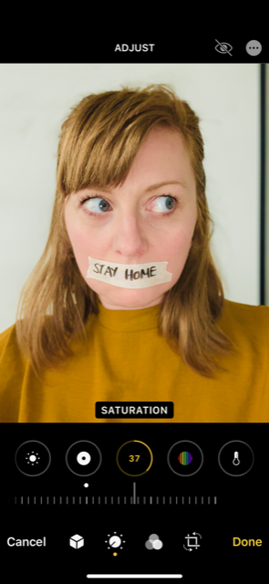
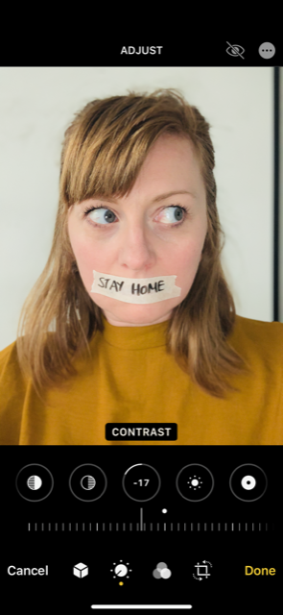
An example
Original Photo
I took the photo on my iphone. I took it with the flash on and on vivid filter.
I used the editing software on iphoto to create my response
My photo is in response to Claire Luxton. I am making a statement about the current situation.
I wish I had some flowers to stick under my tape. That would be a sign of better things to come.

Slide 8
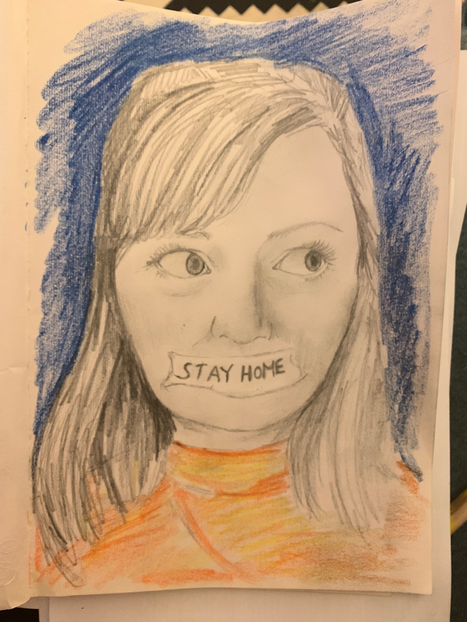
ART: DRAWN RESPONSE
TIP: FOLD THE PAPER TO HELP WITH PROPORTION AND ARRANGEMENT
I DID A SKETCH ON A4 PAPER AND THEN ADDED A LITTLE TONE AND COLOUR. I BORROWS BY LITTLE GIRLS CRAYONS AND COLOURING PENCILS.
HOPEFULLY, THE EXAMPLES WILL HELP YOU SEE WHAT YOU NEED TO DO.

