Slide 1
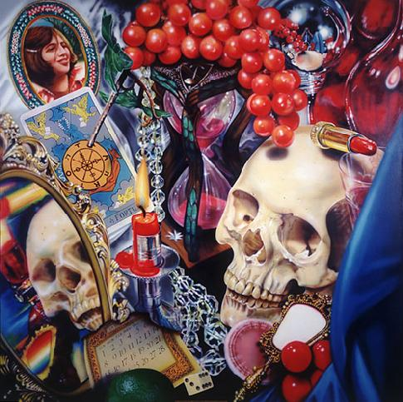
Audrey Flack

Slide 2
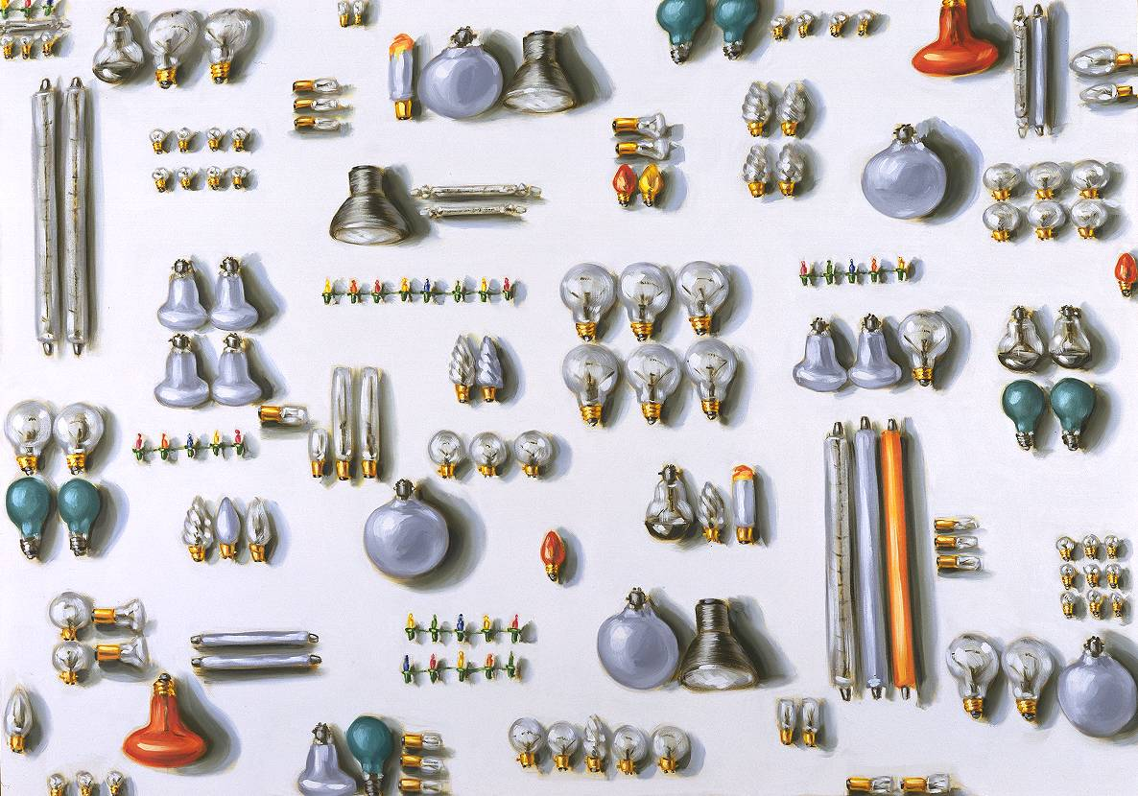
Lisa Milroy

Slide 3
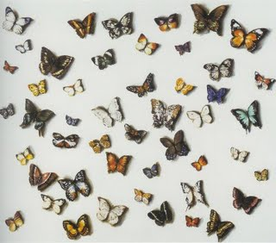
Lisa Milroy Butterflies

Slide 4
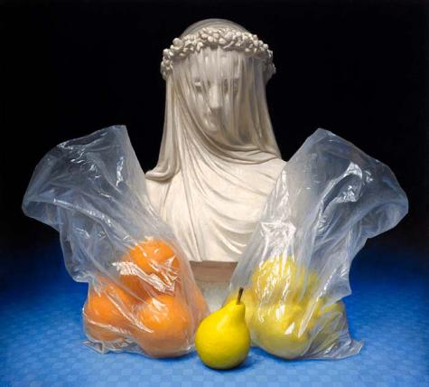
Conor Walton

Slide 5
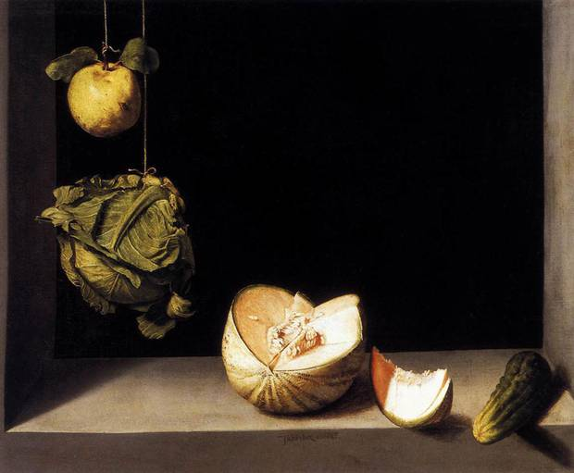
Juan Sánchez Cotán - Quince, Cabbage, Melon and Cucumber, 1602

Slide 6
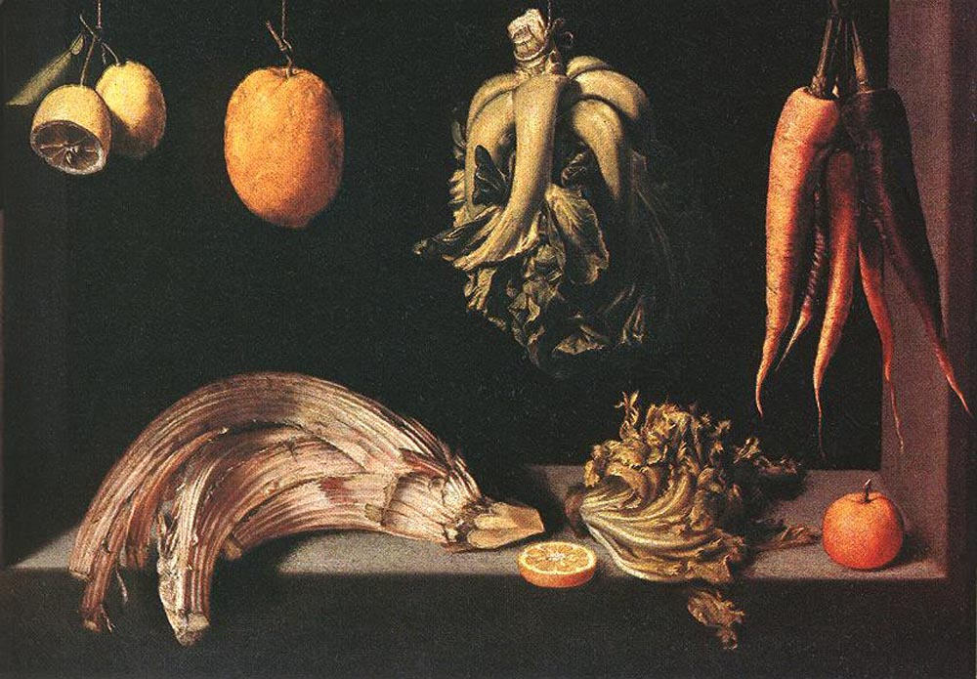
Juan Sánchez Cotán – Still-Life, 1600

Slide 7
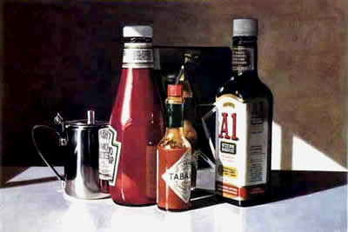
Ralph Goings
Sauces

Slide 8
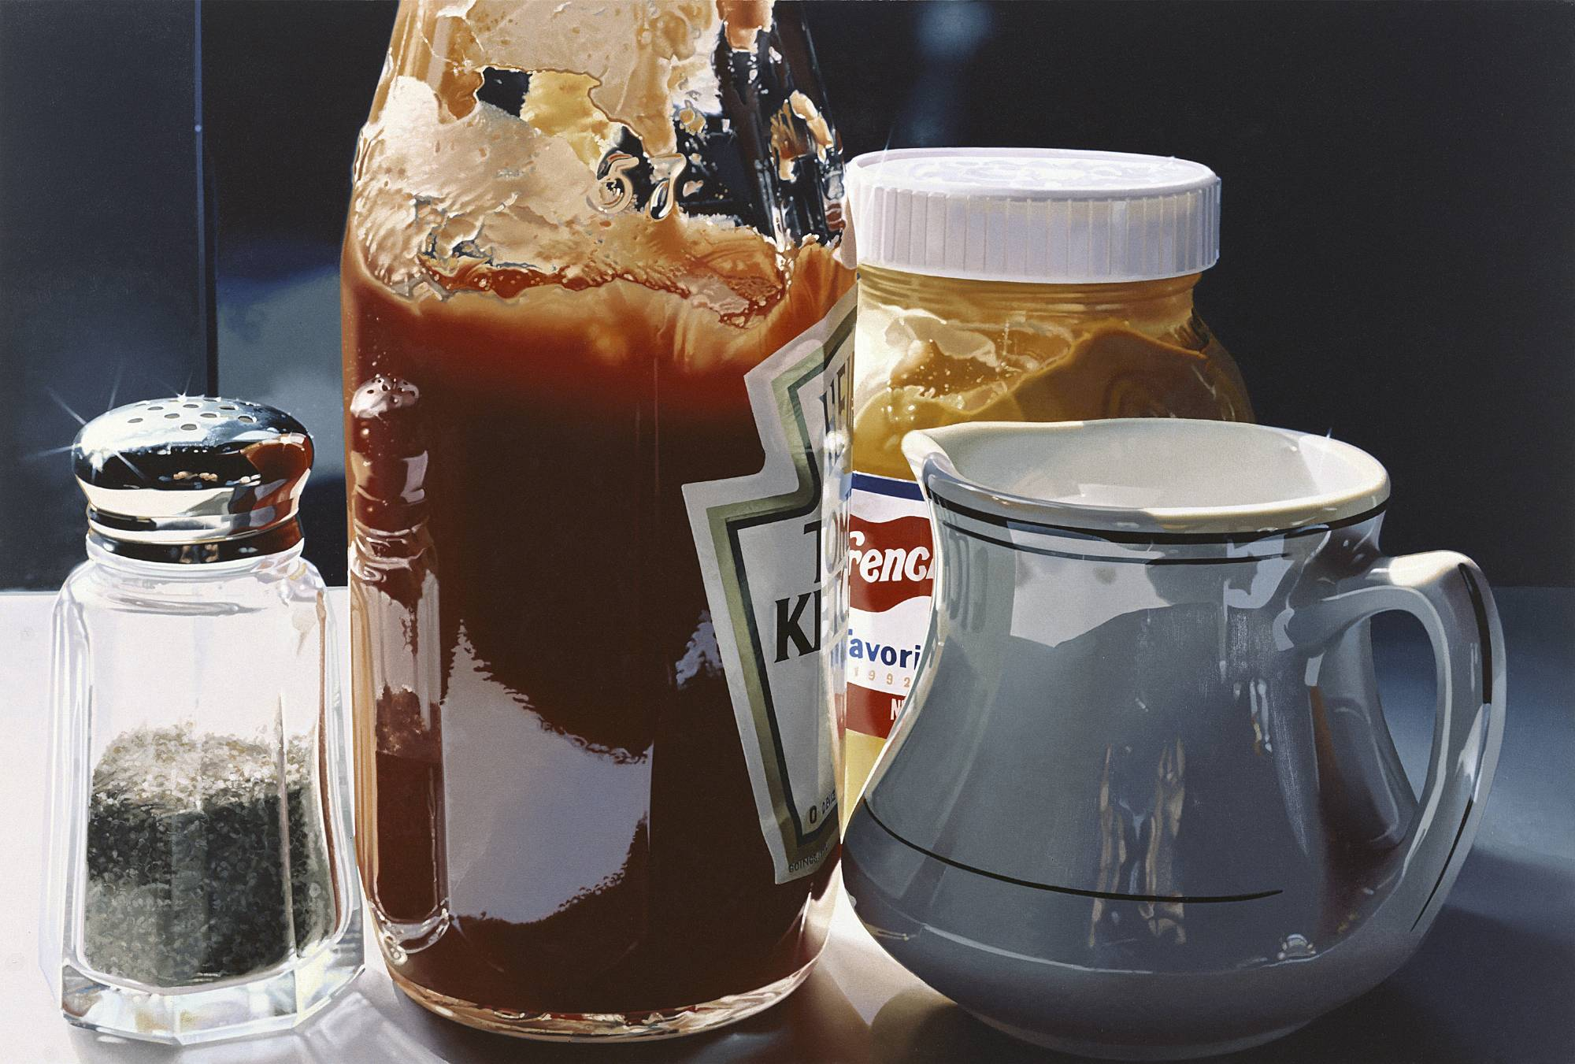
Ralph Goings
Quartet 2006

Slide 9
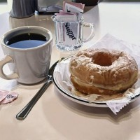
Ralph Goings

Slide 10
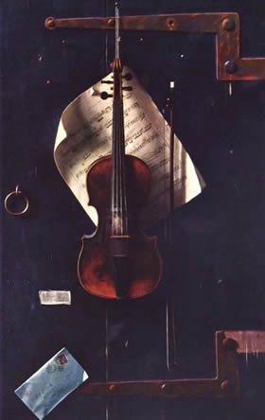
William Harnett
Still Life Violin & Music 1888

Slide 11
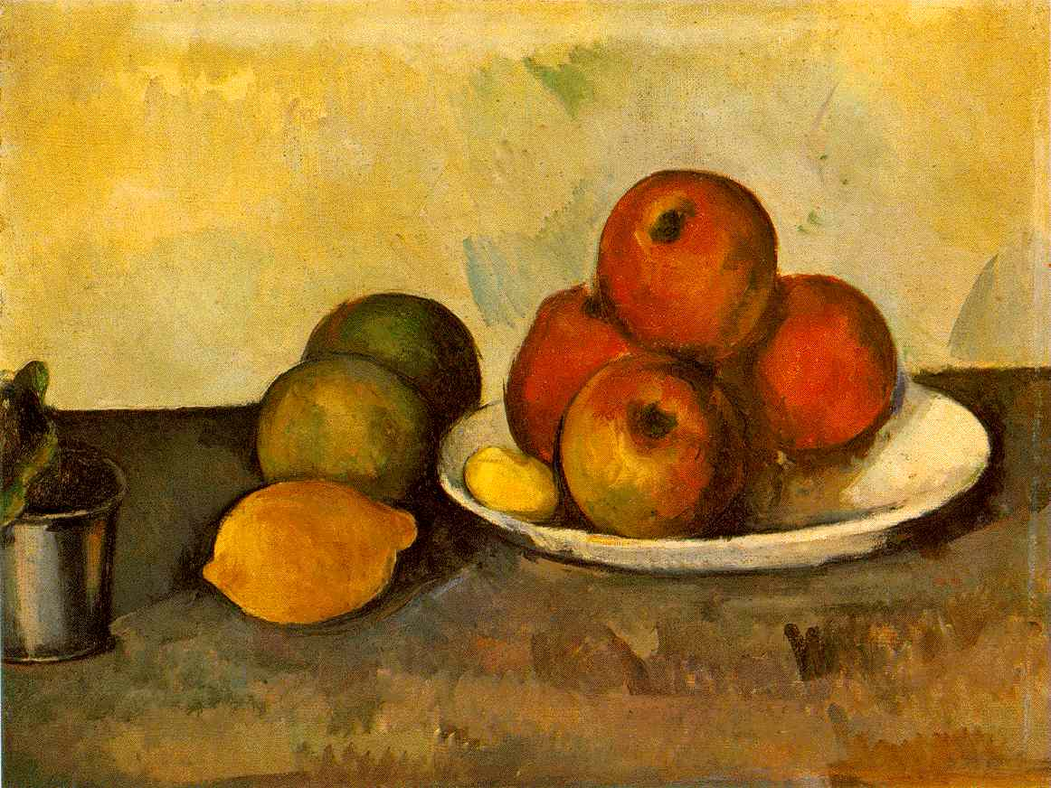
Paul Cézanne
Still Life with Apples c1890

Slide 12
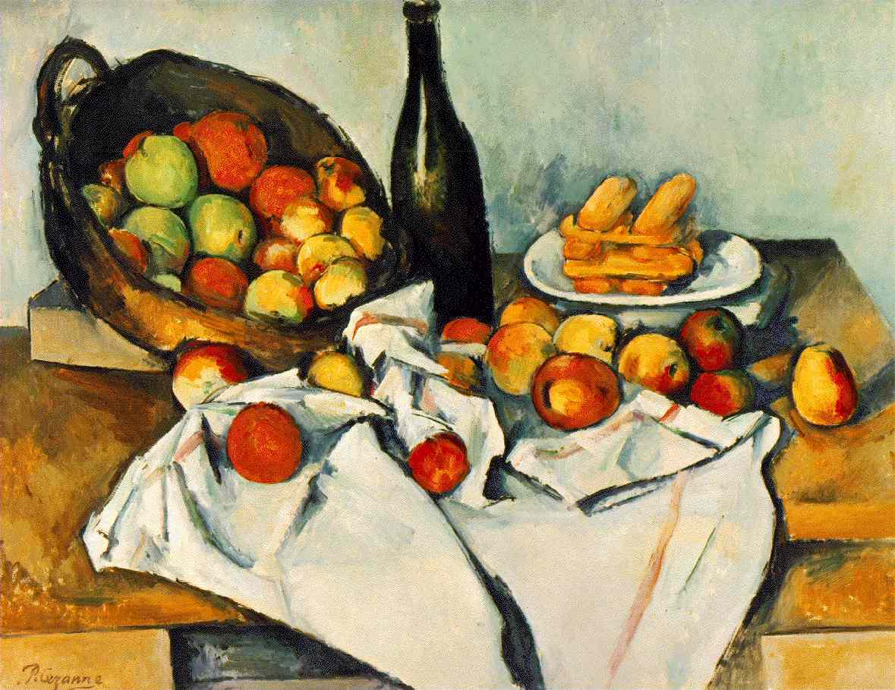
Paul Cézanne
Still Life with Basket of Apples 1890-94

Slide 13
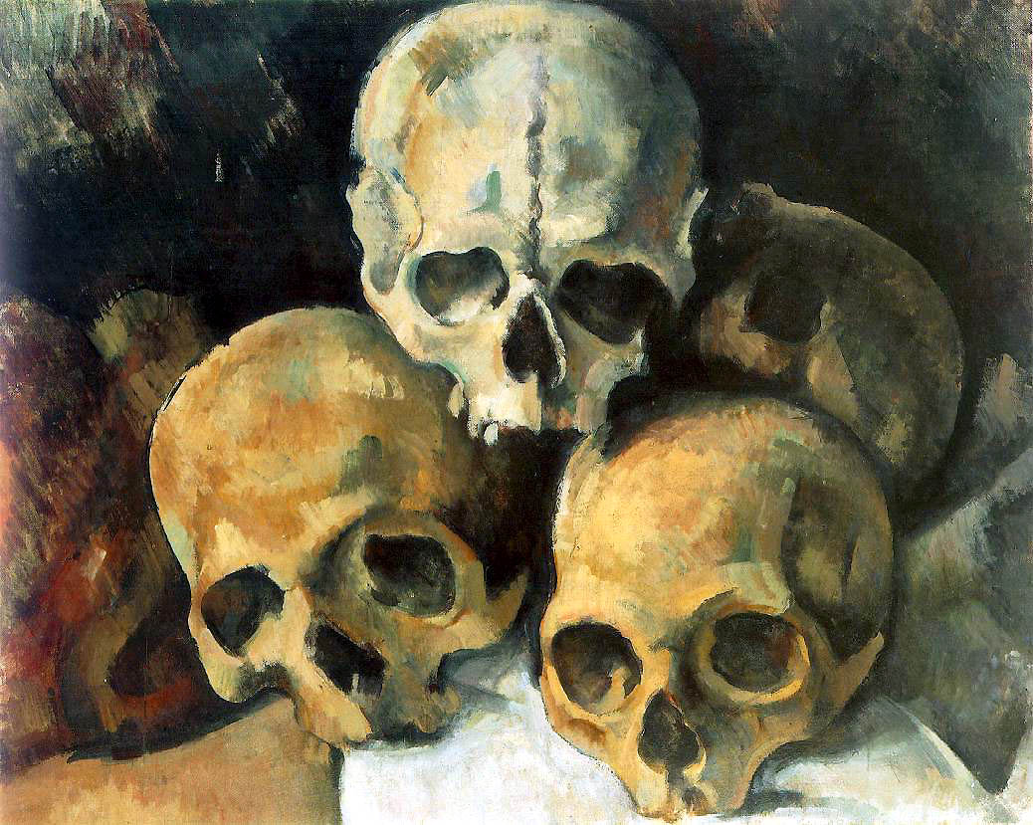
Paul Cézanne
Pyramid of Skulls 1901

