Slide 1
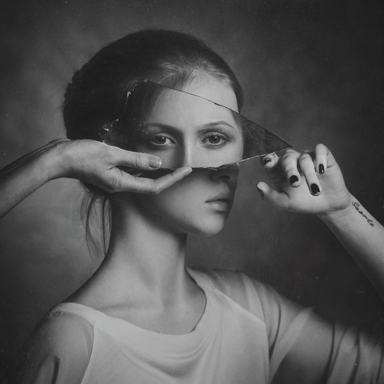
DESCRIBE
What kind of things do you see in the Photograph? What words would you use to describe the Photograph?
UNDERSTAND
What does the photograph remind you of and why?
Facts about
Paul Apalkin
1.
2.
3.
4.
Paul Apalkin
EVALUATE
How does this work relate to REFLECTION?
What makes you think this (link back to previous answers).
ANALYSE
What is the main idea behind the work?
How did the artist make this work?
APPLY
What inspires you about this work?
How can you recreate this?

Slide 2
Note here how you will set up and photograph your response (think about COMPOSITION, LIGHTING, CAMERA SETTINGS)
Sketch below how your photographs could be composed (set out)

