Slide 1
ART DEPARTMENT
EMAIL ADDRESSES
MRS TAYLOR – nta@woodlandsschool.essex.sch.uk
MS ASH
Has@woodlandsschool.essex.sch.uk
MISS WILLMOT
Cwt@woodlandsschool.essex.sch.uk
MRS BAXTER
jbx@woodlandsschool.essex.sch.uk

Slide 2
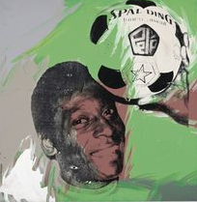
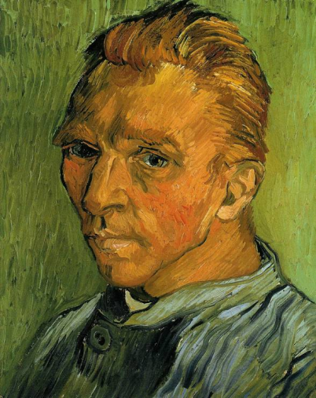
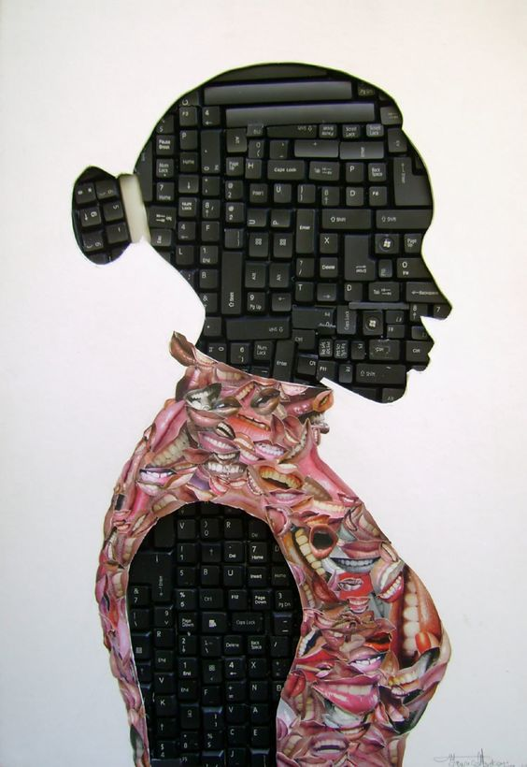
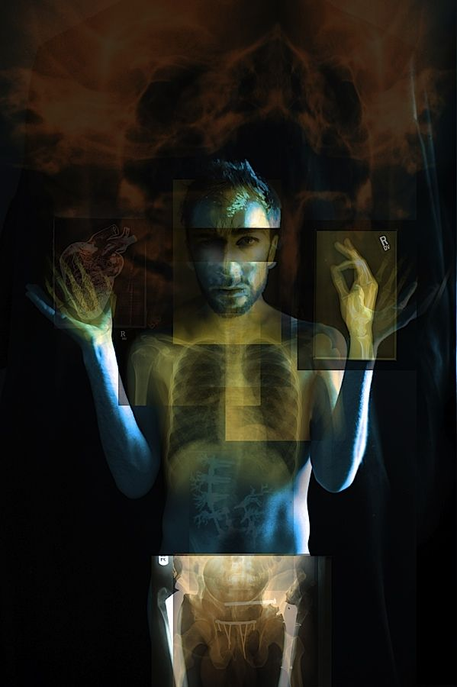
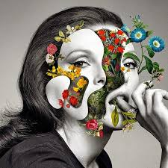
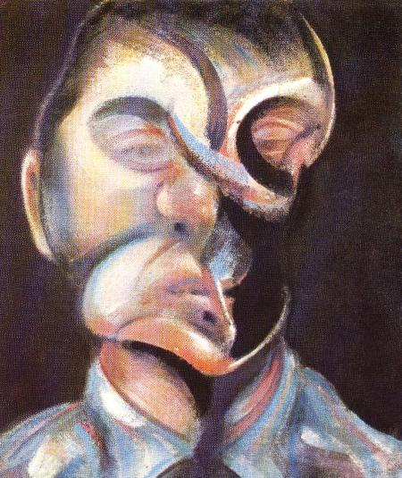
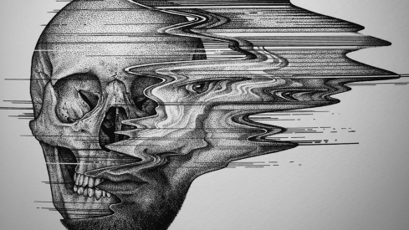
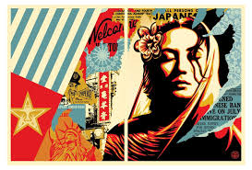
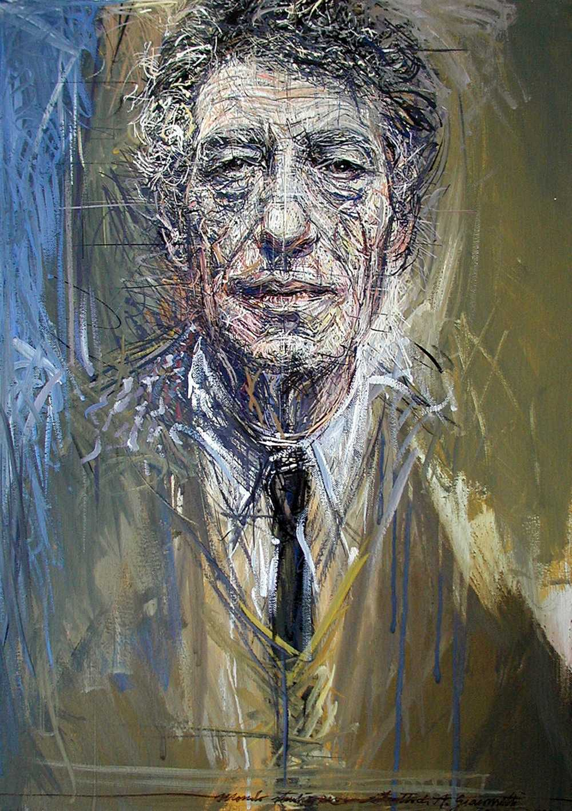
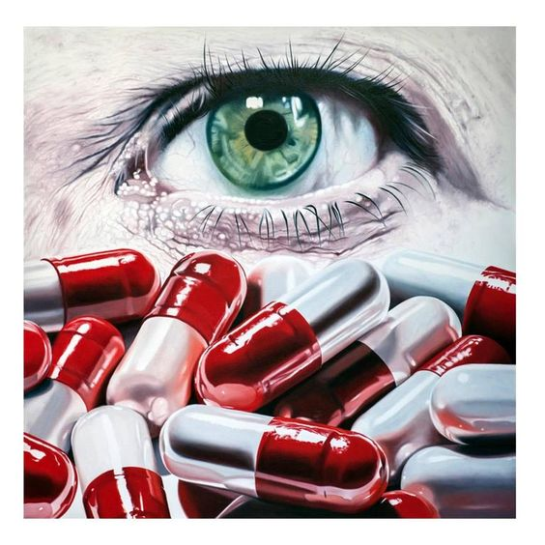
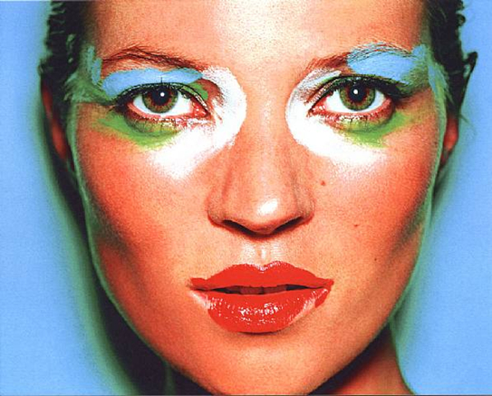
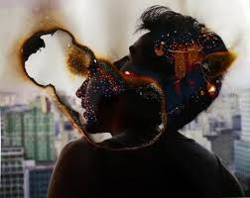
ORDINARY/EXTRAORDINARY

Slide 3
Document this work in your sketchbook – if you have it!
All the work set will be added to your sketchbook. If you want to keep it separate for the time being that is fine, but we expect to see it submitted on the return to school.

Slide 4
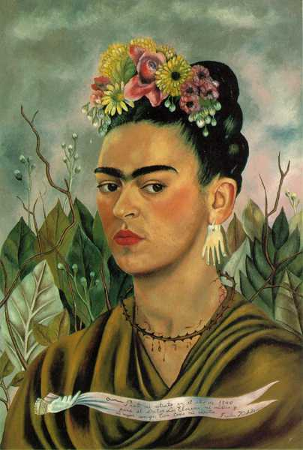
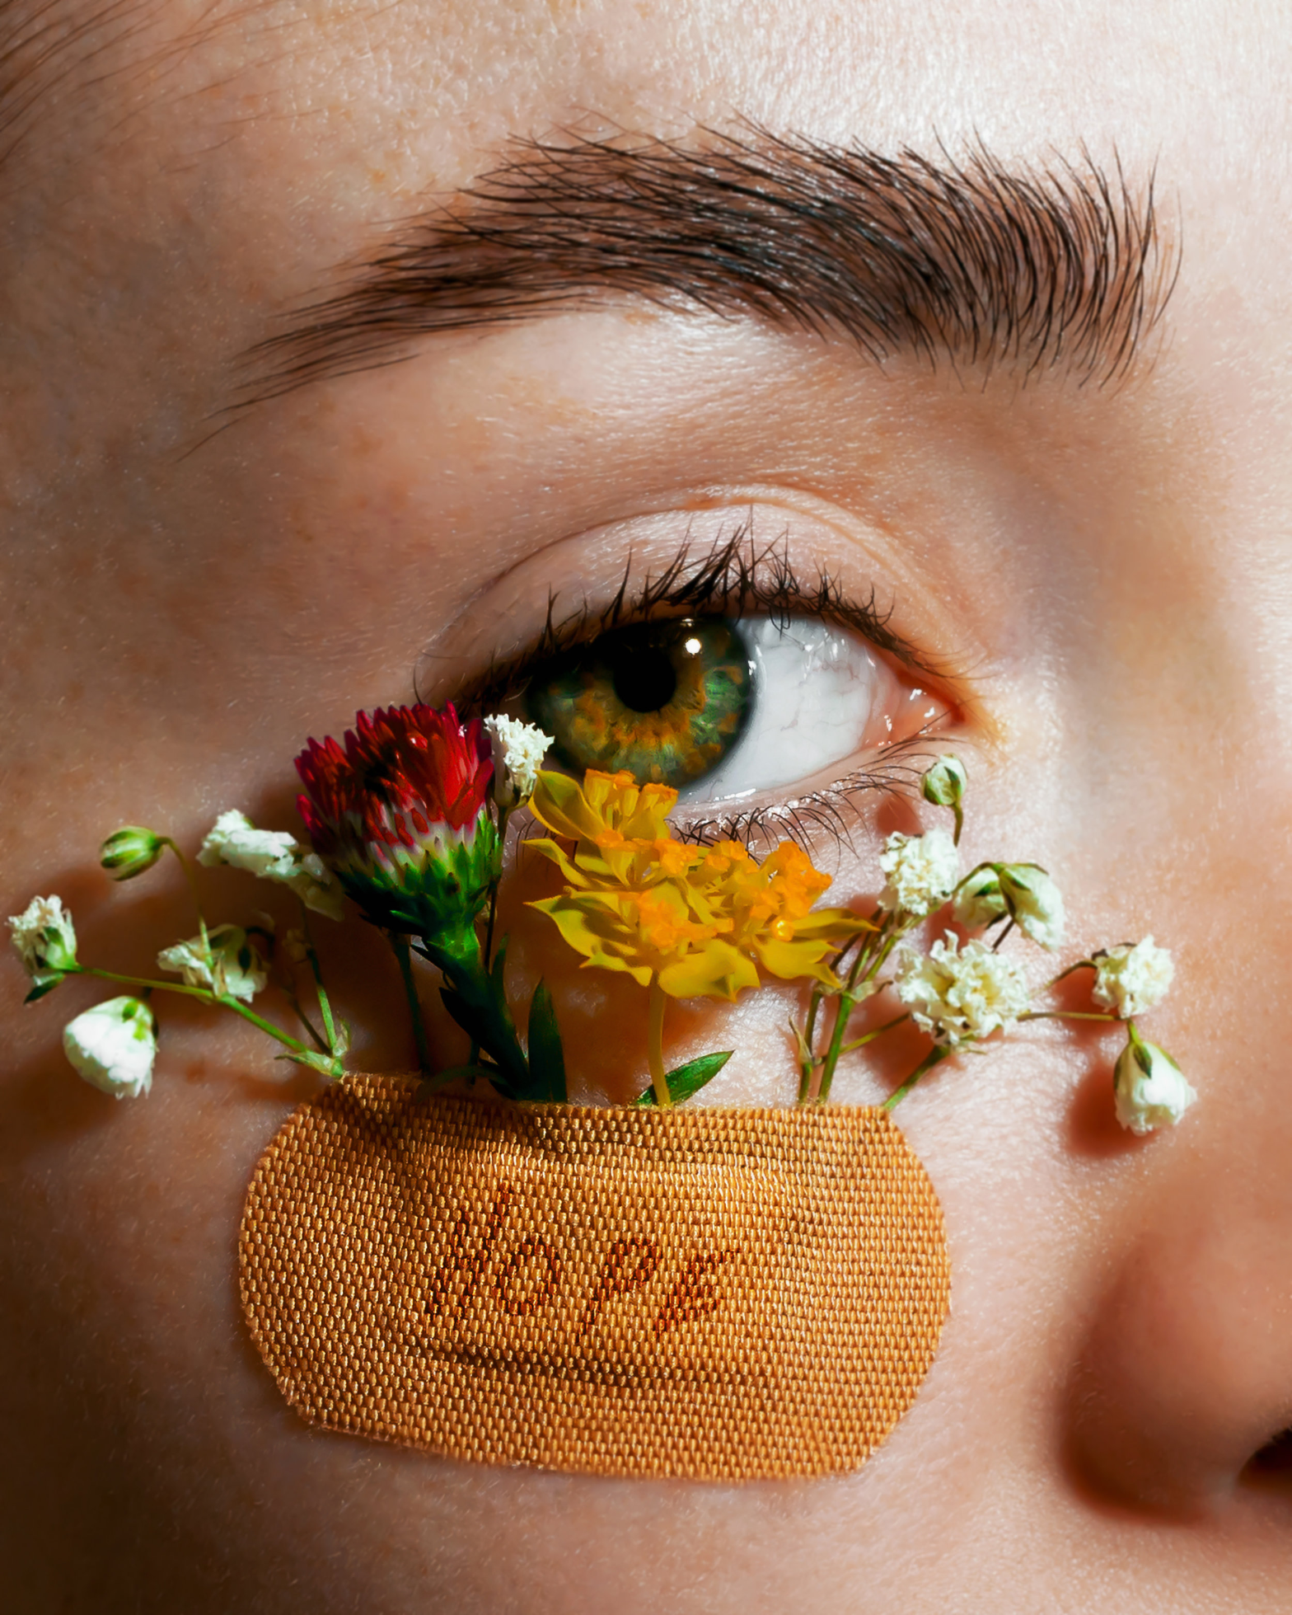
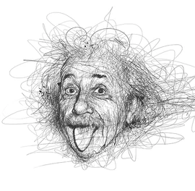
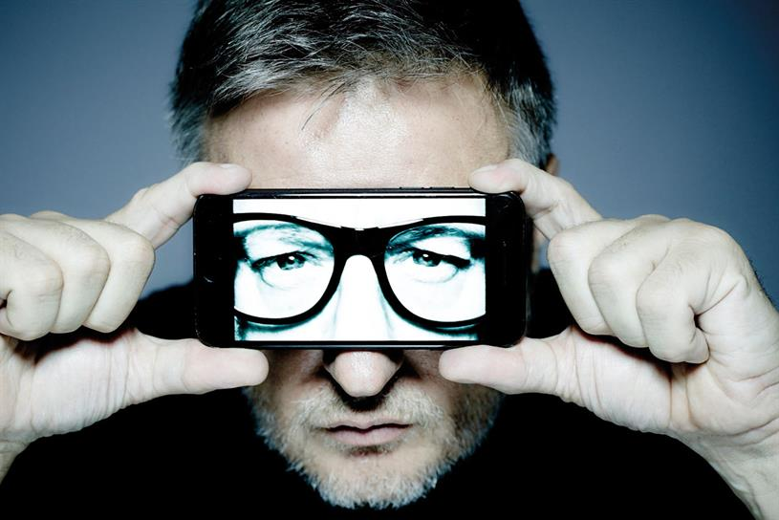
ARTIST STUDY: Investigate to Create
Frida Kahlo
Giacometti
Mario Testino, Kate Moss
Vince Low, Albert Einstein
Francis Bacon – selfportrait1972
Rankin
CLAIRE LUXTON
Andy Warhol
You will choose an Artist/photographer/artwork. It doesn’t matter if its art or Photography you can chose ANY of the above or from the next slide…If you already have a different artist in mind/someone you think links to your ideas more just email your teacher to show them!

Slide 5
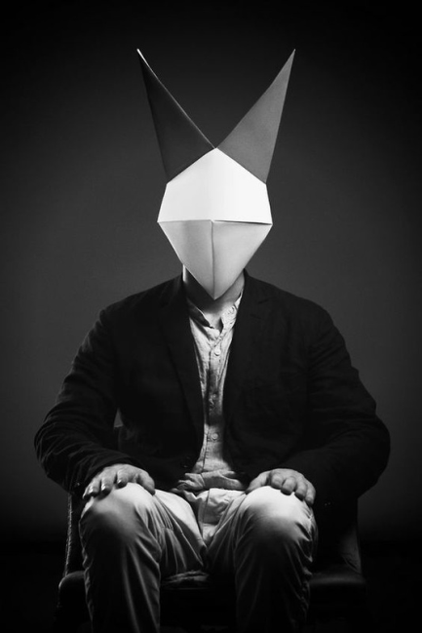
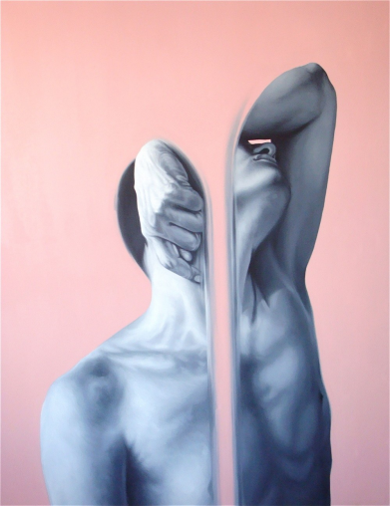
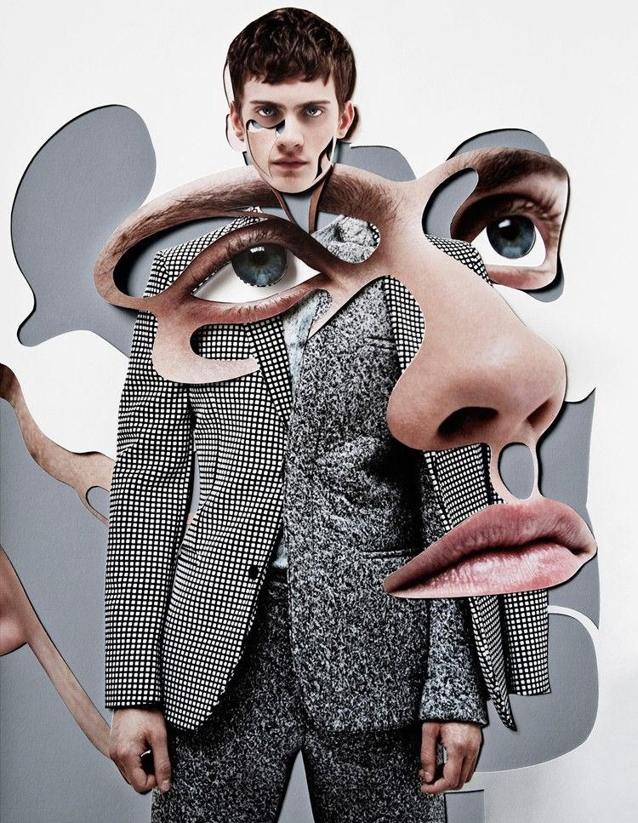
ARTIST STUDY: Investigate to Create
Paul Jackson
Rocio Montoya
Eduardo Mata Icaza
Giacomo Favilla
Shepard Fairey
Lucas Simoes
Damien Blottiere
Phillippe Huart
You will choose an Artist/photographer/artwork. It doesn’t matter if its art or Photography you can chose ANY of the above or from the next slide/or previous…If you already have a different artist in mind/someone you think links to your ideas more just email your teacher to show them!

Slide 6
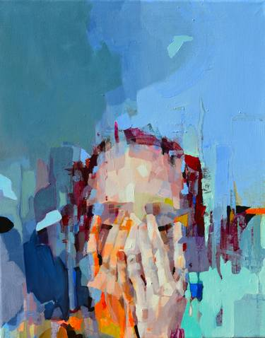
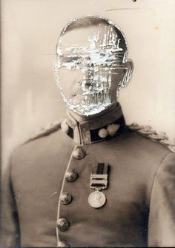
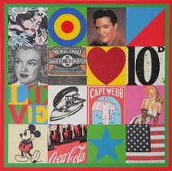
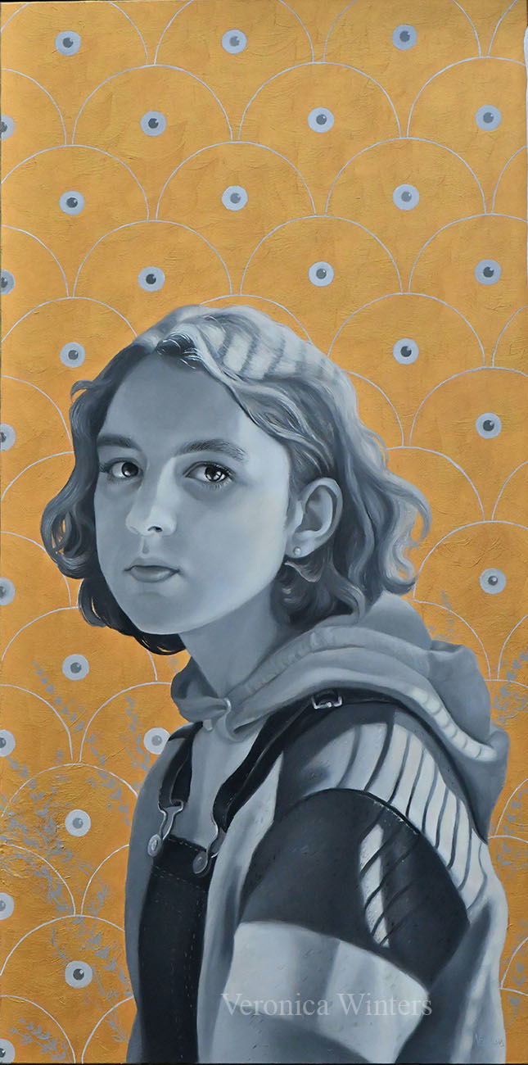
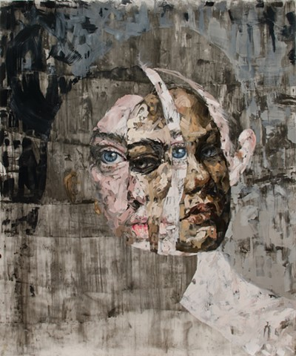
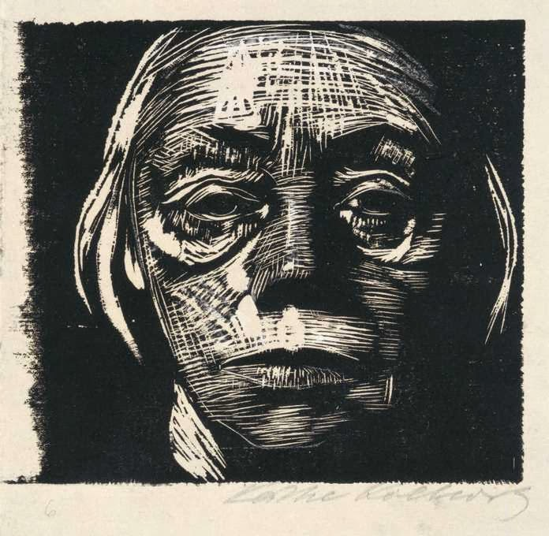
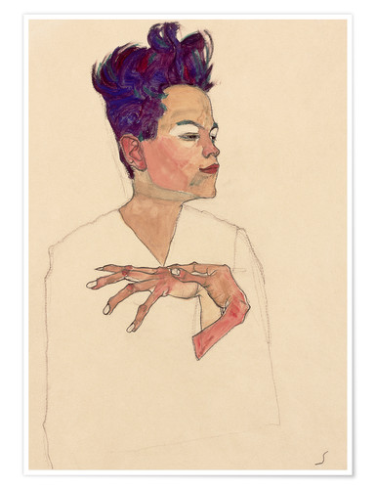
ARTIST STUDY: Investigate to Create
Mike McQuaide
Rosanna Jones
Peter Blake
Melinda Matyas
Lacey McKinney
Veronica Winters
Kathe Kollwitz
Egon Schiele
You will choose an Artist/photographer/artwork. It doesn’t matter if its art or Photography you can chose ANY of the above or from previous slides…If you already have a different artist in mind/someone you think links to your ideas more just email your teacher to show them!

Slide 7
Visual response: Creating your version of the artists work!
ART
TASK 3
ARTISTS: CREATE FROM YOUR PHOTOS, PAINT ON THEM, DRAW FROM THEM ETC. USE WHATEVER MATERIALS YOU HAVE AT HOME – BIRO/PENCIL/PAINT ETC.
TASK 2:
NOW USE SOME EDITING TO ENHANCE YOUR PHOTO:
BLACK AND WHITE
CONTRAST (DIFFERENCE BETWEEN LIGHT AND DARK)
SATURATION OF COLOUR (MAKING THE COLOUR BRIGHTER/DULLER ETC.)
YOU CAN USE FILTERS ON APPS TOO. EMAIL YOUR TEACHER IF YOU NEED HELP.
TASK 1
ARTISTS: You can use a mirror or ask a family member to pose for you? Or take photographs (photographs would be easier!). Do you need to photograph everyday objects?
Use your phones to take photographs of your work,
Email your teacher – final pieces, any sketchbook work or PPTs
WEEK 2 & 3​

Slide 8
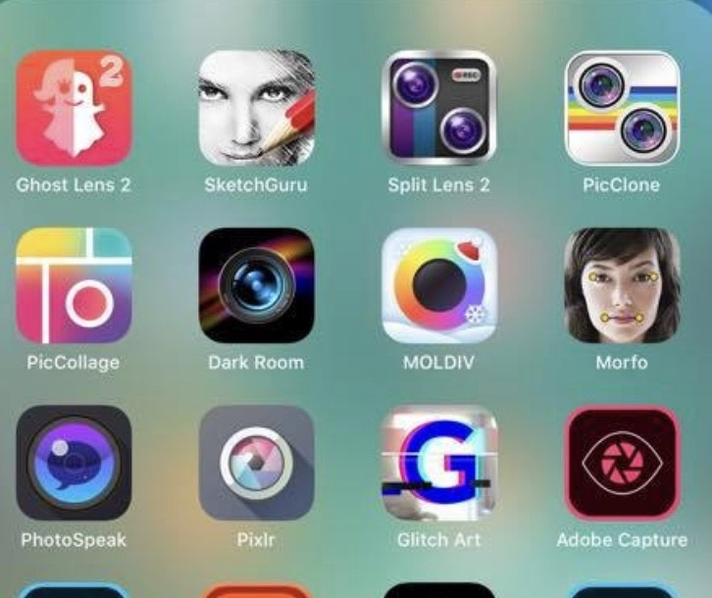
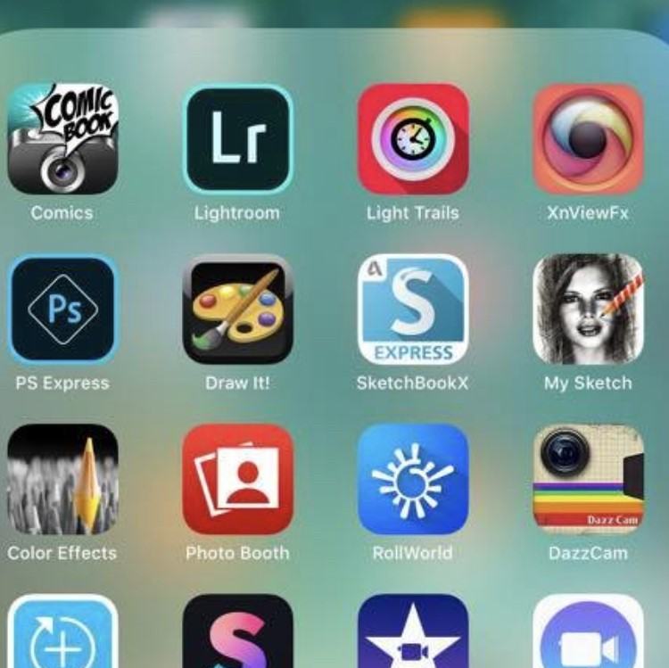
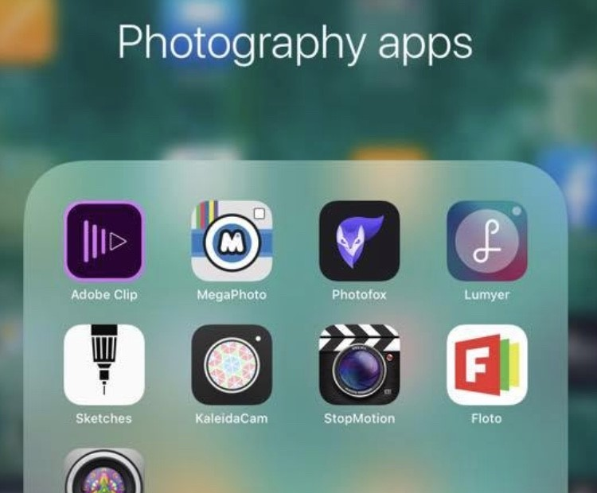
Free Apps for editing photos:
SNAPSEED
VSCO
PIXLR
OVER
LIGHTROOM
SKETCHCLUB
BRUSHES REDUX
MAGIC ERASER
PICS ART
REPIX
GREEN SCREEN
PS EXPRESS
IMOVIE
BEFUNKY
PHONTO
I HAVE BOLDED THE TWO I USE! EXPLORE AS MANY AS YOU LIKE!
TAKE SOME PHOTOS ON YOUR PHONE, LINKED TO YOUR IDEA/ART WORK YOU ARE RESPONDING TO USING SOME OF THESE FREE APPS?
TAKE SCREEN SHOTS OF EDITS AND SAVE YOUR FINALS, READY TO EMAIL TO YOUR SCHOOL ACCOUNT OR TEACHER?

Slide 9
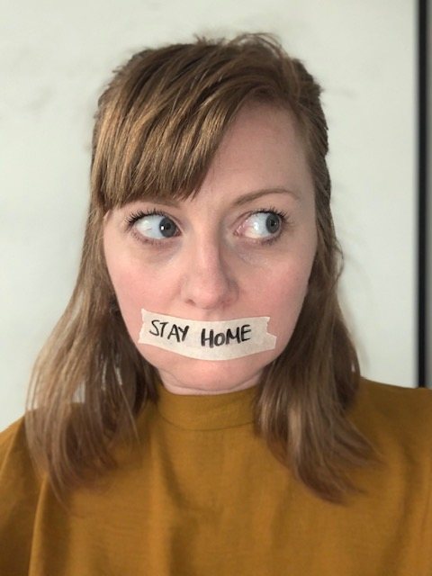
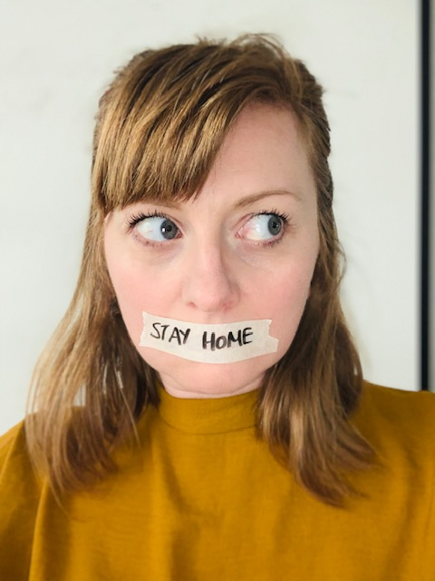
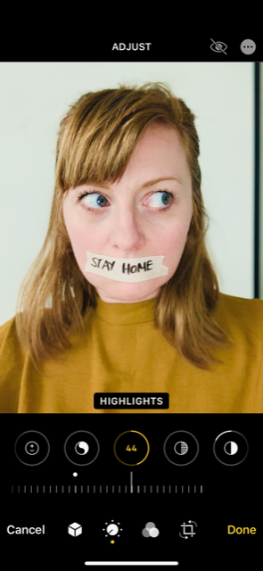
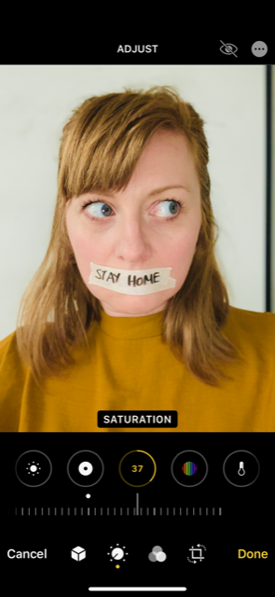
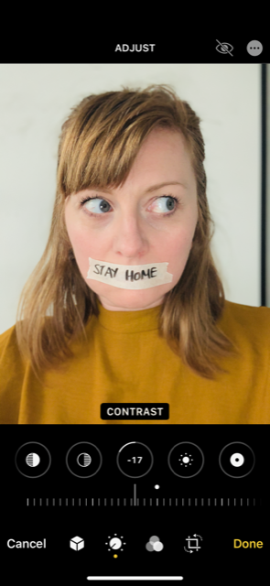
An example
Original Photo
I took the photo on my I phone. I took it with the flash on and on vivid filter.
I used the editing software on iphoto to create my response
My photo is in response to Claire Luxton. I am making a statement about the current situation.
I wish I had some flowers to stick under my tape. That would be a sign of better things to come.
*COULD I NOW DRAW/PAINT ETC FROM THIS PHOTO?

