Slide 1
To get a grade 4 & above
Design my own ideas
Use adequate research
Use notes to analyse my work
Use notes and sketches to analyse artists work
Use notes (and sketches) to show I understand
why artists work has been made.
Select appropriate resources and media
Understand limitations of different media
Choose relevant areas of your research / sources
to use , analyse and give opinions on
Use specialist vocabulary ( composition, tone, texture,
shape, space, pattern, line and words to describe them)
Use notes and sketches to show people what you are
trying to achieve (intentions / meanings)
Produce work which is in my own style and my own idea
Choose appropriate artists work
Make clear connections between my ideas, other artists and sources

Slide 2
MIND MAP
WHAT DO THESE WORDS MEAN?
ORDINARY &/OR EXTRAORDINARY
PORTRAITS
WHAT MATERIALS DO YOU LIKE USING BEST
Extraordinary
Very unusual
Not the norm.
Remarkable
Outstanding
Strange
Uncommon
WHAT IDEAS DO YOU HAVE?
Ordinary
With no special or distinctive features; normal.
Usual
Standard
Regular
Typical
routine

Slide 3
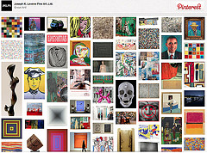
Start to research this theme, through found visuals! Create at least 1 double page of found portraits and imagery which show this. Add the title ‘Ordinary/Extraordinary’ too.
Ordinary/Extraordinary

Slide 4
Mind Map
PEOPLE
NATURAL ENVIRONMENT
PLACES
ORDINARY / EXTRAORDINARY
ACTIVITIES
IMAGINATION
OBJECTS
ORDINARY
EXTRAORDINARY

Slide 5
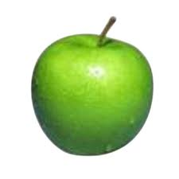
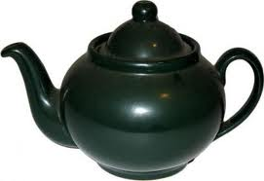
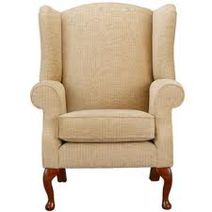
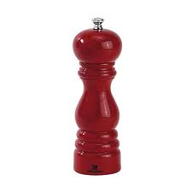
How can these everyday ORDINARY objects be made EXTRAORDINARY
?
?
?
?

