Slide 1
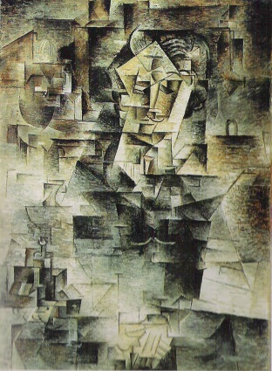
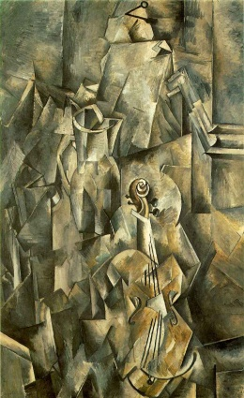
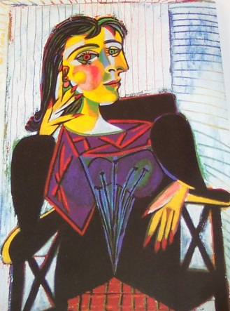
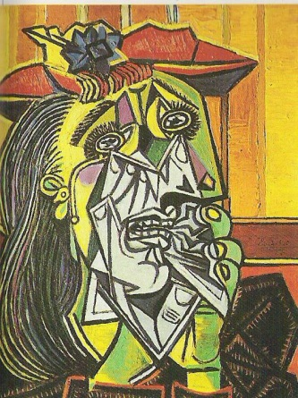
Cubism
An art movement started in Paris in the early 20th Century. Characterised by the reduction and fragmentation of objects. Representing objects from differing view points
The key figures of this movement were George Braque, Pablo Picasso and Juan Gris
The name Cubism comes from the art critic, Louis Vauxcelles who, when commenting on George Braque’s work, referred to it as 'geometric schemas and cubes'
There are two variations of Cubism, Analytical and Synthetic

Slide 2
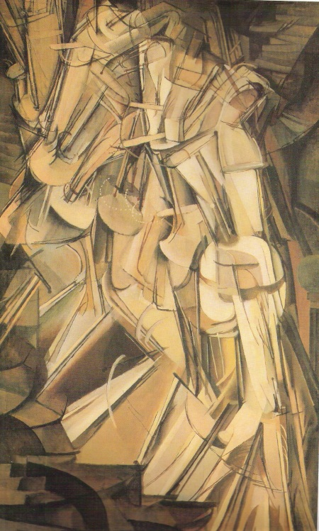
Analytical
You cannot tell what the image is.
Analysis of form, broken up and rearranged.
Use of mono chrome colours
Concentration on line and forms
Making 3D objects look flat.
Fragmented
Marcel Duchamp
Nude descending a staircase 11 1912
Georges Braque
Violin and Pitcher, 1910
Pablo Picasso
Portrait of Kahnweiler, 1910

Slide 3
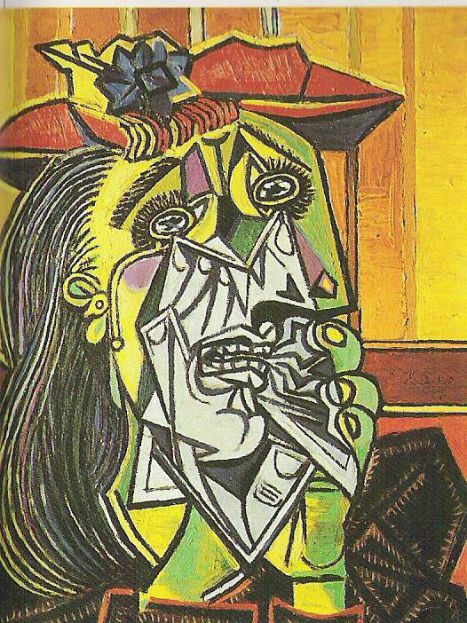
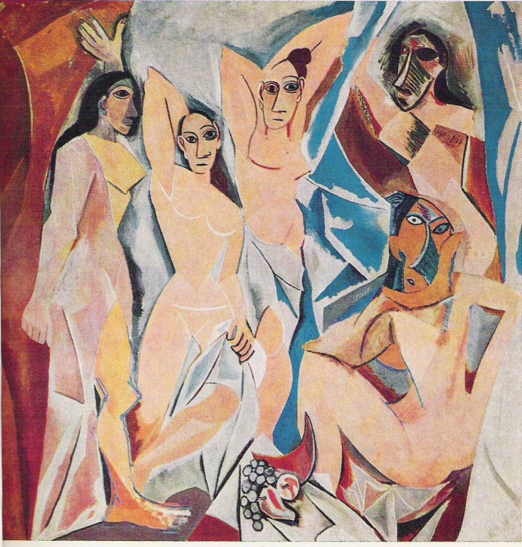
Can make out the basic image
Fragmented images
Introduction of colour and mixed media.
Use of decorative patterns
Not as detailed
Bold colour
Fun
Pablo Picasso - Weeping Woman 1937
Pablo Picasso
Portrait of Dora Maar, 1937
Pablo Picasso
Les Demoiselles d’Avignon, 1907

Slide 4
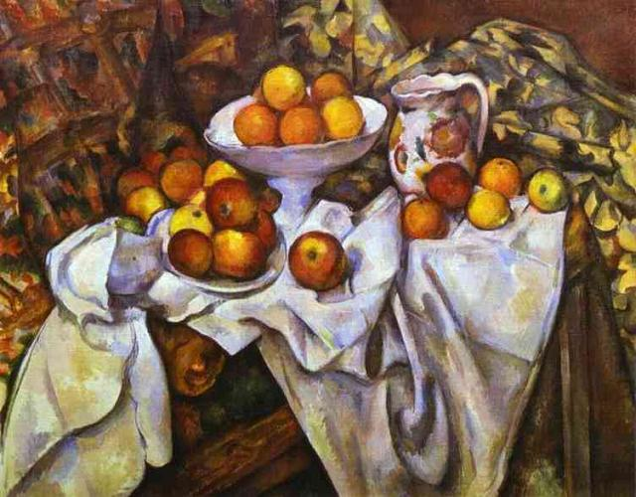
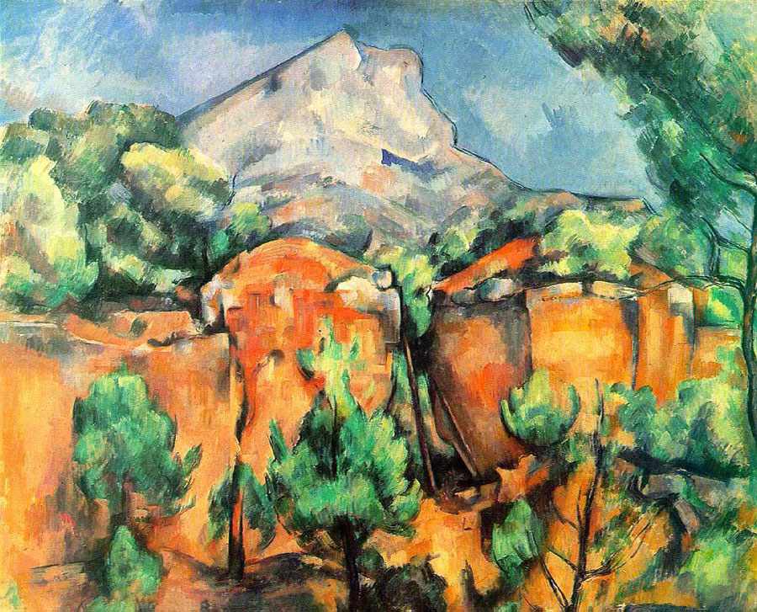
Picasso and Braque were also inspired by Paul Cezanne who once wrote
“Treat nature in terms of the cylinder, the sphere, the cone; everything in proper perspective…one must first of all study geometric forms: the cone, the cube, the cylinder, the sphere.”

Slide 5
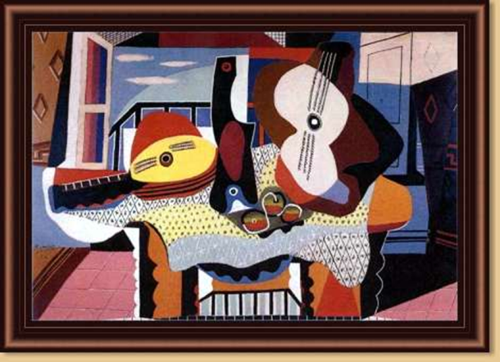
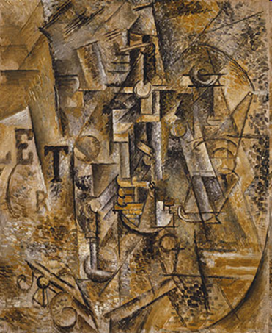
Analytical
Analysis of form, broken up and rearranged.
Use of mono chrome colours
Concentration on line and forms
Making 3D objects look flat.
Fragmented
Fragmented images
Introduction of colour and mixed media.
Use of decorative patterns
Not as detailed
Bold colour
Fun
Cubist Techniques
1. Showed objects from multiple viewpoints.
2. Simplified forms into basic shapes and patterns, such as circles and triangles.
3. Split the picture into fragments and sometimes divided it up to look unrecognisable.
4. Often used a very neutral colour palette.

Slide 8
Task
Create a double page, showing and explaining the differences between analytical and synthetic cubism.
You must include:
Information about the differences in cubism in your own words.
Elements/ information from the two artists Picasso and Georges Braque annotate images. (Use must use your 1 – 9 sheet to help evaluate the images of art
Good presentation.
GCSE ASSESSMENT OBJECTIVES
AO4
Presenting a personal, informed and meaningful response demonstrating analytical and critical understanding, realising intentions and where appropriate making connections between visual, written, oral and other elements.
AO1
Developing ideas through investigations informed by contextual and other sources, demonstrating analytical and cultural understanding.
AO2
Refining ideas through experimenting and selecting appropriate resources, media, materials and techniques.
AO3
Recording ideas, observations and insights relevant to your intentions and/or other forms.

Slide 9
Complete an artist study of either analytical cubism or synthetic cubism.
GCSE ASSESSMENT OBJECTIVES
AO4
Presenting a personal, informed and meaningful response demonstrating analytical and critical understanding, realising intentions and where appropriate making connections between visual, written, oral and other elements.
AO1
Developing ideas through investigations informed by contextual and other sources, demonstrating analytical and cultural understanding.
AO2
Refining ideas through experimenting and selecting appropriate resources, media, materials and techniques.
AO3
Recording ideas, observations and insights relevant to your intentions and/or other forms.

Slide 10
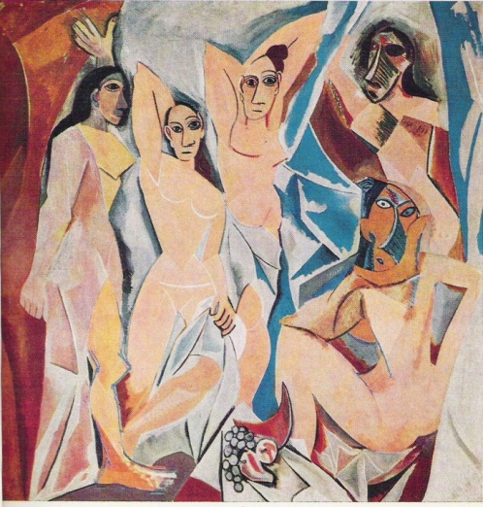
Create a page on research and information about each artist and their link to Cubism and how Braque and Picasso were inspired by Cezanne as explained in class.
Pablo Picasso
Les Demoiselles d’Avignon, 1907
Georges Braque
Violin and Pitcher, 1910
Picasso and Braque were also inspired by Paul Cezanne who once wrote
“Treat nature in terms of the cylinder, the sphere, the cone; everything in proper perspective…one must first of all study geometric forms: the cone, the cube, the cylinder, the sphere.”

Slide 11
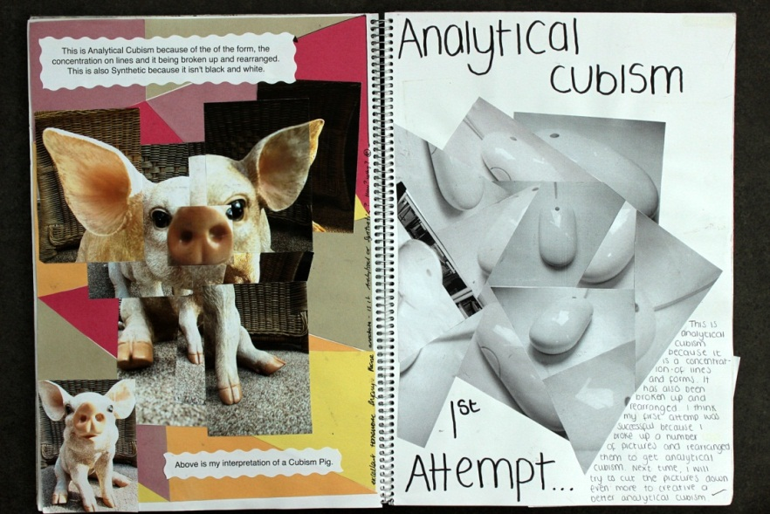
Create your own versions on synthetic and analytical cubism. Using the images provided
A03 and A02
GCSE ASSESSMENT OBJECTIVES
AO2
Refining ideas through experimenting and selecting appropriate resources, media, materials and techniques.
AO3
Recording ideas, observations and insights relevant to your intentions and/or other forms.

Slide 12
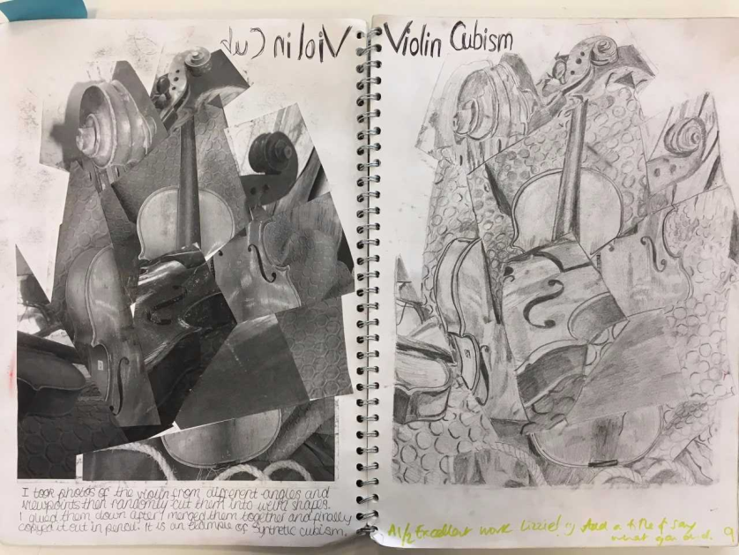

Slide 13
How can you refine your Cubist responses further? Using mixed medium?
Use texture and text?
Use colour, shape and pattern?

Slide 14
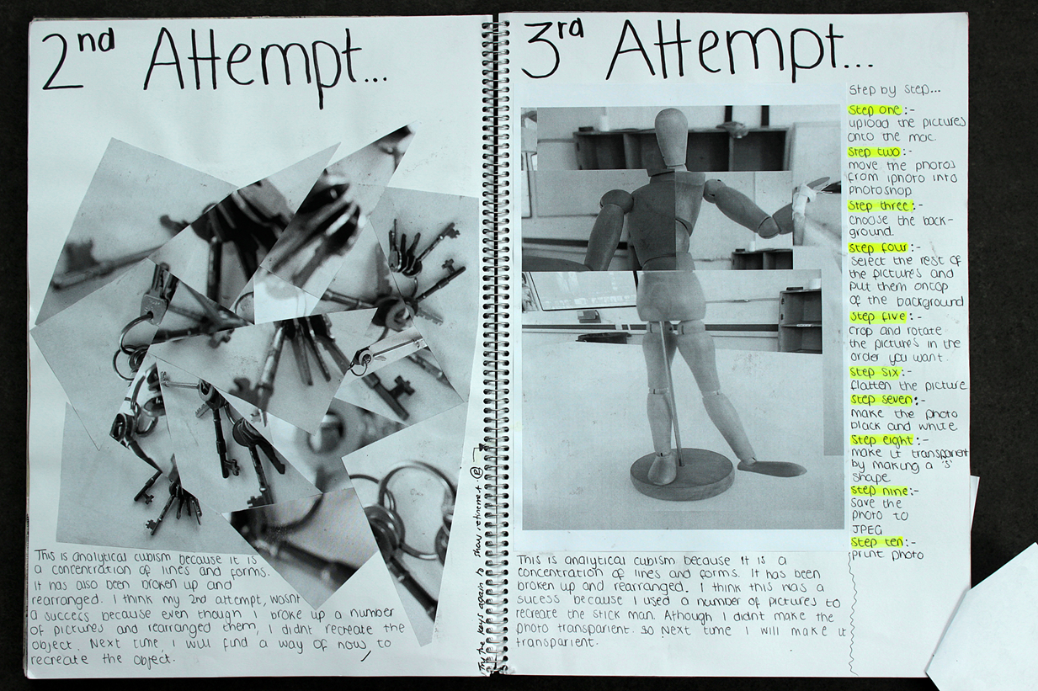

Slide 15
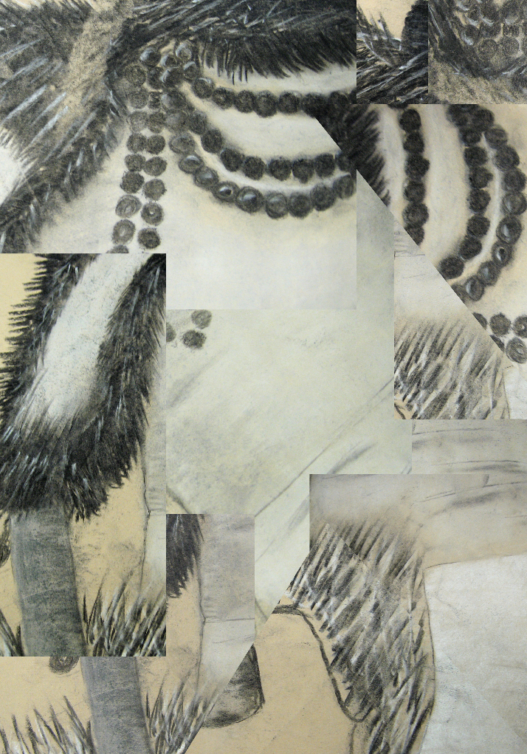
Create your own cubist piece using Photoshop.
You will find the images in the shared area. Use he image above to help you find where.
Must save as a JPEG
Use the Photoshop help sheet.

Slide 16
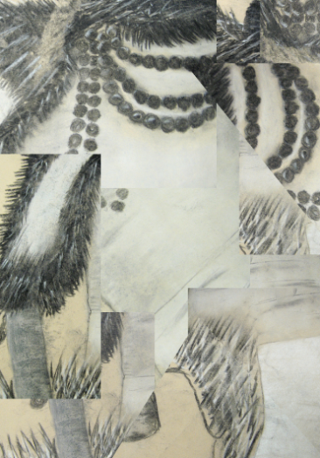
Create your own cubist piece using Photoshop.
Complete sketches of your cubism analytical and synthetic pieces . Complete this on a separate piece of paper and we can attach it into your book afterwards.
Screen Shots
You must take screen shots and put all onto a PowerPoint slide.
To take a screen shot
Ctrl – Alt – Print screen
Paste
PowerPoint
Ctrl - V
You will find the images in the shared area. Use he image above to help you find where.
Must save as a JPEG

Slide 17
Action steps
I need to annotate my own work more, describing how and why I done it.
I need to make links between my own work and those of other artists.
I need to complete my artist research in full, using a range of artworks.
I need to use my 9-1 question sheet to add more analysis to my artist research.
I need to attend art clubs, to help add depth to my work.
I would like to experiment more with my own artworks at home, inspired by artists I have researched.

Slide 18
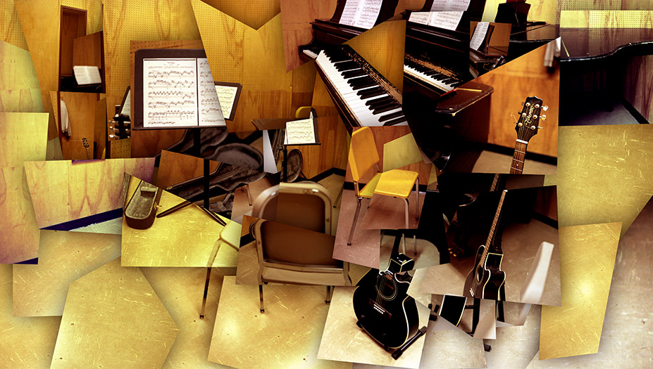
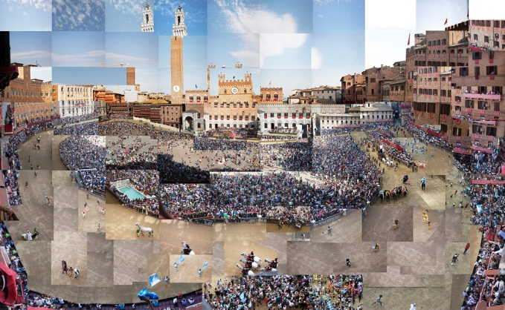
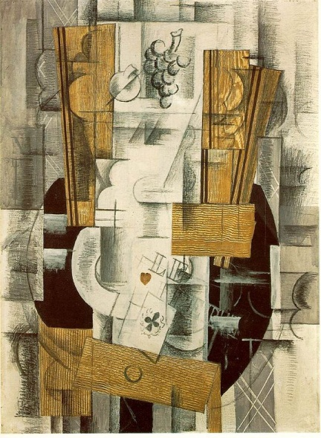
Final Cubism piece
Create a large photographic cubism piece.
Task 1
You must create an A3/A2 photographic cubism piece. You should take a photo of objects, scenery or a still life set up.
Stick the original image in you book and a couple of photos taken from different views. Talk about why you used/choose to take that image. (use 1-9 sheet to help annotate)
Print the images and create/form your final cubism piece.
Extension: Create a mixed tonal cubism piece.
This task meets Assessment
Objective 4
Task 2
Gather a variety of monotone colour papers, White/ brown / grey.
Create a collaged background and work on top of paper drawing you photographic cubism piece.
You can draw an enlarged section or the entire image.
AO4
Presenting a personal, informed and meaningful response demonstrating analytical and critical understanding, realising intentions and where appropriate making connections between visual, written, oral and other elements.

