Slide 1
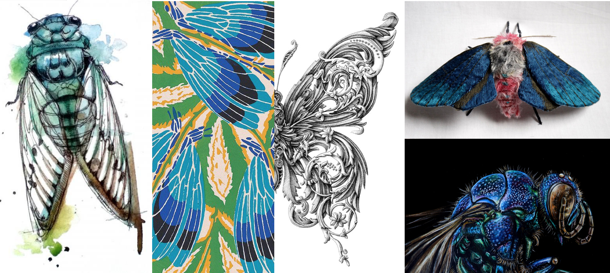
Teacher:
Name:
Class:

Slide 2
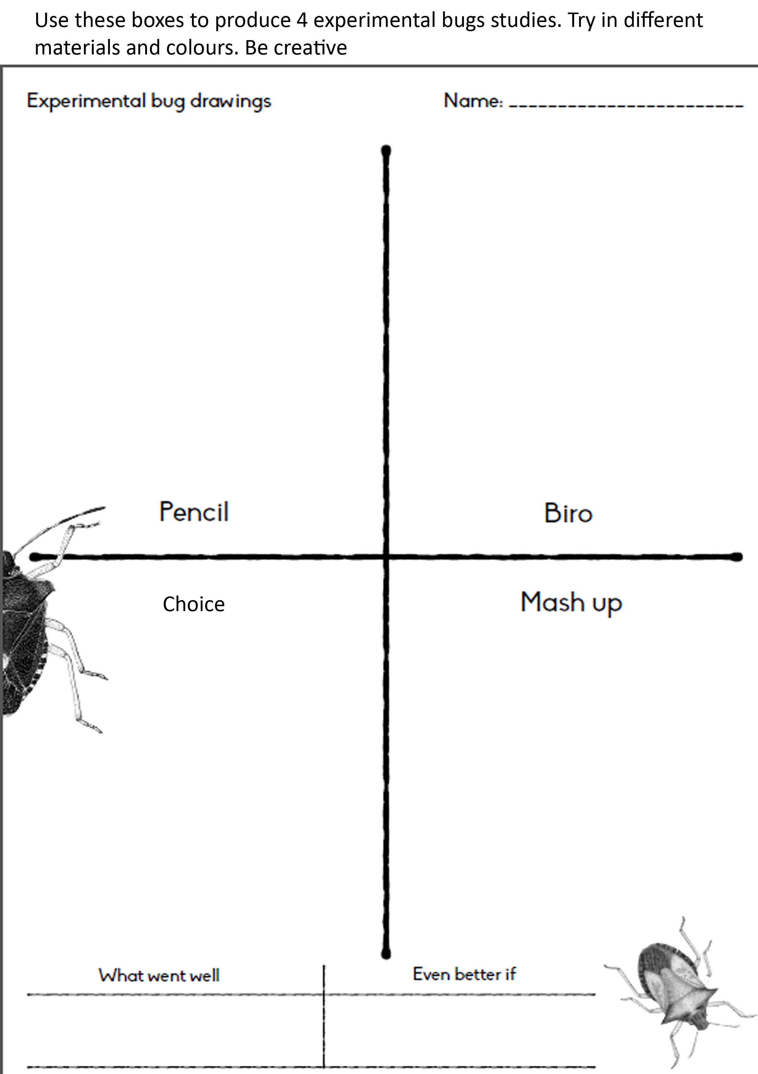

Slide 3
Exciting insects examples.

