Slide 1
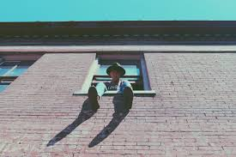
Example’s for inspiration
A challenge using only your phone
Think about different app’s you could use to change & develop the images.
Think about how you can make your images different/ stand out.
15
Show your creativity.
Think outside of the box.
6
8
4

