Slide 1
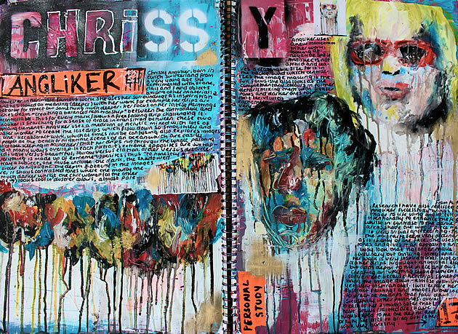
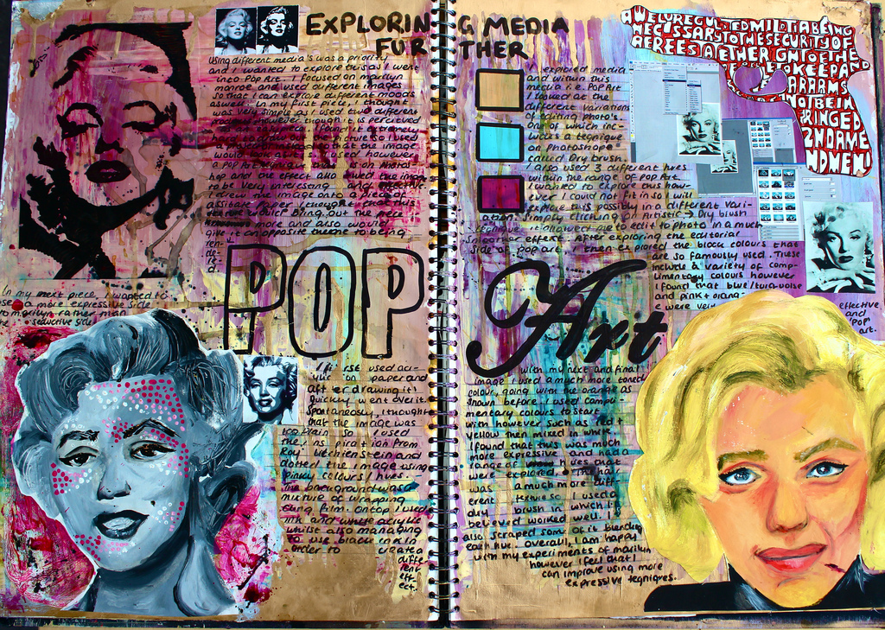
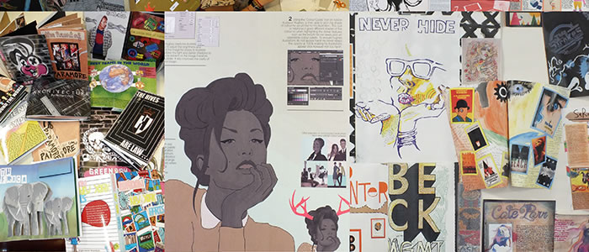
ESA early bird artist study
You have 2 weeks (and Christmas break) to complete an A2 artist study board (AO2).
This includes class lessons and home works!
You will pick a 2D or 3D artist, of your choice, to study on this board.
You must have research (in your own words) and include examples of their artworks you like. How will you find this information, how relevant can it be?
You must show forms of analysis of their work. How can you use the 1-9 question sheet to help with this?
You must have your own visual response, inspired by this artist. How can you respond to their work, in your own way? How will you use medium, technique etc.
Challenge: How can this be presented in the style of the artist?
Please use extra curricular art clubs when need.

Slide 2
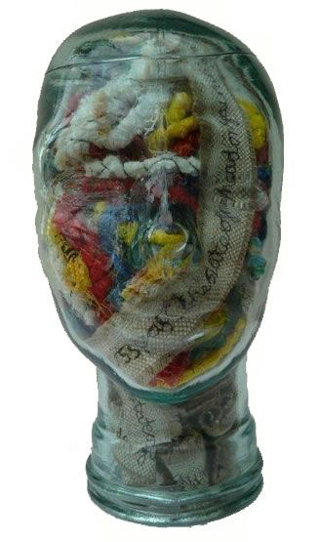
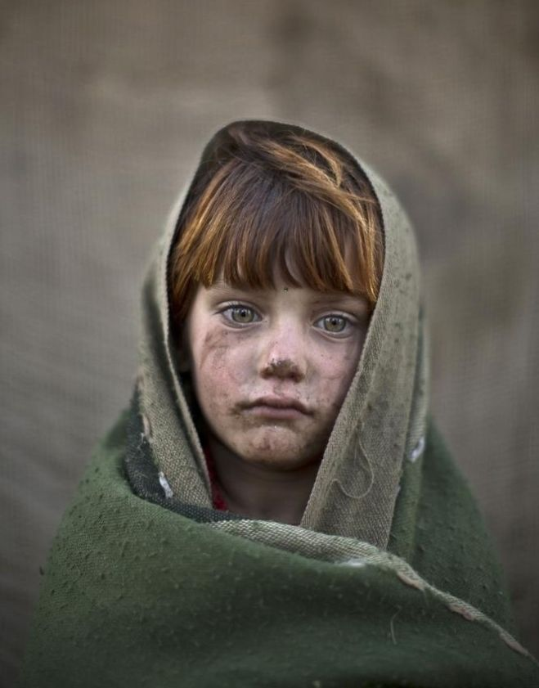
Muhammed Muheisen
Annette Collinge

Slide 3
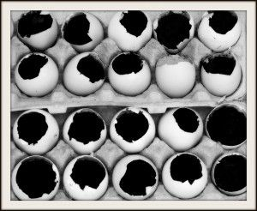
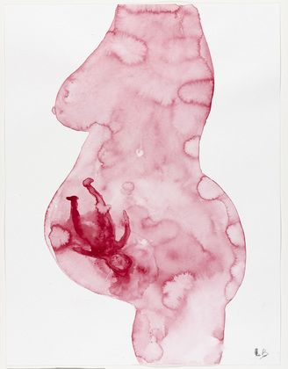
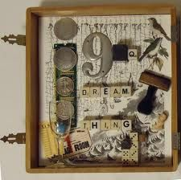
Katherine Minott
Louise Bourgeois
Joseph Cornell

Slide 4
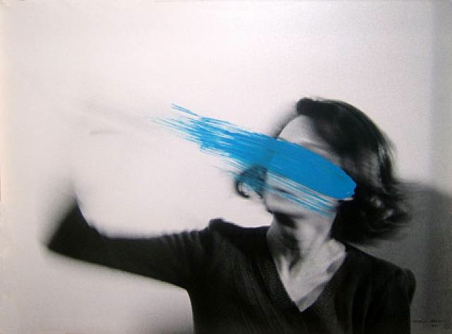
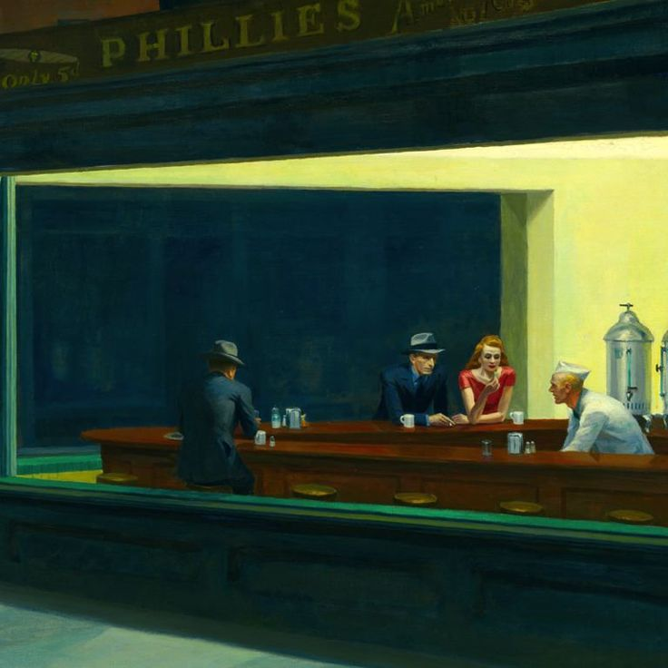
Helena Almeida
Edward Hopper

Slide 5
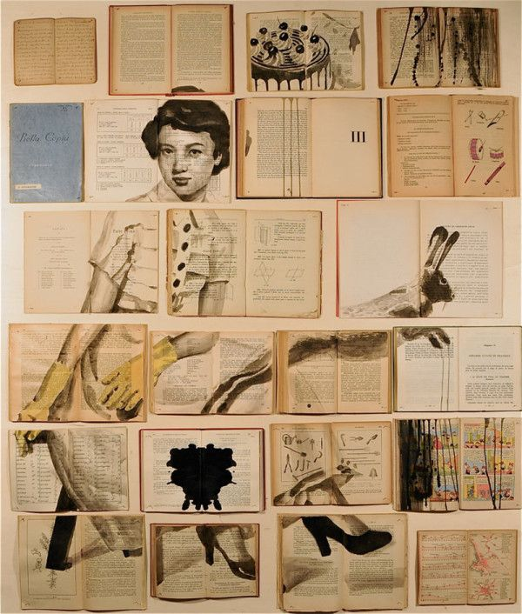
Ekaterina Panikanova

Slide 6
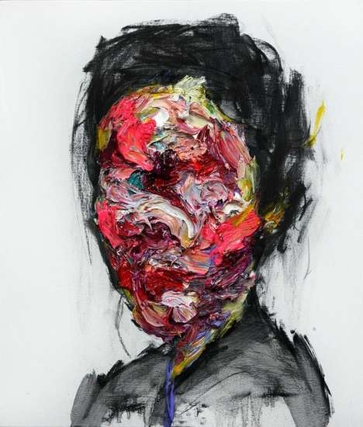
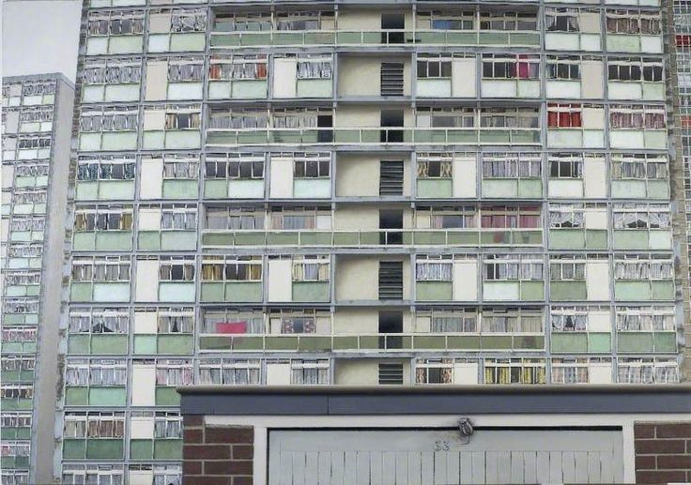
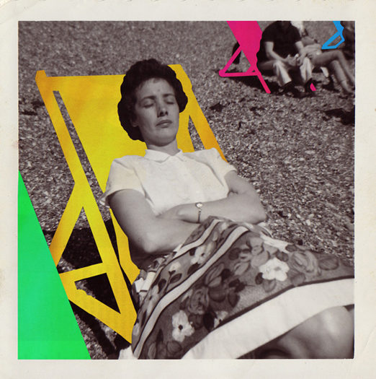
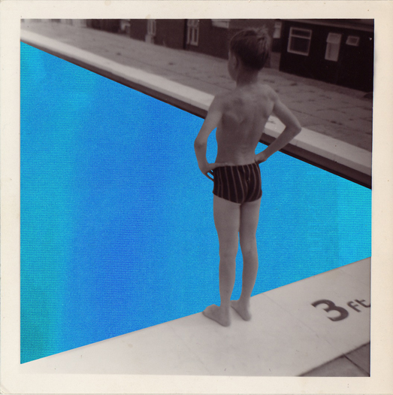
David Hepher
Shin Kwango
Hayley Warnham

Slide 7
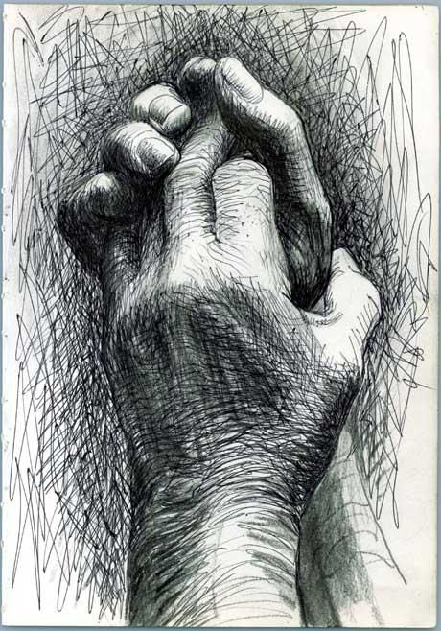
Henry Moore
Eugenia Loli

Slide 8
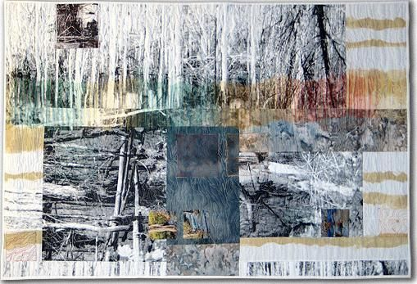
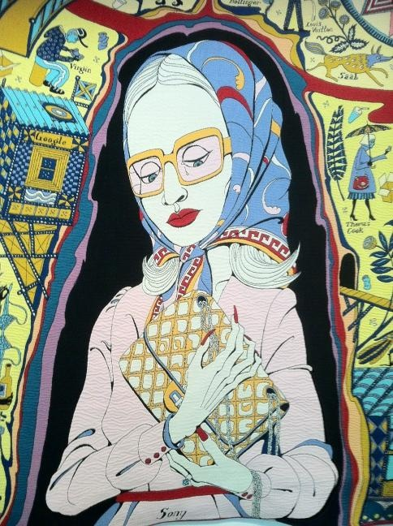
Sandra Meech
Grayson Perry

Slide 9
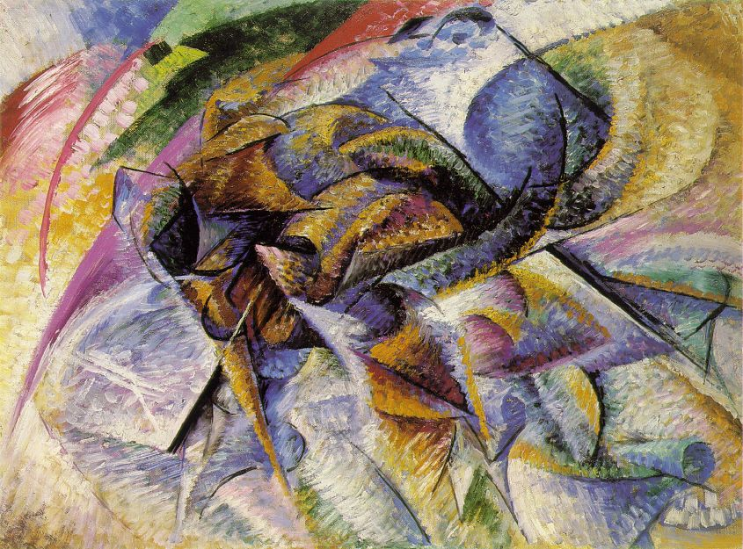
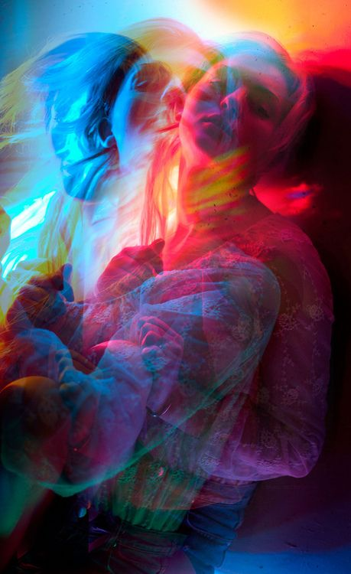
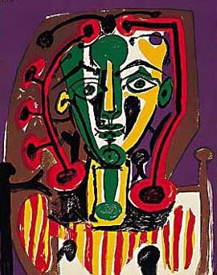
Umberto Boccioni
Mike Monaghan
Picasso

Slide 10
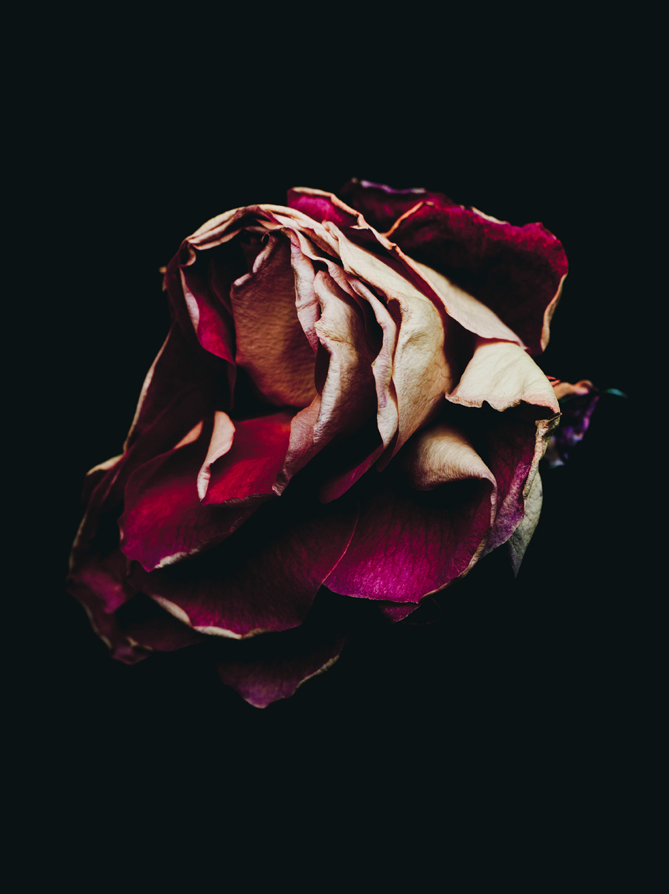
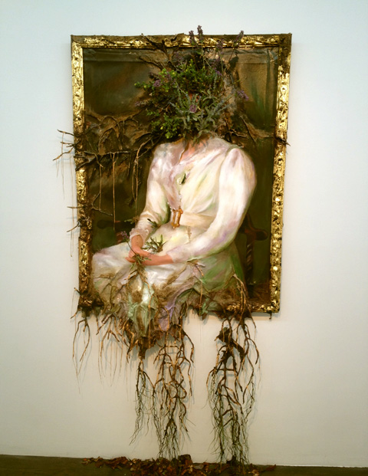
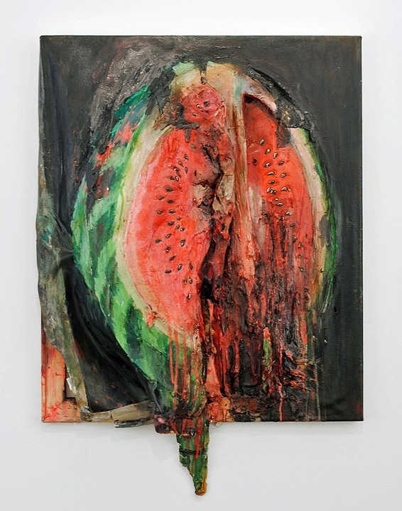
Valerie Hegarty
Billy Kidd Beautiful Decay

Slide 11
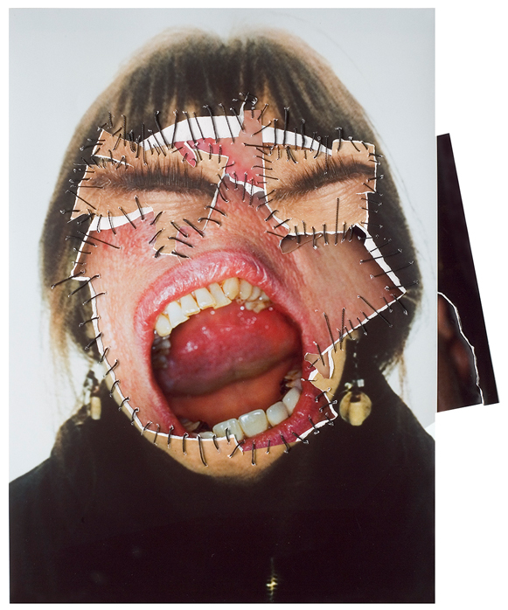
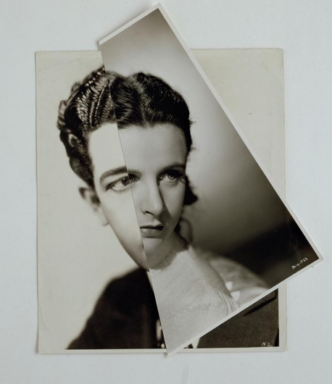
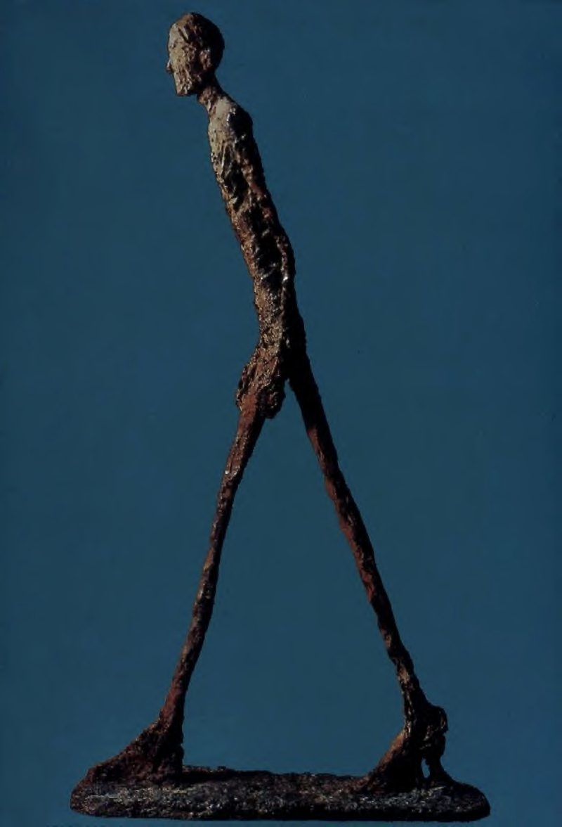
Annegret Soltau
John Stezaker
Giacometti

Slide 12
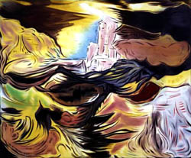
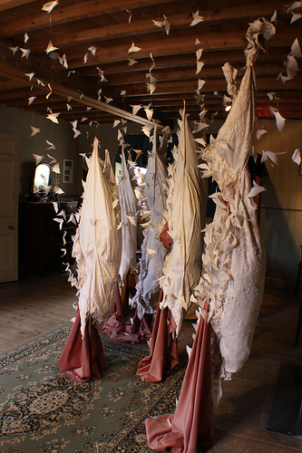
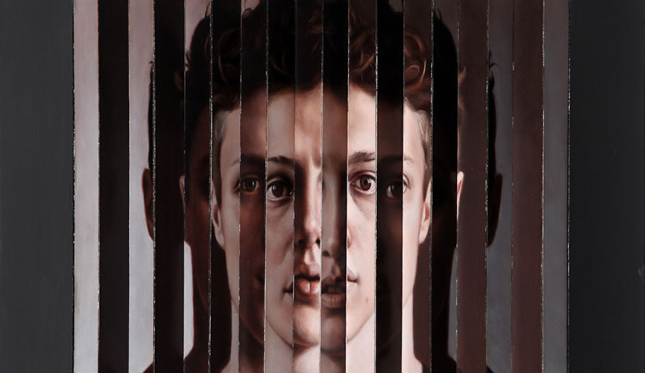
Brian Fahlstrom “ A Blossoming Distant Impassionedness”
Karen Le Roy Harris “Like Flies to Flesh”
Ben Ashton “Face Front”

Slide 13
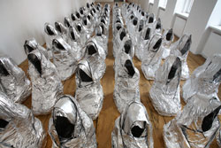
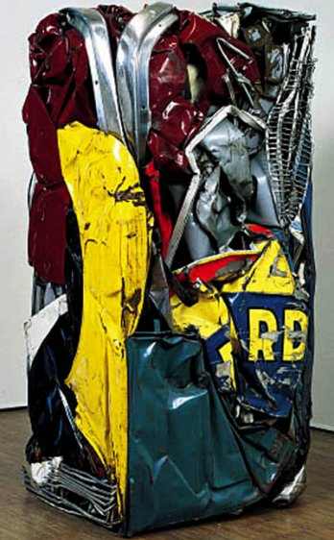
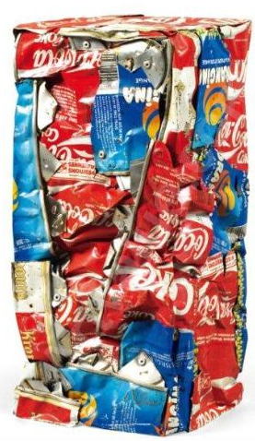
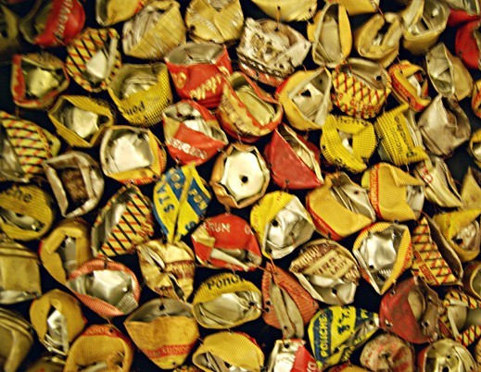
El Anatsui - Cesar “Compressions”
Kader Attia “Ghost”
El Anatsui - (crushed bottle tops)

Slide 14
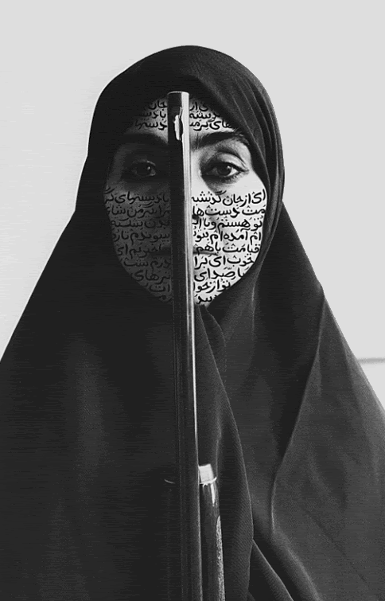
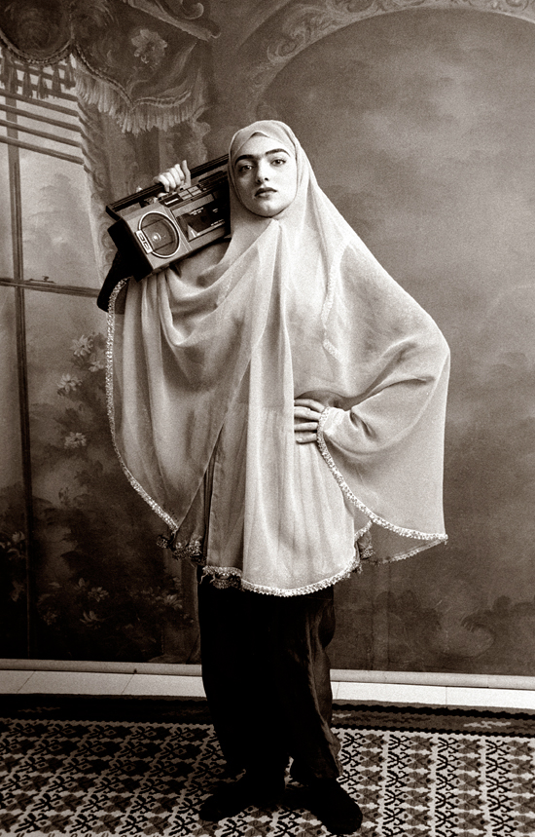
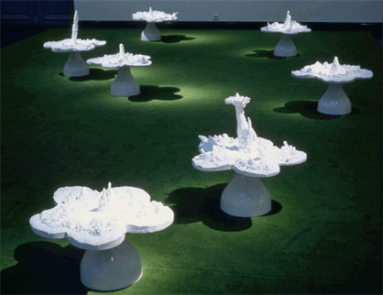
Shadi Ghadirian “The Like Every Day Series”
Helen Chadwick
“Piss Flowers”

