Slide 1
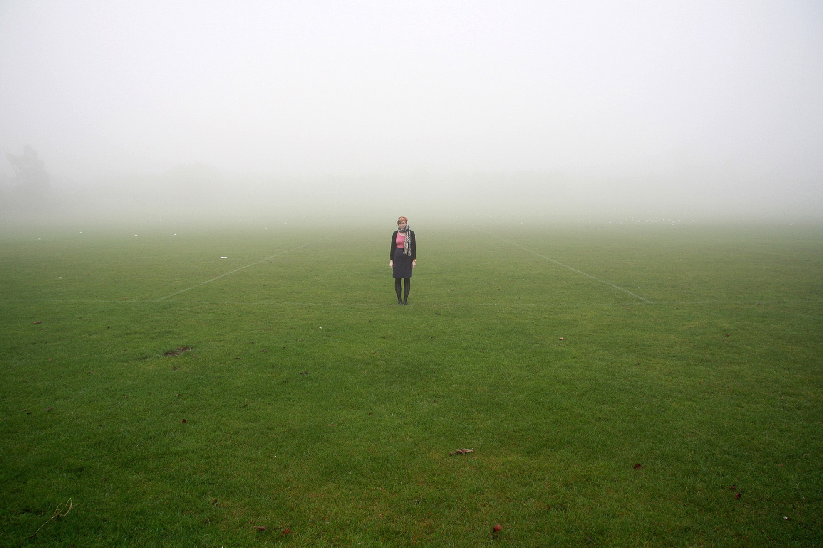
What is Composition?
Here we will look at some basic ‘rules’ of composition.

Slide 2
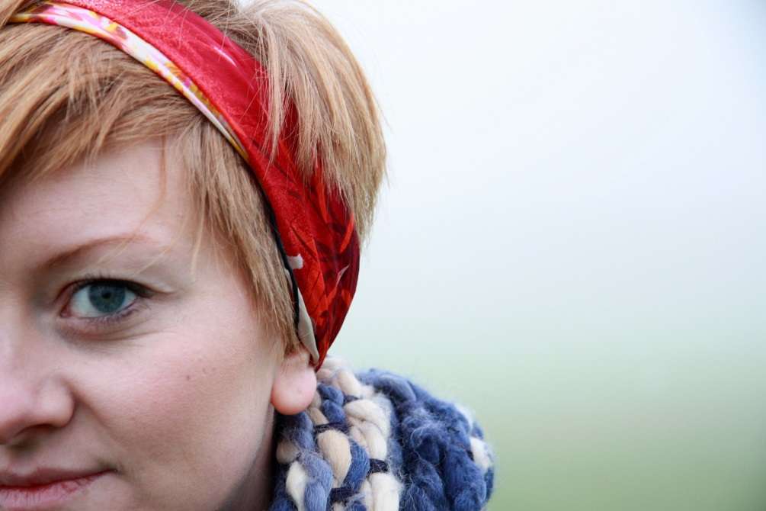
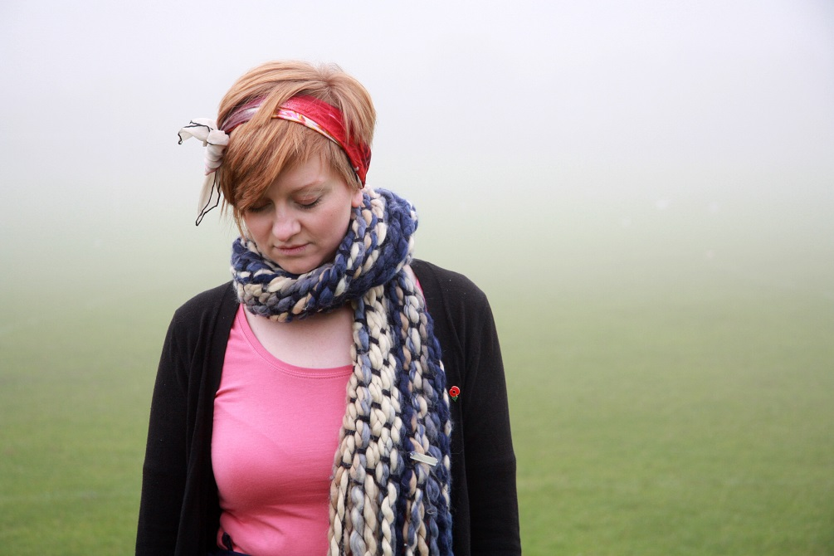
Composition
The word composition means combining or 'putting together’ parts to form a whole.
Composition can apply to many subjects including music and writing – It applies to anything that is arranged or ‘put together’ using conscious thought.
In photography composition is how you arrange the elements of your subject within your frame.
The elements of a picture could include what?

Slide 3
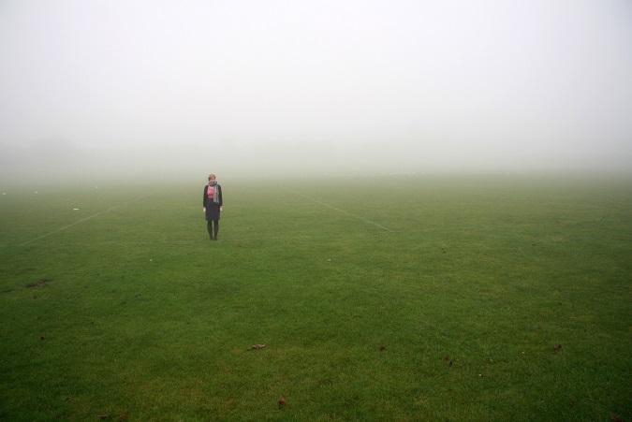
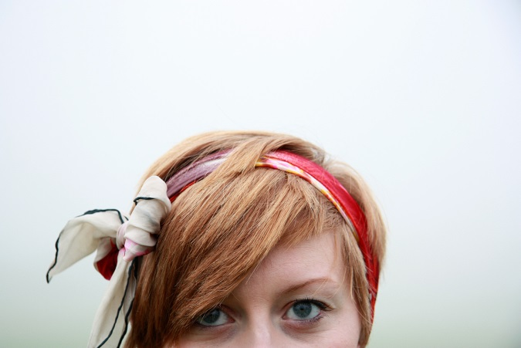
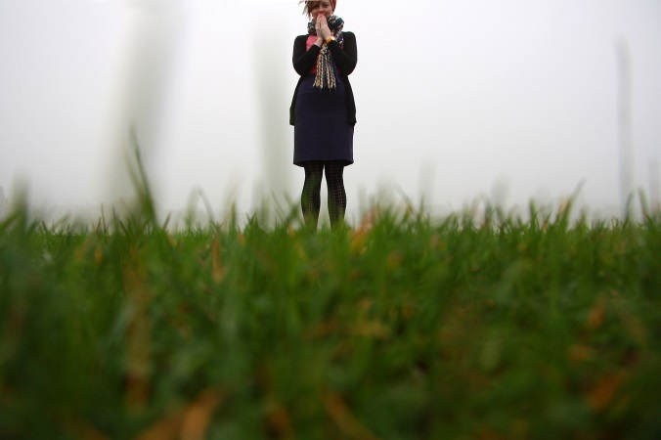
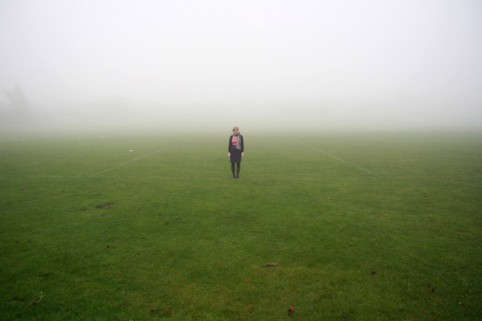
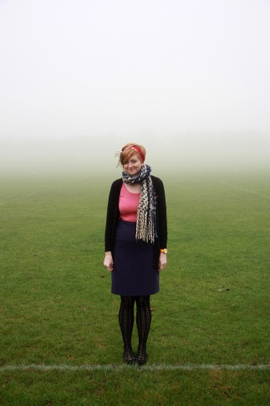
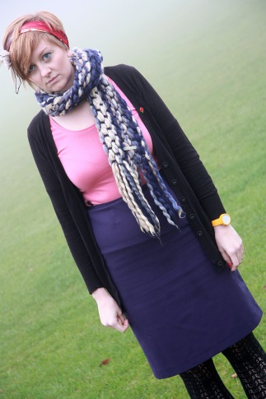
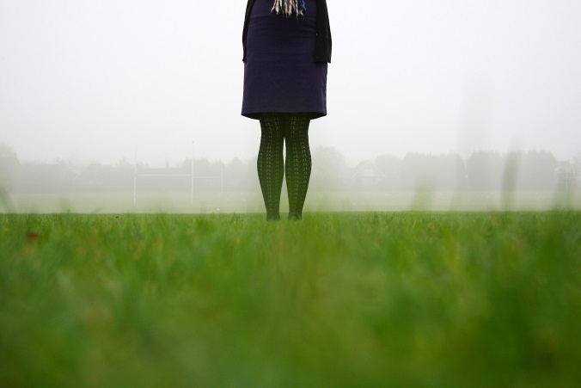
One Subject, standing in one place, lots of different ‘compositions’.
As the photographer ‘you’ control this.

Slide 4
Discuss the composition of these shots.
How do they differ?

Slide 5
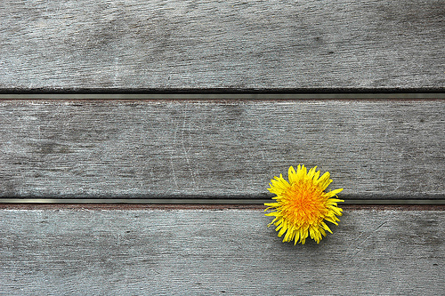
Some rules of composition
Rule of Thirds
Divide the image into thirds as shown – If the main visual components (things in the image) lie near the lines then the image often tends to look ‘right’.

Slide 6
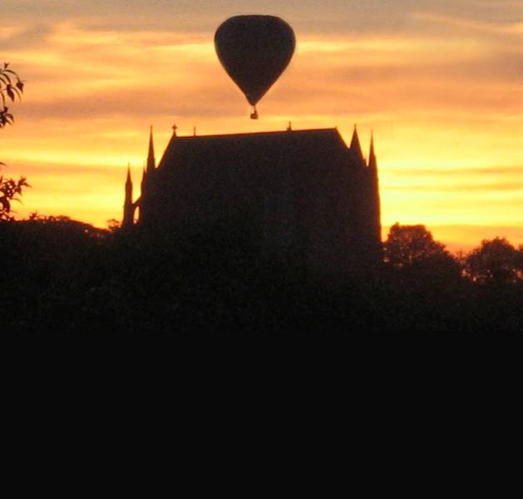
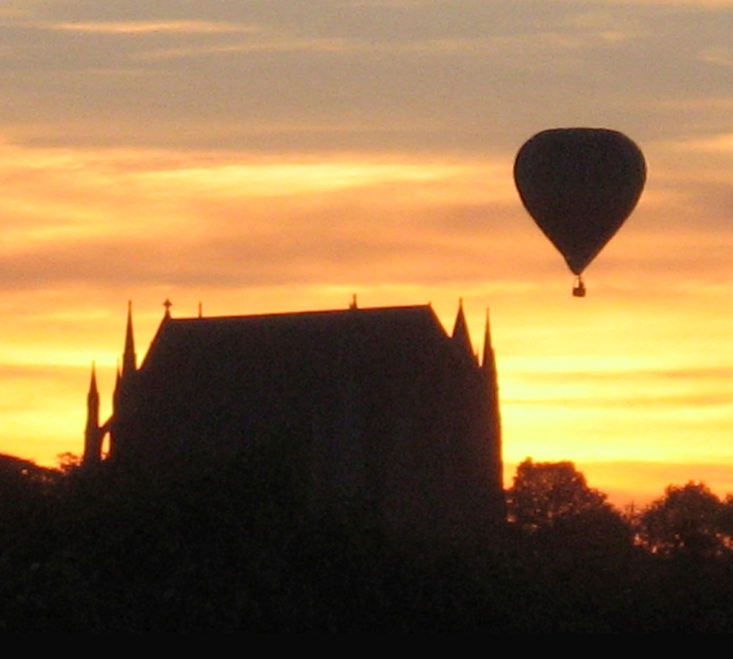
Rule of Thirds
Which image follows the rule of thirds?

Slide 7
Rule of Thirds

Slide 8
Gary Winogrand
Sometimes an image does not follow the rule of thirds exactly, but the main elements in the image are close to the 1/3rd bisectors.

Slide 10
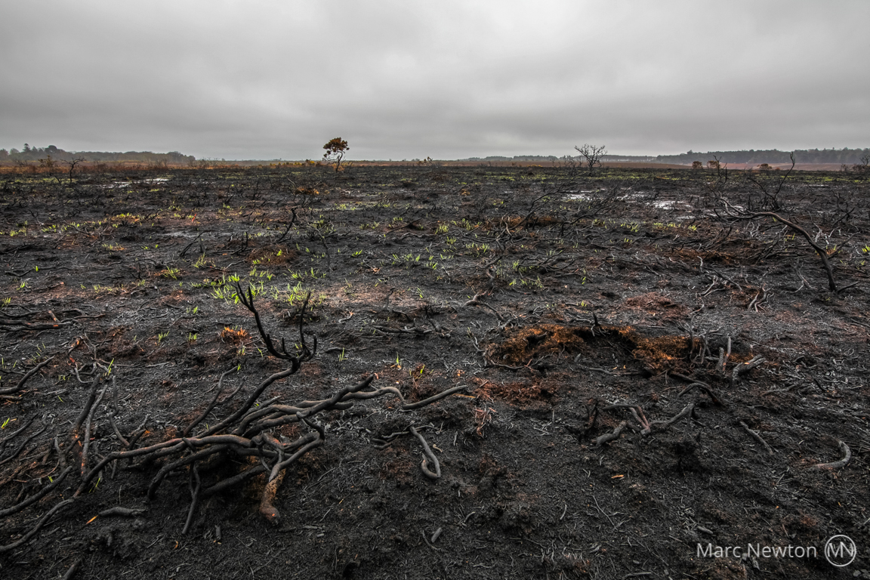
Landscape photography often uses the rule of thirds – how?
Landscape photography often uses the rule of thirds by having the horizon line on or near one of the two horizontal lines

Slide 11
Task
Experiment with the ‘Rule of Thirds’.
Work in pairs
Get Creative!!!

Slide 12
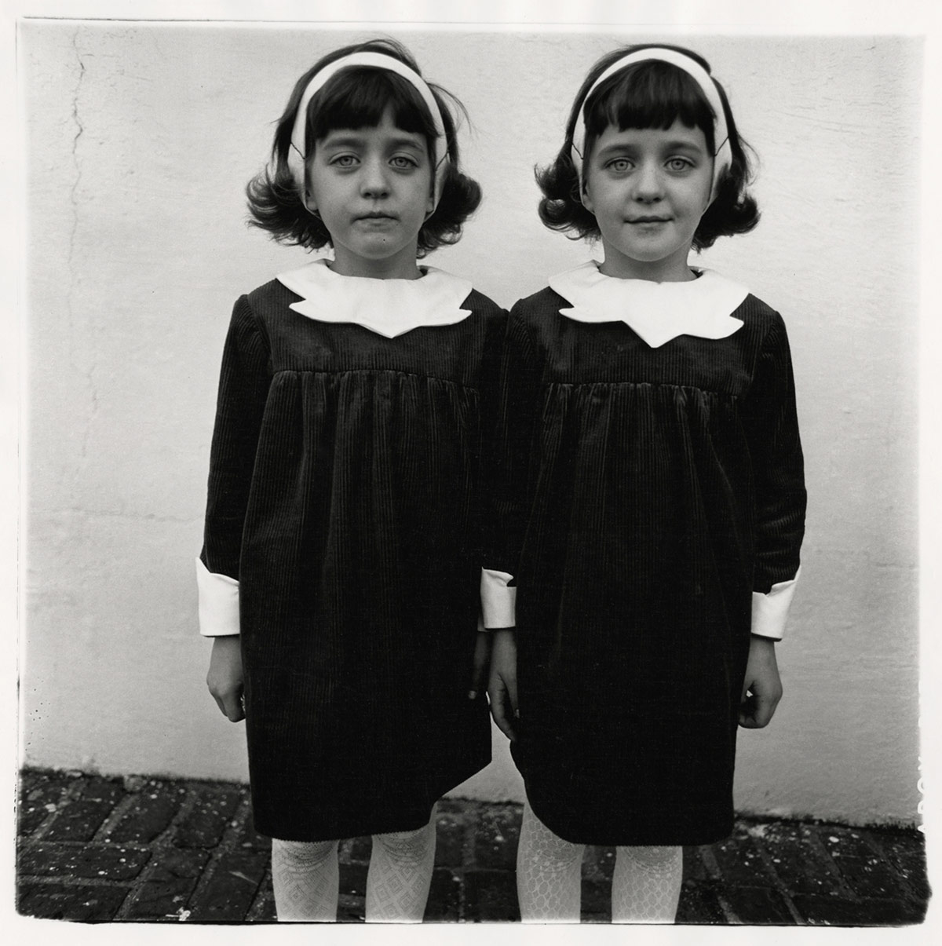
The Rule Of Even And Odd
An even number of ‘things’ in an image can sometimes create a feeling of tension or a slightly un-natural look.
Diane Arbus Identical Twins, Roselle, New Jersey, 1967

Slide 13
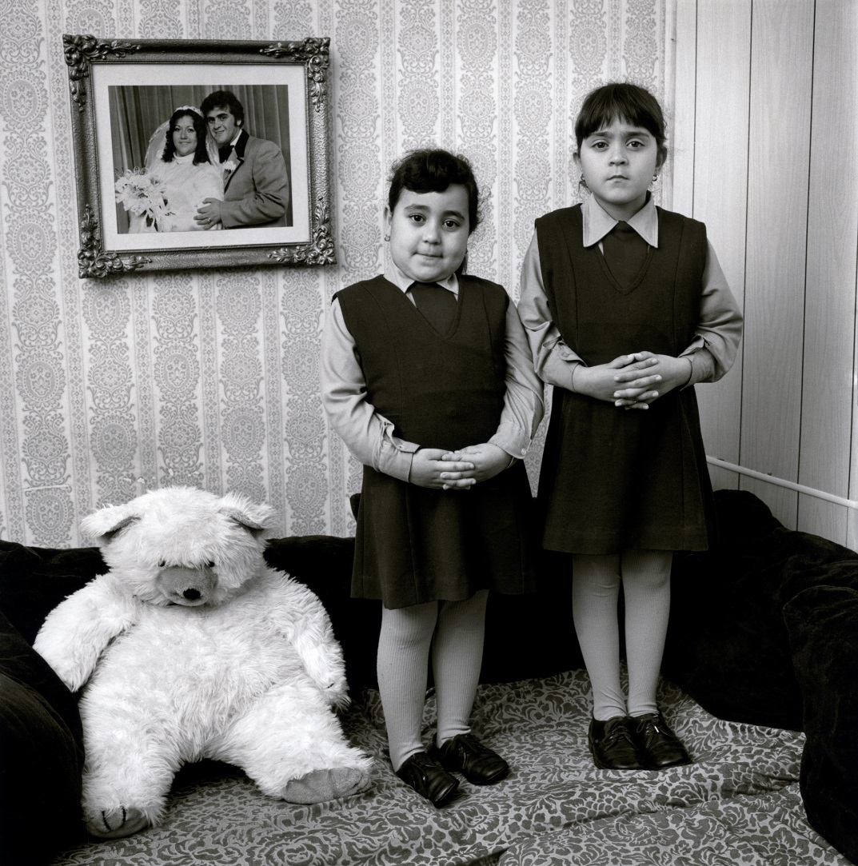
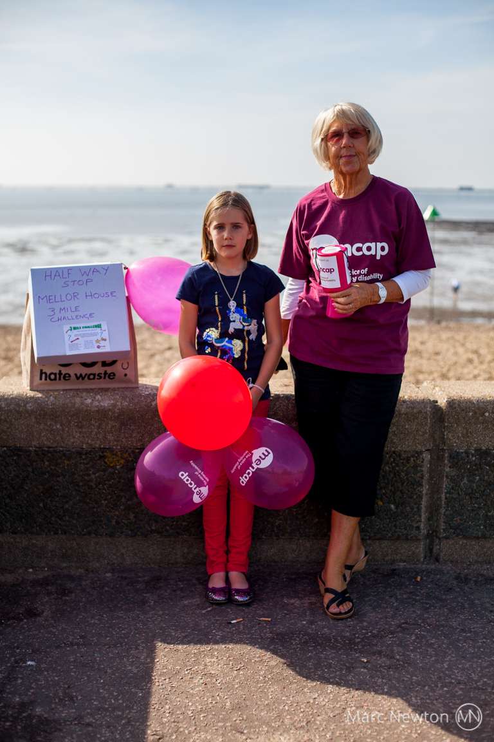
The Rule Of Even And Odd
Mary Ellen Mark

Slide 14
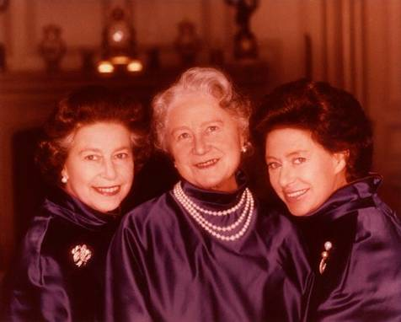
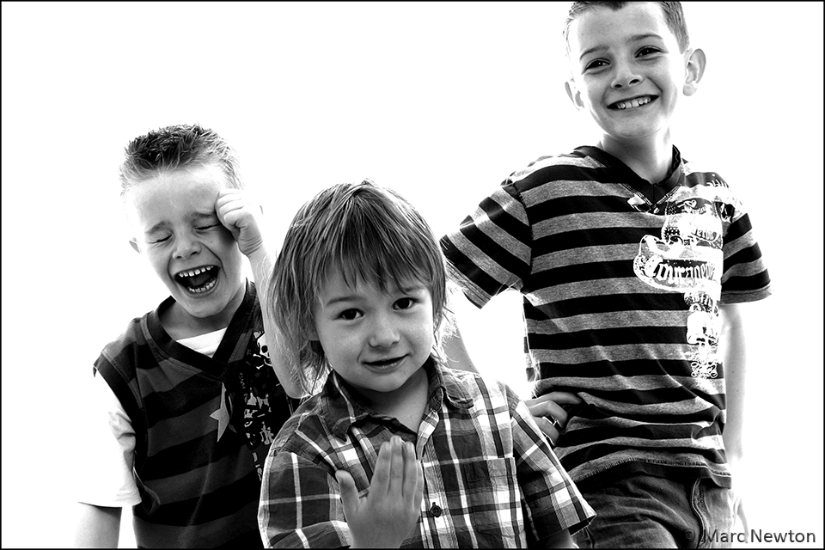
The Rule Of Even And Odd
Norman Parkinson
An odd number of subjects in an image often has a more natural feel than an even number.

Slide 15
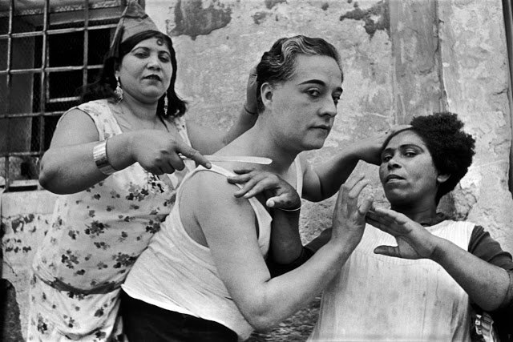
The Rule Of Even And Odd
Henri Cartier Bresson
Where is your eye immediately drawn to in this picture?
In much art, 3 subjects in an image (an odd number) can draw attention to the central subject.

Slide 16
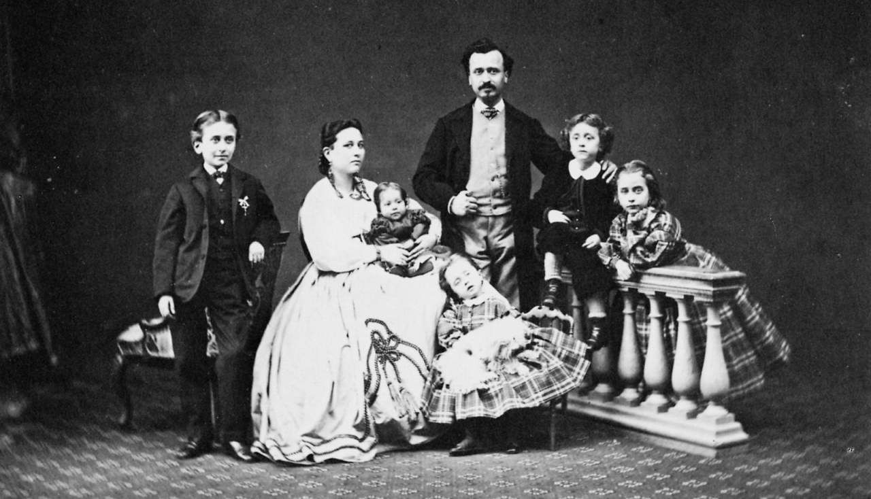
Using Triangles
Victorian Family Portraits
Can you spot any triangles?
Why are triangular compositions often used for family portraits?

Slide 17
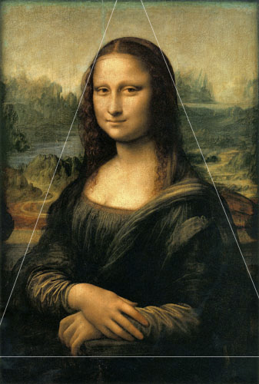
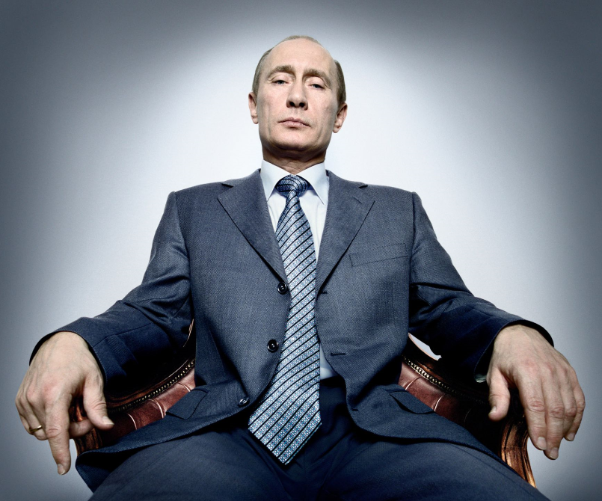
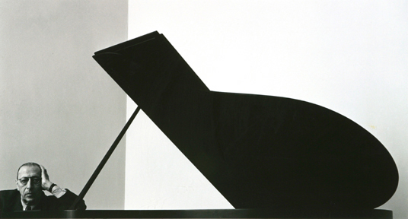
Using
Triangles
President Putin Platon
Triangles have 3 sides and tend to form stable, solid looking compositions.
Arnold Newman
You are to find a SECONDARY image of a photograph that shows rule of thirds. Print off small, to fit half your page, and draw in the triangle you can see. Make notes about using triangles – one page only!

Slide 18
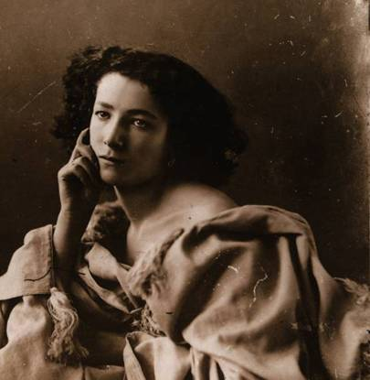
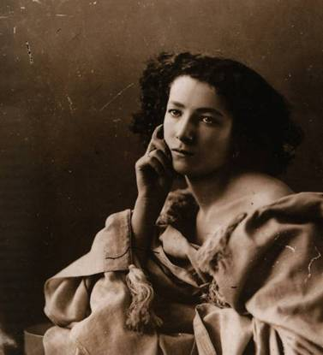
Using space
Nadar
Which composition looks more natural?
The right composition is more ‘restful’, allowing the subject to ‘look dreamily into space’? You can allow space into your composition to enhance the feeling of the shot.

Slide 19
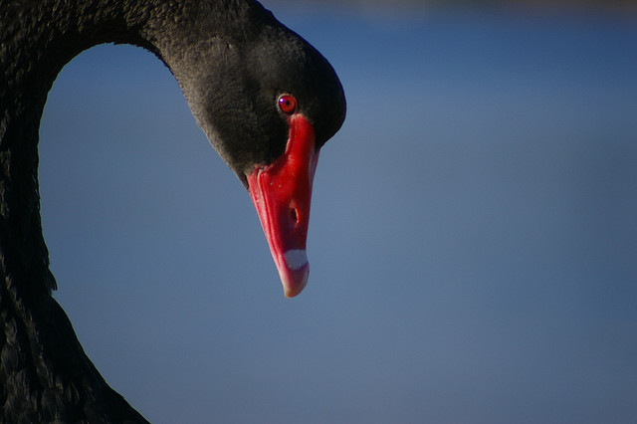
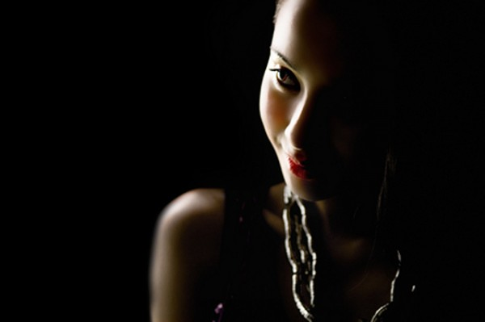
Using space

Slide 20
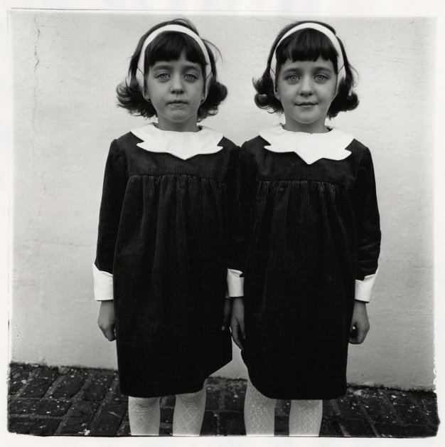
Task
Using the same subject as your ‘Rule of Thirds’ task, take shots using the rule of space or triangles or odds or evens or all of them! Work in pairs/groups. - Get Creative!!!
When evidencing in your books can you explain how your own photos show these rules?

Slide 21
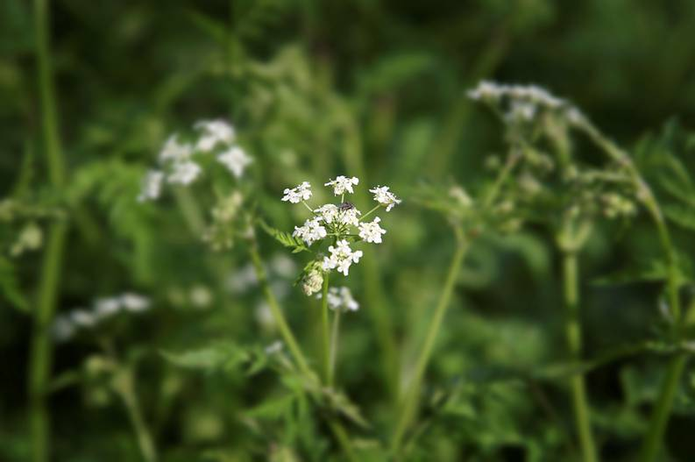
The rule of Simplification
What technique has the photographer used to simplify this image?

Slide 22
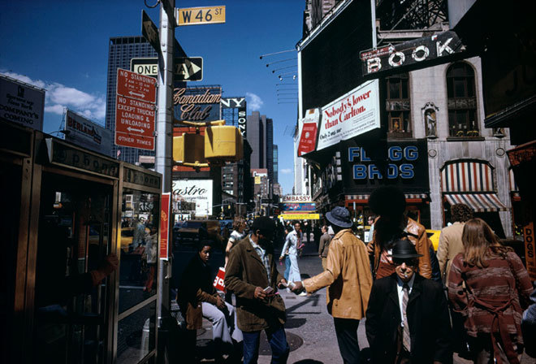
Joel Meyerowitz
Is this picture ‘simplified’?
What might the photographer be saying about life in the modern city?
Try to compose your shot to give a feeling of the place or person.

Slide 23
Using Symmetry

Slide 24
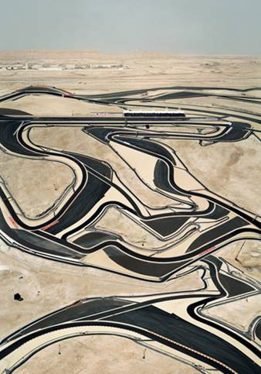
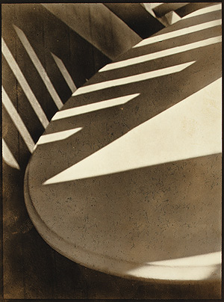
Using Pattern
Andreas Gursky
Paul Strand
Pattern can be used to suggest texture, or can produce an abstract visual experience.

Slide 25
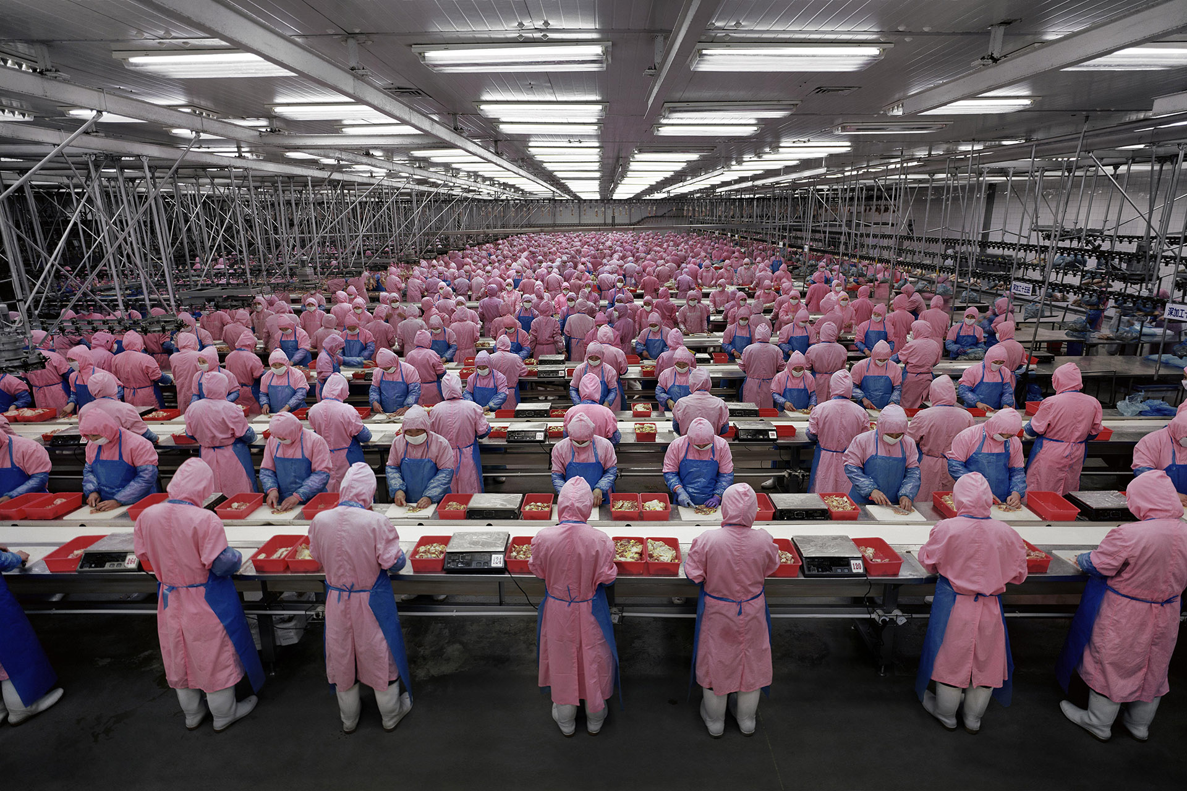
Pattern and symmetry
Andreas Gursky

Slide 26
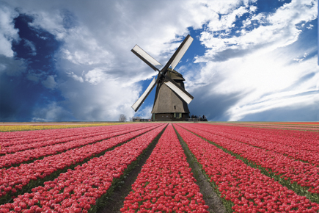
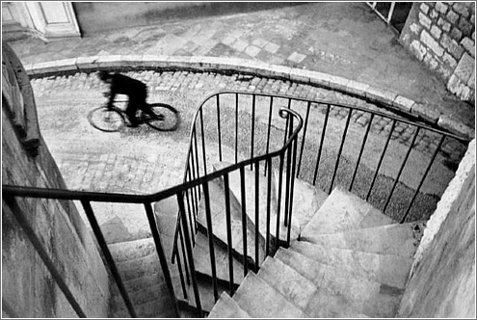
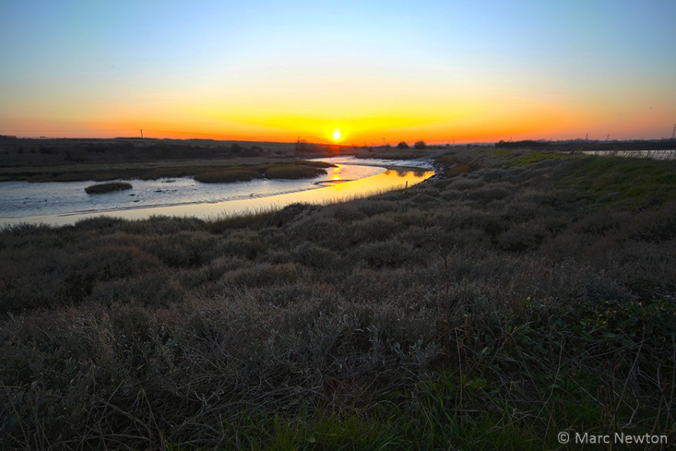
Leading Lines
Use things in the composition to lead your eye to a part of the image
Henri Cartier Bresson

Slide 27
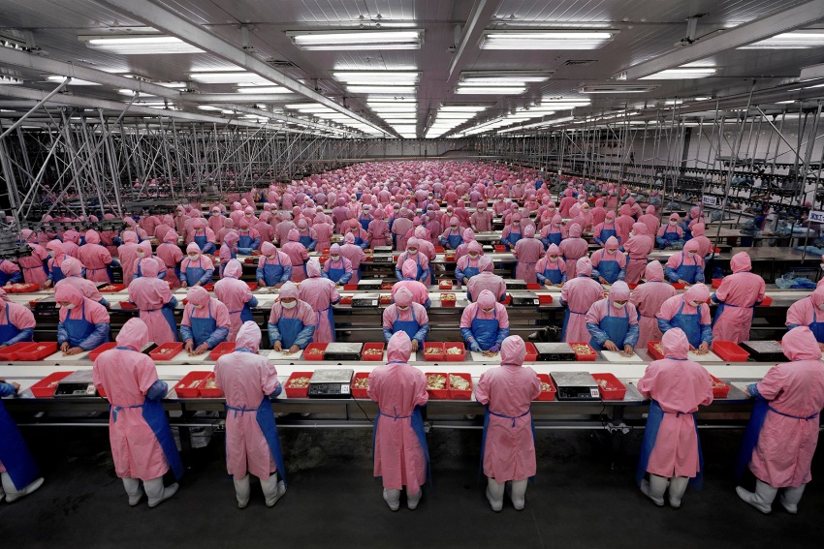
Task
Take shots using the rule of pattern or symmetry or simplification/busy or leading lines or all of them! Work in pairs/groups. - Get Creative!!! Must be evidenced over a double page in your book!

Slide 28
What’s the best rule of composition?
To break the rules of composition!!

Slide 29
Remember – as the photography you control the ‘composition’ of the shot.

Slide 30
Check the presentation in your books
Reflect and refine our Composition studies in our books!
Rules of: Thirds, even & odds, triangles, space, simplification, symmetry, pattern and leading lines.
Annotate each picture;
How has it been composed?
What ‘rules’ have you used?
How has your ‘composition’ made the image better?

Slide 31
Action steps
I need to make sure I have examples of Gursky’s photographs, with dates and titles.
I need to find at least 5 relevant facts about his works.
I need to start to show my understanding of the photographs, using the 1-9 question sheets.
I need to complete my own visual response and note how it links to his works.
I need to be creative with my presentation, linking to the artist, where possible.
I could enhance my photographs further – how?
I need to look back and complete unfinished work, as indicated in book!
I need to check spellings and use of keywords!

