Slide 1
ALL LESSON TIME ON YOUR COURSEWORK IS FINISHED.
All work incomplete needs to be completed in YOUR OWN TIME THIS WEEK.
SATURDAY 18TH SESSION for those who are not finished BY FRIDAY. Letters and phone calls home will be made.

Slide 2
Exam Project starts today….40 %
13 WEEKS – shortest project you have done
EVENT

Slide 3
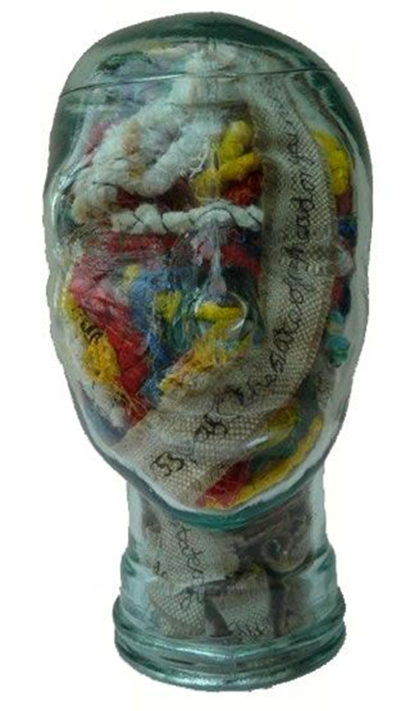
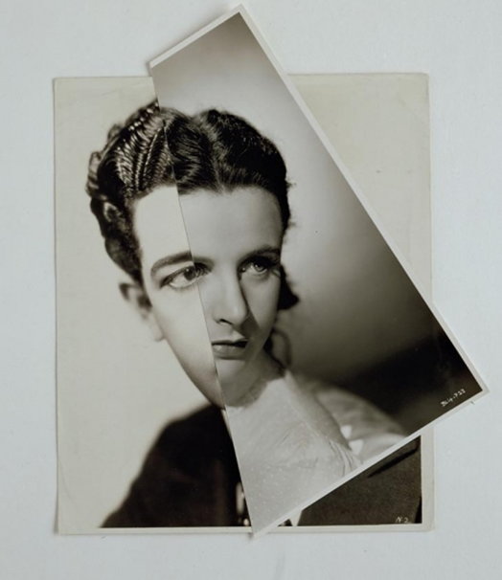
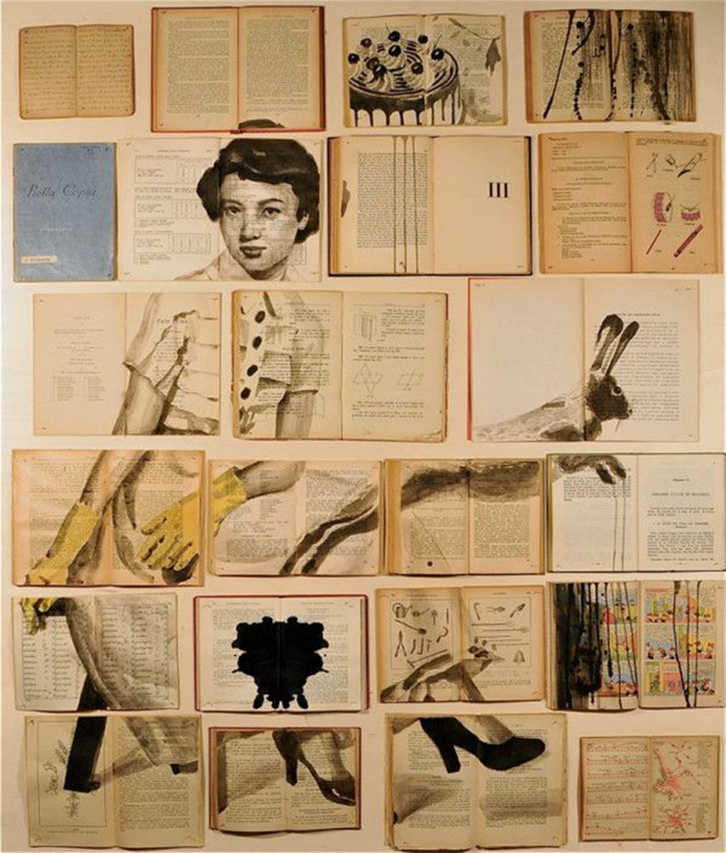
ESA Introduction!
The theme is:
EVENT
(Competition, news, celebration, uniform, teams, conflict, devastation…)
You have 2 weeks to complete a MIND MAP & MOOD BOARD and look at your first chosen ARTIST/CULTURE (AO1 & 2). This should be you thinking about how you can INTERPRET the theme and what artists works you like that you could link to your mind map in some way?
Use artists from this power point as a start?
Think about what your what Photography techniques you have learnt and what where your strengths from your MAKE A STATEMENT project?
Photography/Photoshop?
Reflect back on your coursework, what themes have been your strength?
Portraiture?
Still Life?
Challenge: Can you take some PRIMARY photos based on your mind map already? HOW?

Slide 4
Our task this week..
Are you looking at OBJECTS, PEOPLE or PLACES?
Do you have a folder called ESA, in your documents, ready to save PRIMARY & SECONDARY sources to?
What is the first artist study you are going to complete and why?
Can you take photographs in response to this artist? How? Why?

Slide 5
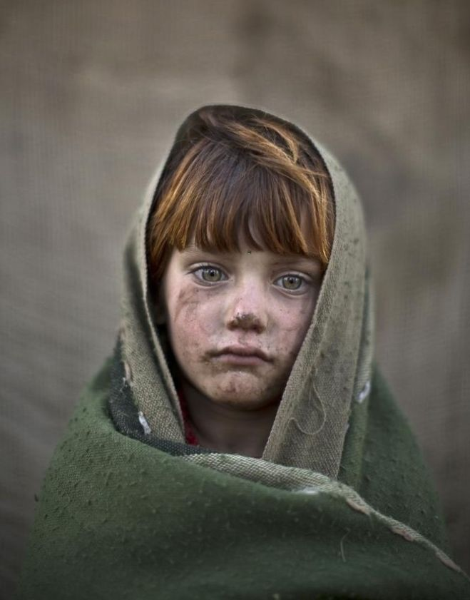
Muhammed Muheisen
Annette Collinge

Slide 6
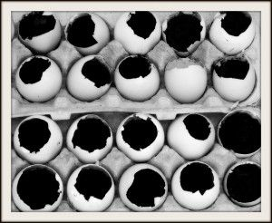
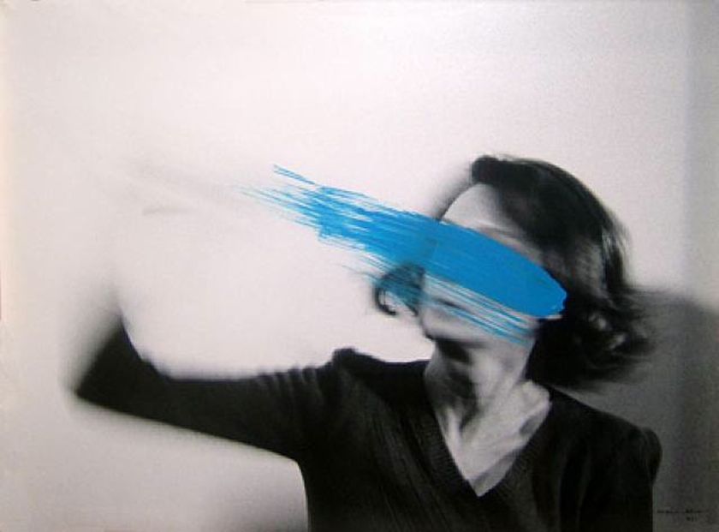
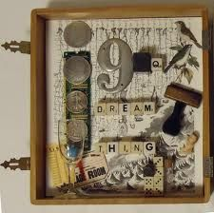
Katherine Minott
Helena Almeida
Joseph Cornell

Slide 7
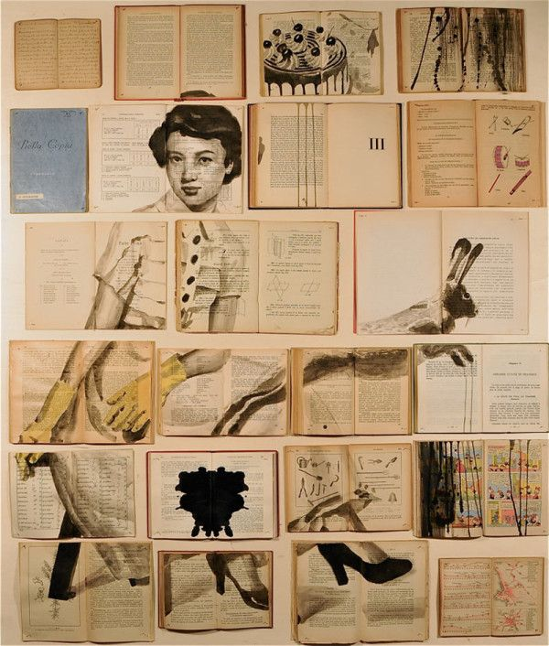
Ekaterina Panikanova

Slide 8
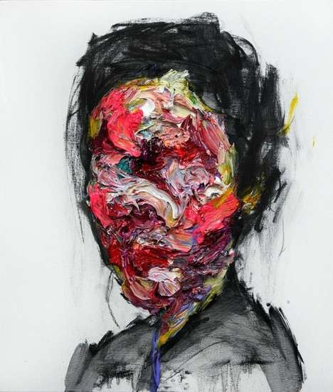
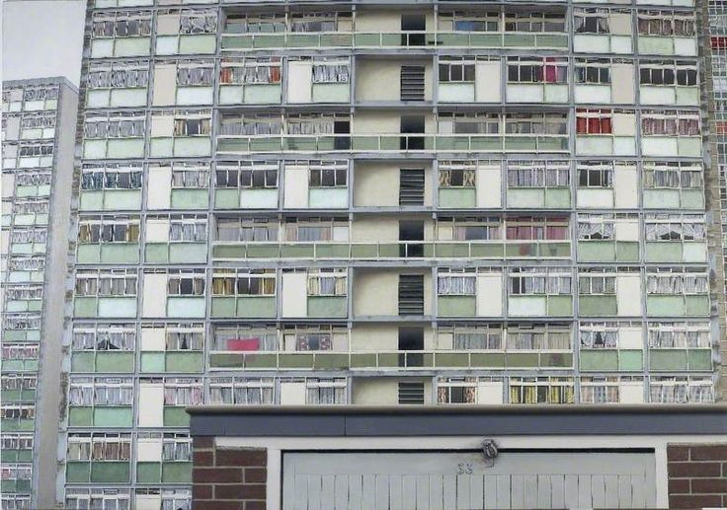
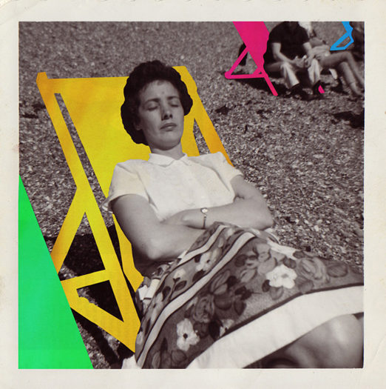
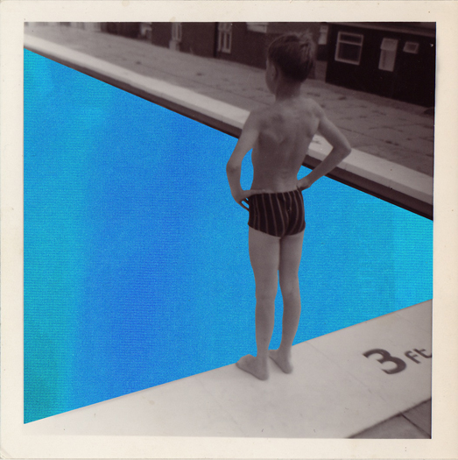
David Hepher
Shin Kwango
Hayley Warnham

Slide 9
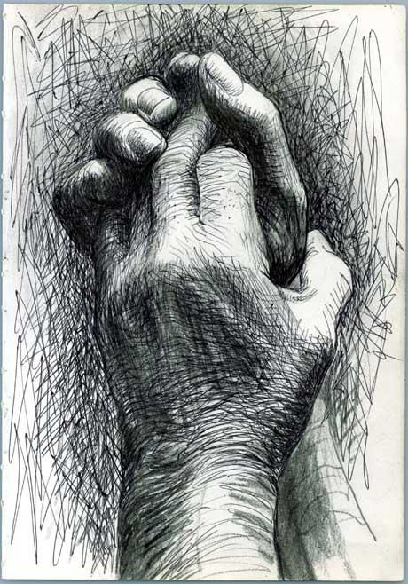
Henry Moore
Eugenia Loli

Slide 10
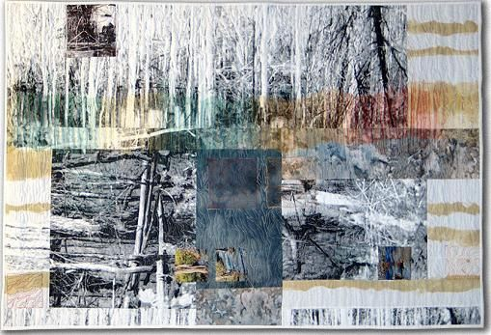
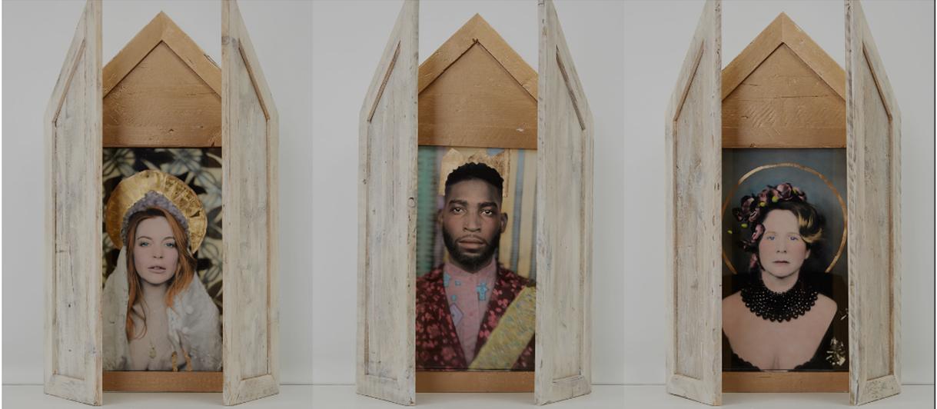
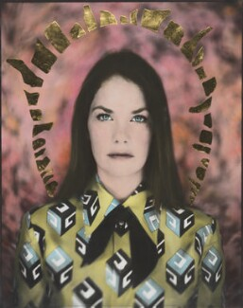
Sandra Meech
Walter & Zoniel

Slide 11
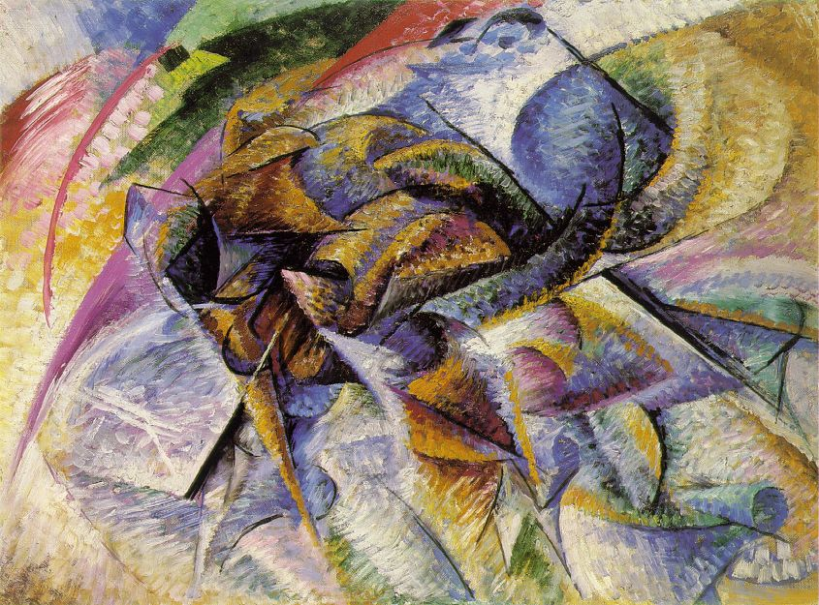
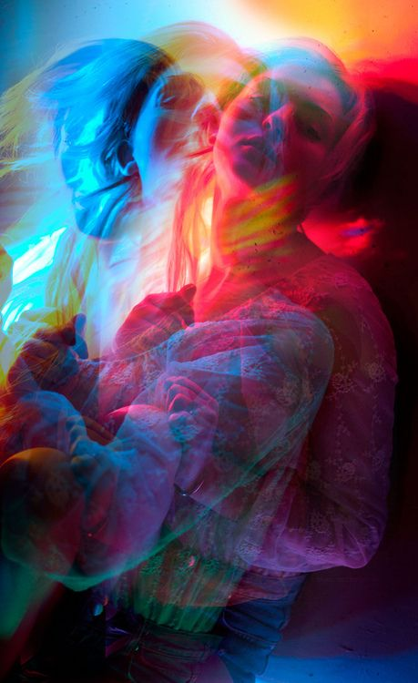
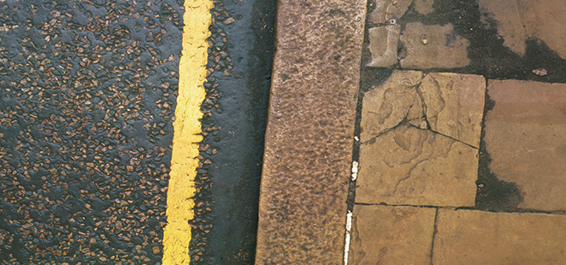
Umberto Boccioni
Mike Monaghan
The Boyle Family

Slide 12
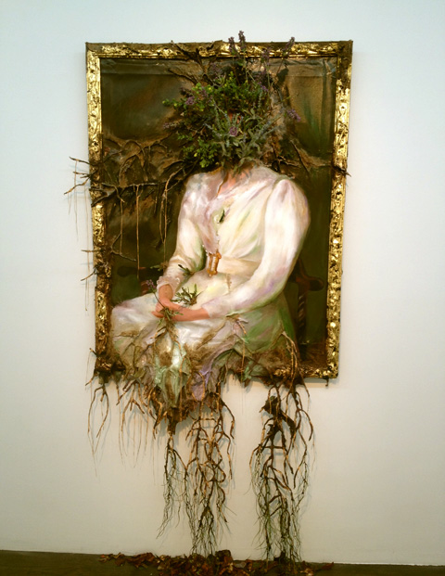
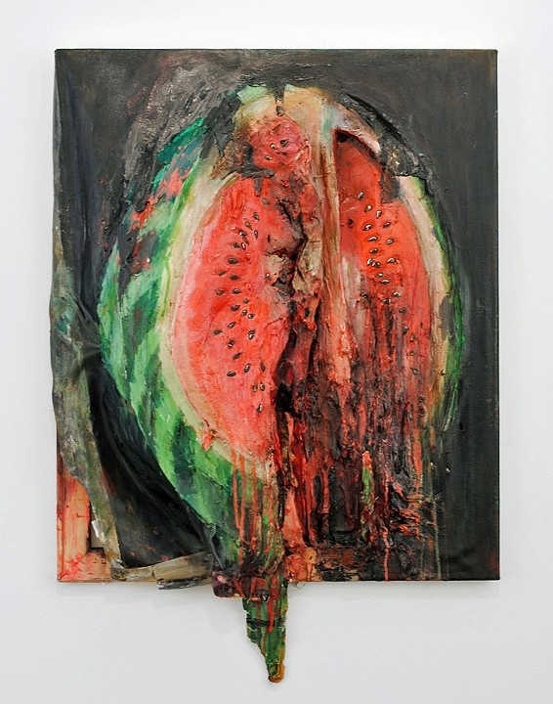
Valerie Hegarty
Billy Kidd Beautiful Decay

Slide 13
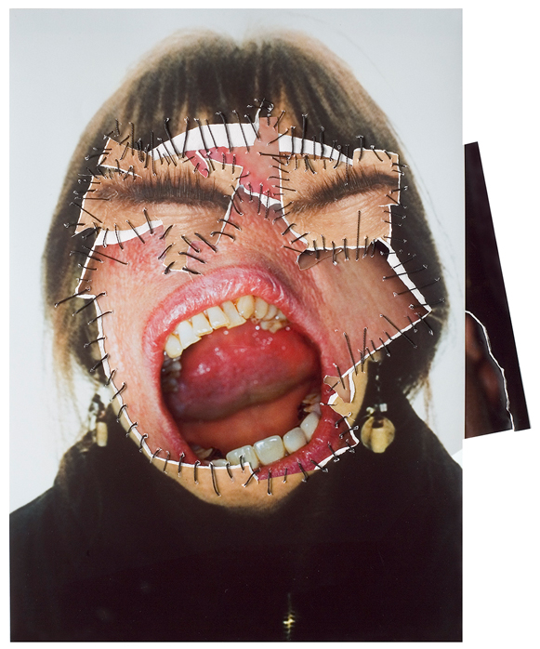
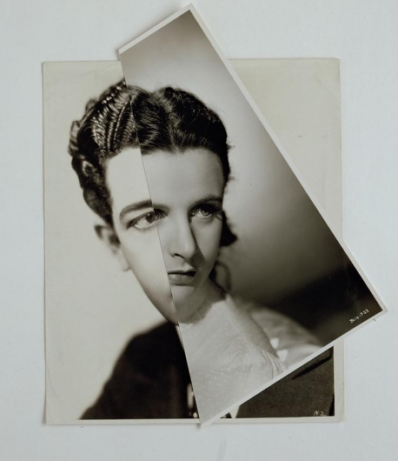
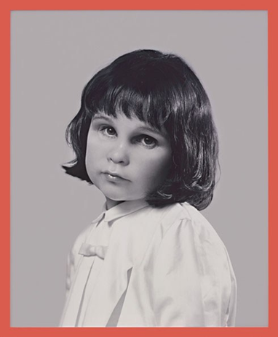
Annegret Soltau
John Stezaker
Cindy Sherman
Gillian Wearing

Slide 14
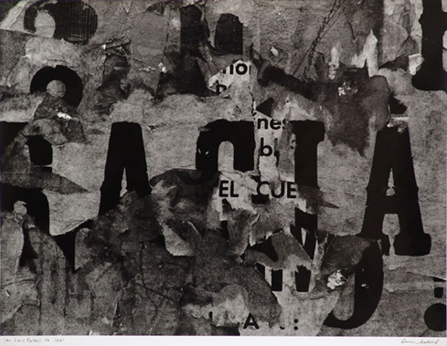
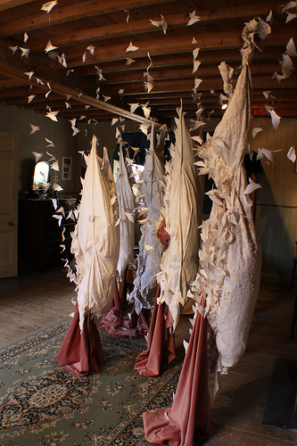
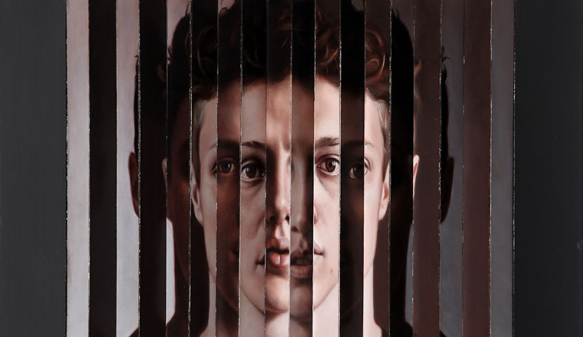
Karen Le Roy Harris “Like Flies to Flesh”
Ben Ashton “Face Front”

Slide 15
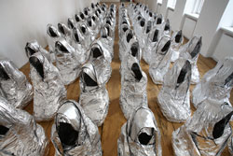
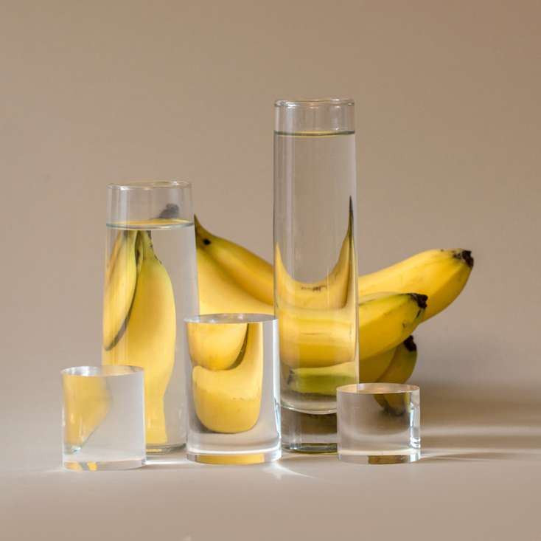
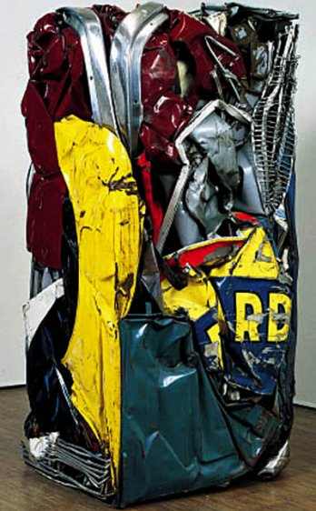
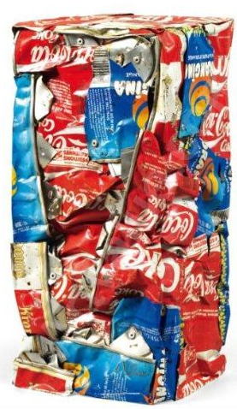
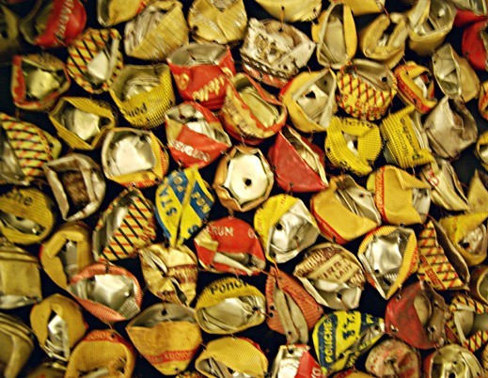
El Anatsui - Cesar “Compressions”
Kader Attia “Ghost”
El Anatsui - (crushed bottle tops)

Slide 16
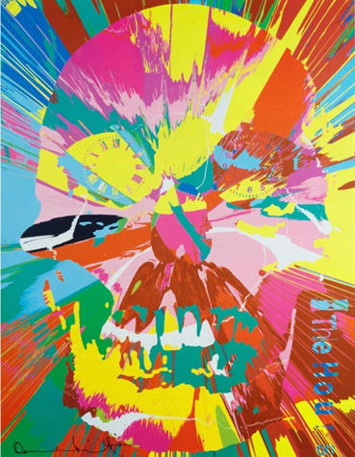
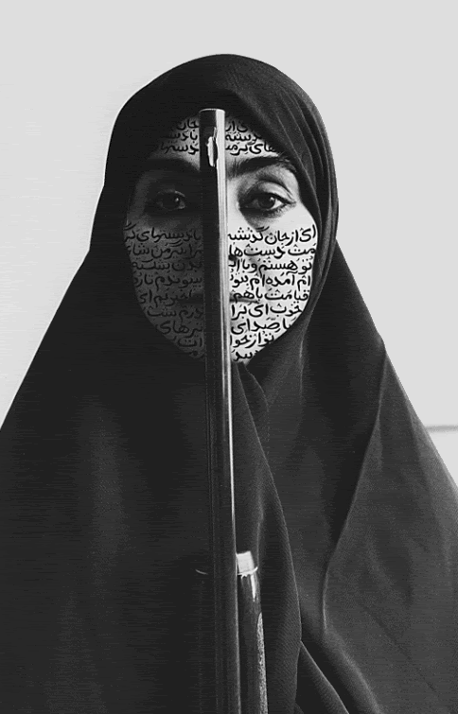
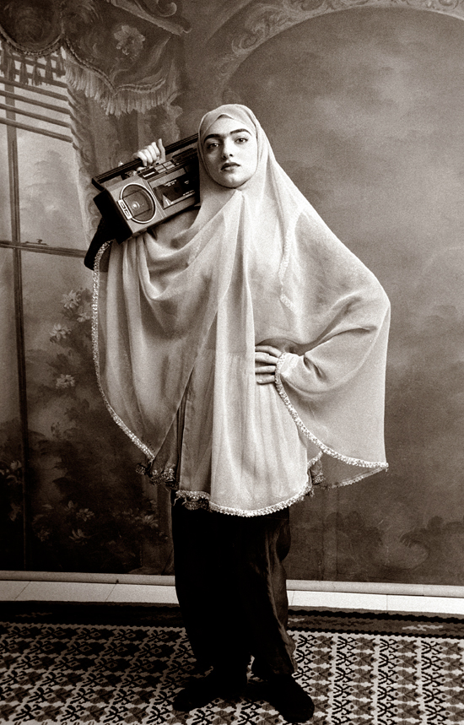
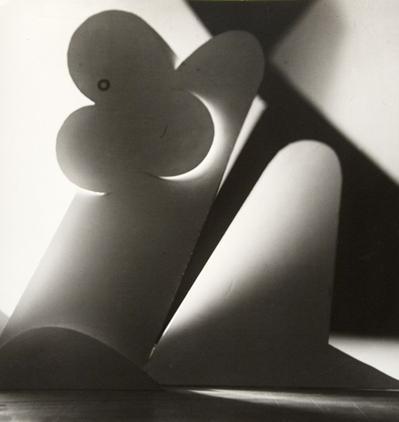
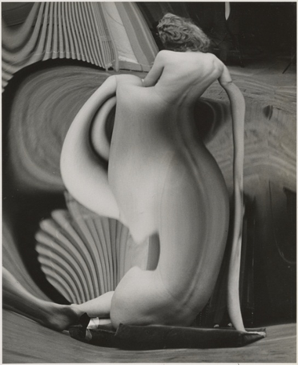
Shadi Ghadirian “The Like Every Day Series”

