Slide 1
Facts :
1.
2.
3.
4.
DESCRIBE the artwork
What kind of things do you see in the artwork?
What words would you use to describe the artwork?
-
-
-
-
-
UNDERSTAND the artwork
How does this artwork make you feel and why?
EVALUATE your answer
What do you think is good/not so good about this work?
What makes you think this (link back to previous answers).
ANALYSE the artwork
What is the main idea behind the work?
How do you think the artist made this work, what materials/equipment?
APPLY
What inspires you about this work? What techniques could you use?
How does this work link to your current class theme and why?

Slide 2
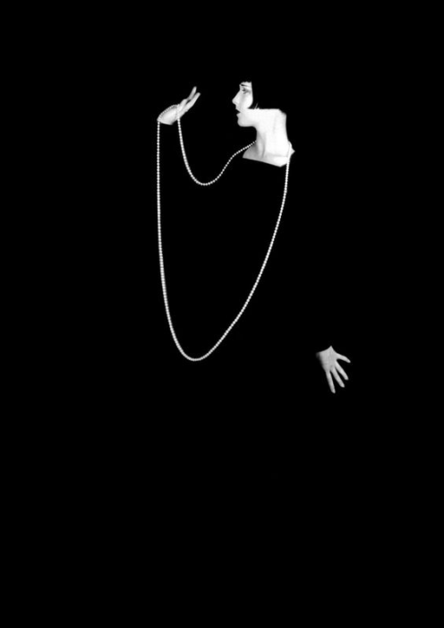
Facts about George Hurrell:
1.
2.
3.
4.
DESCRIBE the artwork
What kind of things do you see in the artwork?
What words would you use to describe the artwork?
-
-
-
-
-
UNDERSTAND the artwork
How does this artwork make you feel and why?
EVALUATE your answer
What do you think is good/not so good about this work?
What makes you think this (link back to previous answers).
ANALYSE the artwork
What is the main idea behind the work?
How do you think the artist made this work, what materials/equipment?
APPLY
What inspires you about this work? What techniques could you use?
How does this work link to your current class theme and why?

Slide 3
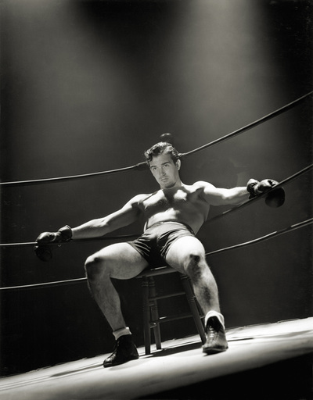
Facts about George Hurrell:
1.
2.
3.
4.
DESCRIBE the artwork
What kind of things do you see in the artwork?
What words would you use to describe the artwork?
-
-
-
-
-
UNDERSTAND the artwork
How does this artwork make you feel and why?
EVALUATE your answer
What do you think is good/not so good about this work?
What makes you think this (link back to previous answers).
ANALYSE the artwork
What is the main idea behind the work?
How do you think the artist made this work, what materials/equipment?
APPLY
What inspires you about this work? What techniques could you use?
How does this work link to your current class theme and why?

