Slide 1
ESA PREP
You have approx 14 school weeks to prepare for your 10 hr sustained period of focus (EXAM) in MAY.
This preparation will include AO1, AO2 and AO3 evidence.
If you use your lesson time and homework time effectively this is plenty of time to prepare successfully !
TOP TIPS!
1.Create a new folder, in your documents, titled ESA. This will be your exam folder which you will keep all images and research in.
2.Use your ARTIST STUDY QUESTION SHEETS to help DESCRIBE and ANALYSE artists works in YOUR OWN WORDS!
3. Where possible use PRIMARY sourced photographs – use the studio and lighting too!
4. Make sure you note ANY ideas, experiments (use notes, bullet points, sketches) so as to COMMUNICATE your ideas!
5. Make sure you are using your class time and home work time wisely – USE SMHW regularly!
6. Use the Art Dept at lunchtimes or after schools where possible!
There will always be a member of staff to help you!
Find artists you like and save their images (names and titles) You can use PINTEREST, THE REDLIST.COM AND GOOGLE.

Slide 2
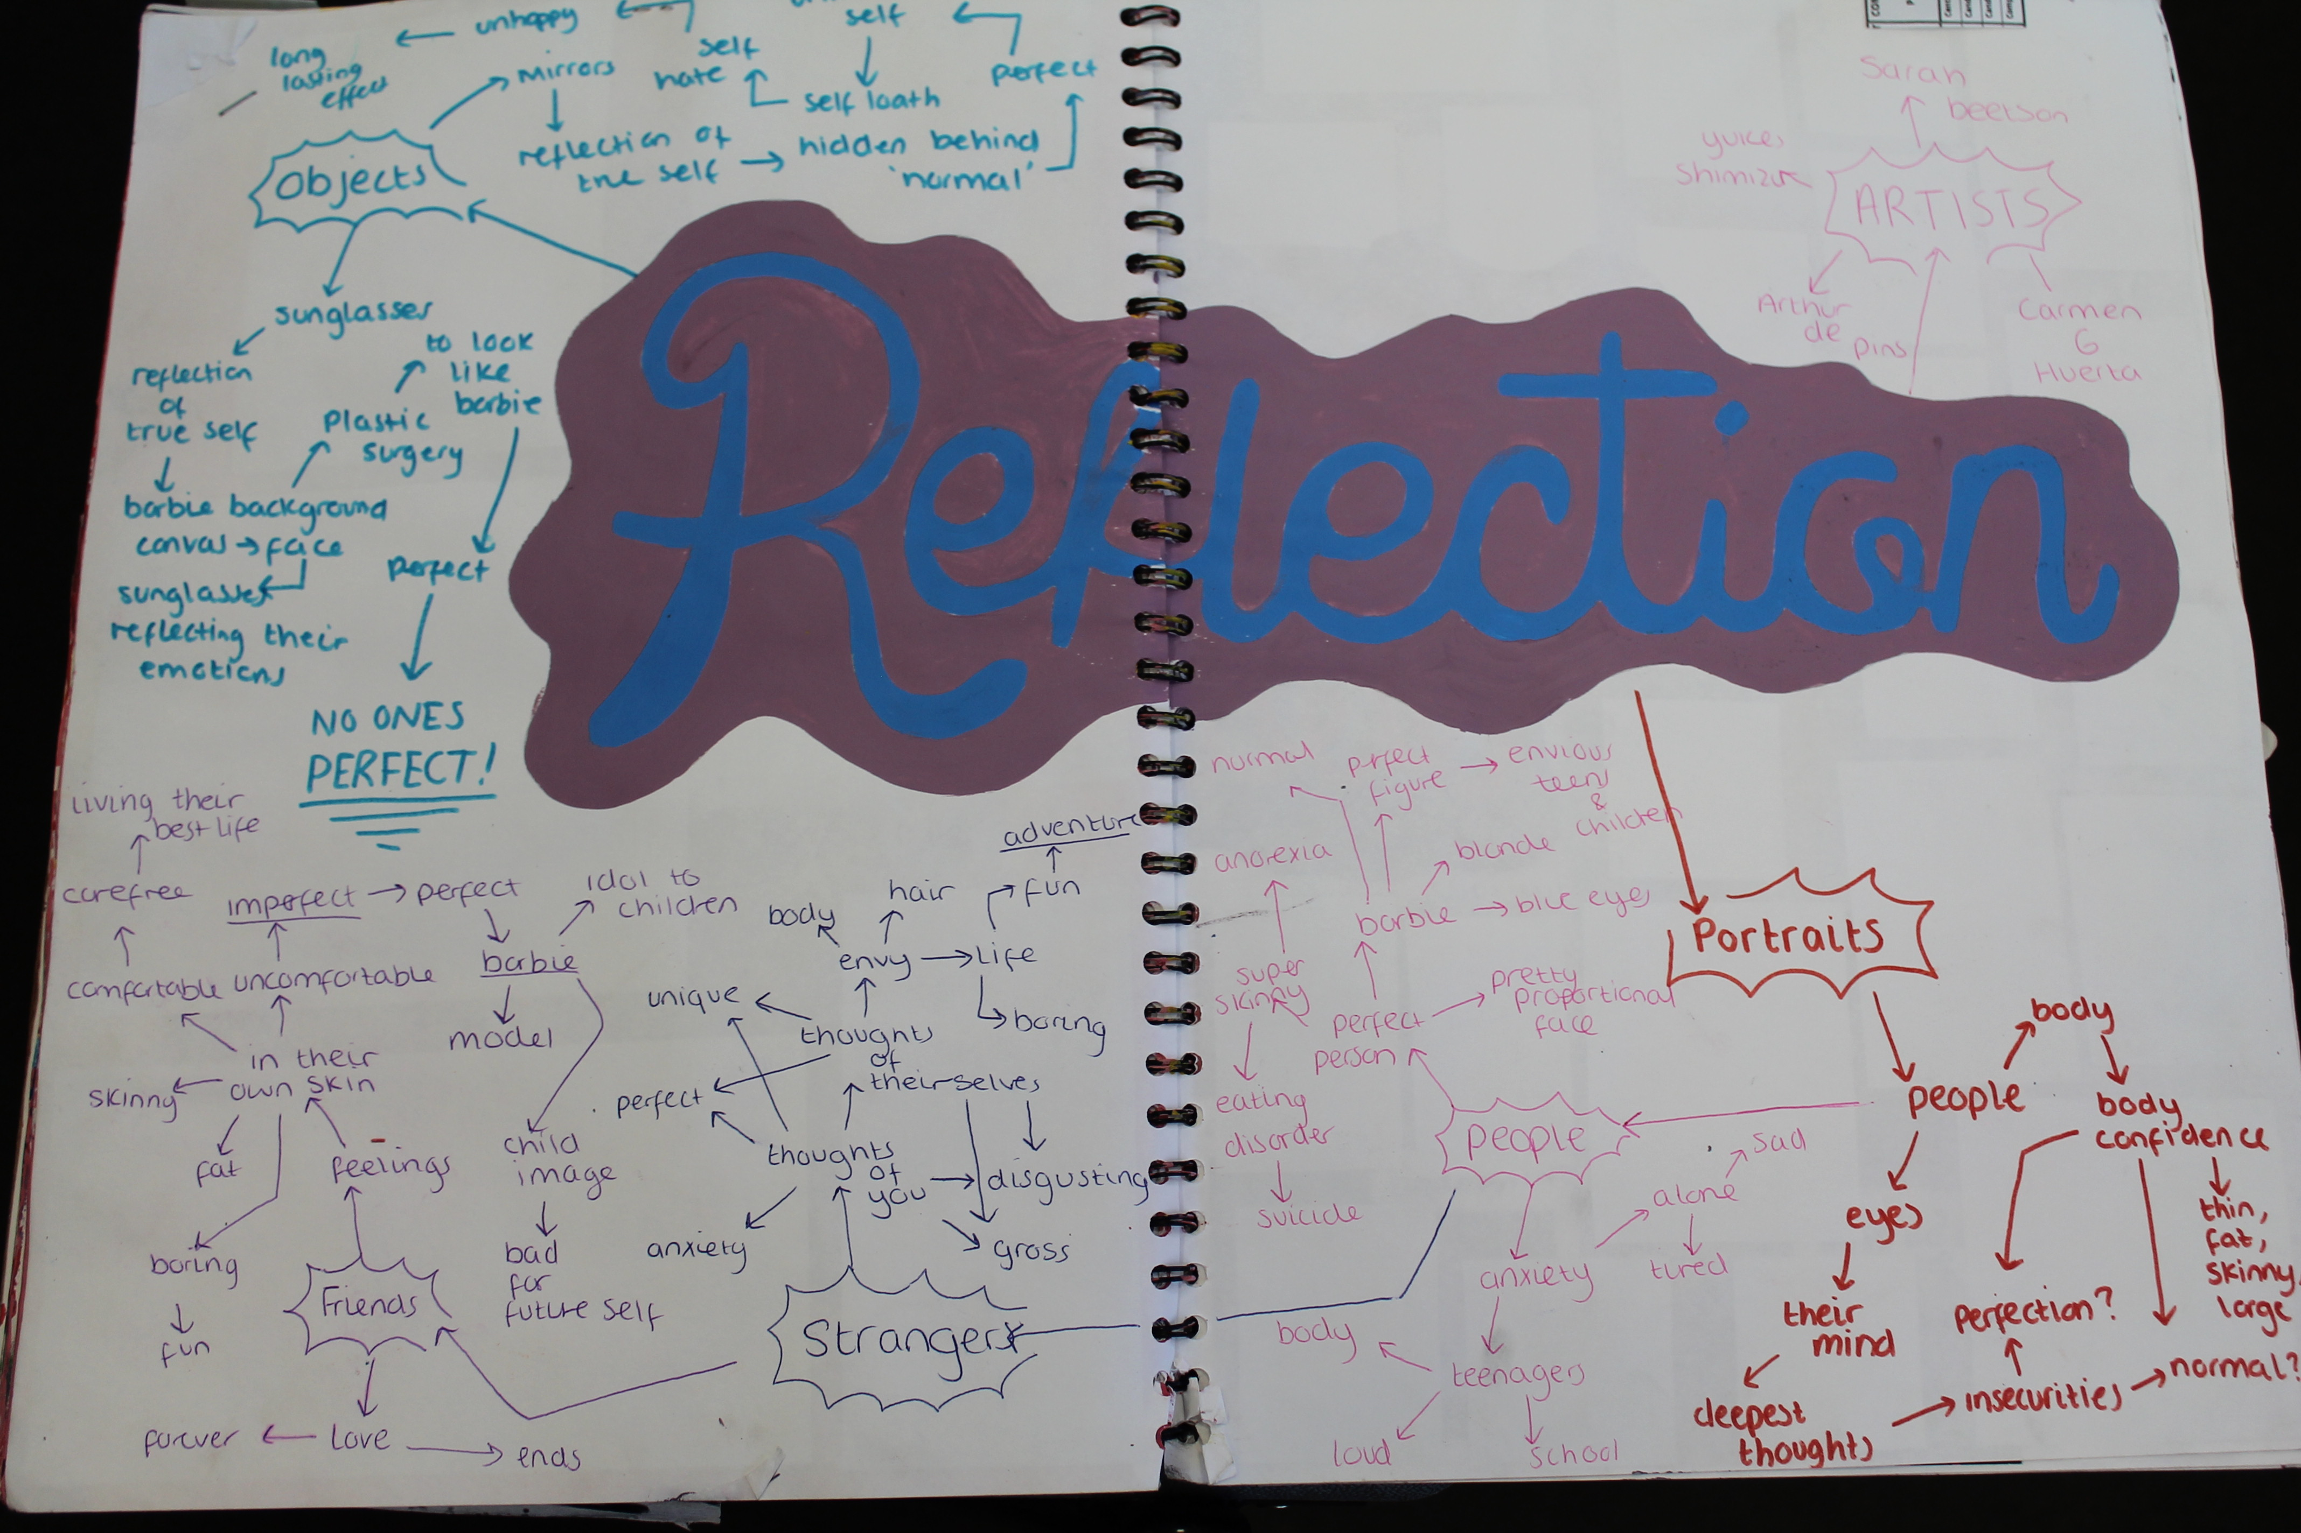
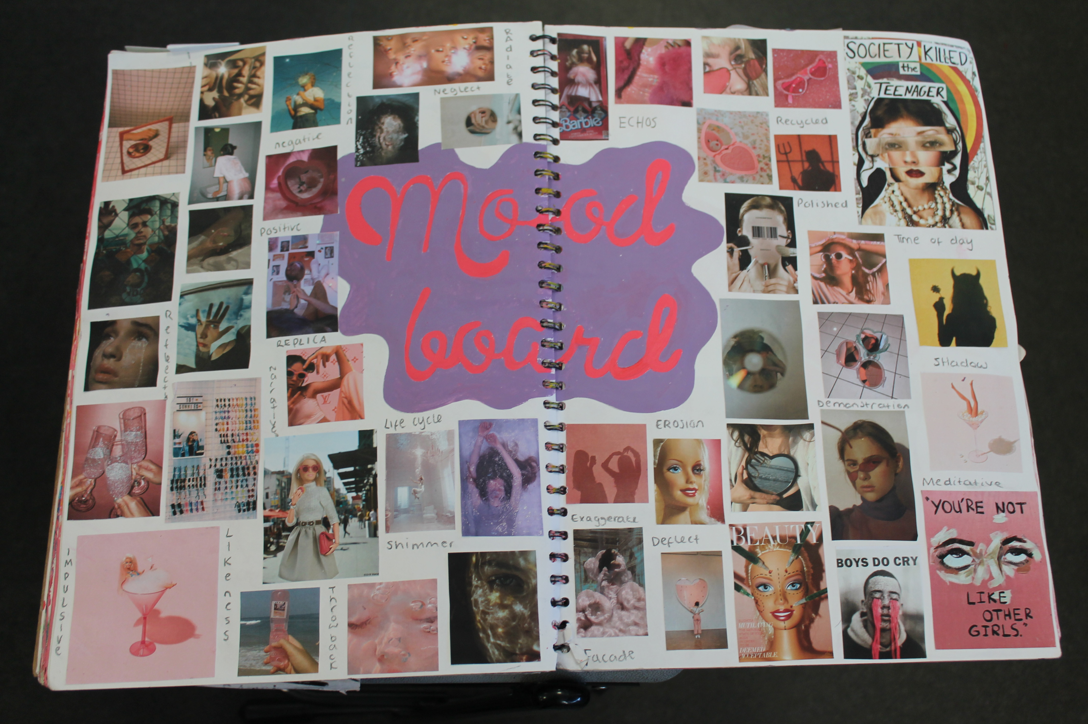
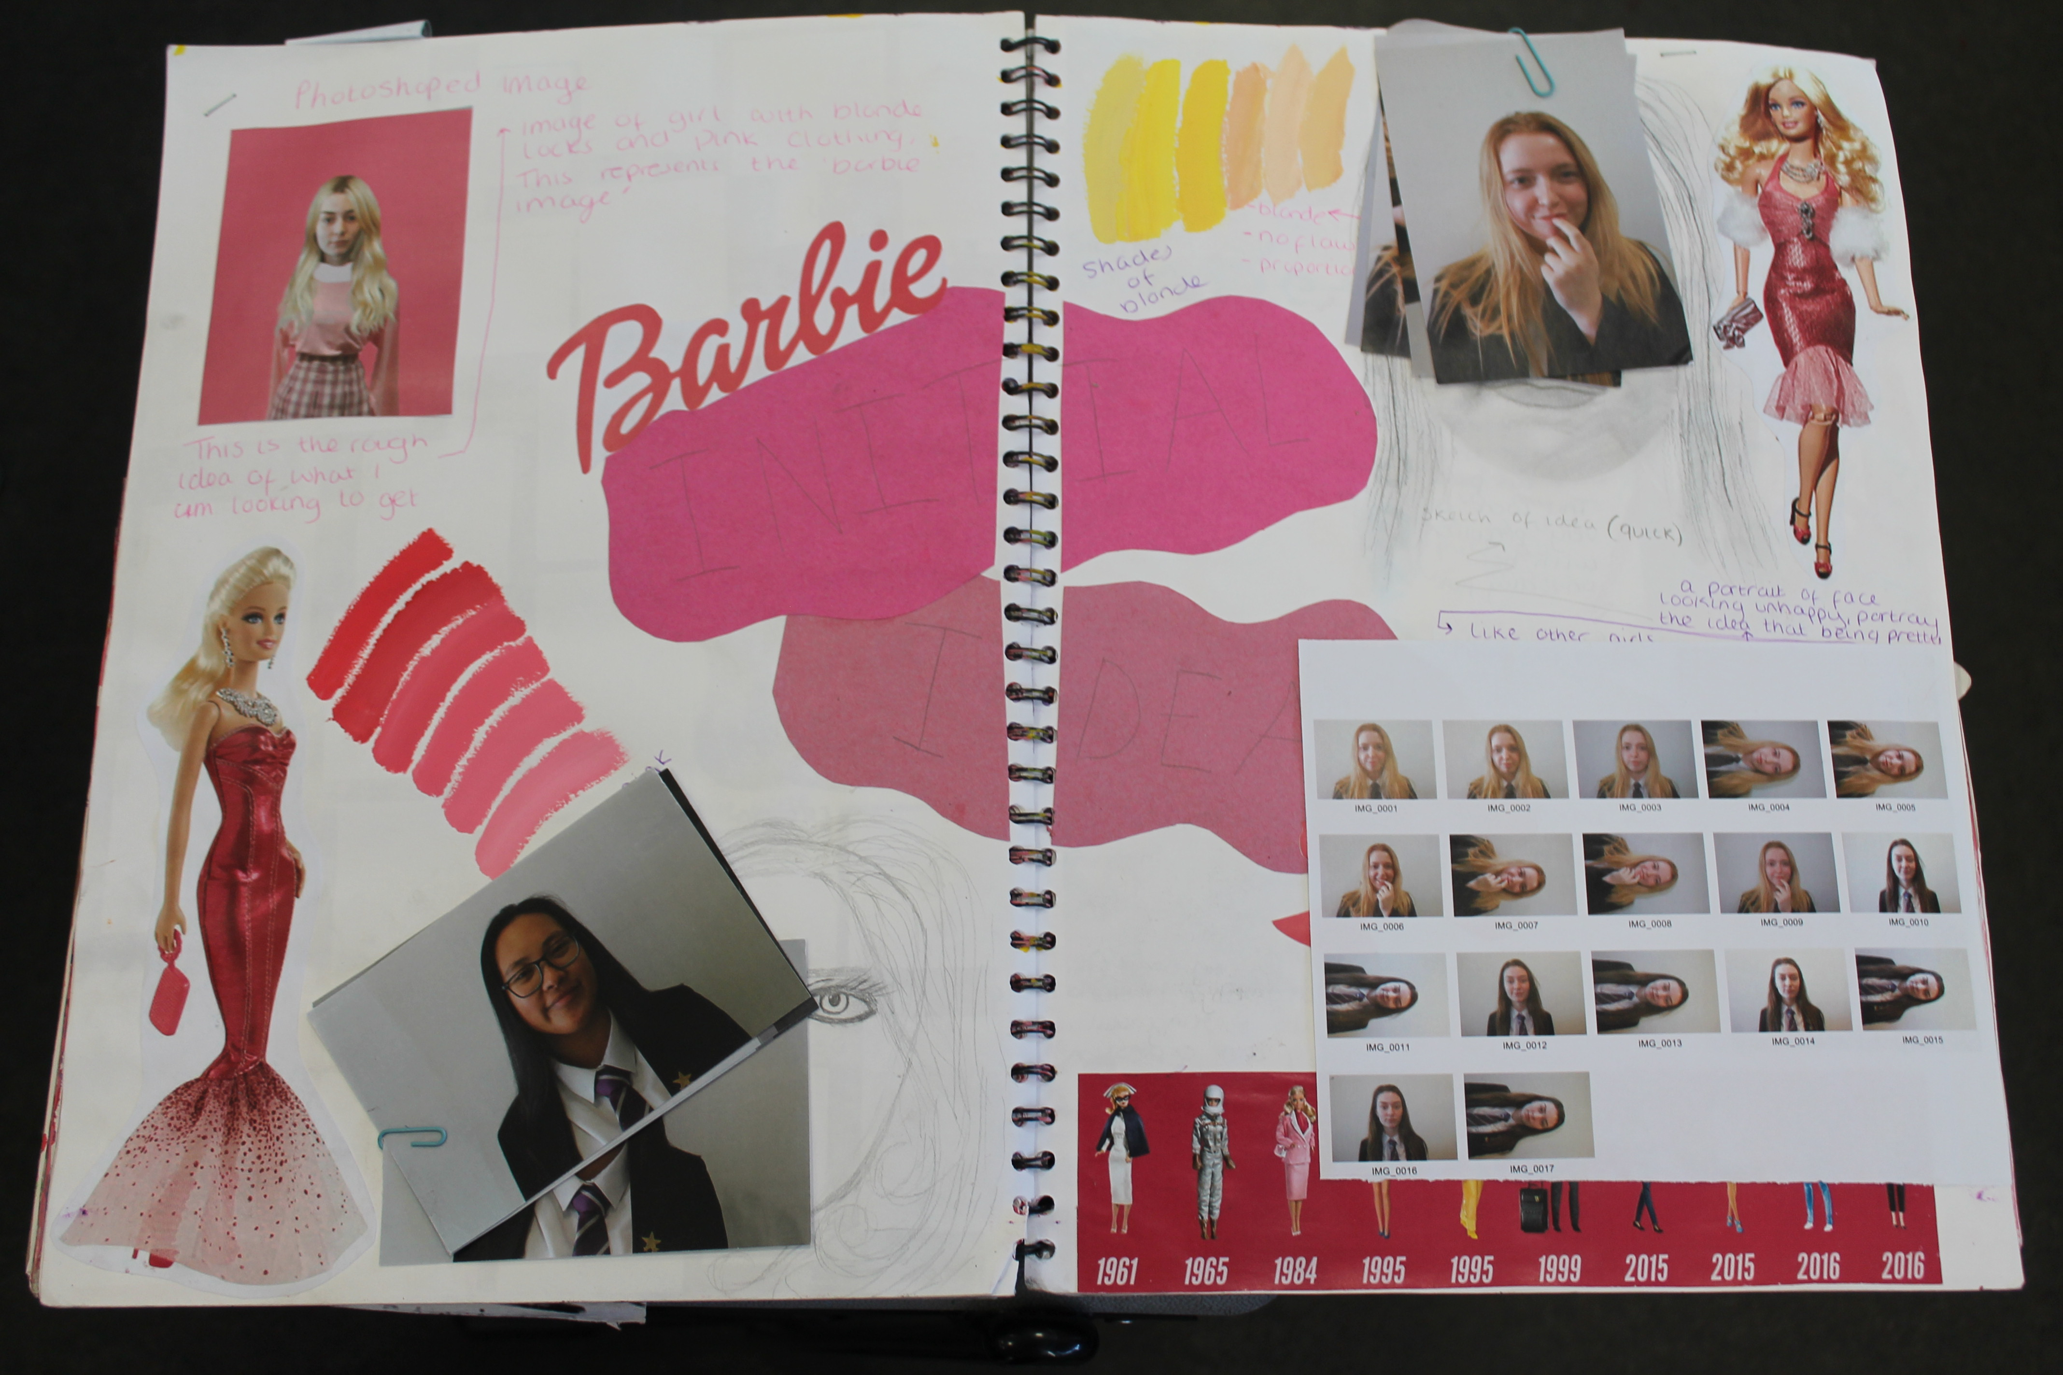
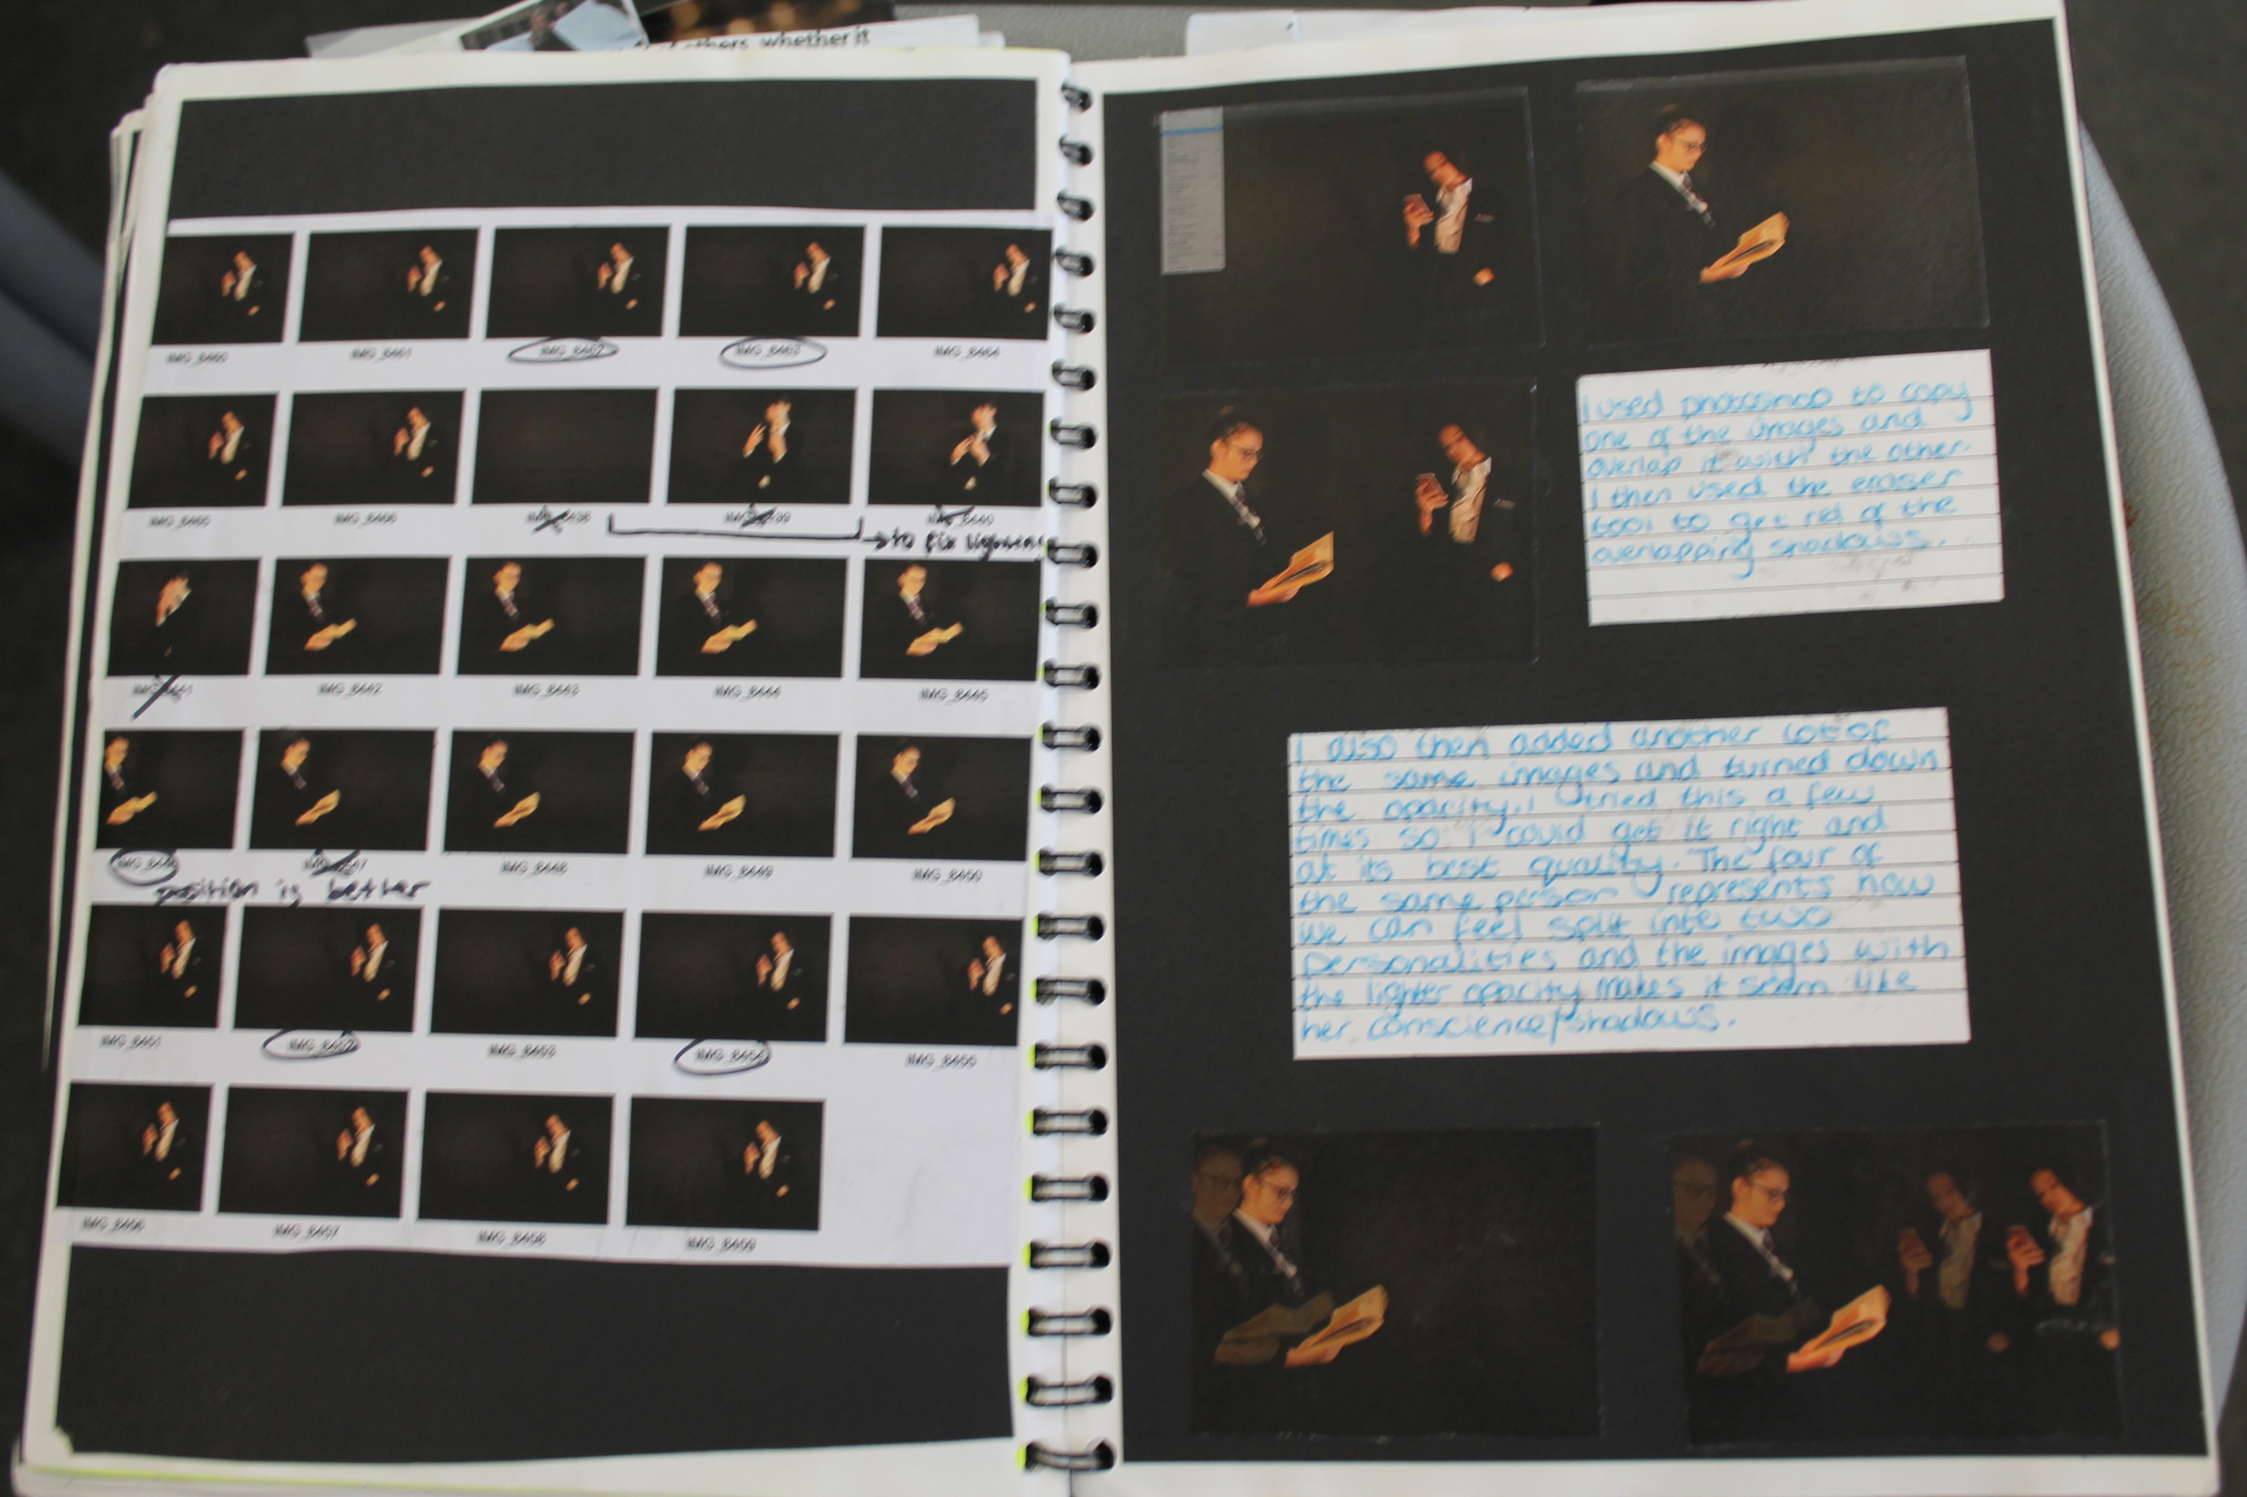
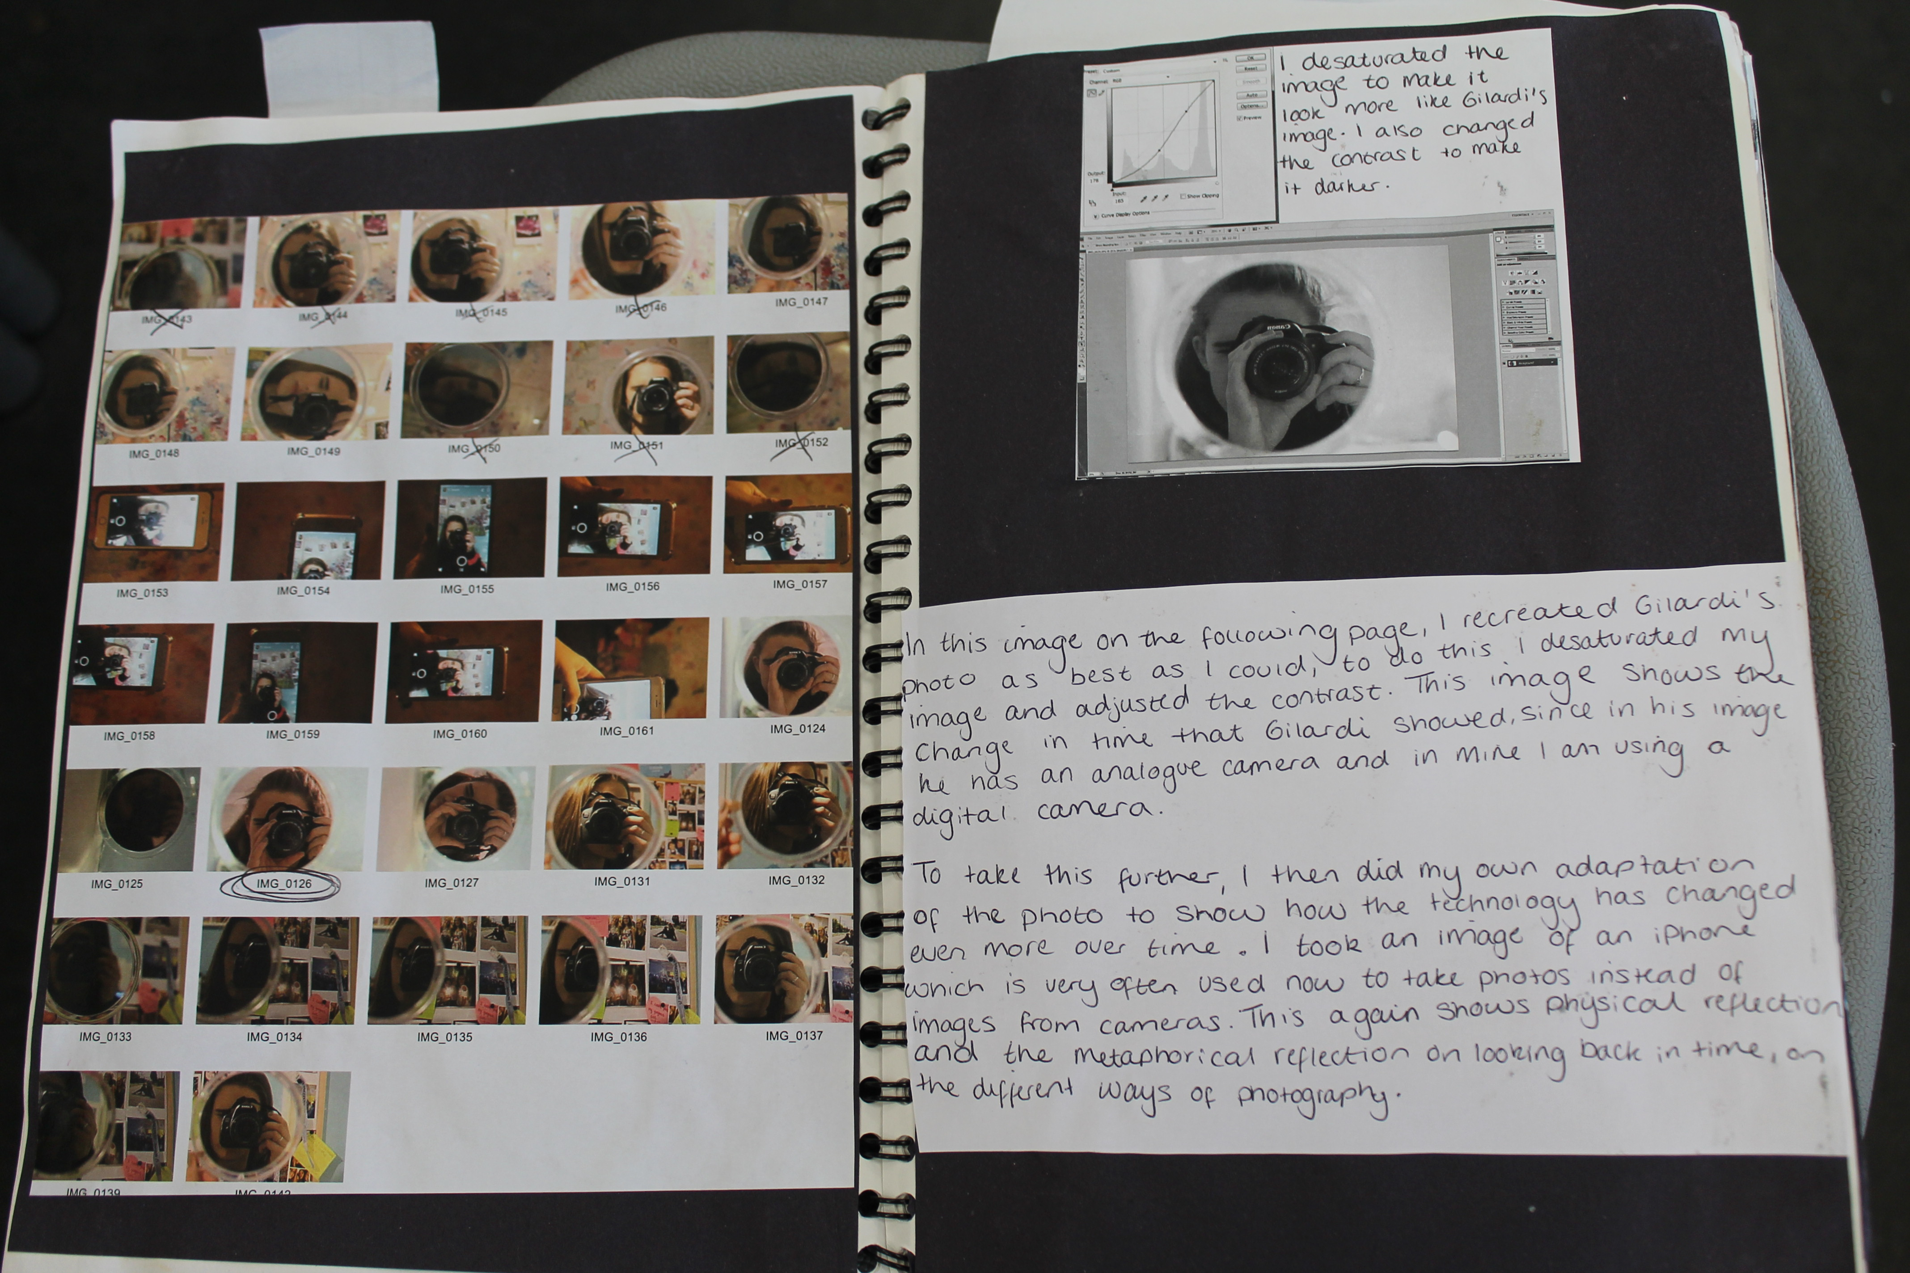
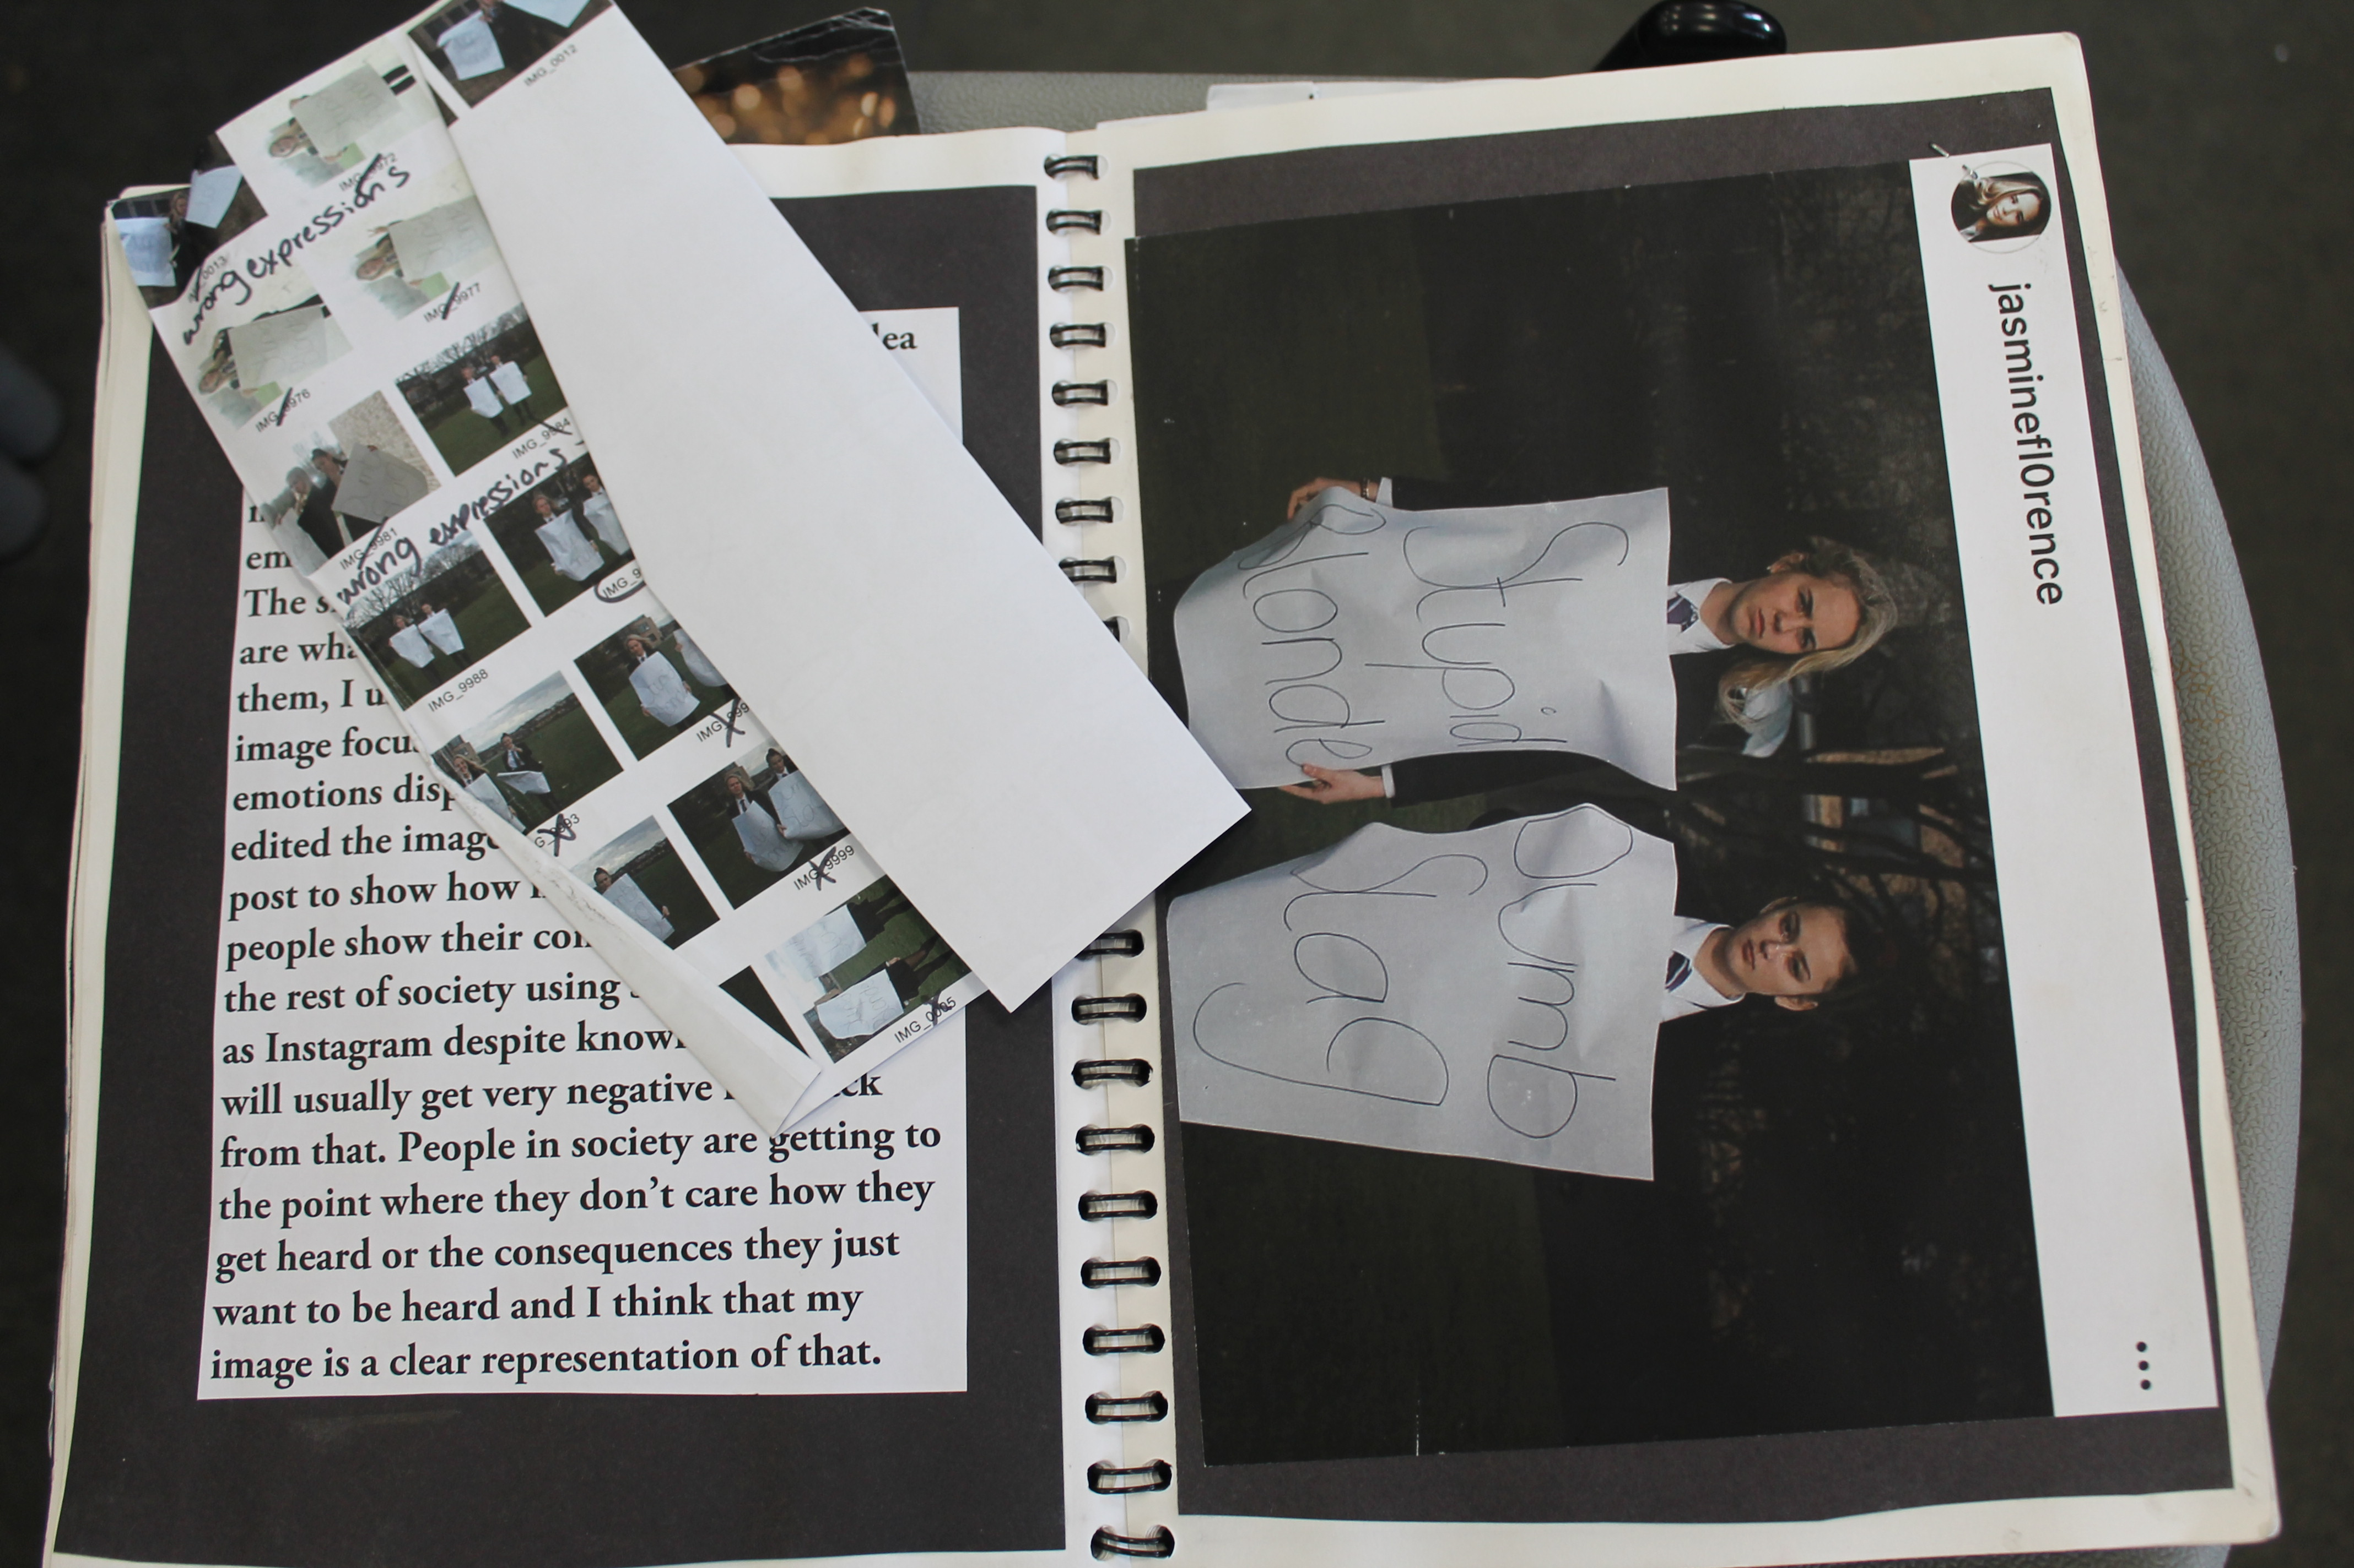
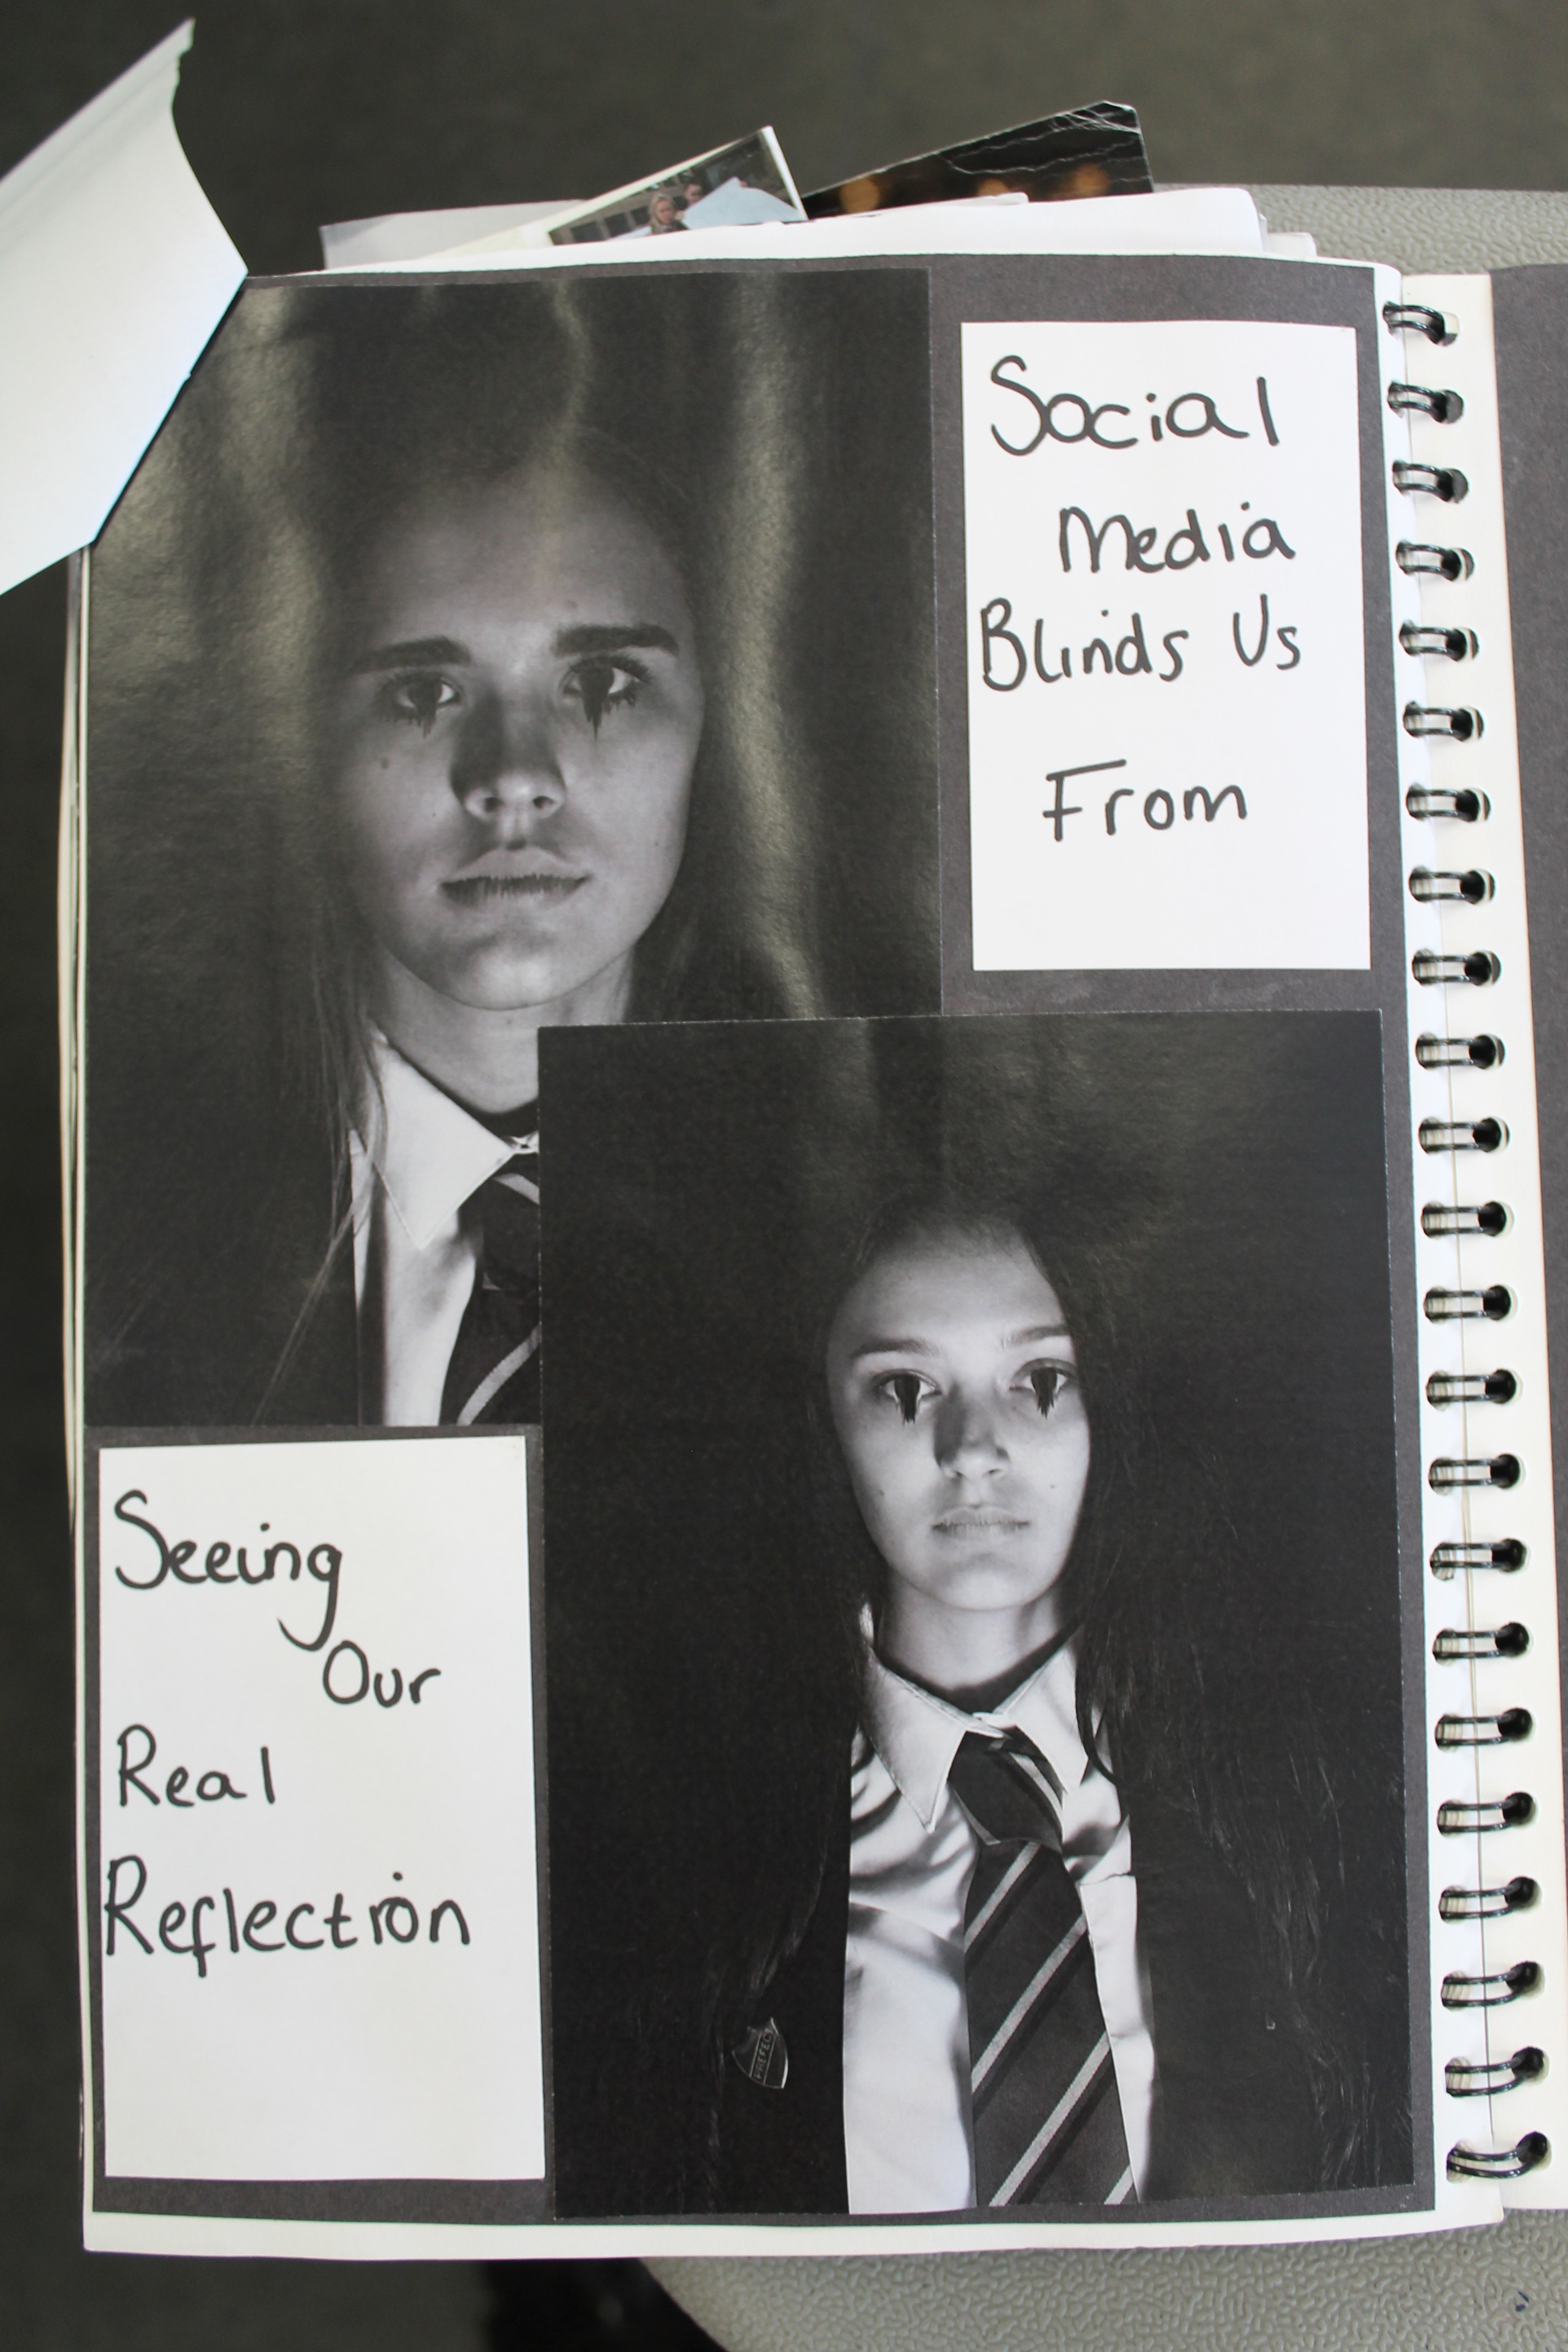
Think about how you present your book prep!

Slide 3
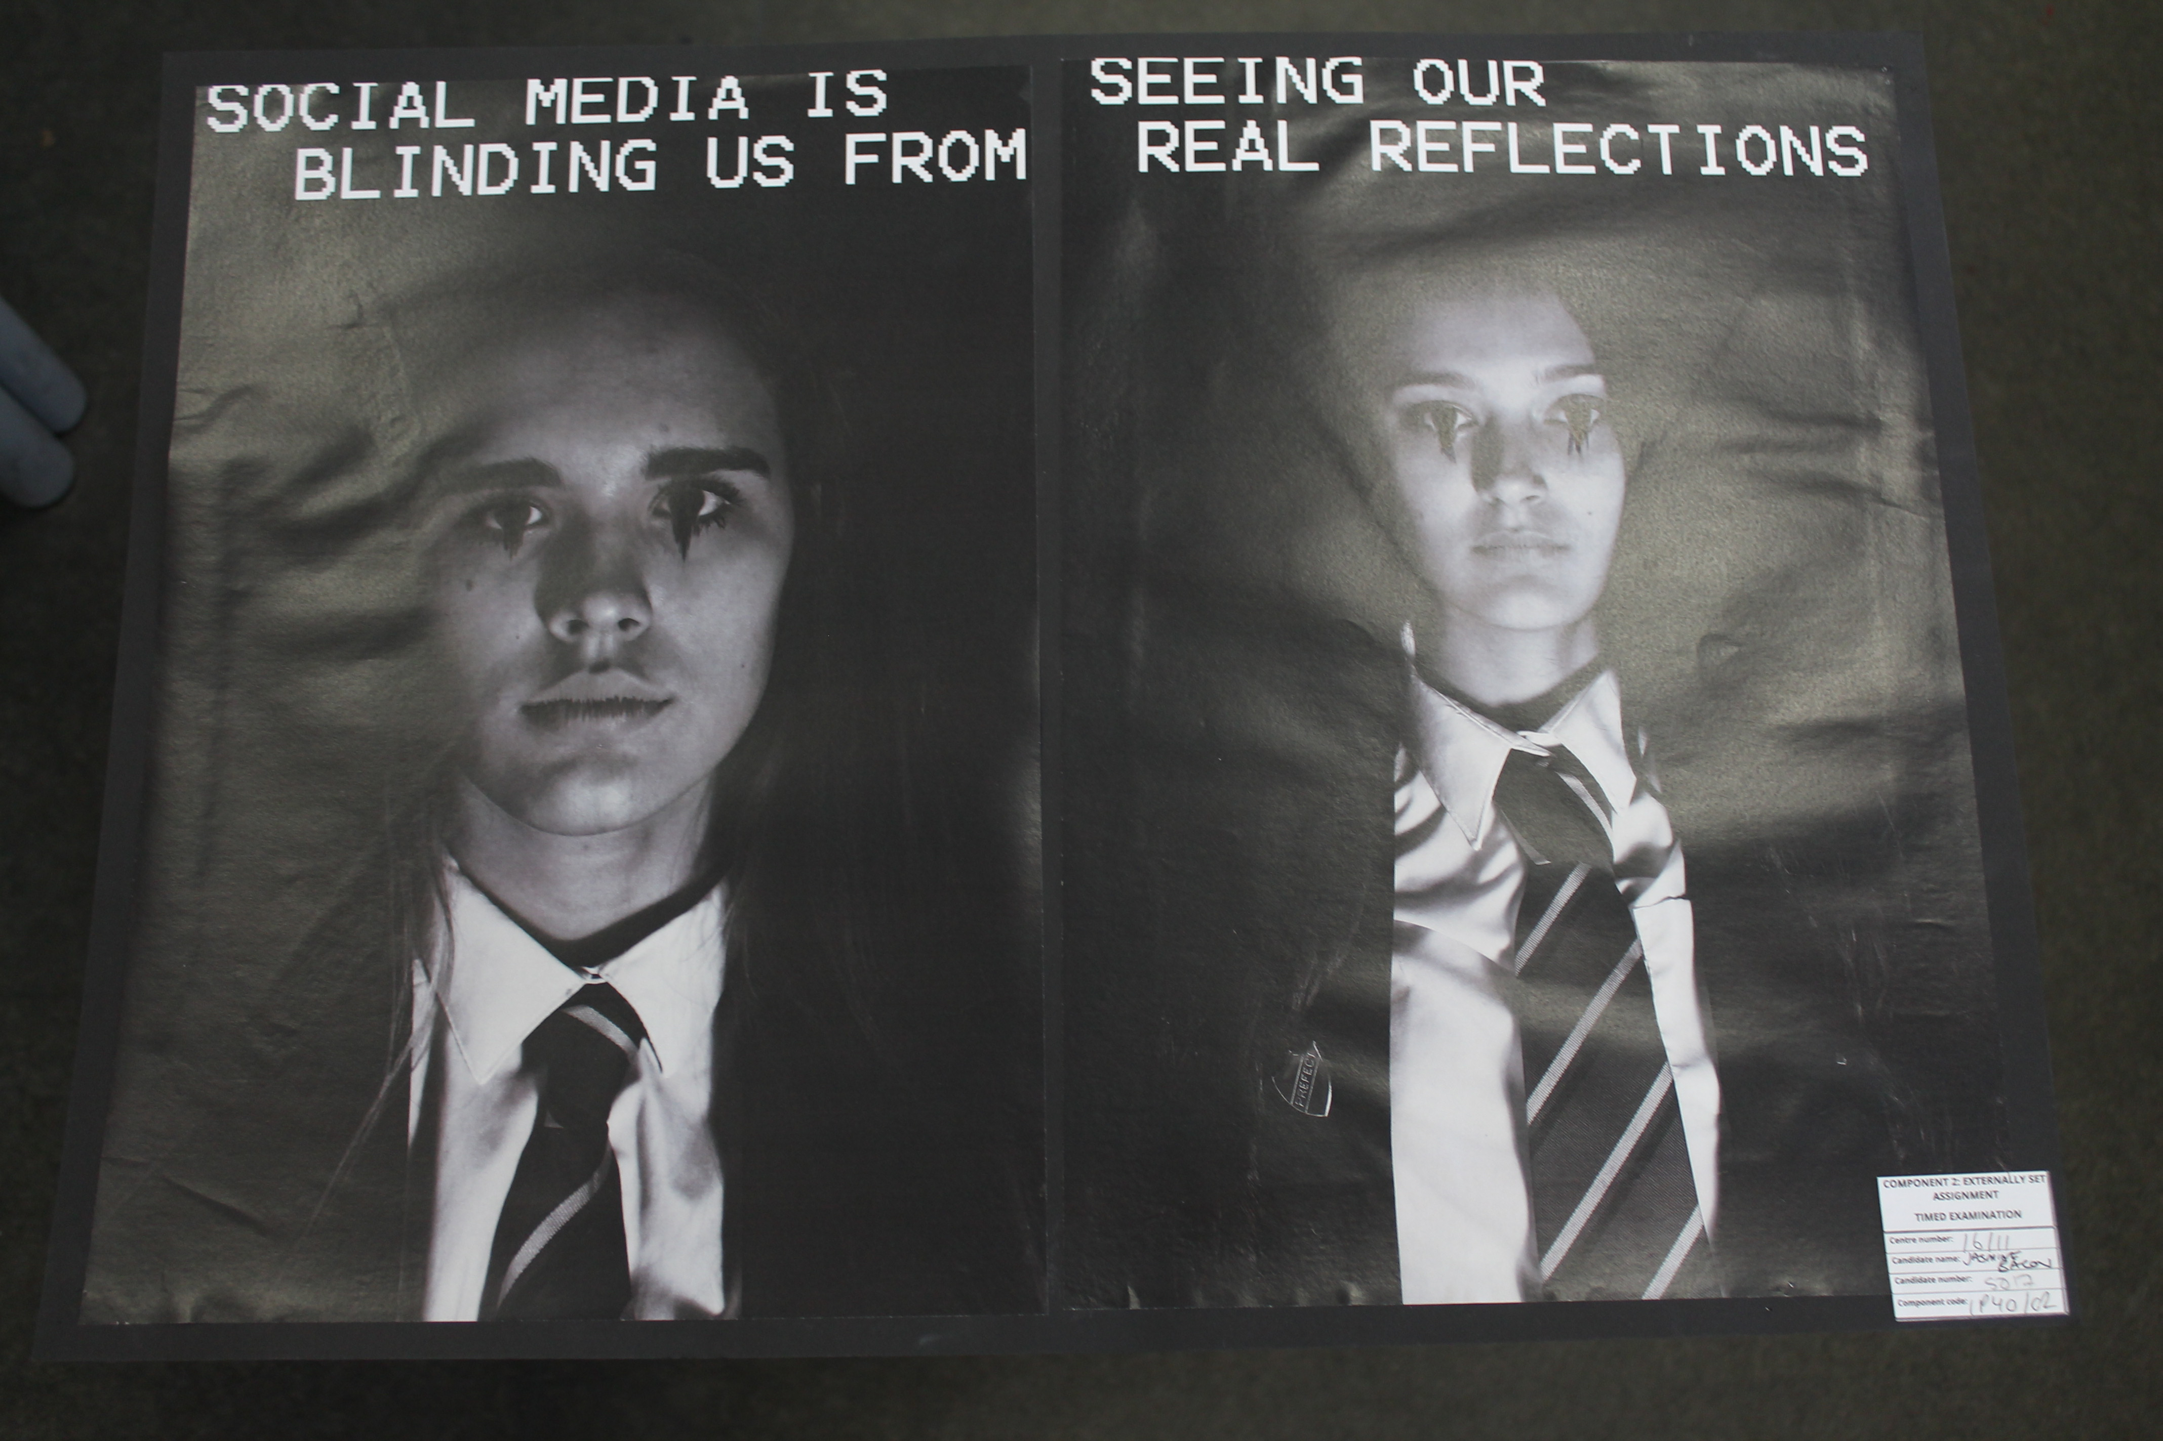
IN THE 10HR TIMED TEST YOU WILL EDIT YOUR FINAL PHOTOS AND RECORD YOUR STEPS IN YOUR SKETCHBOOK. YOU WILL PRINT OUT AND MOUNT YOUR FINALS ONTO CARD ALSO. YOU CAN ALSO DO AN EVALUATION BOARD IN THE 10HR TIMED TEST IF YOU HAVE TIME!

Slide 4
RESPOND
EXPERIMENT
TRANSFER
apply
Can you recreate the work?
What parts of the work will you respond to?
What materials/techniques would you use? Why?
What challenges will you encounter?
Would you change anything about the style o work?
What question would you ask the Artist?
HIGH
KNOWLEDGE COMPARE
SUMMARISE
understand
What does the image relate to?
What style of Art does it belong to?
Does it remind you of anything?
What is interesting about the work?
Can you explain what is happening in the picture?
What Art/Artist could you compare it to?
LOW
OBSERVE
RECOGNISE
WHAT?WHEN?HOW?
identify
Can you list 3 facts about the artist?
How would you describe the work?
What is the work called / what date was it made?
Describe the work in 5 words.
Can you label the image with the key parts you recognise? (objects/people/props etc)
LOW

Slide 5
JUSTIFY
OPINION
CRITICUSE
evaluate
Now you have understood the work and recreated your own response:
Do you agree with the outcomes?
What is the importance of the work?
What is the best bit about the work? What areas are there for improvement?
How would you rate/grade the work?
What would you do next?
How will you take this knowledge and experience forward?
HIGH
DEVELOP
REFINIE
ORIGINAL
Create
Create a response to the artists work:
What is your work about?
What do you want other people to feel/react to your work?
What else could you do in response?
Is it a successful response to the artist/theme?
What message does your work have?
How could you develop this idea?
How could you improve on your own work?
Could you think of an original way to recreate the work?
HIGH
EXAMINE
INVESTIGATE
analysis
What theme does the work have?
What is in the foreground/middle-ground/background?
Tell me about the colours?
Tell me about the presence of light?
Is it busy or deserted?
What do you notice about the person in the image?
What is the most powerful part of the image?
Discuss the composition of the image, how is it arranged?
What style of Art/Artists is the work inspired by?
What connects the image?
HIGH

Slide 6
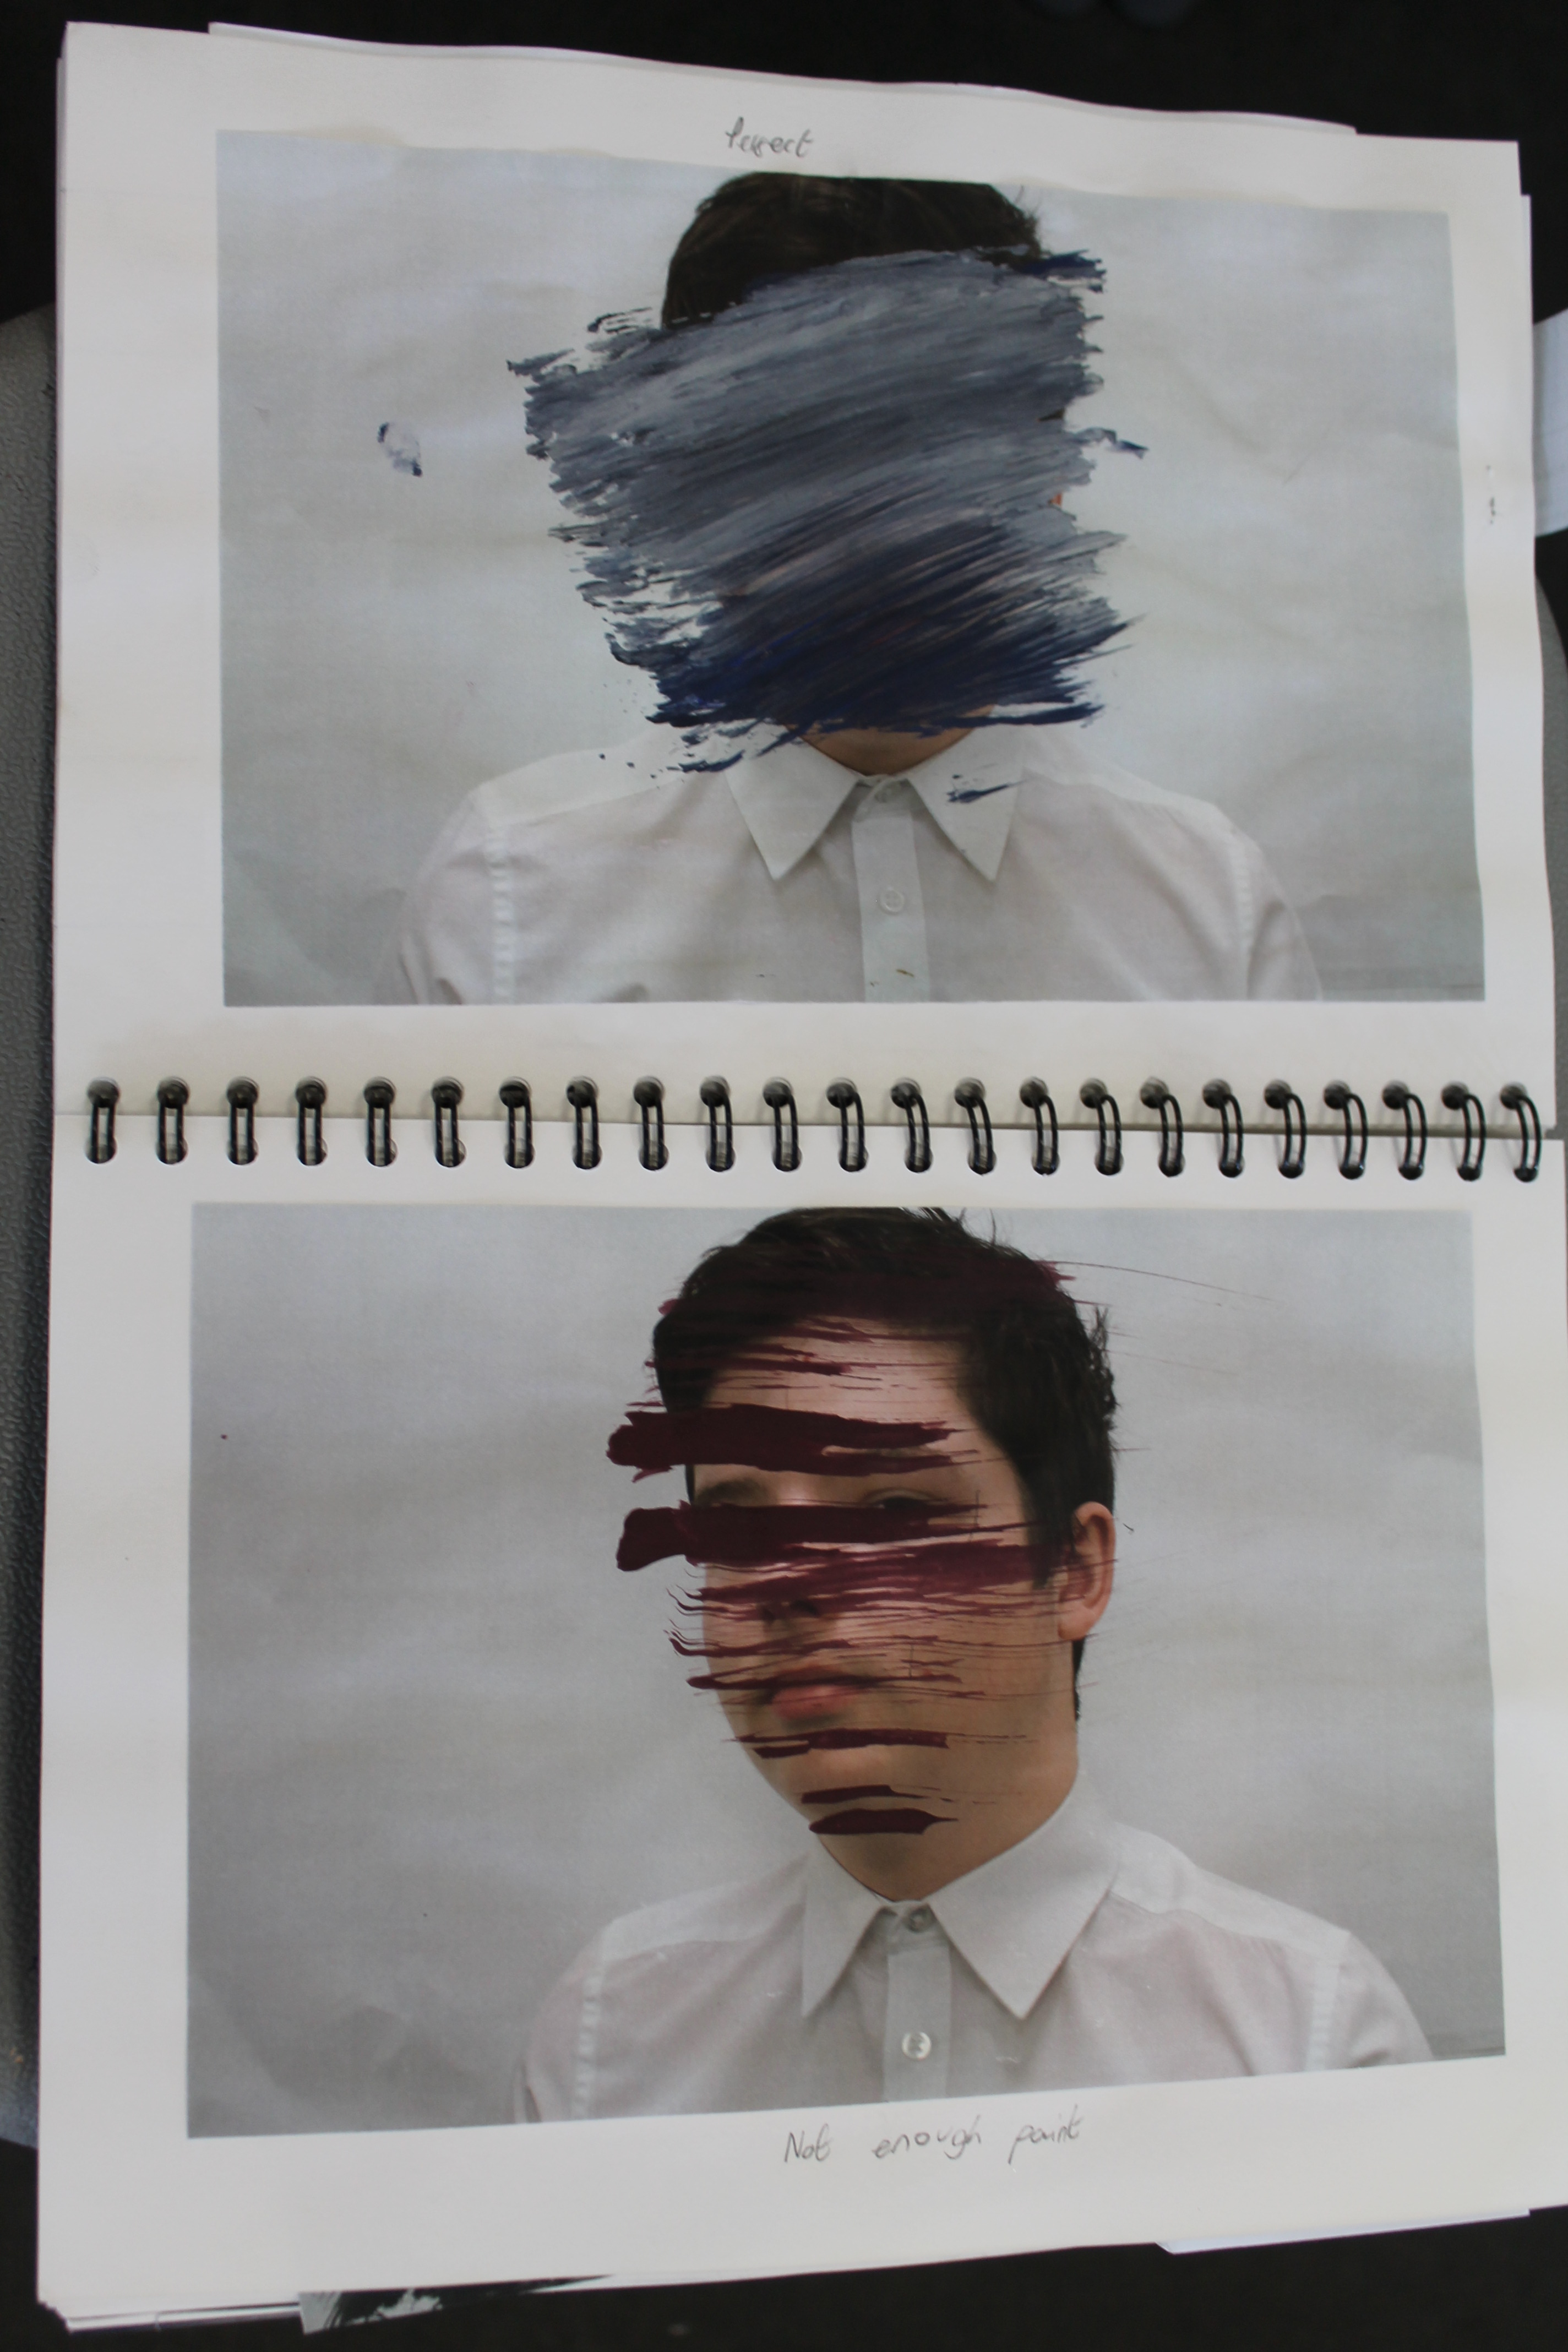
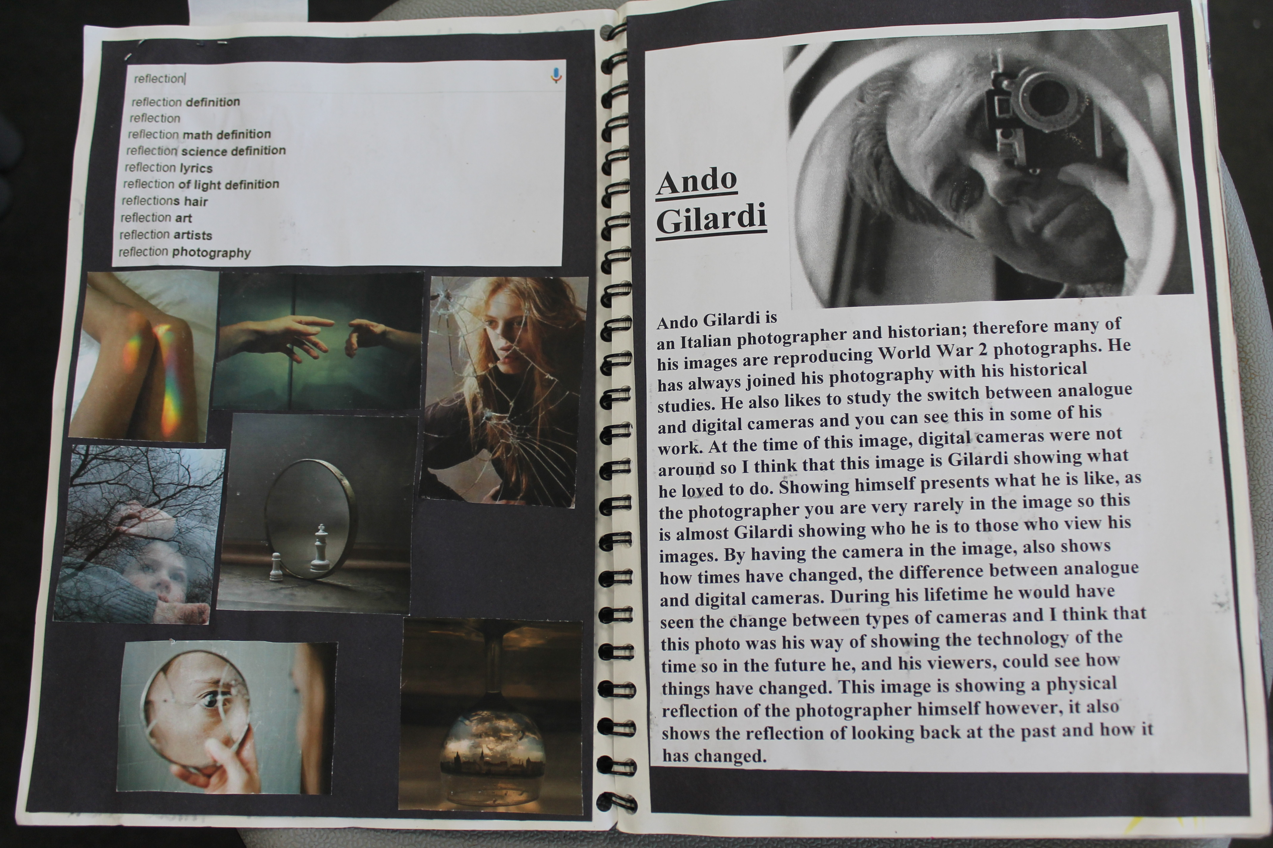
How you could present your artist/cultural study?
VISUAL RESPONSE CAN BE YOUR OWN IMAGE BUT IN THE STYLE OF THE ARTIST!
WRITTEN RESPONSE SHOULD BE YOUR OWN VIEWS – USE THE ATTACHED QUESTION SHEETS IF NEED!
YOUR TEACHER WILL ALSO HAVE EXAMPLES OKEYWORDS AND SENTENCE STARTERS IF NEED!
ARTIST NAME.
RELEVANT FACTS.
CHOSEN IMAGES OF THEIR WORK.
WHY HAVE YOU CHOSEN TO LOOK AT THEM?

Slide 7
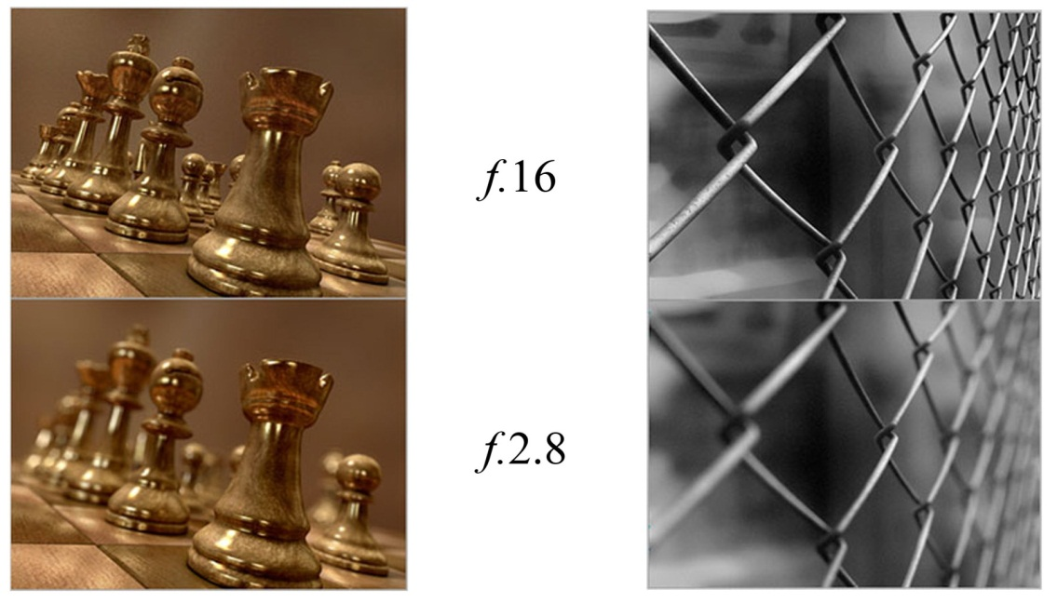
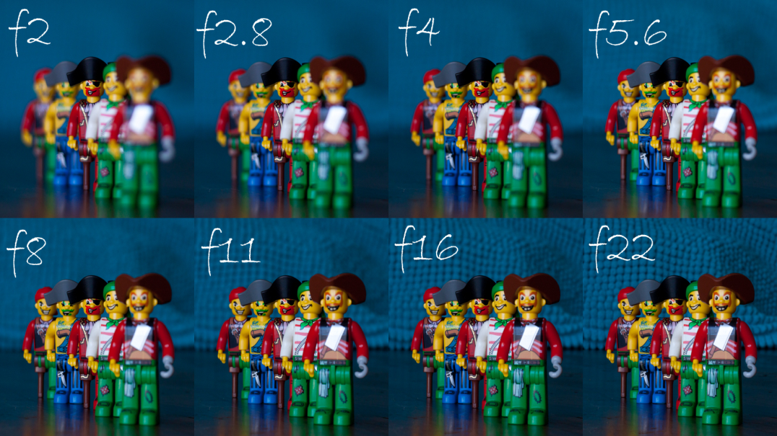
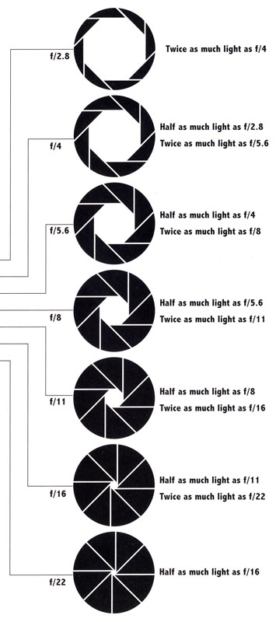
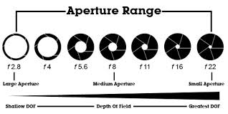
Examples of D.O.F.

Slide 8
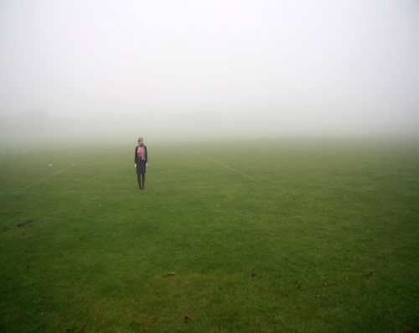
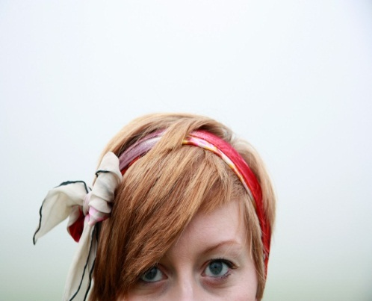
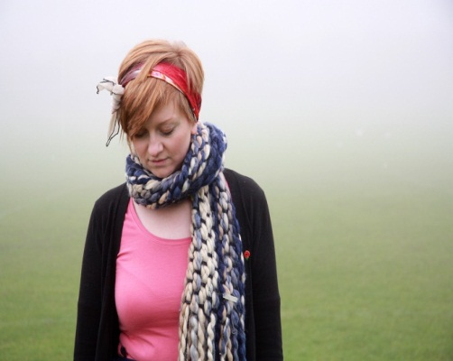
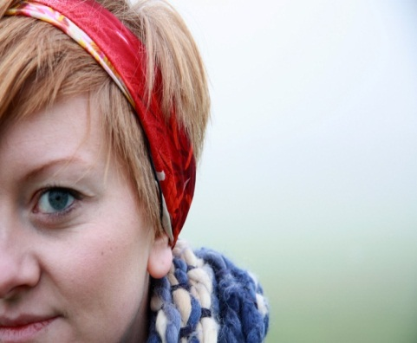
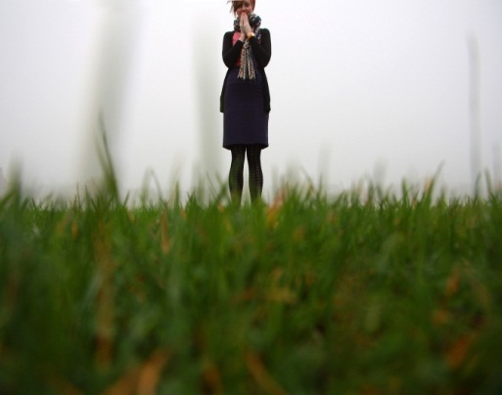
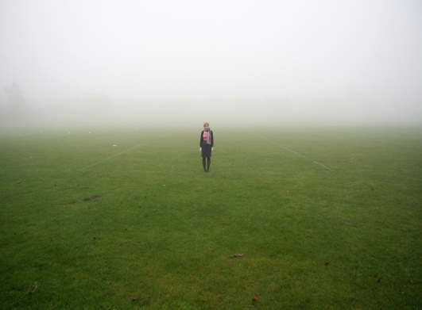
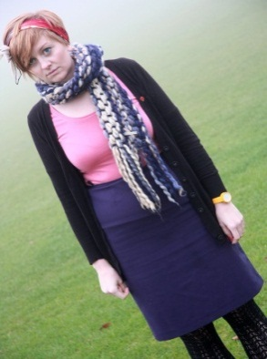
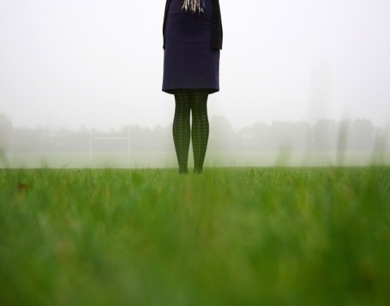
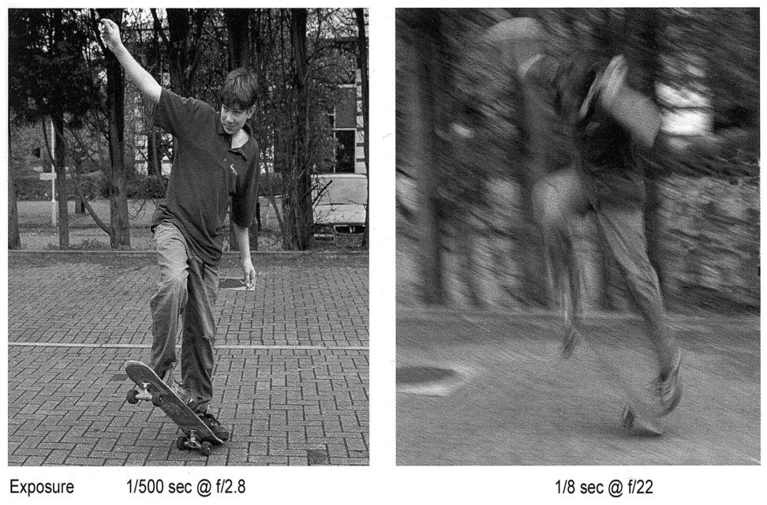
One Subject, lots of different ‘compositions’.
As the photographer ‘you’ control this.
The effects of different ‘Shutter Speeds’
Fast Shutter Speed
The person has been frozen in action.
Slow Shutter Speed
The person is blurred. Sometimes referred to as ‘Camera Shake’

