Slide 1
Performance Roles within the performance industry
Actor
Singer
Dancer
Musician
Musical Theatre Performer

Slide 2
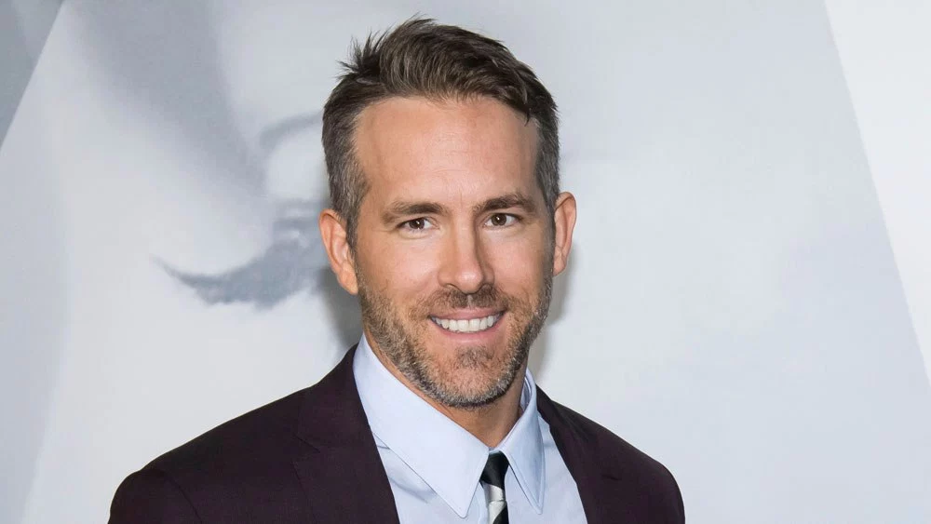
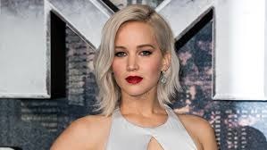
Actor
1 : one that acts.
2a : one who acts in a play, movie, television show, etc.
b : one who behaves as if acting a part.
A person who plays the part of a character in a performance. They are not themselves on the stage and screen

Slide 3
Roles and responsibilities
An actor is responsible for using their skills as a performer to help convey a clear character to the audience. The interpretation and performance of this character will then help to shape the storyline.
An actor will play various roles throughout their career, from the world of theatre and on the screen.
An actor may also have to be interviewed about a film or play they are in so they must ensure that have a secure knowledge of their part within the finished product.

Slide 4
Skills and qualities
Many professional actors and actresses will have had formal training at a drama school or a university that specialises in Drama and acting.
This is not a requirement though, many actresses and actors have found their way into acting after years working in a different role. Jennifer Lawrence is one of the most celebrated actresses of her generation but did not have any formal training to become an actress.
Qualities that you need to be an actor is to be able to be creative with your approach to a role and to use your skills as a performer to play varying roles.
You do not need to be a confident as yourself but you should have a strong confidence as a performer. Many actors, Robert DeNiro, are excellent actors but is difficult to communicate with when being interviewed as himself.
When performing for the theatre you must ensure that you have a strong use of voice to help you project your voice and to use clear tone to show a range of emotions. Also within the world of theatre you must dedicate yourself to learning pages upon pages of lines to ensure you are confident when stepping onto the stage

