Slide 1
“Don’t go in there!”
“That was the worst day of my life!!!”
“I can’t believe you did that?”
What is in there?
Who is going in there?
How will they feel when they get in there?
Challenge
Add at least three strategies
Who is having the worst day?
Why are they having the worst day?
Challenge
Add a clear genre
What happened?
Challenge
Change the structure of your performance using strategies

Slide 2
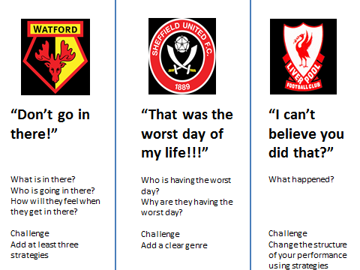
Identify an idea to your group based on the quote stimulus
Apply strategies and a genre to your performance
Create a performance using a different structure to your performance

