Slide 1
How does the music
make you feel?
What might be going on?
Where might you be?
What time period are you IN?
https://www.youtube.com/watch?v=vhSHXGM7kgE

Slide 2
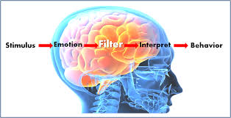
Learning Objectives
Understand a variety of stimuli
Apply the ideas to a performance (based on the music given)
Evaluate the success of another groups use of music
Where are you?
What are you doing?
Who are you?
How are you feeling?
Why are you feeling this way?
Challenge
Add the music to your performance at a specific time
https://www.youtube.com/watch?v=9gokb_Ssp3I

