Slide 1
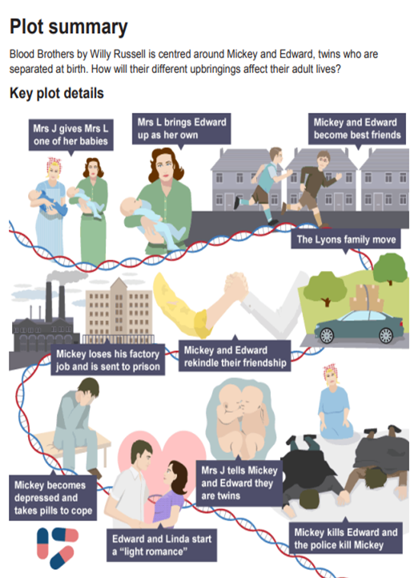
Script

Slide 2
Blood Brothers plot
To understand the plot to "Blood Brothers"
To identify key moments of the play
To analyse your interpretation of these key scenes.
Make notes on the plot structure and add to your starter list.

Slide 3
Choosing a scene
Find two moments that you think are the most significant moments in the play.
Once you have decided on this justify your answer, I.e. does it change the outcome of the rest of the play? Does it change the perspective of a character's thoughts or actions?
Spend 15 minutes on this.

Slide 4
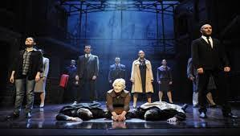
Analyse the scene
You are going to imagine you are to play one of the characters in the most important scene.
Answer the following question in 15 minutes.
How would you (playing a chosen character) create tension in this scene?
This would usually be a 12 mark question in the exam
Things to consider when answering the question:
How you will use your vocal and physical skills to play this character?
How will you use spacing and proxemics to create tension?
How do your decisions help to create tension?

Slide 5
Plenary
The main scene that you chose would link to one of the main themes of the play.
Class system
Violence
Superstition
Nature versus nurture (may need explaining)
Which theme does this scene fall into? Make sure you justify your reasons and give examples where it is clearly shown within the scene.

Slide 6
Complete your work on a Word document, or you can complete it on pen and paper as long as you can take a photo of it at the end of the lesson.
Please ensure you turn in your work via this assignment at the end of the lesson. You will need to attach your work as a Word document, or as a photo if you completed it on pen and paper. If you are not sure how to hand in and attach your work, watch this video: https://youtu.be/Re3ejPVvA8E
All pupils are expected to attend the live lesson and complete and hand in this work. Teachers will check to ensure this has been done and your parent/carer will be contacted if work is missing or not completed to a good quality.

Slide 7
Learning Outcomes
To have a knowledge about the themes of the play "Blood Brothers"
To identify themes within specific extracts
To analyse how the themes could be shown practically.
Starter
Click the link to start the BBC Bitesize quiz on the plot of Blood Brothers.
Let me know your scores on the chat and make a note of any answers you got wrong.
I actually got the first question wrong.
Starter quiz

Slide 8
Themes of "Blood Brothers"
While you are watching the clip make notes on the themes that are mentioned.
Challenge
After the clip spend 5-10 minutes finding quotes that link to the play using the Woodlands CA Website.

Slide 9
The three main themes of the play
Spend ten minutes finding scenes where one of the themes is shown clearly in the script and give an example.
CHALLENGE: Can you identify a scene that has all three of these themes in the one scene and explain your answer

Slide 10
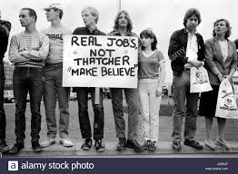
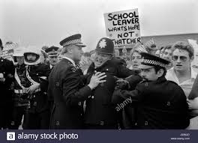
Russell wrote Blood Brothers in 1981, and it was first performed as a musical in 1983. This was during the period that Conservative Prime Minister Margaret Thatcher was in power. There was very high unemployment during this time, particularly in industrial working-class areas in northern England, such as Liverpool - where Russell is from and where the play is set. Mickey and his family represent the working classes, who were badly affected by the economic downturn, whereas Edward and the Lyons family embody the middle classes, who thrived in the 1980s.
A reminder, the play is set in 1960s-70s, but written in 1983.

Slide 11
Willy Russell's aims
One of the playwright’s aims is to show us that there are disadvantages to being poor and working class. The failure to succeed in life is not because of a lack of ability, but a lack of opportunity. This can clearly be seen in Edward and Mickey. We must ask ourselves whether this is still true in the 21st century.

Slide 12
How is the theme of social class and inequality shown in the play? (5 minutes)
In Blood Brothers, Russell explores social class through:
Mrs Lyons’ manipulation of Mrs Johnstone.
The differences between the twins’ childhoods.
Mickey’s difficult adult life in contrast to Edward’s privileged existence.

Slide 13
Clear example of the class system
Mickey and Edward as children .When they first meet at the age of seven, Mickey and Edward are completely different.
Evidence
EDWARD
Fantastic. When I get home I’ll look it up in the dictionary.
MICKEY
In the what?
EDWARD
The dictionary. Don’t you know what a dictionary is?
MICKEY
‘Course I do … It’s a, it’s a thingy, innit?
Analysis
The way that the boys speak is very different, which reflects their backgrounds. While Mickey uses swearwords which Edward has not heard before, Edward is shown to be better educated. Russell indicates to the audience that social class can have a significant impact on the levels of education for children, giving them different starting points in life.

Slide 14
How does this short extract highlight the contrasts in the class system? (Spend five minutes with your analysis)
When Mickey loses his job, he is unable to support his family but has no support or options available to him, which Edward doesn’t understand.
Evidence
EDWARD
Why... why is a job so important? If I couldn’t get a job I’d just say, sod it and draw the dole, live like a bohemian, tilt my hat to the world and say ‘screw you’. So you’re not working. Why is it so important?
MICKEY
[Looking at him]: You don’t understand anythin’, do ye? I don’t wear a hat that I could tilt at the world.

Slide 15
Model answer
Due to Edward’s privileged background, he is unable to understand the difficulties that Mickey has being unemployed. Mickey has nothing to fall back on and Edward will never be in that position because of the support he gets from his family. This demonstrates the lack of understanding the higher classes can have of the desperation of unemployment for the working classes.

Slide 16
Plenary
When Mickey finds out that he and Edward are twins, he is jealous of the opportunities that Edward has (and he missed out on).
"I could have been him!"
What is Willy Russell trying to tell his audience here?
Once completed hand all your work in, either through Microsoft or picture of your handwritten work.

Slide 17
Learning Outcomes (Lesson 3)
To understand the contrasting lifestyle of Eddie and Mickey
To develop your understanding of themes within Blood Brothers
To analyse the use of vocal and physical skills to play specific characters.
Starter
Click the link to start the BBC Bitesize quiz on the plot of Blood Brothers.
Let me know your scores on the chat and make a note of any answers you got wrong. The lesson will be delivered after the first ten minutes.
Themes quiz

Slide 18
Mickey and Edward
Answer the questions below as the characters of Mickey and Eddie. Answer as the character a month before the characters both die. (Remember to think about their class divide and use formal and informal language to challenge you work.) Spend 15 minutes on this activity. Maybe someone will be confident enough to perform their responses.
What was your childhood like?
What was your education like?
Have you been given any opportunities in life? Explain what they are.
What do you wish for the future?
What is your one regret in life?

Slide 19
List five vocal skills and five physical skills in two minutes.
Pace –Can show how someone is feeling.
Tone
Clarity-Can highlight class system
Volume-How confident or not someone is
Pitch - How happy or upset someone is.
Eye contact – Prolonged eye contact for anger.
Posture – Hunched over to show annoyance.
Pause/stillness - Showing a significant moment.
Body language – How open you are could show confidence.
Facial expressions – Clear emotions are shown.
Gestures - Clenched fists.

Slide 20
This scene is in act two when Eddie has just arrived back home after his time at university.
Take five minutes to read the scene and then we will look at an exam based question.

Slide 21
Now spend five minutes making notes on the difference between Eddie and Mickey in this scene.
Things to consider:
How are they feeling in this scene?
What are their motivations in this scene?
How have they got to this stage in their lives?
How does the class system play into what has happened to each of these characters?

Slide 22
Exam question
You are performing the role of Mickey.
Describe how you would use your vocal and physical skills to perform the line below and explain the effect you want to create.
"In your shoes I'd be the same, I'd still be able to be a kid. But I'm not in your shoes, I'm in these, lookin' at you. An' you make me sick..."
(8 marks)
Things to consider.
Spend at least ten to fifteen minutes on this question.
Give at least two examples on vocal skills and two examples for physical skills.
Ensure you clearly describe what you would do with you acting choices.
Justify your decisions.
State what effect these decisions will have on the audiences understanding of Mickey at this moment.

Slide 23
Complete your work on a Word document, or you can complete it on pen and paper as long as you can take a photo of it at the end of the lesson.
Please ensure you turn in your work via this assignment at the end of the lesson. You will need to attach your work as a Word document, or as a photo if you completed it on pen and paper. If you are not sure how to hand in and attach your work, watch this video: https://youtu.be/Re3ejPVvA8E
All pupils are expected to attend the live lesson and complete and hand in this work. Teachers will check to ensure this has been done and your parent/carer will be contacted if work is missing or not completed to a good quality.

Slide 24
Learning Outcomes (Lesson 4)
To develop costume designs for Blood Brothers
To examine the use of costume design to highlight character
To adapt these skills into an appropriate exam answer
After watching the clip to remind you of costume design, write a paragraph about what the role of a costume designer is.
Challenge: Create a job description for a director looking for a costume designer for a production of Blood Brothers.

Slide 25
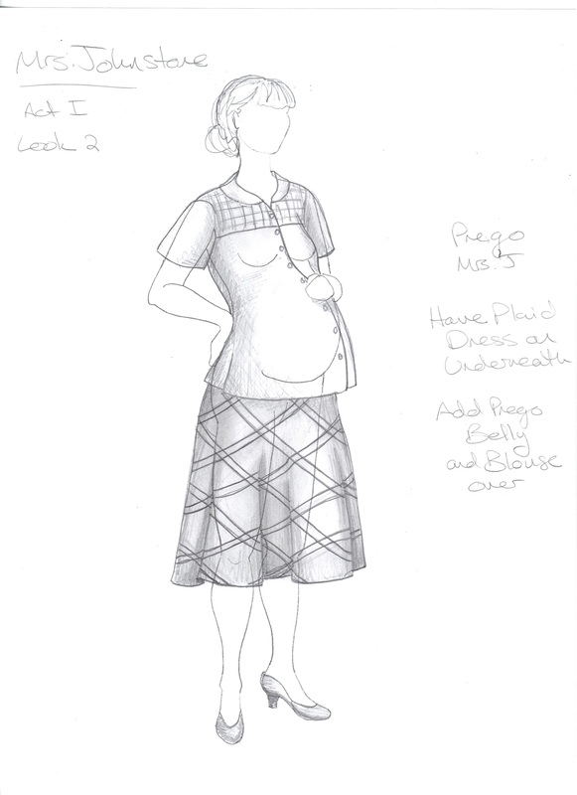
Costume design - List down what aspects of costume you have to consider for a play. (Two minutes)
Colours-Can include symbolism
Materials-Materials that show the class system
Fit – Baggy clothes may mean that the clothes are hand me downs
Condition – May represent someone's wealth
Hair and makes up can be discussed, I,e, pig-tails for innocence, gel being used if they could afford it,.

Slide 26
Popular materials in the 70s
Denim was very popular in the 70's and into the 80's and affordable
Who may have worn this style of material?

Slide 27
Cheesecloth
Lightweight and made from cotton.
More fashionable and cheaper due to it being made from cotton.
Who may have had an outfit like this?

Slide 28
Corduroy trousers/dresses
A more expensive material used in the 70's

Slide 29
Crimpeline
Hard wearing material made from nylon and polyester.
Popular in the 60s and the early 70's but then started to fade in appeal.
Who may have been wearing this in the 70's?

Slide 30
Why might Mrs Johnstone wear this dress throughout the whole play? What could be added to this base costume throughout the play to show different parts of her life? What might the materials be for these costumes? What does the condition and fit tells is about the characters?

Slide 32
Mickey Act 2 - Discussion
What does this costume design tell us about Mickey?
Why has the costume designer made these decisions?
What materials maybe used? Why?
What colours would you give this costume? Why?

Slide 33
Things to consider:
Firstly clear describe how you would design the costumes for the characters in the scene I.e. Materials, fit, condition, colour.
Then analyse why your ideas are appropriate to the extract.
Then link your designs to the rest of the play. How do the ideas link to the whole play? Give examples of what would be changed to the costumes for other parts of the play and why they are still appropriate
Exam question (20 minutes)
You are a designer working on one aspect of design for this extract. (COSTUME)
Describe how you would use your design skills to create effects which support the action of this extract and explain why your ideas are appropriate both for this extract and the play as a whole. (20 marks)

Slide 34
Exam based question (10 minutes)
You are designing a costume for Mrs Johnstone. (The scene will take place when Mrs Johnstone is working for Mrs Lyons as her cleaner)
The costume must reflect the context of Blood Brothers, set in a working-class community in and around the 1960s. Describe your design ideas for the design. (4 marks are awarded for this question)
The scene you are refering to is the first two scenes where Mrs Johnstone is working for Mrs Lyons.
Consider:
Giving four design elements with a clear description.
Material
Colour
Fitting
Condition
You can draw the design and annotate your design.

Slide 35
Complete your work on a Word document, or you can complete it on pen and paper as long as you can take a photo of it at the end of the lesson.
Please ensure you turn in your work via this assignment at the end of the lesson. You will need to attach your work as a Word document, or as a photo if you completed it on pen and paper. If you are not sure how to hand in and attach your work, watch this video: https://youtu.be/Re3ejPVvA8E
All pupils are expected to attend the live lesson and complete and hand in this work. Teachers will check to ensure this has been done and your parent/carer will be contacted if work is missing or not completed to a good quality.

Slide 36
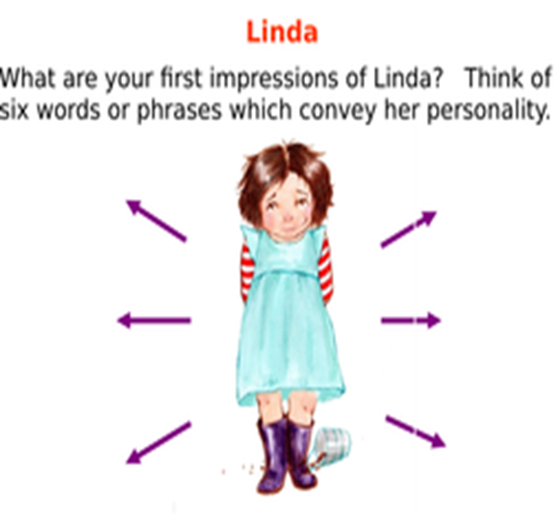
Learning Outcomes (Lesson 4)
To develop your understanding of Linda
To examine the use of design skills to highlight Lindas character throughout the play
To adapt these skills into an appropriate exam answer
Starter for year 11 period 4 – Respond to your feedback from your lesson on playing Mickey last tuesday the 19th.
Activity 1First ten minutes of the lesson)
Create a spidergram, PowerPoint, or detailed description of who Linda is in Blood Brothers.
Things to include:
What happens to her throughout the play?
How her feelings towards Mickey and Eddie change and why?
Why is she a significant character within the play?
What theme of the play effects Linda the most? Justify your answer.
CHALLENGE – Use quotes to support your answer.

Slide 37
Linda's relationship with Mickey and Eddie (10 MINUTES)
1. List three significant moments that happen between Mickey and Linda.
2. List three significant moments between Eddie and Linda.
3. Describe the change in Linda at three points in the play

Slide 38
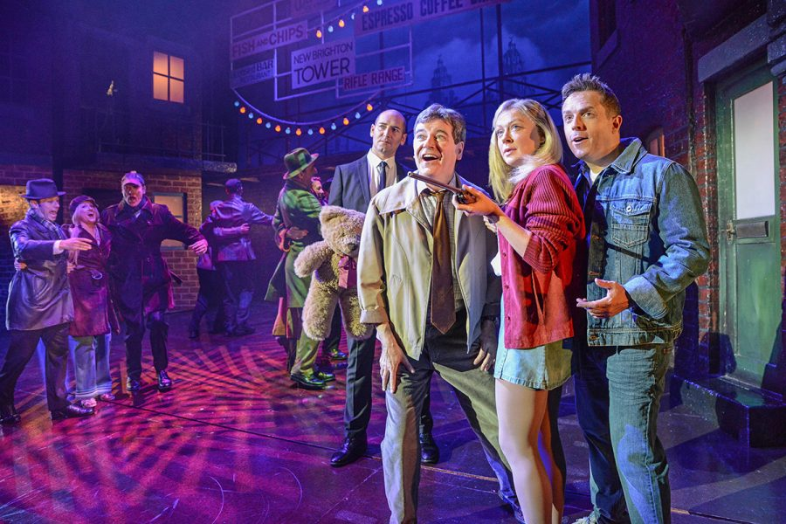
Costume design
Blood Brothers is set over twenty years so the costumes should change to show how the character develops throughout the play.
Take 15 minutes to draw 3 costume designs for Linda at three various points of the play.
Think about:
Material
Colour (symbolism)
Fitting
Relevance to the time period
Age appropriate

Slide 39
Complete your work on a Word document, or you can complete it on pen and paper as long as you can take a photo of it at the end of the lesson.
Please ensure you turn in your work via this assignment at the end of the lesson. You will need to attach your work as a Word document, or as a photo if you completed it on pen and paper. If you are not sure how to hand in and attach your work, watch this video: https://youtu.be/Re3ejPVvA8E
All pupils are expected to attend the live lesson and complete and hand in this work. Teachers will check to ensure this has been done and your parent/carer will be contacted if work is missing or not completed to a good quality.

Slide 40
Learning Outcomes
To understand the purpose of set design
To apply a clear set design to Blood Brothers
To analyse the set design for Blood Brothers
Starter
Click the link to start the BBC Bitesize quiz on the costume design.
Let me know your scores on the chat and make a note of any answers you got wrong.
Costume starter quiz

Slide 41
Set design
What is the role of a set designer?
What does the set designer have to consider when creating the visual world of the play?
Who does the set designer discuss with when creating her initial ideas?
(10 minutes)

Slide 42
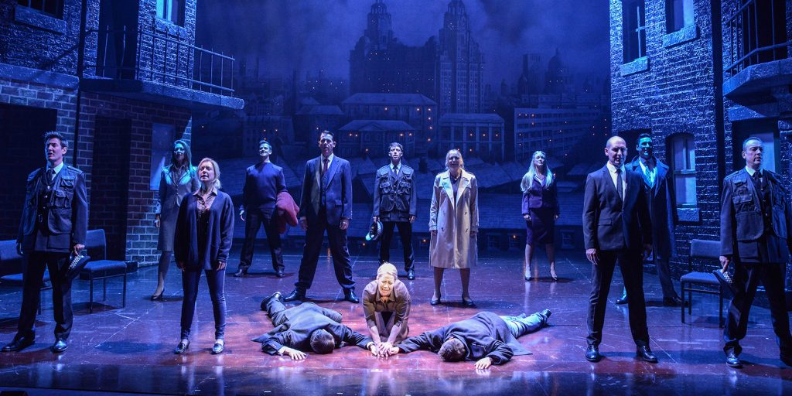
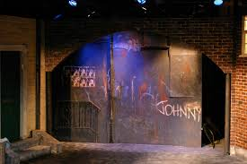
Backdrop of Liverpool
(The Liver Building)
Flats that are used for walls that has visible graffiti
Balcony
Flat that is used for a door
Stage furniture
Truck –This can be stored backstage and wheeled on

Slide 43
Things to consider with set design
Clearly show where the action is being shown
Conveying period of time (Retro furniture. Yellow and brown were popular in the 70s)
Communicate themes or symbols (Class system, violence, superstition.
Support the style of the performance (Minimilism/naturalism/abstract)
Appropriate colours for the time period.
The condition of the set.
How practical your set design is/scale
Textures
Transitions
Set dressings
Exits and entrances
Trap door

Slide 44
What type of set?
Traditional - (See the picture to the right)
Projections
Levels (Using bocks or scaffolding)
Flats

Slide 45
Analyse and evaluate the set
(Spend twenty minutes completing the activities below)
Describe the set design to someone who cannot see it
How does the set design link to some of the themes of the play?
What is the strongest aspect of the set design and why?
Evaluate the impact the set has on the audience

Slide 46
Exam question
You are a set designer for Blood Brothers.
Create a set design for the scene where Mickey first meets Eddie
Your set design must reflect the era in which the play is based.
Things to consider:
What colours will you use?
What type of backdrop will you use?
Will you use flat? What will the flats be used for?
Will the set design be realistic? Why?

Slide 47
Complete your work on a Word document, or you can complete it on pen and paper as long as you can take a photo of it at the end of the lesson.
Please ensure you turn in your work via this assignment at the end of the lesson. You will need to attach your work as a Word document, or as a photo if you completed it on pen and paper. If you are not sure how to hand in and attach your work, watch this video: https://youtu.be/Re3ejPVvA8E
All pupils are expected to attend the live lesson and complete and hand in this work. Teachers will check to ensure this has been done and your parent/carer will be contacted if work is missing or not completed to a good quality.

Slide 48
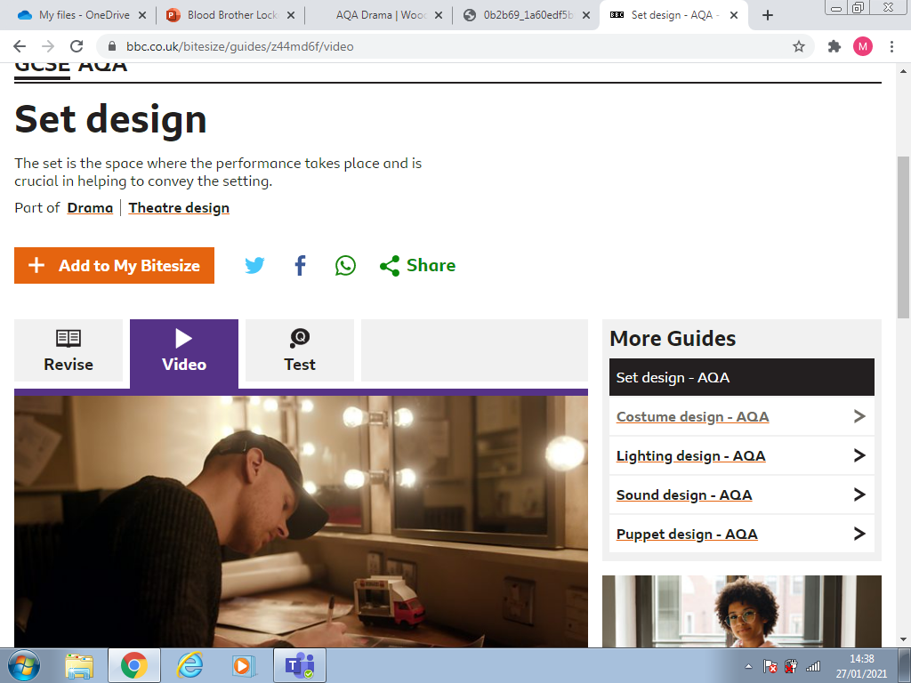
Starter
Revision and quiz link
Click the link to the revisions for set design and then complete the quiz.
You have ten minutes to complete this. If you finish then please watch the clip.

Slide 49
Learning outcome
5 minutes discussion
What do different colours represent?
What type of lights can you use in the theatre?
Where may you use a spotlight? Justify your decision
To understand lighting key vocabulary
To apply lighting design to the context of Blood Brothers
To analyse the use of lighting design to a specific scene in Blood Brothers.

Slide 50
Types of lighting
Spotlight – Can identify a particular spot within the stage. You can add colored gels to create intention.
GOBO – Projects silhouettes to the wall or floor. This can help people understand where the scene may be set.
Flood - This will light up the whole stage. This is great for scenes with lots of people on the stage. A straw shade of lighting is used here to make it appear like day or inside a well lit room.
LED – Light that can change colour without any gels being used.
Fresnel – A generic lights that can help light up different parts of the stage. Very popular use of lighting to add gels to.

Slide 51
Send 15 minutes identifying different scenes that you could consider for each of these categories, I.e. when Eddie returns from University he says Merry Christmas to Mickey. This means it is winter and you can develop a lighting design for this scene.
You need one for
Seasons
Atmosphere
Marking the moment
Use of a blackout
A clear time of day
Challenge - where might you use shadows to create effect and use quotes to support your responses.

Slide 52
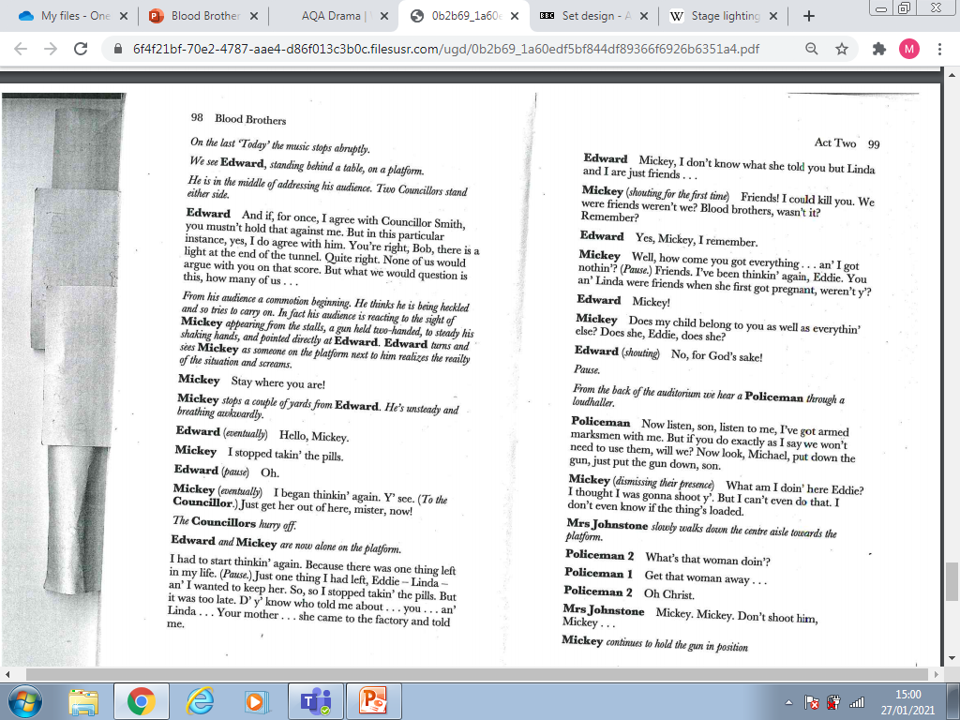
Read the script and the respond to the activity on slide 46

Slide 53
You are designing the lights for this extract
The lighting design must reflect the context of Blood Brothers, set in a working-class community in and around the 1960s. Describe your design ideas for the design. (4 marks are awarded for this question)​
Spend the remainder of the lesson completing the 4 mark question.

Slide 54
Re-read the script and make notes on the motivation of Eddie and Mickey in this scene (10 minutes)

Slide 55
Once you have read the script makes notes on:
The characters motivations within this scene?
How are the characters feeling?
What has happened to these characters to lead to this dramatic moment?

Slide 56
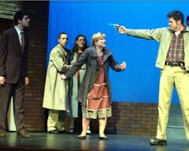
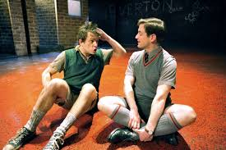
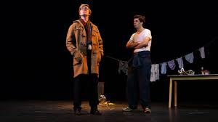
Mickey
As the Narrator of Blood Brothers I would like you to spend 10 minutes writing dialogue for the character. The Narrator will be telling the audiences about Mickeys life, his trials and tribulations, and how he has changed over the years.
CHALLENGE – Write it in the style used by Willy Russell, I.e. in verse.

Slide 57
Checklist:
Use key vocabulary to for vocal and physical skills.
Describe your intentions clearly.
Make reference to certain lines within the extract.
Always justify your reasons and state what it will tell the audience.
You must refer to other parts of the play, this may be to show a contrast in how he would be played when he is younger and happier, or how his relationship with Eddie has changed throughout the performance.
Structure
Paragraph describing your acting choices
Paragraph justifying your decisions and making notes on the impact on the audience.
At least two paragraphs and how this is appropriate for the play as a whole.
Exam question
You are playing the role of Mickey for this extract.
Describe how you would use your performance skills to create effects which support the action of this extract and explain why your ideas are appropriate both for this extract and the play as a whole. (20 marks)

Slide 58
Starter - Whose props do these belong to?! Explain your answer and tell me what theme the props are link to. Can you find anything in your house that would be a good prop?

Slide 59
Blood Brothers in action
To identify design element used in Blood Brothers
To analyse the use of design and acting elements
To evaluate the use of design elements.
This week you will be watching Blood Brothers to give you a clear sense of how you could design this play.
The acting will also show you different approaches to the characters.
You must makes notes on:
ALL design elements and analyse what the design tell the audience and how it links to the themes of the play. What impact/effect do these have on the audience?
HOW do the actors use vocal skills and physical skills to show the characters paths from young and innocent to adults facing difficult decisions.
Challenge – Evaluate the performance. What was a strong design element and explain your decisions? How could this have been improved on? Are there and parts of the play that are not successful? Why? How could you have made this stronger?

Slide 60
Complete your work on a Word document, or you can complete it on pen and paper as long as you can take a photo of it at the end of the lesson.
Please ensure you turn in your work via this assignment at the end of the lesson. You will need to attach your work as a Word document, or as a photo if you completed it on pen and paper. If you are not sure how to hand in and attach your work, watch this video: https://youtu.be/Re3ejPVvA8E
All pupils are expected to attend the live lesson and complete and hand in this work. Teachers will check to ensure this has been done and your parent/carer will be contacted if work is missing or not completed to a good quality.

Slide 61
Starter - What is the odd one out
Violence – Class system – Superstition – Power
Liverpool – Willy Russell – Tony Blair – Poverty
Mrs Johnstone – Mrs Lyons – Judge – Mr Lyons
Proscenium – Thrust – Traverse – Theatre in the around
Pitch – Pace – Volume – Clarity – Dictation -
Mickey – Sammy – Edward – Mr Lyons
Costume designer – Director – Performer – Theatre manager
Walking under a ladder – Shoes on the table – Meeting a long lost twin – Having more money than others
Cotton – Leather – Wool - Silk
Make sure that you highlight why you have chosen the odd one out.

Slide 62
Blood Brothers in action lesson 2
To identify design element used in Blood Brothers
To analyse the use of design and acting elements
To evaluate the use of design elements.
SOME STUDENTS CAN USE THIS TIME TO WORK ON COURSEWORK. INDIVIDUAL EMAIL HAVE BEEN SENT.
This week you will be watching Blood Brothers to give you a clear sense of how you could design this play.
The acting will also show you different approaches to the characters.
You must makes notes on:
ALL design elements and analyse what the design tell the audience and how it links to the themes of the play. What impact/effect do these have on the audience?
HOW do the actors use vocal skills and physical skills to show the characters paths from young and innocent to adults facing difficult decisions.
Challenge – Evaluate the performance. What was a strong design element and explain your decisions? How could this have been improved on? Are there and parts of the play that are not successful? Why? How could you have made this stronger?

Slide 63
Complete your work on a Word document, or you can complete it on pen and paper as long as you can take a photo of it at the end of the lesson.
Please ensure you turn in your work via this assignment at the end of the lesson. You will need to attach your work as a Word document, or as a photo if you completed it on pen and paper. If you are not sure how to hand in and attach your work, watch this video: https://youtu.be/Re3ejPVvA8E
All pupils are expected to attend the live lesson and complete and hand in this work. Teachers will check to ensure this has been done and your parent/carer will be contacted if work is missing or not completed to a good quality.

