Slide 1
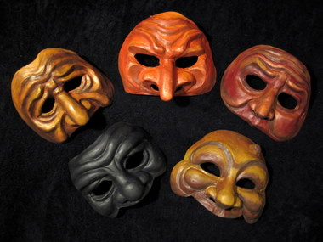
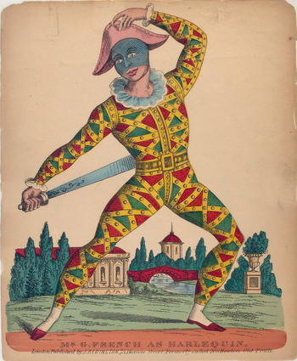
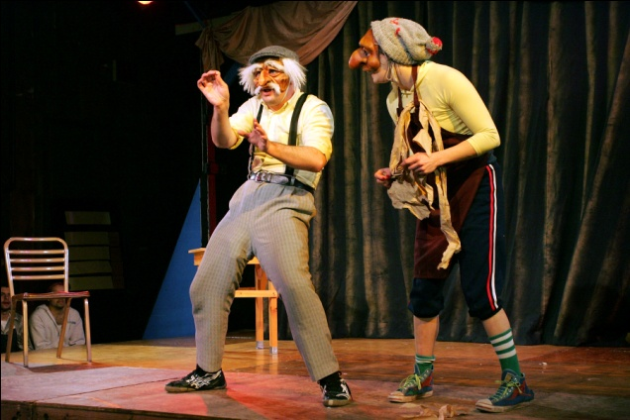
Commedia dell’Arte (Co-May-Dee-Ah dell Art-ay)
Understand how to communicate character without dialogue.
Perform a clear Mime, applying their knowledge of characterisation.
Identify and recommend areas for improvement within performance.
Notes:
Using the break down a good starter could be to get students to guess what the word may mean.

Slide 2
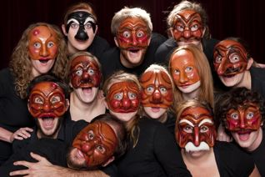
Notes:
So what does it mean? Now they can refine their answers from the first slide.

Slide 3
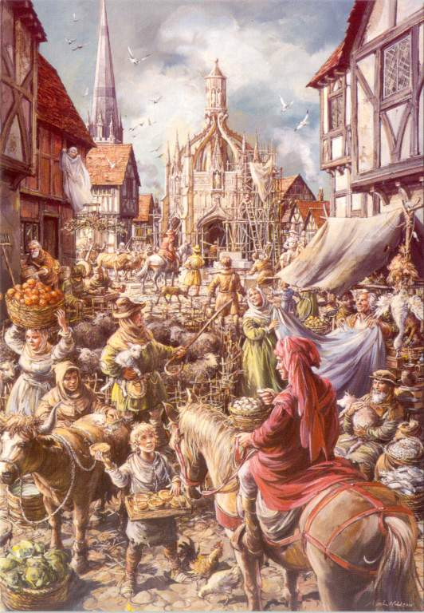
Smells
Sight
Sounds
Notes:
Students can respond to the three senses on white boards then bring this market place to life.

Slide 4
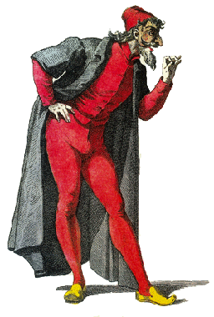
PANTALONE
Pan-tah-lone-ay
Loves money
He thinks he is very intelligent
He tries to woo ladies who are rich and tries to get his daughter to marry someone with money
He is the villain of the Commedia world and never wins
Notes:
Students can discuss who he is and what he likes.
Challenge can be for students to show their interpretation and justify their reasons to the class.
Students can then develop these characters in a workshop environment and then you can show excellent performances and also highlight students that need an improvement.

Slide 5
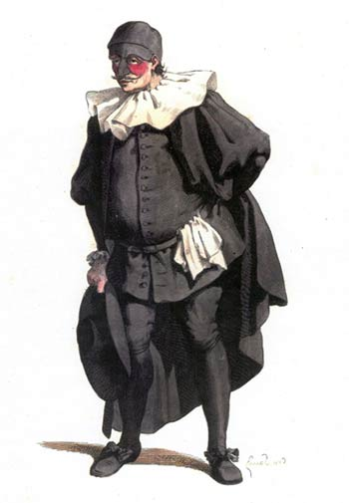
DOTTORE DUH-TOUR-RAY
He is an elderly man who usually has a daughter named Isabella
He uses long words to sound really intelligent
He always thinks that he is right and that everybody else is wrong
He is a doctor

Slide 6
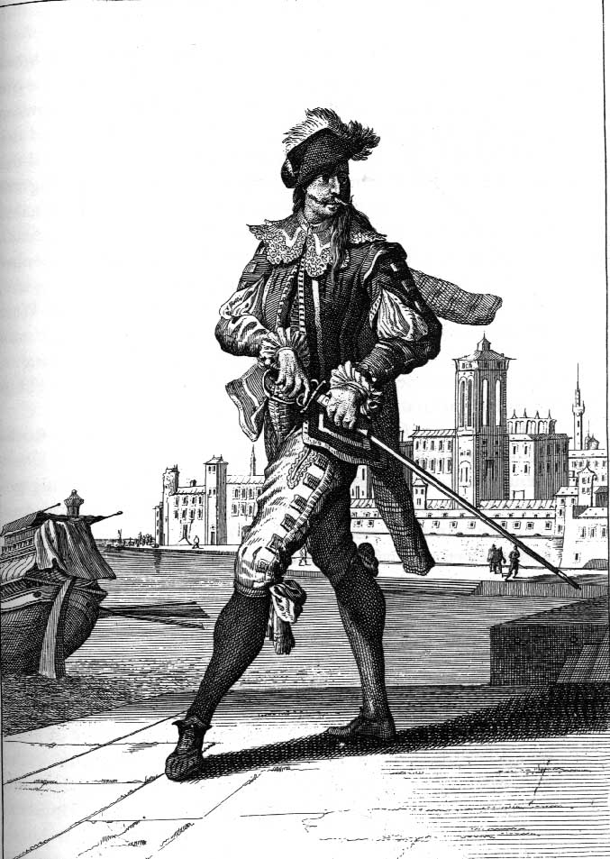
CAPITANO Ca-pe-tah-no
The Captain uses bravado and being manly to impress people
He loves the ladies
He is a coward
He tells tall stories, he lies about how brave he is and what he has done in battle
Notes:
Plenary can be a short improvised scene where audiences have to guess who was who.
Challenge to bring voice into the performance.

