Slide 1
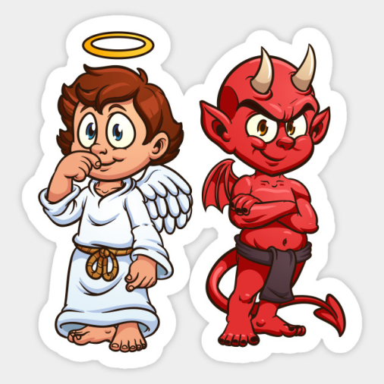
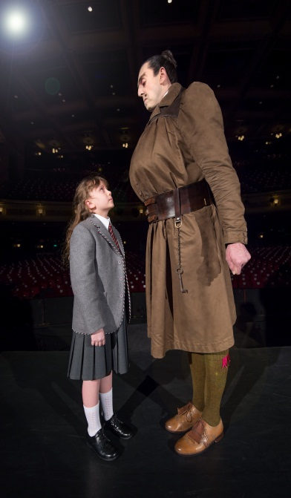


Understand what a duologue is
Apply characters that have contrasting views.
Create a performance showing contrasting characters

