Slide 1


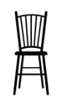

Sound
Set
Design Elements
Lighting

Slide 2






Vocal
Body/Physical
Performance Skills
Levels/Space/Positioning

Slide 3


Body
Gestures
Physical Skills
Movement

Slide 4



Staging
Space
Production
Elements
Costume

Slide 5
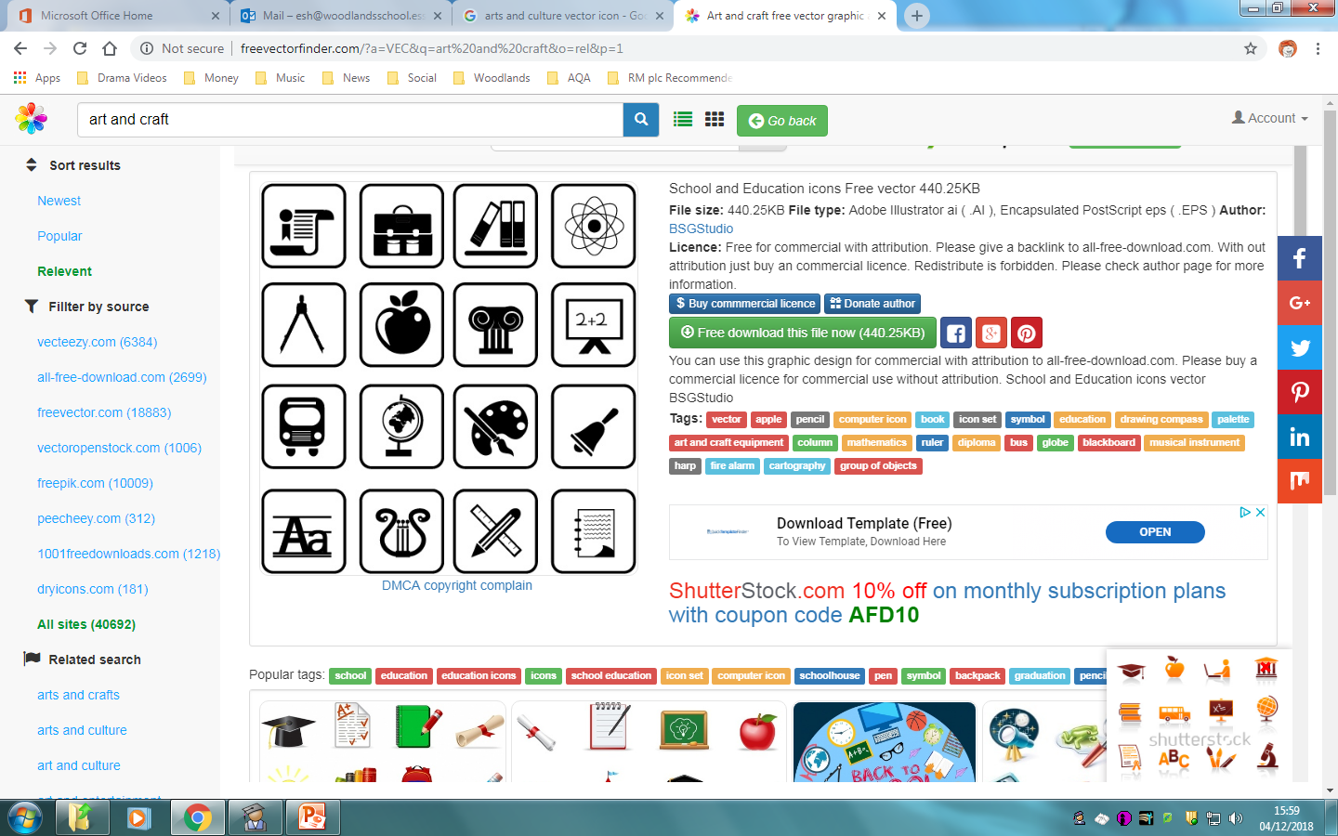
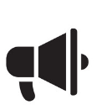


Cultural
Social
Context
(Background to Play)
Historical

Slide 6


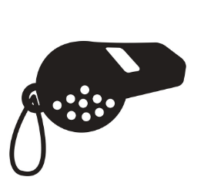
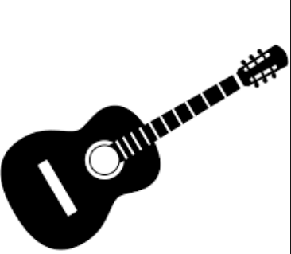



Sound
What?
Volume
Vocals
Live
Recorded
SFX

Slide 7
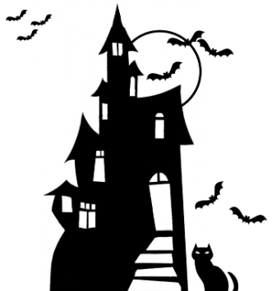
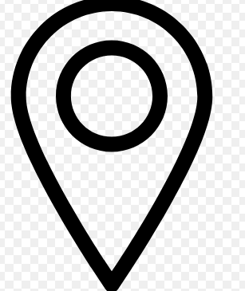
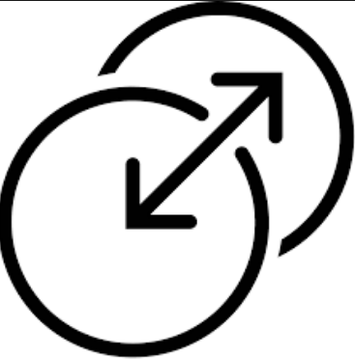
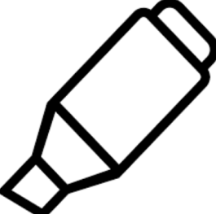
Sound
Why?
Enhance atmosphere
Establish location
Mark the Moment
Scene transition

Slide 8
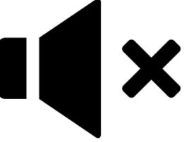
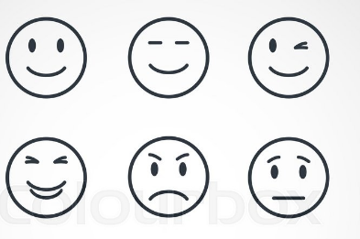
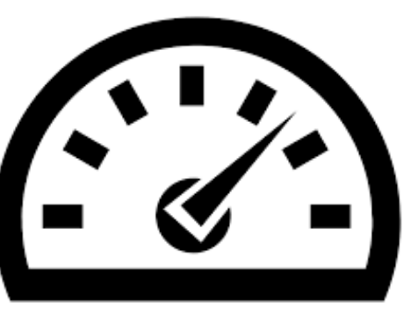
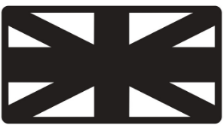
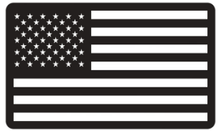
Vocals
Volume
Use of silence
Tone
Pace
Accents

Slide 9

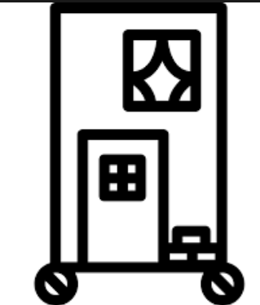
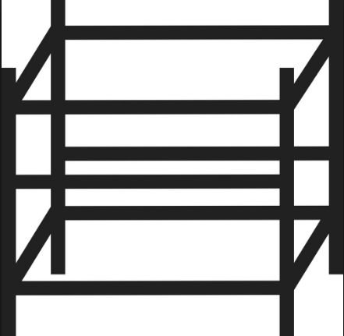


Set
Stage Furniture
Back drops/Flats
Projections
Structures/ Scaffolding
Raised staging/ platforms/Levels/ramps

Slide 10
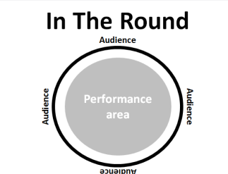

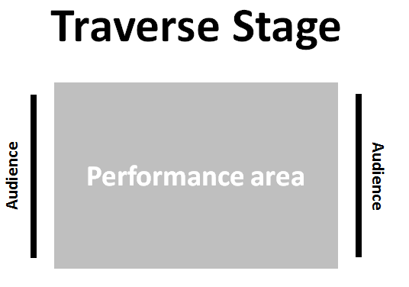

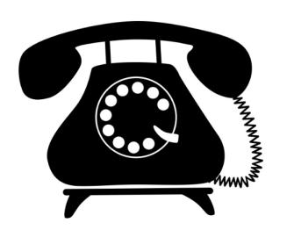

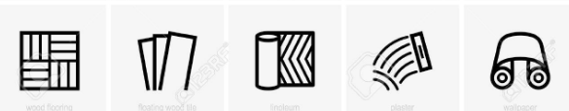
Set
Scale
Stage Configuration
Entrances and Exits
Props
Colours/materials/textures/shape

Slide 11
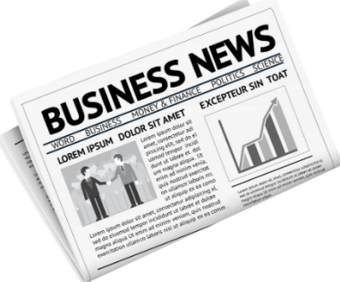
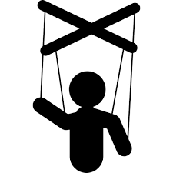

Props
Puppets
Hand held objects

Slide 12
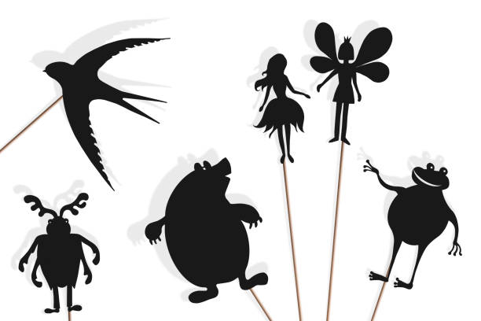
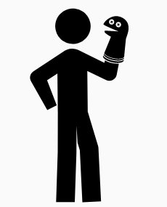

Puppets
Shadow
Hand
Marionette

Slide 13
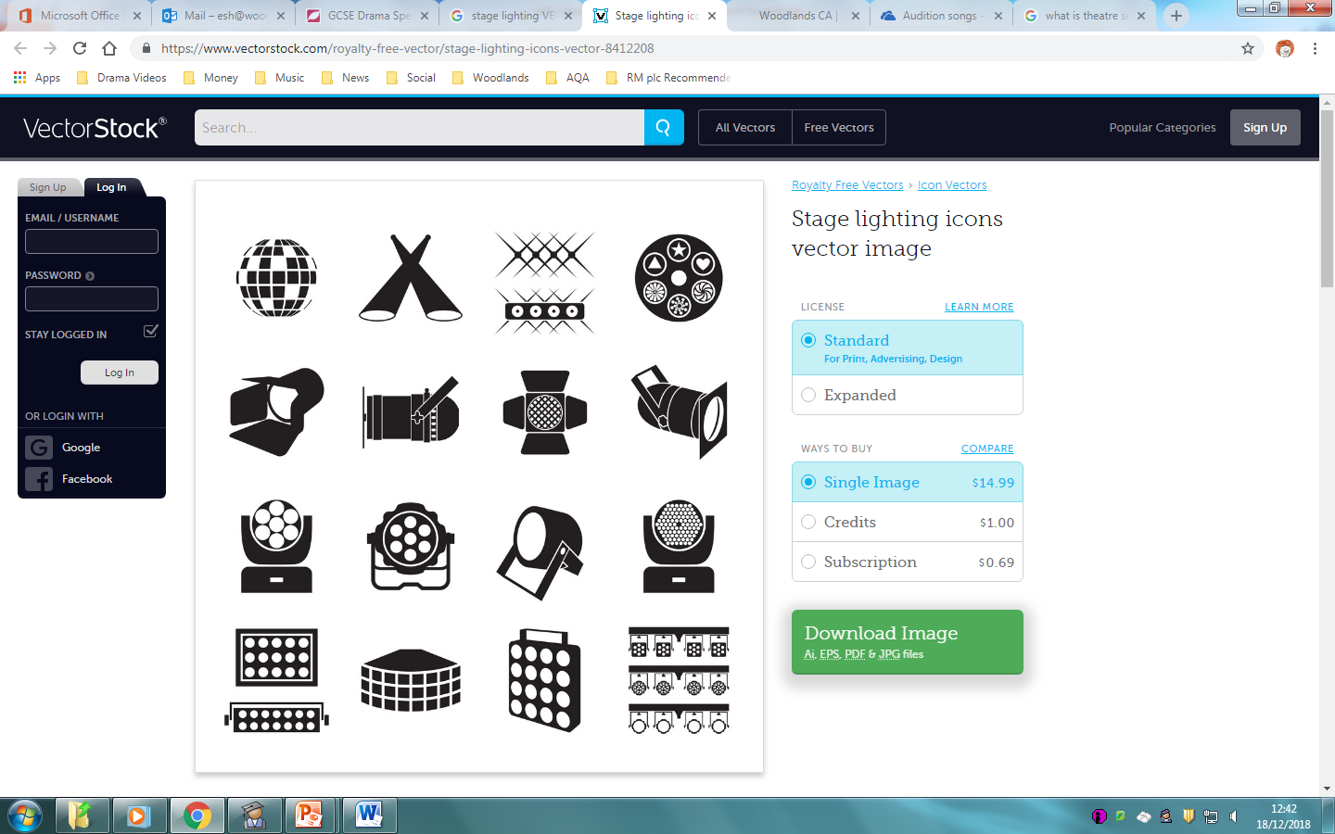
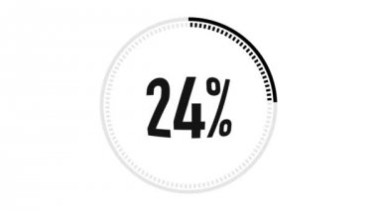
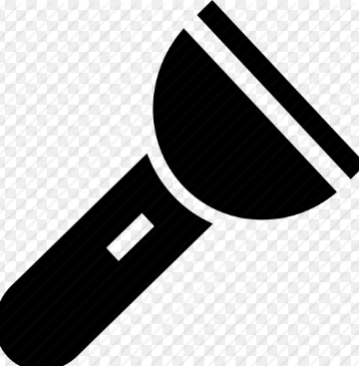


Lighting
What?
Intensity
Type
Colour
Gobos

Slide 14
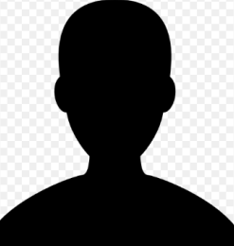
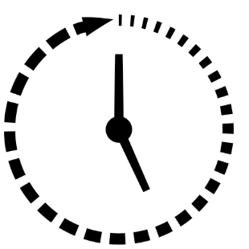
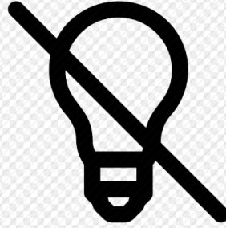
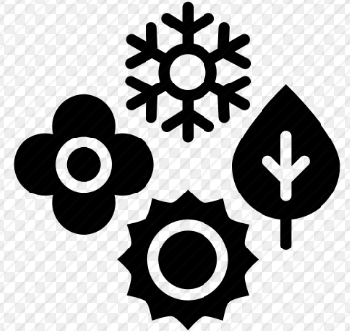

Lighting
Why?
Use of Shadow
Time of Day
Blackouts/fade
Seasons
Atmosphere/
Mood
Mark the Moment

Slide 15
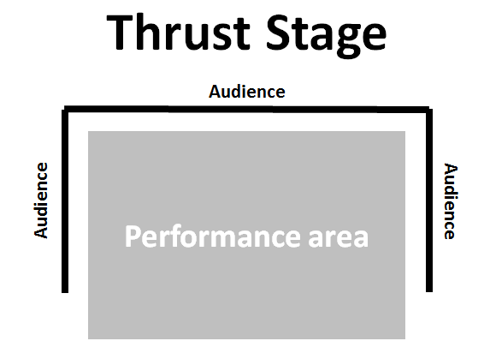
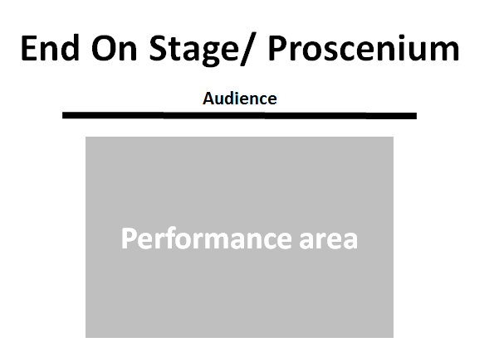
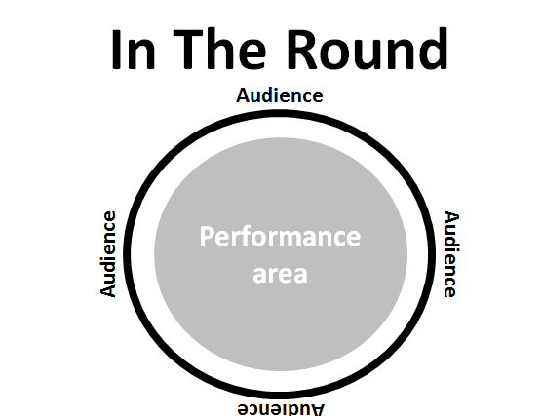
Staging

Slide 16
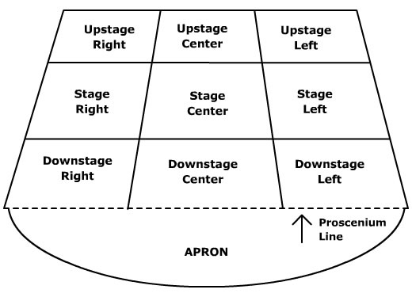
Stage Positioning
AUDIENCE

Slide 17

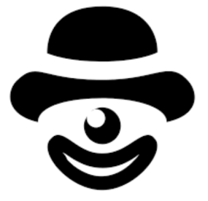
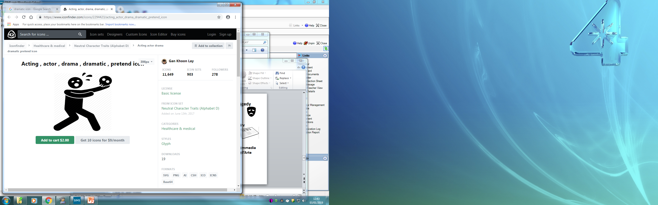
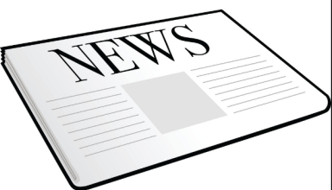
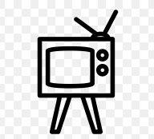

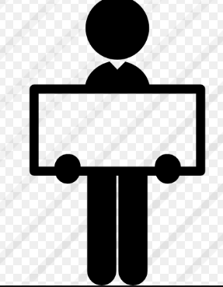
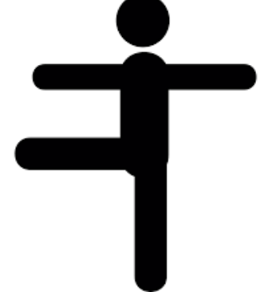
Styles/ Genres
Tragedy
Comedy
Melodrama
Documentary Theatre
Naturalism
Commedia Dell’Arte
Epic Theatre
Physical Theatre

Slide 18
Roles in the Theatre
Technician
Playwright
Performer
Lighting Designer
Understudy
Sound Designer
Puppet Designer
Set Designer
Theatre Manager
Stage Manager
Costume Designer

Slide 19
Style
The way in which something is written or performed.
E.g. The use of naturalistic dialogue or physical theatre movement

Slide 20
Non Naturalistic
Stylised, not realistic

Slide 21
Naturalistic
Life like, realistic, believable.

Slide 22
Abstract
Not realistic. Not Life like.
Instead uses colour, shapes, textures and sounds to achieve an effect.

Slide 23
Stylised
Non realistic, done in a particular manner.
Maybe emphasising one element of the performance

Slide 24
Minimalistic
Simple, using few elements, stripped back.

Slide 25
Symbolic
Using something to represent something else
Red = danger, a dove = peace etc

Slide 26
Genre
A category or type

Slide 27
Melodrama
A performance with exaggerated characters and exciting events

Slide 28
Concept
A unifying idea about the production.
Something that ties everything together

