Slide 1
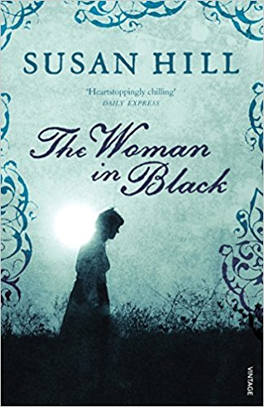
Context
Woman in Black

Slide 2
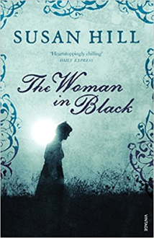
The novel
Looking at both the play and the novel it would be wise to first consider the context of the piece, in both the theatrical and wider literary context. Susan Hill’s novel aimed to write a short ghost story for which there would be no clear explanation, evoking the rules of classical ghost stories by having a humane figure appearing at regular intervals. Hill wanted to keep the gothic tradition firmly in mind throughout, which she achieves due to the setting and isolation of many of the key places, such as Eel Marsh House.

Slide 3
Isolationism, especially within the countryside is a typical setting for a Gothic story, and Hill uses this to her advantage throughout most of her work. The piece achieves recognition as a short story as the suspense is drip fed to the reader for maximum dramatic potential.

