Slide 1
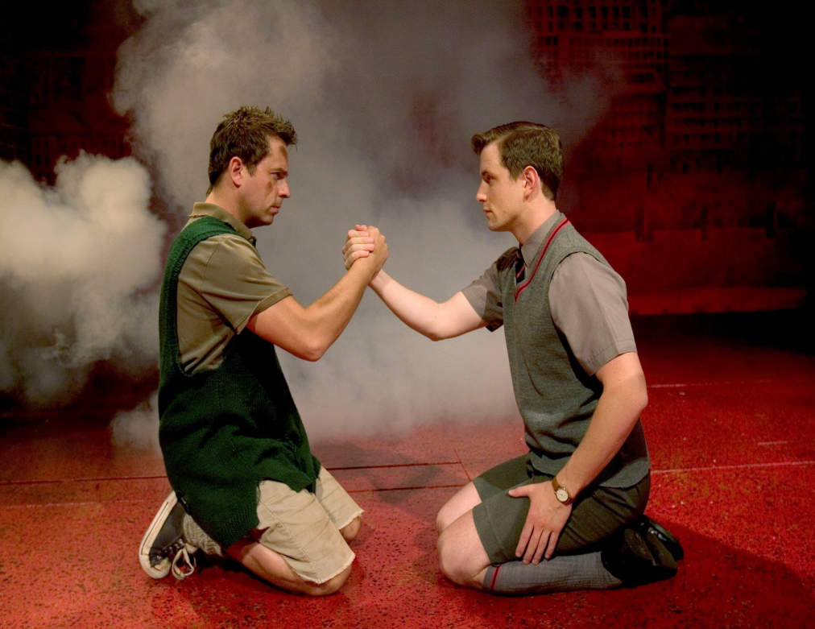
Mickey & Eddie (Children)
Streetwise
“I know loads of swear words.”
Mischievous
Kind
Sheltered
“My mummy doesn’t allow me to play down here actually.”
Non-Academic
“You don’t know. I told y’ two minutes ago!” (Teacher to Mickey)
Educated
“When I get home I’ll look it up in the dictionary.”
Values Loyalty
“This means we’re blood brothers and that we will always have to stand by each other.”
Friendly
“Do you want to come and play?”
Naïve
“Yes, I gave you one for Sammy, remember?”
Deprived
“You’ve not had much of a life with me…”
Middle class
“He’s a friggin poshy”
Common

Slide 2
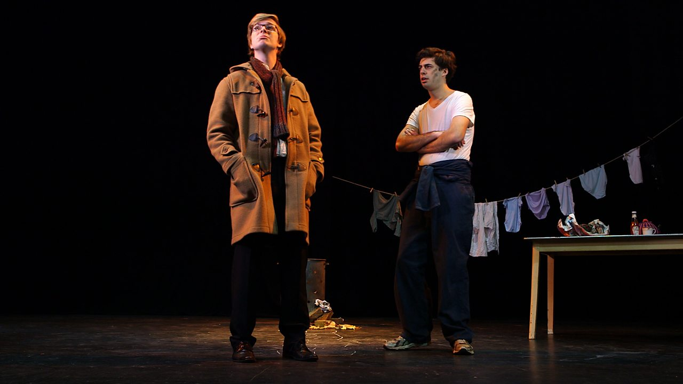
Mickey & Eddie (Adults)
Resentful
“Why didn’t you give me away?”
“…While no one was looking I grew up. A’n you didn’t because you didn’t need to…”
Overwhelmed
“I can’t cope!”
Articulate
“We have been undergoing a
remarkable celluoid experience.”
Disloyal
“Play their part in a light romance.” (Eddie kisses Linda, Mickeys wife)
Generous
“Look, look, money, lots of it, have some…”
Desperate
“The jury found him guilty, sent him down for seven years.” (After being arrested for theft)
Care-free
“If I couldn’t find a job I’d just say sod it and draw the dole, live like a bohemian.”
Unfortunate
“They’ve started layin’ people off..”
Secure
“Why is a job so important?”

Slide 3
Mrs Johnstone
&
Mrs Lyons
Poor
“I’m starvin’ an’ there’s
nothin’ in. There never bloody is!”
Vulnerable
“They said I should put them into care.”
Paranoid
“Wherever I go you’ll be just behind me.”
Wealthy
“I’m talking about thousands if you want it?”
Manipulative
“They say that if either twin learns that he once was a pair, they shall both immediately die.”
Discriminated against by class
“Well there’ll be no more bloody warnings from now on.” (Paying back money for things she has brought)
Superior
“(Laughing) Oh…you mean your superstitious?”
Superstitious
“Never put new shoes on a table…You never know what’ll happen.”
Deceitful
“Since the baby arrived she ignore most of her jobs.” (Talking about Mrs Johnstone)
Worn-out
“By the time I was twenty five, I looked like forty-two”
Manipulated
“You swore on the Bible.” (Said by Mrs Lyons)
Protective
“…mixing with boys
like that.”

