Slide 1
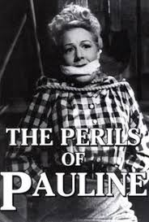
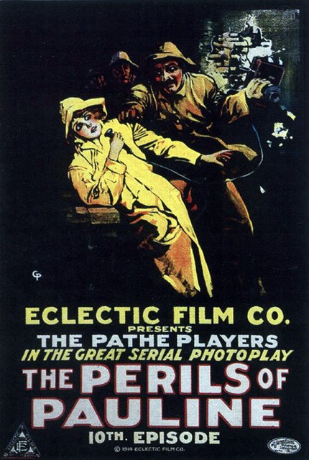
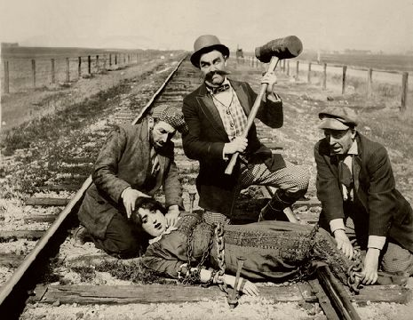
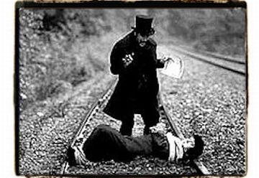
What may the films of Peril of Pauline be about?
http://www.youtube.com/watch?v=FwJKzoKRN8U

Slide 2
Create the right order
Pauline inherits some money as her dad dies.
She is strapped to a train track.
Her uncle finds out and wants to get rid of her so he can get the money.
The uncle tells Pauline that her boyfriend needs help at the train track.
Pauline gets captured by the uncles
henchmen.
The uncle creates a plan, with his
henchmen to get rid of Pauline.

Slide 3
Pauline inherits some money as her dad dies.
Her uncle finds out and wants to get rid of her so that he can have all the money.
The uncle creates a plan with his henchmen to get rid of Pauline.
The uncle tells Pauline that her boyfriend needs help at the train tracks.
Pauline gets captured by the uncles henchmen.
She is strapped to a train track.

Slide 4
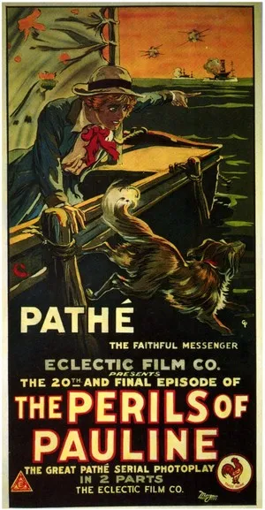
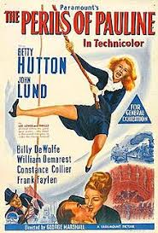
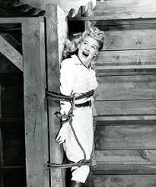
Understand the plot of Perils of Pauline
Apply acting skills to tell the story of the Perils of Pauline
Create a performance with the added element of slapstick comedy.

