Slide 1
Discuss what is happening in the news right now

Slide 2
Todays stimulus is…..

Slide 3
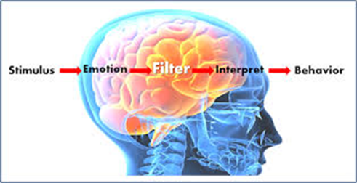
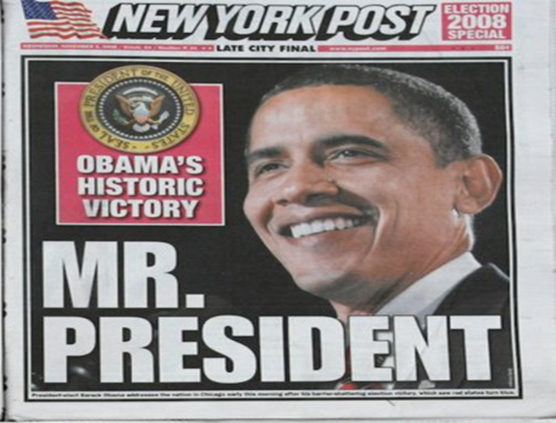
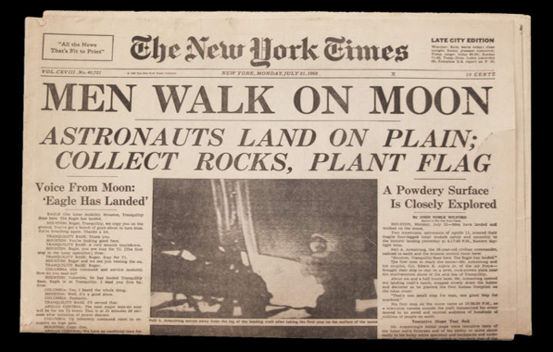
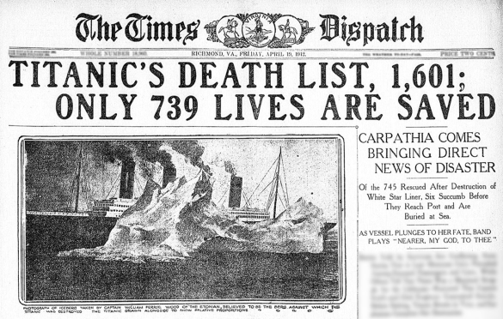
Suggest an idea based on the stimulus given
Apply strategies to tell this headline
Create a performance with a strong theme
THEMES
Good Vs Bad
Love
Power
Achievement
Showing courage

Slide 4
Why is this such an important story?
How will you use strategies to tell this story?
Who else will be in the performance?
Challenge – What are the themes of the headline?

Slide 5
What are the importance things
that happened in this time period?
Who was involved?
Why did this happen?
Challenge: What are the themes of this newspaper headline?

Slide 6
How would it feel to be the first person to do something as big as this?
Why did they do this?
Who might be inspired by these events?
Challenge – What are the themes of this headline?

Slide 7
How were people feeling that night?
Who may have lived to tell their story?
How can you use strategies to show this story?
Challenge: What are the themes of this headline?

