Slide 1
NCFE Level 1 / 2 Technical Award in Performance Skills (603/2960/9) Unit 1 Working in the Performance Industry Session 7 Learning Outcome 2

Slide 2
What we learned last session…
Last session was an assessment session to end Learning Outcome 1

Slide 3
What we’ll learn today…
By the end of the session…
You must be able to…
Identify topics to be explored in LO2
Identify prior knowledge of topics
You should be able to:
Describe topics to be explored in LO2
Describe prior knowledge of topics with some discussion
You could also aim to:
Explain topics to be explored in LO2
Explain prior knowledge of topics with some discussion and enthusiasm

Slide 4
Learning Outcome 2
What will we be assessed on…
LO2 – Understand national organisations related to employment in the performance industry
What do we mean by ‘national organisations’?
There are 3 key topics in LO 2…

Slide 5
LO 2 Topics
Funding Agencies
What do you think their role is?
(2) Unions
What do you think their role is?
(3) Business Organisations
What do you think their role is?

Slide 6
Activity 1: Funding Agencies
5 minutes!
Create a spider chart of possible sources of funding for artists/ projects/ events in performing arts. Work with a partner.
Funding Agencies
Notes:
Mind-map ideas to gain funding/find out what they know – broad /considering all possibilities – arts council, sponsorship, fundraising ideas, funding platforms e.g. Kickstarter/Crowdfunder, private funding, grants, loans etc – Draw out from learners.

Slide 8
Feedback
Where can we get money from for performing arts projects?
Consider who may need funding?

Slide 9
Locally Funded Projects
Consider any events you have attended locally.
Events such as summer music concerts, dance performances, youth drama groups.
How may they have been funded? Did you see any advertising for charities or logos for funding bodies?

Slide 10
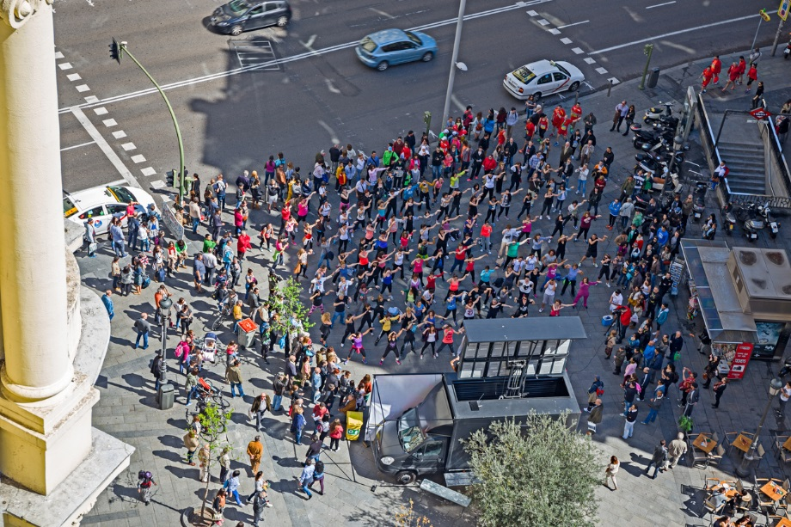
Example of Locally Funded Performing Arts Project
Company: Southpaw Dance Company
The performance was a mass dance spectacular featuring a volunteer cast of 90 performers alongside Southpaw’s professional cast.
Where: It was performed at the opening ceremony of ‘The Word’ in South Shields
About: Wordplay is about using language to take ownership over the fears that limit us from achieving our dreams and aspirations. It examines how language can affect the opportunities we allow ourselves.
This project was funded by the National Lottery
Notes:
http://southpawdancecompany.co.uk/project/wordplay/ (Video Link – WordPlay by Southpaw Dance Co. – to show class as example
Projects benefit the community in some way e.g. 90 volunteers, the idea/concept behind the work etc.

Slide 11
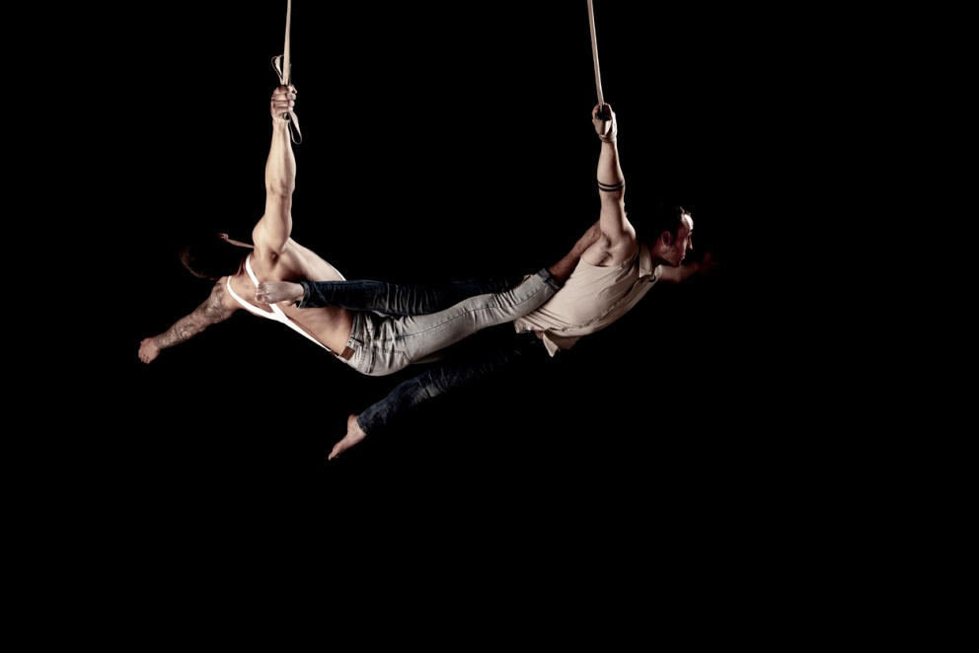
Example Locally Funded Performing Arts Project
Company: Circus Central's 'House of Light’
Where: The performance took place at The North East Institute of Mining and Mechanical Engineers, as part of Juice Festival.
About: 60 people age 6 - 60 were involved in making the 'House of Light' project. Featuring Circus performers, Musicians and Actors.
Funded by National Lottery
Notes:
Benefits all e.g. wide age range 6-60, audience participation, performers from all areas coming together, celebration of the building and architecture where it was performed. Circus artists creating short films during the residency will encourage audience members of all ages to participate. The events features circus shows performed by Five Ring Circus and Circus Central, activities and games, and live music from Holy Moly and the Crackers in the evenings.

Slide 12
Activity 2: Public Funding
8 minutes!
Consider different performing arts events; music events, theatre and dance performances. Complete the table below and write down project ideas that could benefit the community in some way, inspire others and show diversity.
Public Funding Criteria | What project ideas/scenarios could include the following:
Benefit the community
Inspire, challenge and engage
Equality and Diversity
Notes:
Draw links to previous slides 10 & 11 – what did they include in their performances that ‘inspired’ and ‘benefitted the community’ in some way?

Slide 14
Feedback
What project ideas did you come up with for different performing arts events?
How did your idea:
Benefit the community
Inspire others
Show diversity
Have you heard of the Arts Council England?
The Government funds the arts through Arts Council England, the national body for the arts in England.
Is this a public or a private funding body?

Slide 15
Performing Arts Unions
Below are a list of unions within the Performing Arts Industry. These include:
Equity
Musician’s Union
Broadcasting Entertainment Communications and Theatre Union (BECTU)
What is the Aim of a Union?
A unions main aim within the Performing Arts Industry is to help protect and support performing artists in the workplace. They focus upon improving standards and working conditions in the interest of the performer.
Notes:
Discuss how unions are membership-based organisations / cost to join / briefly talk through three unions listed as example & their aims

Slide 16
Activity 3: Unions
5 minutes!
Now that you know the names of some of the unions who support performing artists, including Equity, Musician’s Union, Broadcasting Entertainment Communications and Theatre Union (BECTU).
You should now identify at least 5 points to show how being a member of a union would be beneficial to a performing artist
Unions
Notes:
Why benefit performing artist? They support Fairness of pay - salary, overtime pay, regulated hours of work, working standards / environment, (e.g. Dancers space /floor), health and safety (appropriate technique class, to ensure body and voice is prepared, protected & ready for rehearsals, equality, contracts, breaks/rehearsals,

Slide 18
Feedback
What is a union?
Who can be a member?
What do they do?
Any well known public services in regular dispute with unions?

Slide 19
Activity 4: Business Organisations
5 minutes!
What do we mean by business organisations/ agencies within the performance sector?
Can you give some examples.
Organisations
Notes:
Do they know of any business organisation that support the development of the performing artist as well as the overall product. E.g. record labels, dance companies, theatre companies, booking agencies, management companies.

Slide 21
Feedback
Do you know the names of any business organisations or agencies in the performance industry?
For example Record Label ‘Sony’
Notes:
Discuss ’Business Organisations’ under the 5 areas in criteria: (Record Labels, Theatre Companies, Dance Companies, Booking Agencies & Management Companies: Provide clear examples to reinforce what they do e.g. Record Labels – Sony, Universal, Warner, Theatre companies Northern Stage, Live Theatre, Alphabetti Theatre, Theatre Royal. Dance Companies - Rambert Dance Company, Matthew Bourne – New Adventures, Candoco Dance Company, Dance Agency – Dance City. Booking Agencies – example The Dixon Agency – Band booking and Entertainment agency for live shows, Management Companies: ARC Stockton Arts Centre - supports artists development of work.

Slide 22
During this part of the course…
You will be creating a number of hypothetical examples of ideas and companies for which you will need to be creative.
We will be having a Dragons Den day where you will present ideas to your peers in a bid for funding.
We will look at the internal structure of business organisations including booking agents, record labels and management companies.

Slide 23
What did you learn?
Can you now…
Identify topics to be explored in LO2
Identify prior knowledge of topics
Can you also…
Describe topics to be explored in LO2
Describe prior knowledge of topics with some discussion
You may also be able to…
Explain topics to be explored in LO2
Explain prior knowledge of topics with some discussion and enthusiasm

Slide 24
Homework
Unions: Equity, Musicians Union and Broadcasting Entertainment Communications and Theatre Union (BECTU)
Select 1 of the unions above and research into 1 of their campaigns. These campaigns could include tackling better salary/pay, improving work conditions or campaigning for equal opportunities. Find an example of a campaign where any of the 3 main trade unions were involved.
What union have you researched into?
What is the focus of the campaign?
What do they plan to do to overcome issue?
In what way will the campaign improve working conditions for those currently working in the industry?
Any quotations or articles to support your findings will help.
Notes:
Below are links which lead direct to campaigns by Unions
Equity: https://www.equity.org.uk/getting-involved/campaigns/
Musicians Unions: https://www.musiciansunion.org.uk/Campaign
BECTU: https://www.bectu.org.uk/get-involved/campaigns/live-events-network

Slide 25
Next session…
We will look in to performers unions.
We will specifically explore…
Who are they?
Who uses them?
When they are needed?
What do they do?

