Slide 1
Monologues
To understand what a monologue is
To understand why monologues are used in a performance
To develop and write your own monologue
To evaluate your monologue and character development

Slide 2
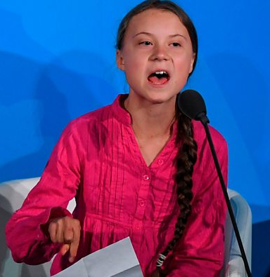
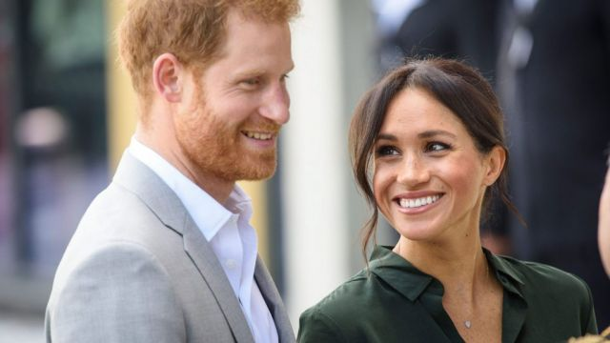
You will need to create a character and write a monologue as that character…!
The character can be famous/fictional/superhero/from your own imagination! Whomever you choose – you must have something interesting to say as that character…!

Slide 3
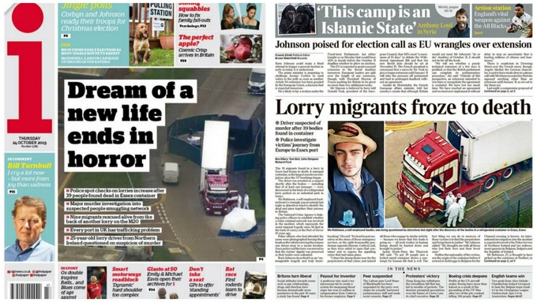
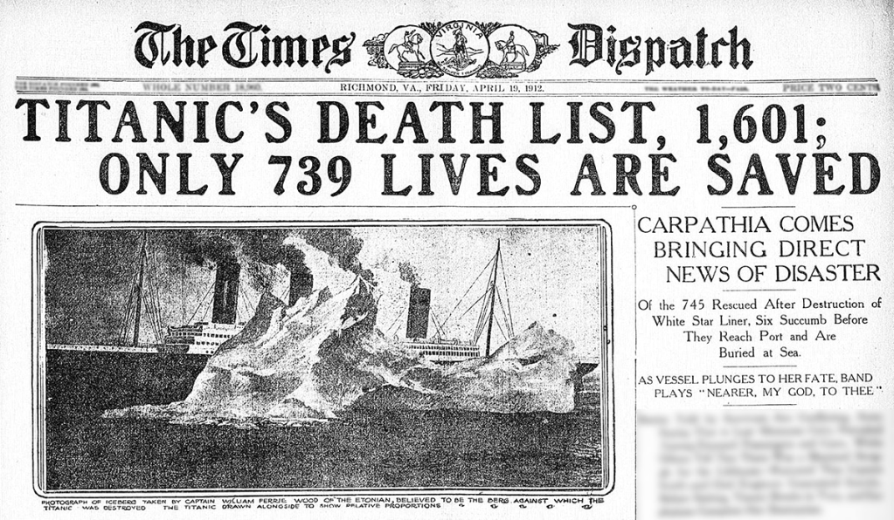
…Or your character could be based on a real life event……

Slide 4
Monologues
Before you start planning on the sheet….you need to think about WHY your character has a monologue.
What is your character’s motivation or intention?
A monologue could:
Give NEW information to the audience
Give a different perspective on an event
Change the audience’s opinion on something

Slide 5
A couple of things to think about…
What event(s) have happened just before your character performs their monologue?
What might happen after the monologue?
Who is your character to speaking to? (The audience/Police interview/ press conference/ diary entry/ vlog etc etc)

Slide 6
You only have 100 words!
Make every word count!
Remember: First person – I/me/we

