Slide 1
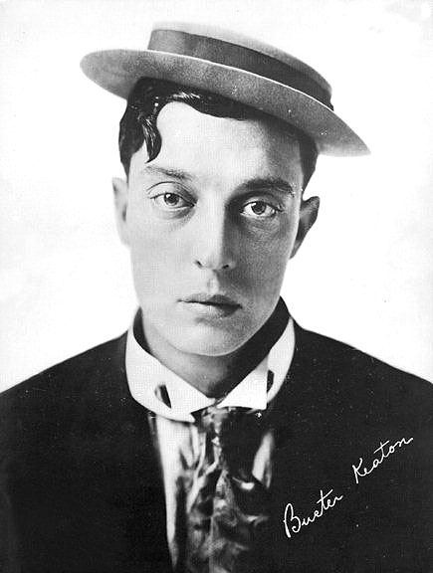
BUSTER KEATON
https://www.youtube.com/watch?v=JRXkAhMYKEc
Notes:
Watch the chase towards the end of the film

Slide 2
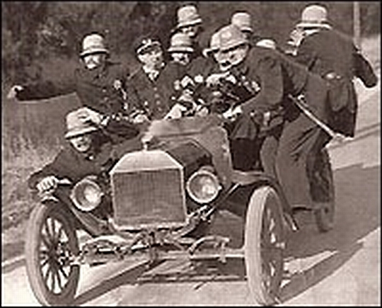
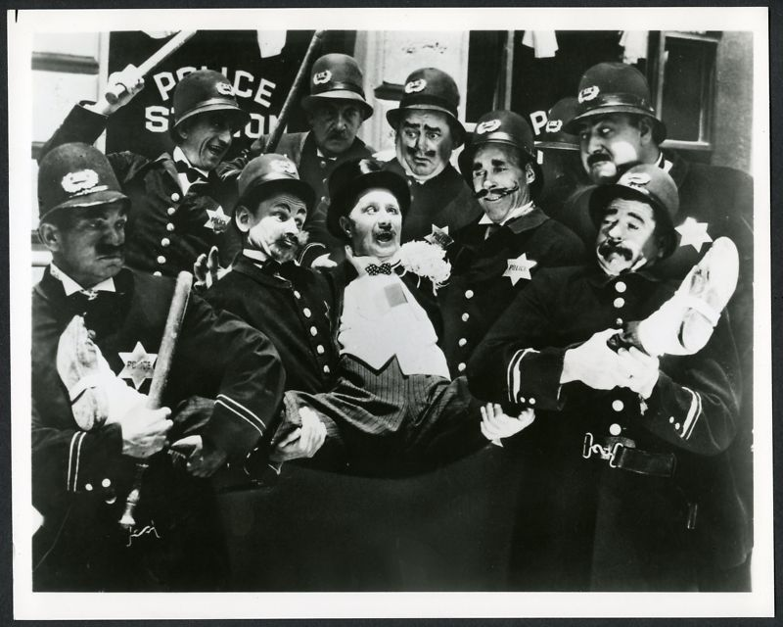
Car Chase Comedy KEYSTONE COPS
https://www.youtube.com/watch?v=a8jphxpi1ro
Another popular type of silent movie was the car chase comedy. It showed a team of madcap policemen who were always chasing villains. This type of film was invented by Mark Sennet at the Keystone studio.

Slide 3
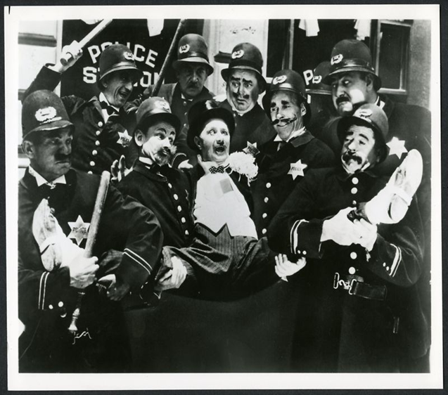
To understand Keystone Cops
To apply acting skills to a Keystone Cops performance
Create a performance with elements of slapstick and Keystone Cops (Link to last weeks lesson

