Slide 1

Where do the doors lead to?
Who might be behind the doors?
Why is the character in this room to begin with?
Challenge:
What could the themes of the performance be about?

Slide 2

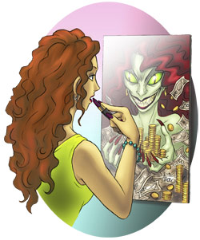
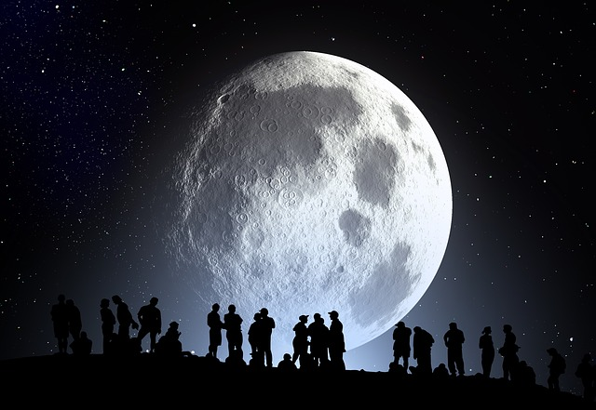
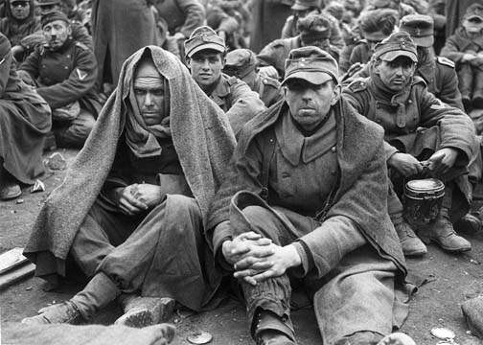
Devising for a
Stimulus

Slide 3

So what is a Stimulus, I hear you ask?
A stimulus is something that excites your brain, makes it active and wants to work very quickly to achieve something.
It is a starting point to base your
performance around.
Golly gosh a stimulus sounds very exciting!!!My head is spinning!!!!
I
Understand a range of stimuli
Apply themes to a performance, based on your chosen stimulus
Evaluate the impact of using a stimulus to help you devise

Slide 4



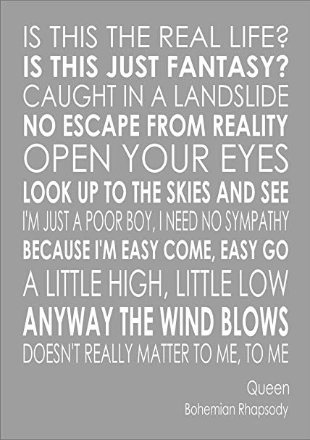


Types of stimuli

Slide 5
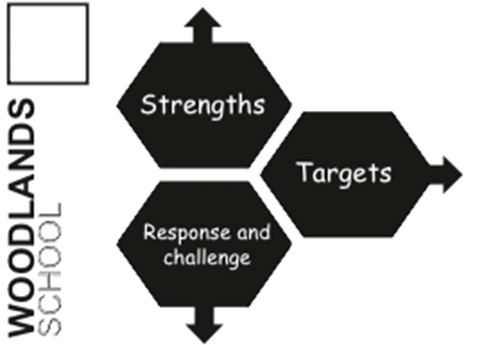
Response and Challenge
Something that has been ticked
Something that is not ticked
KFC 1 – Name three performance skills
KFC 7- Can you identify an idea that you contributed in rehearsal?
BK 2 – Was this strategy used well? Why/why not?

